Slide 1
Welcome to Interface!
Season 6 is starting soon...

Slide 2
Introductions
Let’s introduce ourselves
Presentation ideas for upcoming weeks
Help us organize discussions!

Slide 3
Labor struggles in (big) tech
Please respect Chatham House rules for this discussion.

Slide 4
Who counts as a tech worker?

Slide 5
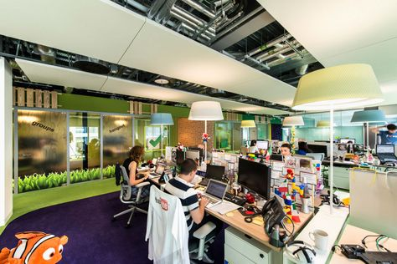
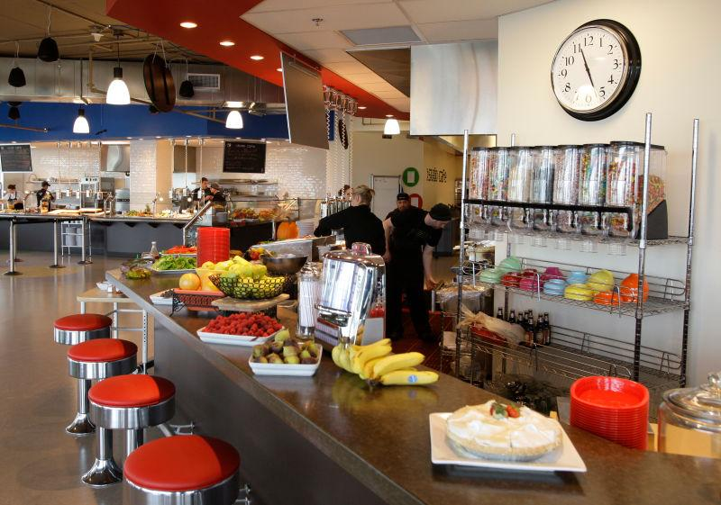
Case study: Google
Notes:
https://www.vox.com/recode/2019/12/31/21043467/google-union-cafeteria-workers-unionized-alphabet-silicon-valley-mountainview

Slide 6
Why do workers organize?

Slide 7
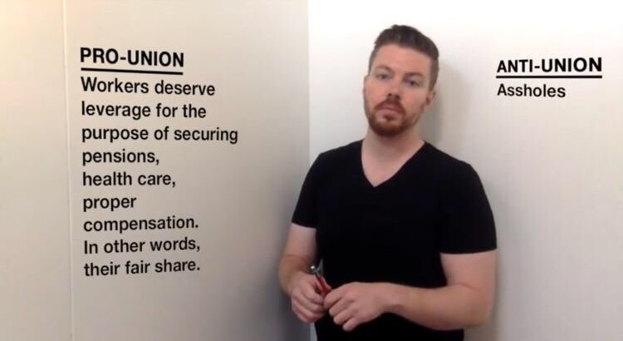
Jon Bois, my favorite sportswriter.
Notes:
What if you already have everything on the left?

Slide 8
Why are Googlers organizing?

Slide 9
“Hi. I’m not at my desk because I’m walking out in solidarity with other Googlers and contractors to protest sexual harassment, misconduct, lack of transparency, and a workplace culture that’s not working for everyone. I’ll be back at my desk later. I walked out for real change.”
Text from a flyer left by November 1, 2018 Google walkout participants.

Slide 10
Flashpoints

Slide 11

Damore: “Google’s Ideological Echo Chamber”
July ‘17: Damore memo is posted internally and subsequently leaked.
August ‘17: James Damore is fired by Google, a day after filing a NLRB complaint. However, his memo (its “discriminatory statements) was not ruled a protected action.

Slide 12
What is protected concerted action?
Protected: The NLRB will fight to restore what’s taken from you.
Concerted: A group of employees are working together to…
Action: Trying to improve pay and working conditions, with or without a union.

Slide 13
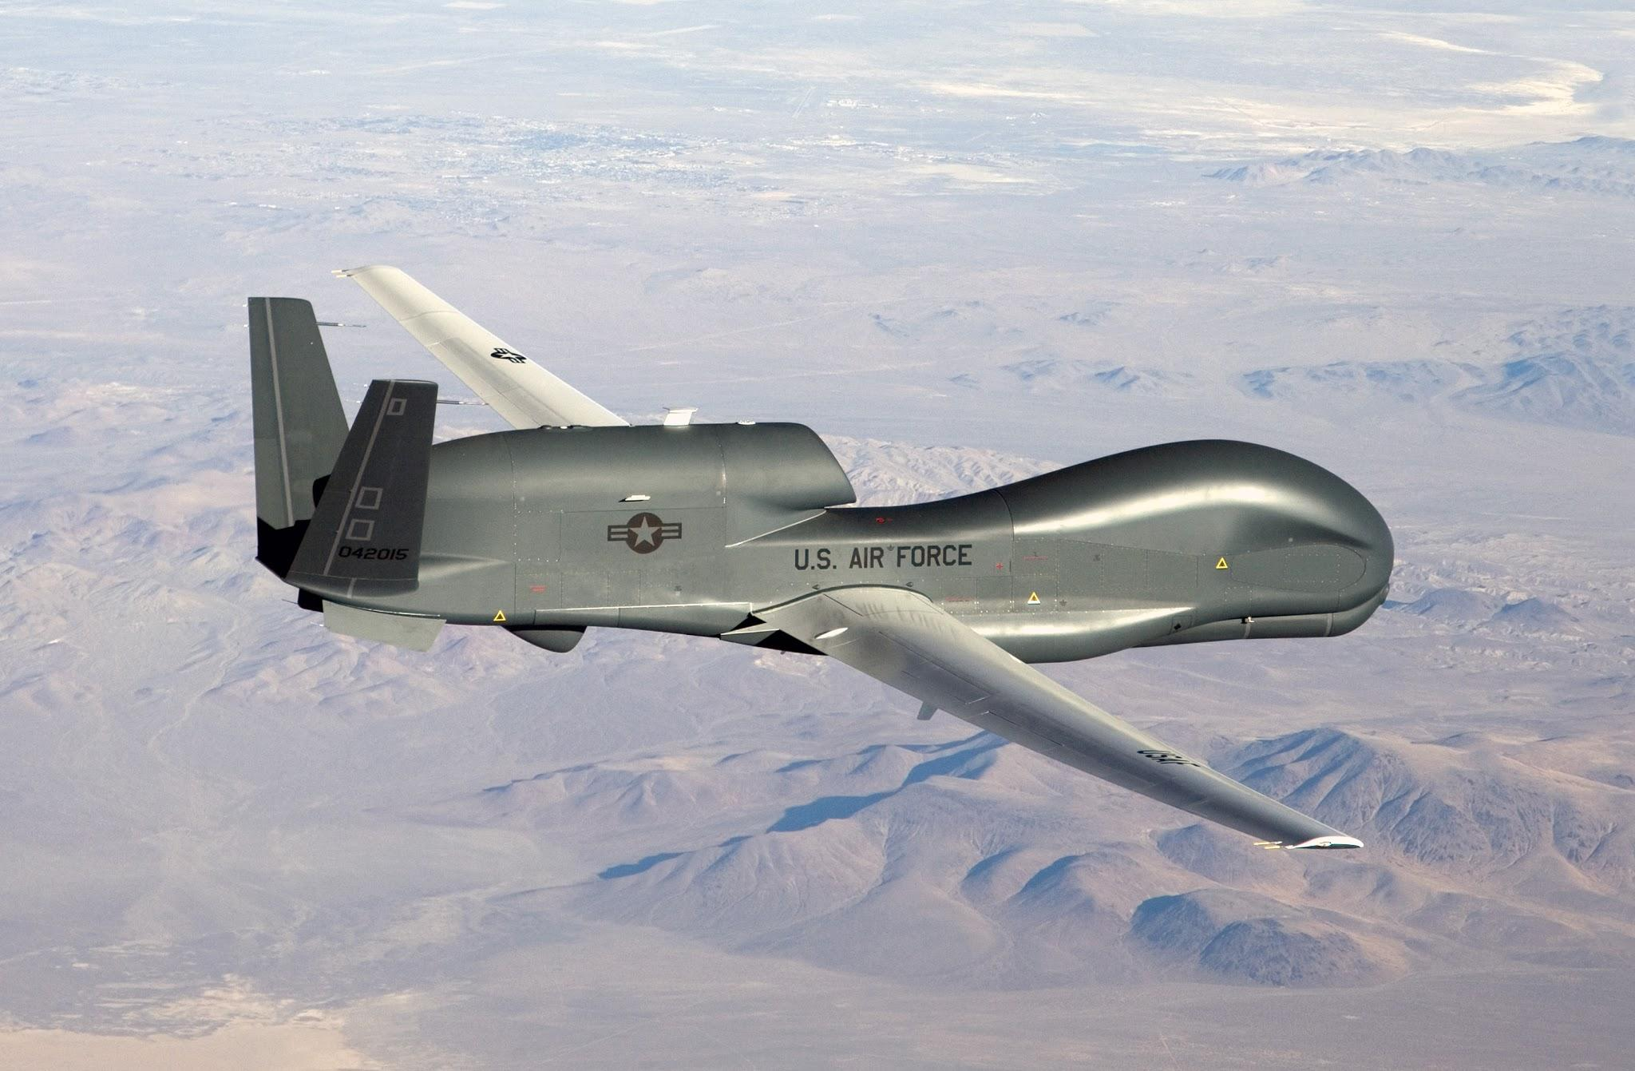
Project Maven (DoD Algorithmic Warfare Cross-Function Team)
Google engineers develop CV algorithms for analyzing DoD video data
April ‘18: 3,000 employees sign a petition protesting Project Maven
June ‘18: Google decides to not renew the Maven contract after it expires.

Slide 14
“We believe that Google should not be in the business of war...we cannot outsource the moral responsibility of our technologies to third
parties. This contract puts Google’s reputation at risk and stands in direct opposition to our core values.”
Text from the Project Maven petition, April 2018.

Slide 15
The Walkout

Slide 16
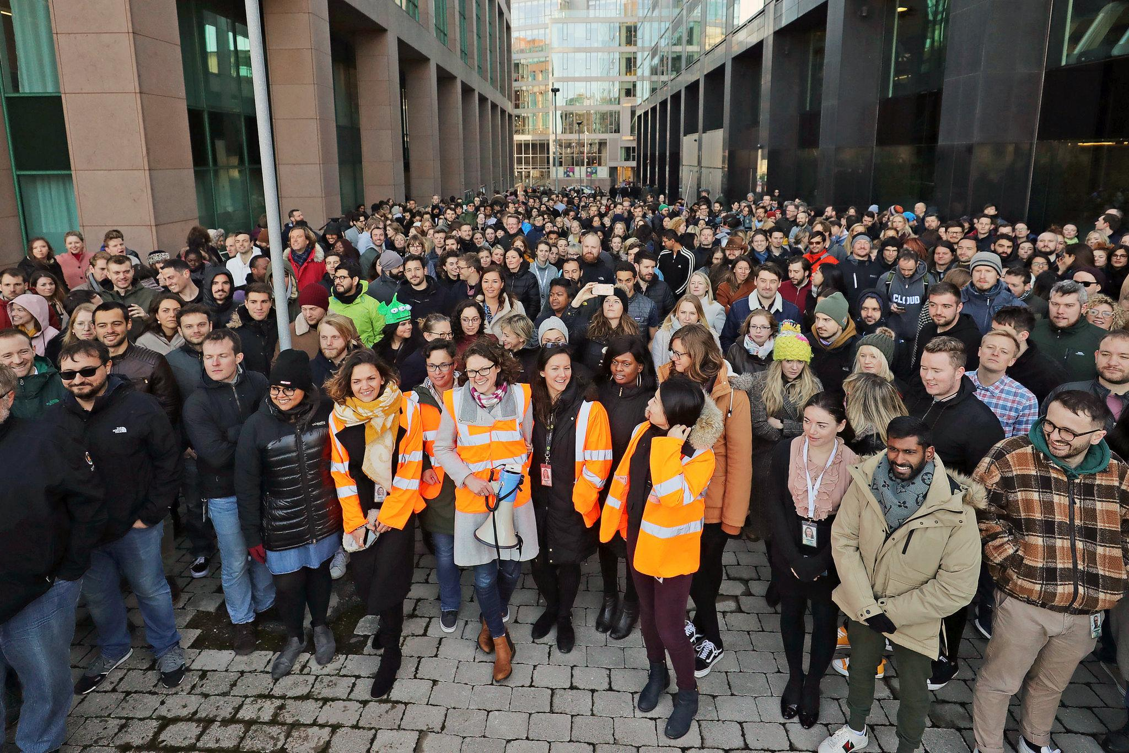
November 1, 2018: Over 30,000 employees walk out in a protest sparked by executives’ sexual misconduct.

Slide 17
“Hi. I’m not at my desk because I’m walking out in solidarity with other Googlers and contractors to protest sexual harassment, misconduct, lack of transparency, and a workplace culture that’s not working for everyone. I’ll be back at my desk later. I walked out for real change.”
Text from a flyer left by November 1, 2018 Google walkout participants.

Slide 18
Executive misconduct at Google
Andy Rubin, SVP of Android: Coerced an employee into oral sex. Received a $90 million exit package.
David Drummond, CLO of Alphabet: Had a child with an employee in his department in 2008. Married another employee in his department in 2019. Retired after selling >$200 million in stock in 2020.
Sergey Brin, co-founder: Had an affair with a marketing director.

Slide 19
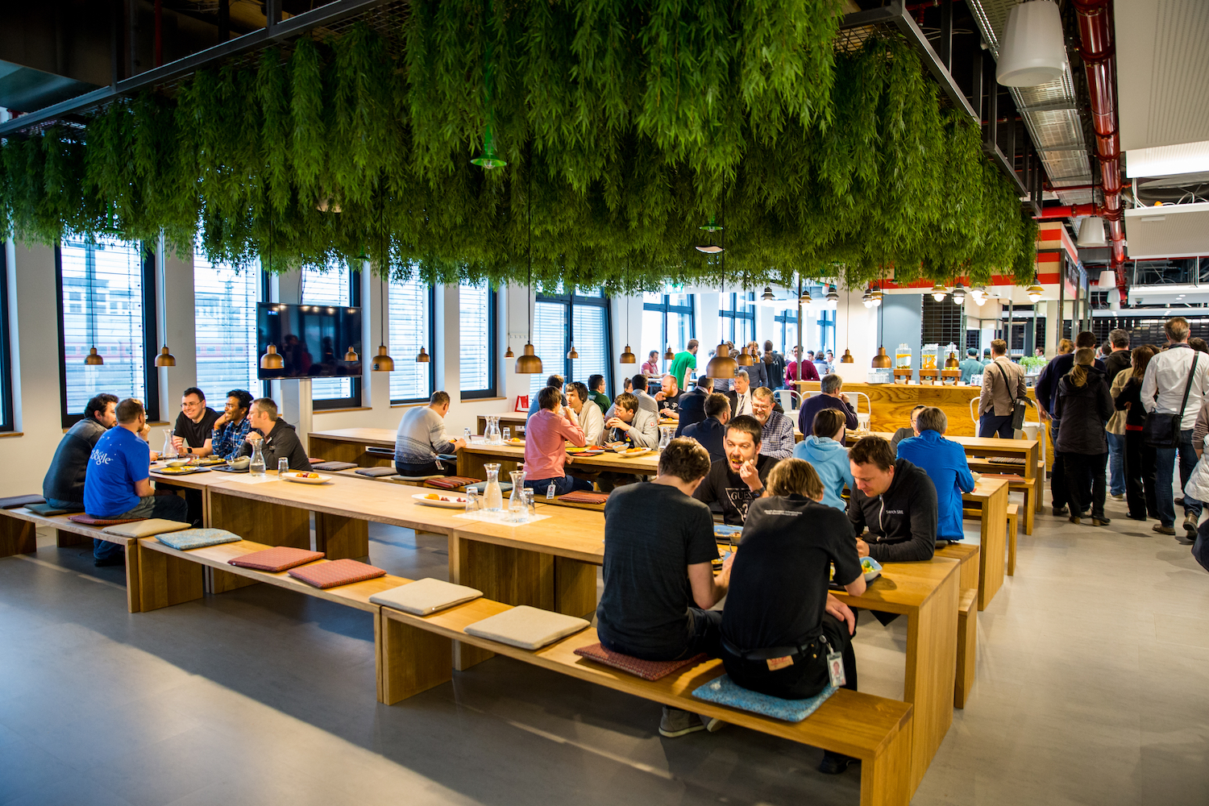
Temps, vendors, and contractors
November ‘19: Google cafeteria workers in SV vote to unionize.
Cafeteria workers are paid $35,000 a year, and don’t get retirement benefits.

Slide 20
Retaliation
Meredith Whittaker, founder of Google Open Research: Asked to abandon her work on AI ethics at the AI Now Institute to stay at Google. Resigned in July ‘19.
Claire Stapleton, YouTube marketing manager: Demoted, lost half of her direct reports, had projects cancelled, and was asked to go on medical leave. Resigned in May ‘19.

Slide 21
Retaliation (II)
August ‘19: New internal community guidelines instituted, perceived as harsher on traditional internal debate.
Laurence Berland, Paul Duke, Rebecca Rivers, Sophie Waldman: Discovered Google’s hiring of a union-busting consultancy by accessing internally-public documents. Under a new, vague data access policy, Google fired them for “leaking” in November 2019. They were all employee organizers.
The Thanksgiving Four filed an NLRB complaint in December.

