Slide 1

Team 4: A.I. Shutterbugs

Slide 2
Nilutpol
Sarvesh
Richard
Yannick
Developer
Developer
Developer
Program Manager | Innovation Expert | Specializing in Data Driven Business Growth & Excellence

Slide 3
The BIG problems
Imperfect production processes
increased resource usage
unnecessary waste
lack of precise control ~ risks
Inequal wealth distribution and business development opportunities
endangers democracies & peace
slows development progress
Designed by freepik

Slide 4
Our Archimedean Point
Enhance production processes by digitization
accurate information allows optimization
achieve better quality with reduced costs and higher security
Level the economic playing field
empower businesses worldwide
bring production process to top technological level everywhere
establish power balance
Designed by freepik

Slide 5
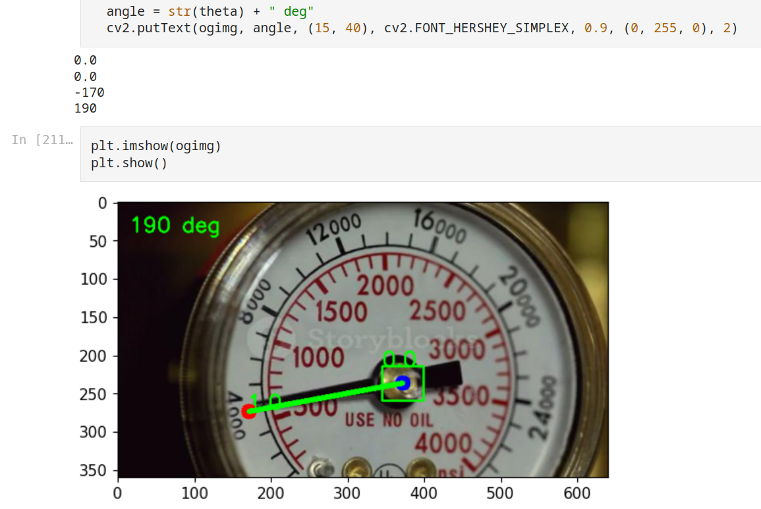
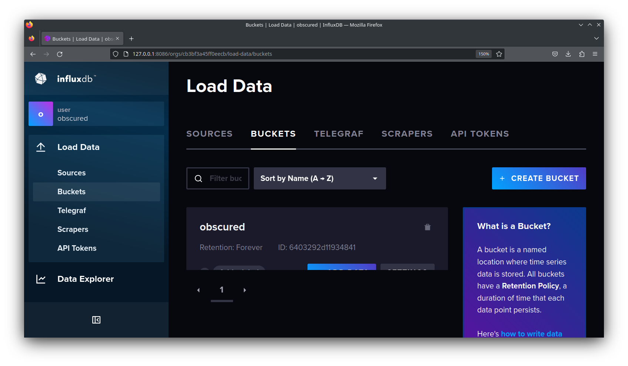
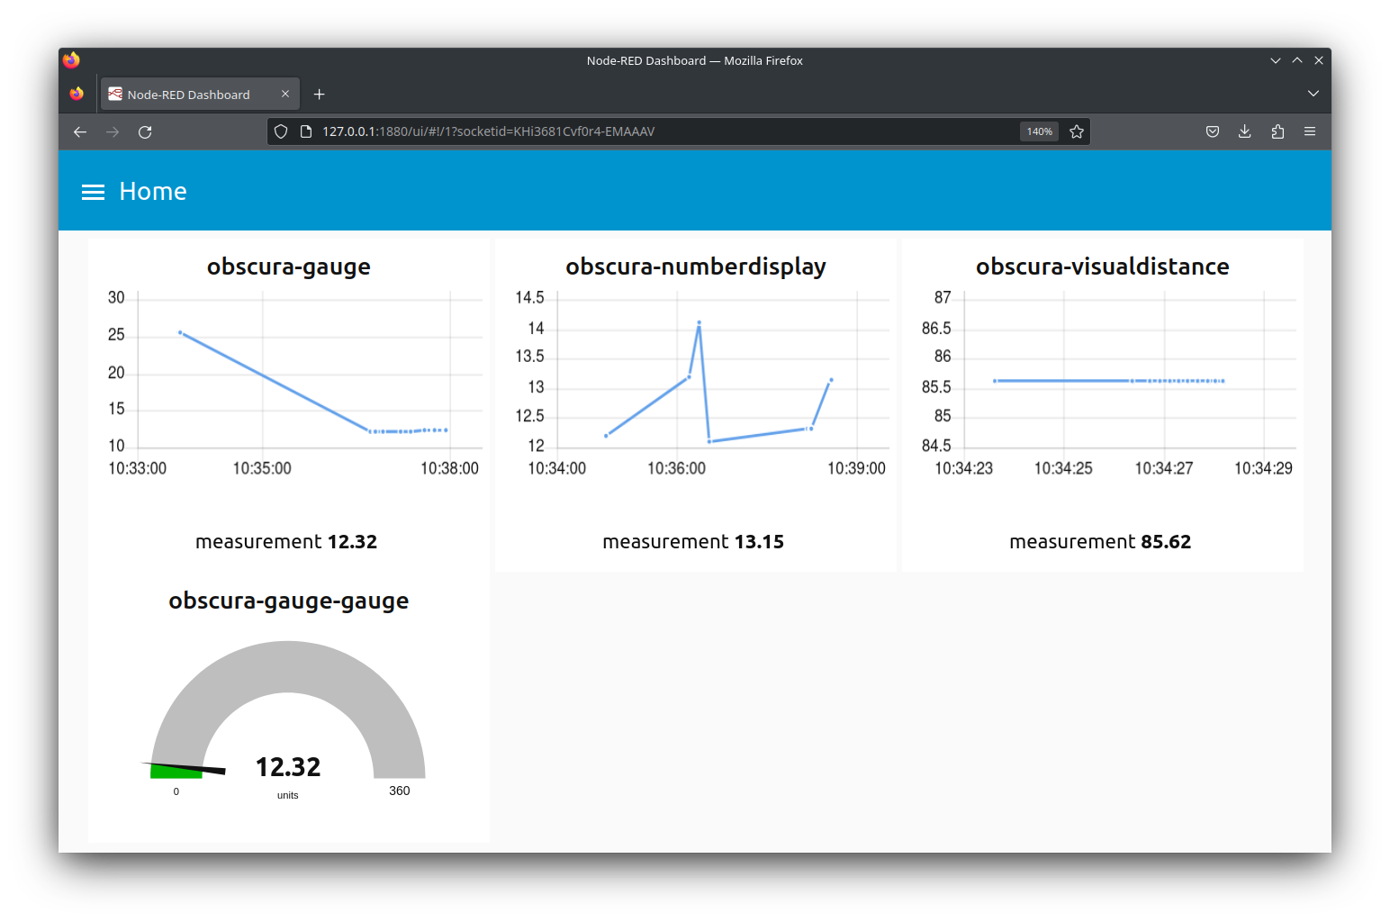
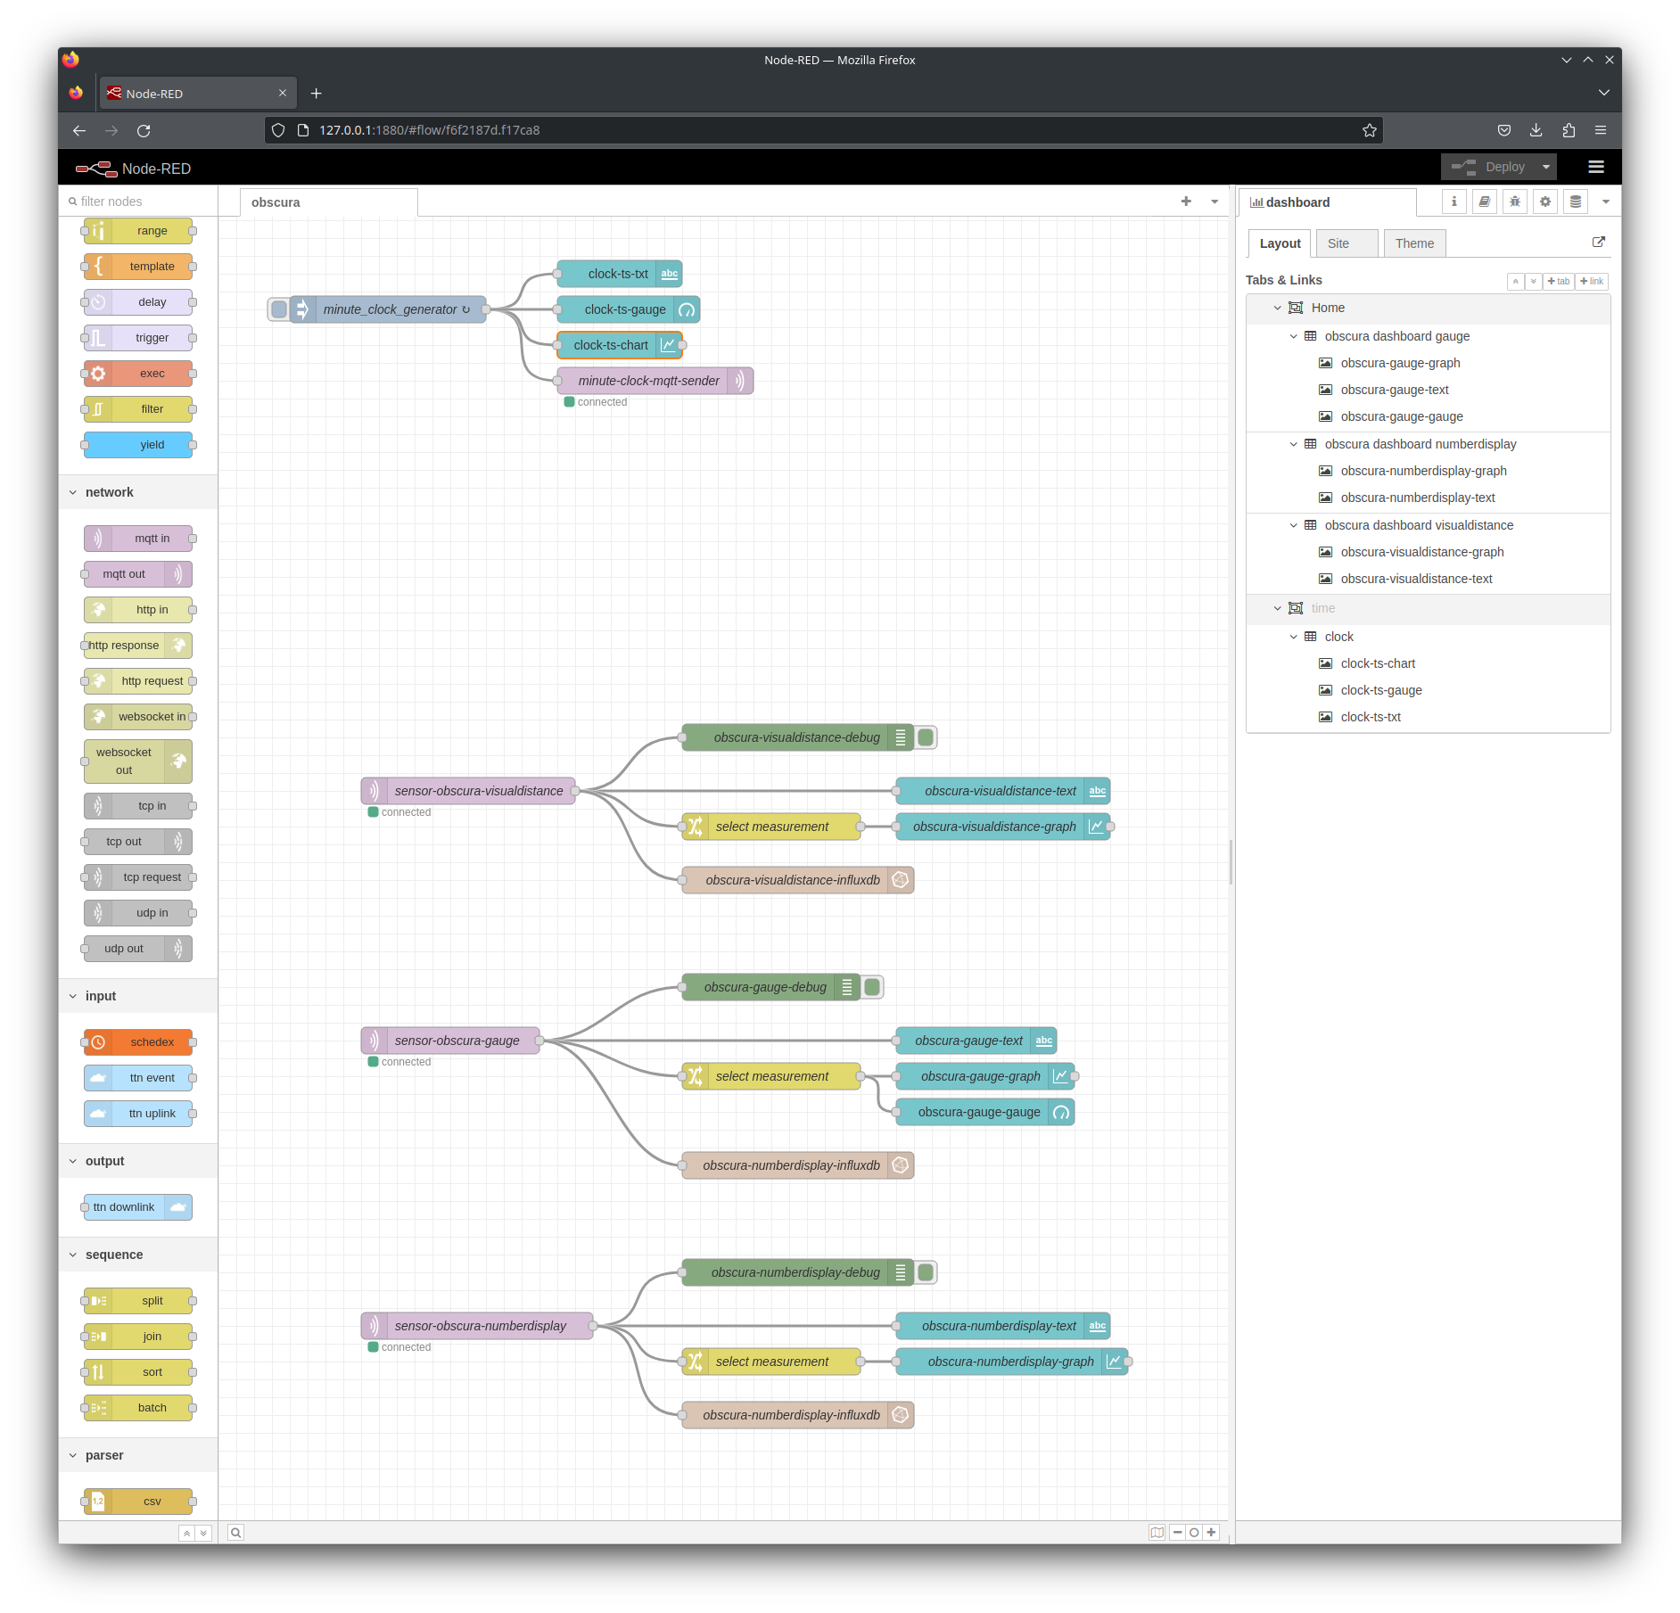
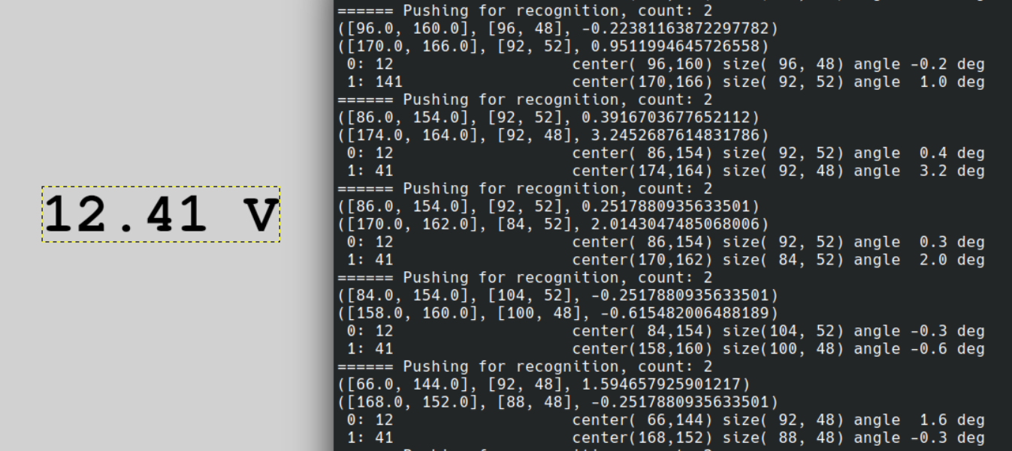
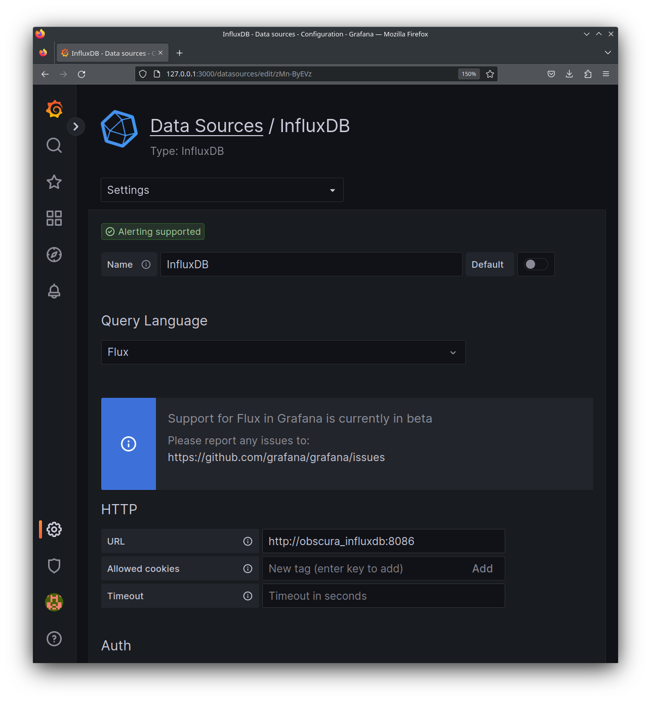
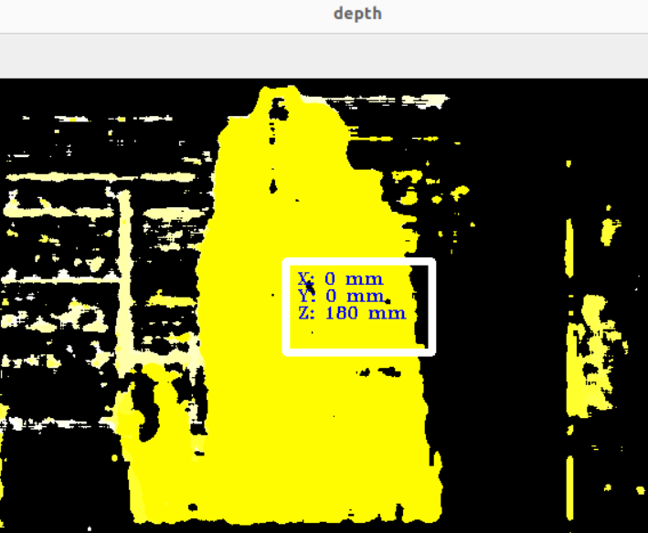

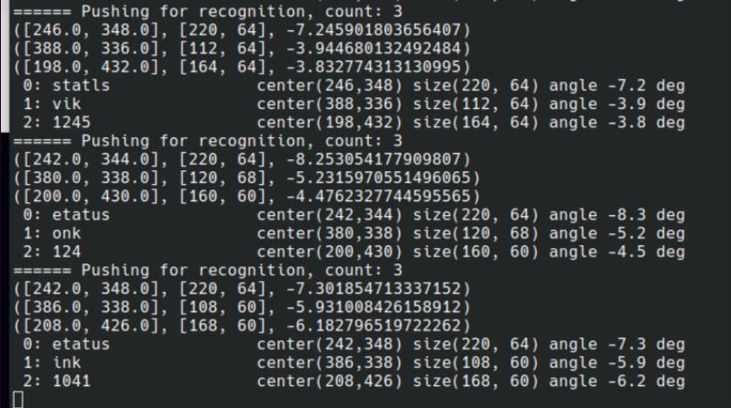
source @ https://github.com/intergalactichack/obscura

Slide 6
Our Technical Approach
Equip production lines with configurable visual sensors
adaptable to most (all?) analog workflows with visual control
implemented in hackathon: captures information from gauges, fill levels, number displays
Send data to Dashboard and time series database
Analyze based on accurate data
Optimize processes :
energy consumption
ordering and usage of materials
timing (just in time)
preventive maintenance
…

Slide 7
Our Service
S.O.S
Applying fast response “out of the box” service.
What we respond to
Easy Set-up
Cost efficient maintenance
Trusted technology partnerships

Slide 8

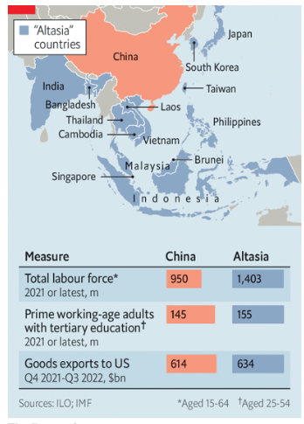
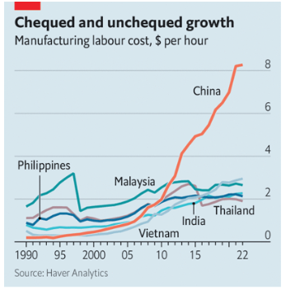
Global firms shift focus to “Altasia”

Slide 9









BUSINESS MODEL
Subscriptions & Premium Memberships
SAAS Infrastructure
Cloud Services
Manufacturing Companies
Direct Customer relationship
Solar Panels
Hardware prices
A.I. Camera
CUSTOMER SEGMENTS
REVENUE STREAM
CUSTOMER RELATIONSHIP
KEY RESOURCES
COST STRUCTURE
01
02
03
04
05
06
07
08
09
VALUE PROPOSITION
CHANNELS
KEY ACTIVITIES
KEY PARTNERS
Smart Monitoring
Intelligent analytics
B2B Conferences Supply Chain Forums
Development & Deployment of software solution

Slide 10
PERCEPTUAL MAP FOR COMPETITIVE ANALYSIS
HIGH QUALITY
Obscura
Celonis
Cognite
Seeq
LOW COST
HIGH COST
Endress+Hauser
Telit Communications
Instrumental
Tulip
LOW QUALITY

Slide 11
Questions?
https://github.com/intergalactichack/obscura

Slide 12
Benefits
Right to the target long term investment
Value added services
Store and analyze
Strong partnerships
Monitor in real-time
Communicate Insights
Discover More

Slide 13
Our Solution
S.O.S
Applying fast response “out of the box” service
What we respond to
Easy Set-up
Seamless integration in your manufacturing workflow. Our system takes one day to show results.
Cost efficient maintenance
Our low-code solution offers subscription service without any commitment.
Trusted technology partnerships
We partner with Intel and Luxonis for a state-of-the-art cloud edge service combined with the latest A.I. video features.

Slide 14
The Problem
Geographical Distance between countries
Difficult Know-How Transfer
Old manufacturing equipment
Designed by freepik

