Slide 1
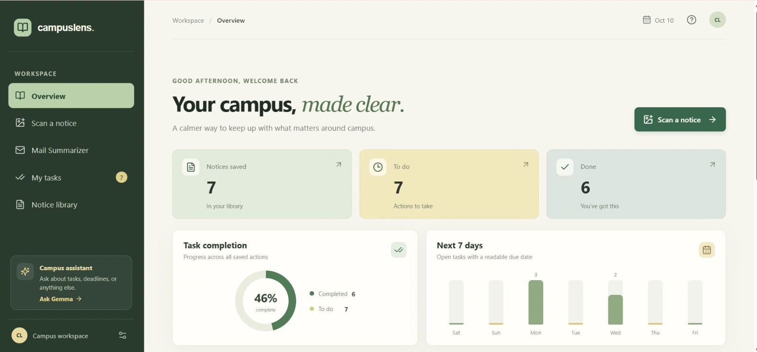
CampusLens
AI-powered campus productivity assistant
Built with Gemma 4
Your campus, made clear.

Slide 2













Important information shouldn’t get lost in campus notices.
AI-POWERED CAMPUS PRODUCTIVITY ASSISTANT
Notice overload
Missed details
Scattered tasks
CampusLens
important deadlines and actions buried in long
notices and emails
students manually
identify what matters,
risking oversight
saved info and follow-ups become disconnected
and hard to track

Slide 3

















From campus notices to
clear next steps.
AI-POWERED CAMPUS PRODUCTIVITY ASSISTANT
Upload notice
Gemma 4 analysis
(gemma-4-26b-a4b-it)
Review extracted details
Save notice
and tasks
Track progress
CampusLens
add any campus notice or email in seconds
stay on top of deadlines and completed tasks
our AI extracts key details and action items
you verify, edit,
and confirm before anything is saved
store confirmed information and tasks in one place
You stay in control — review and edit first for accuracy and clarity.

Slide 4










Notice Scanner
Turn a notice into a next step.
CampusLens
Notice Scanner
Notice Scanner
Upload or paste a notice to extract key details.
Dashboard
Upload Image
Upload PDF
Paste Text
Extracted Details
Edit
Accepts image, PDF, or pasted text inputs
My Tasks
Title
Annual Tech Symposium 2025
Saved Items
Drag and drop an image here
or click to browse
Deadline
March 15, 2025
AI-POWERED CAMPUS PRODUCTIVITY ASSISTANT
Settings
Extracts title, deadline, venue,
eligibility, and actions when present
Venue
Main Auditorium, Block A
Eligibility
Open to all undergraduate students
CampusLens
Editable extraction results before saving
AI Model
Actions
Register online and submit abstract
gemma-4-26b-a4b-it
Cancel
Save
Powered by AI model `gemma-4-26b-a4b-it'
Extraction may be incomplete or inaccurate.
Always review before relying on it.

Slide 5

















YOUR CAMPUS WORKSPACE
Everything important, in one place.
CampusLens
Dashboard
Dashboard
Welcome back
Notices
Saved notices
Open tasks
Completed tasks
Tasks
8
6
12
View saved notices
Calendar
Unread
In progress
This week
Manage open and completed tasks
Settings
Task completion
Upcoming workload
AI-POWERED CAMPUS PRODUCTIVITY ASSISTANT
Track task completion at a glance
75%
Completed
CampusLens
Plan ahead with your upcoming workload
Mon
Tue
Wed
Thu
Fri
Sat
Sun
A clear dashboard that brings what matters together, helping you focus on what’s next and stay ahead with confidence.

Slide 6


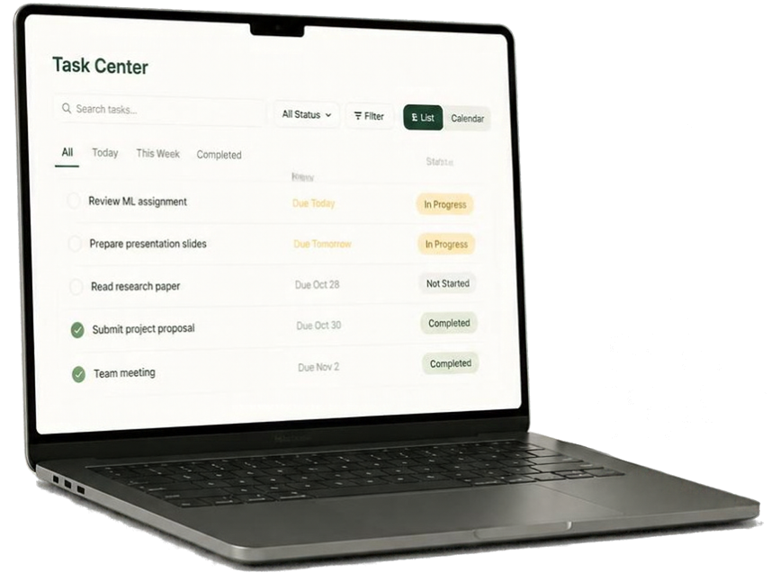
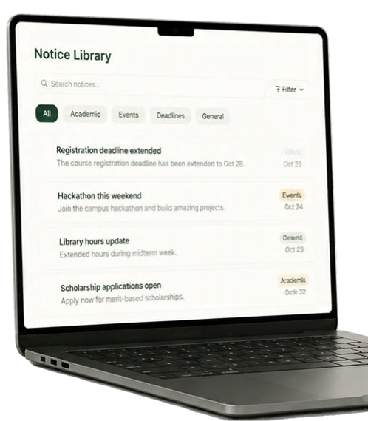



Save it. Find it. Finish it.
Search and filter tasks easily
Track completion status
AL-POWERED CAMPUS PRODUCTIVITY ASSISTANT
Switch between list and
calendar views
CampusLens
Search and revisit
saved notices
From information
to action — all in
one connected flow.

Slide 7







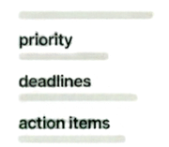




Mail Summarizer and Campus Assistant
make messages easier to act on.
Campus Assistant
What are my upcoming deadlines this week?
key information
priority
deadlines
action items
You have 3 deadlines this week: Project proposal on Wednesday, Lab report on Friday, and Reading response on Sunday.
AI-POWERED CAMPUS PRODUCTIVITY ASSISTANT
incoming email
condensed summary
What did my professor say about the proposal?
CampusLens
Mail Summarizer
condenses email content and highlights key details, priority, deadlines, and action items when available.
Your professor requested more detail on the timeline and success metrics.
Campus Assistant
answers your questions about tasks, deadlines, and the information you’ve saved.
Illustration, not actual UI

Slide 8












Built around Gemma 4.
React +
TypeScript +
Vite
Python + FastAPI
Google
Gemini API
Student
model
gemma-4-26b-a4b-it
AI-POWERED CAMPUS PRODUCTIVITY ASSISTANT
backend
frontend
CampusLens
The backend coordinates AI analysis and powers every app operation.
Local JSON persistence
saved data

Slide 9










Useful AI,
with the student in control.
Review and edit AI-extracted details before saving
Verify AI-generated deadlines and actions carefully
AI-POWERED CAMPUS PRODUCTIVITY ASSISTANT
Uses local JSON persistence for data storage
CampusLens
Review & edit
check and refine
AI-extracted details
Save securely
store locally using
JSON persistence
Track & follow up
stay on top of what matters
API credentials kept private
Backend tests, frontend build passed, and demoed locally

Slide 10









Your campus, made clear.
CampusLens
🔄 Overview
🔄 Notices
Good morning
Here's what's happening today
🔄 Tasks
CampusLens turns campus information
into clear, manageable next steps.
🔄 Events
🔄 Resources
8
Unread notices
3
AI-POWERED CAMPUS PRODUCTIVITY ASSISTANT
Tasks due
2
TEAM
Saumitra Kumar
Anirudh Bansal
Parth Jambukiya
Yug Patel
Malank Gawai
Events
Latest notices
CampusLens
Library maintenance schedule
Upcoming events
Tech Talk: AI in Campus
Live Demo
Internship fair this week
Tomorrow, 2:00 PM
Yesterday
Hackathon Kickoff
Exam timetable released
Sat, 10:00 AM
Yesterday
Built with Gemma 4 | OpenLake × MLH Build with Gemma 4 Hackathon

