Slide 1



Gamification canvas
A gamification canvas can be a useful tool for designing and planning gamified experiences. It helps to visualize and structure the key elements and components of a gamification strategy.
CC BY-SA 4.0

Slide 2
GAMIFICATION CANVAS
The Canvas is a tool that prompts you to ask many questions:
On which platforms will your Gamification exist?
What mechanics, dynamics, and components do you want to include within it?
What aesthetic, narrative, and storytelling aspects will you consider to add that extra touch?
What behaviors do you want to stimulate, and in which type of player-customers?
How much will it cost you in terms of finances, time, and skills to bring into the company, and what will you gain in return?
1
2
3
4
5

Slide 3
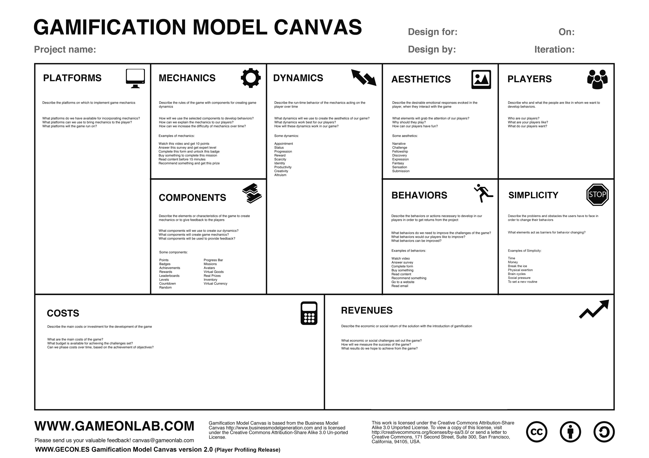

Slide 4
This document, prepared by the INTERLINK European project, is licensed under a Creative Commons Attribution-ShareAlike 3.0 International license (CC BY-SA 3.0).

