Slide 1

HOW TO LOGIN / REGISTER TO THE COLLABORATIVE ENVIRONMENT?

Slide 2
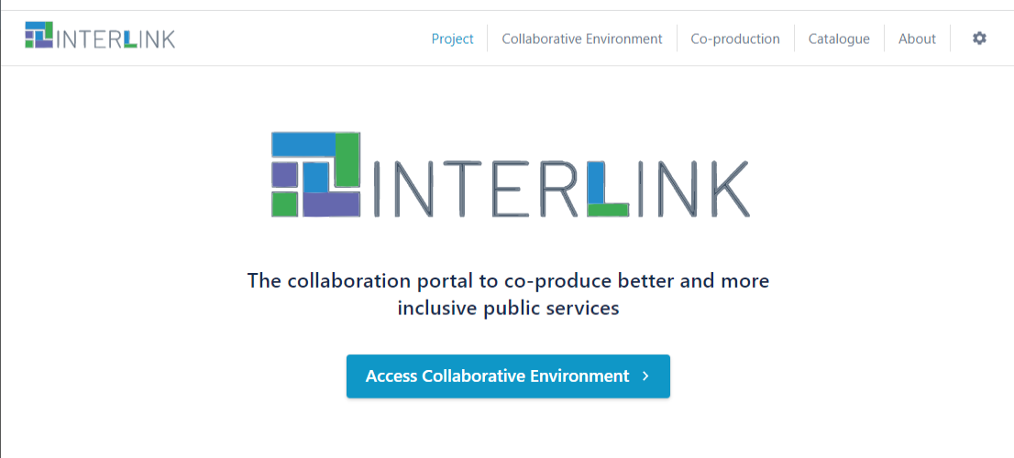
Access the collaborative environment
DEMO
https://demo.interlink-project.eu/
MEF
https://mef.interlink-project.eu/
VARAM
https://varam.interlink-project.eu/
ZARAGOZA
https://zgz.interlink-project.eu/

Slide 3
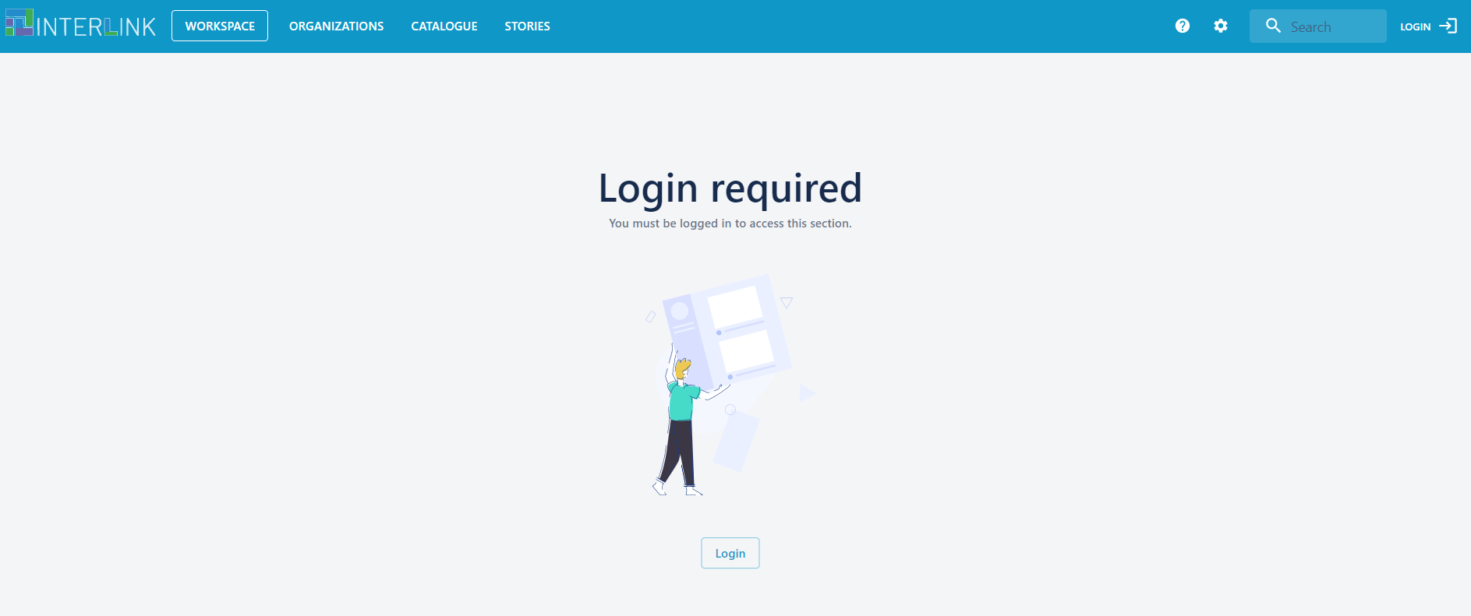
Login
Click on LOGIN

Slide 4
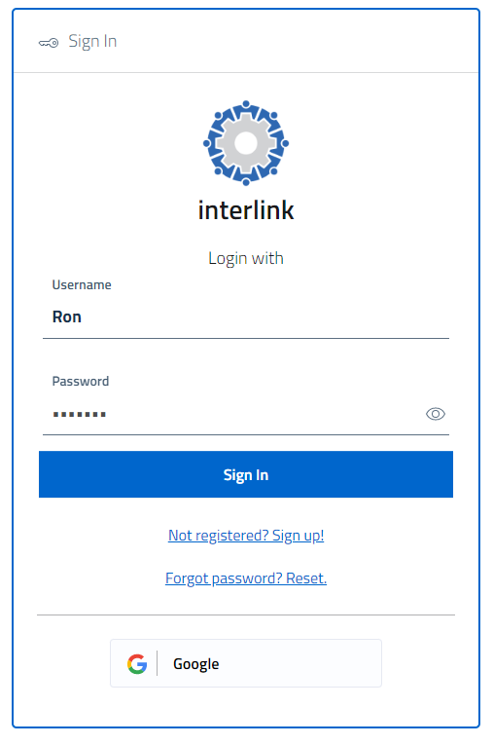
Already registered to the platform?
Sign in with your credentials if you are already have registered to the platform
or
Sign in with you google account if you have one and want to use it to access the platform

Slide 5
Not yet registered to the platform?
Click on “Not registered? Sign up!”

Slide 6
Access with Google credentials

Slide 7
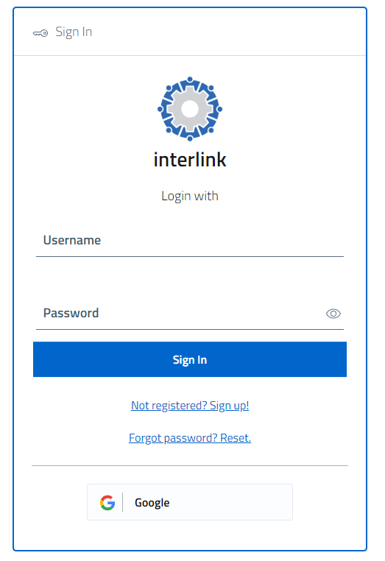
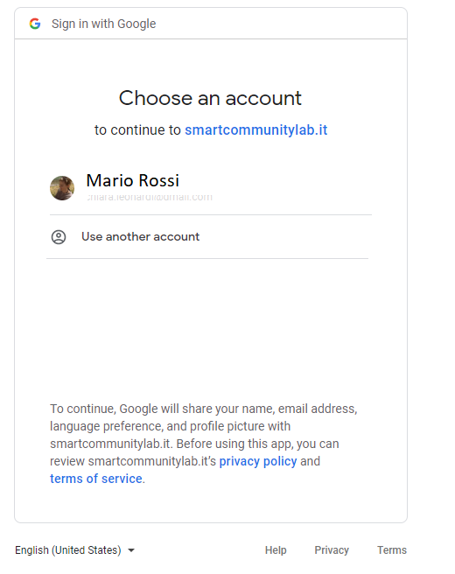
Access with Google credentials
If you have a private or work account managed by Google (for example xxxx@gmail.com) you can enter the platform using your usual Google email and password
(the platform is able to dialogue with Google servers for a safe user identification, in compliance with data protection regulations)

Slide 8
Access for users already registered with username and password

Slide 9
Access with platform credentials
If you have already registered to the platform with a chosen username and password, use your defined credentials to login to the platform
(if you have not registered yet, see next slides)

Slide 10
New registration to the portal

Slide 11
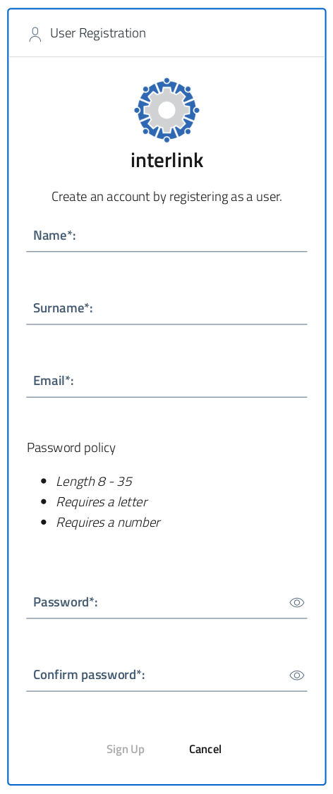
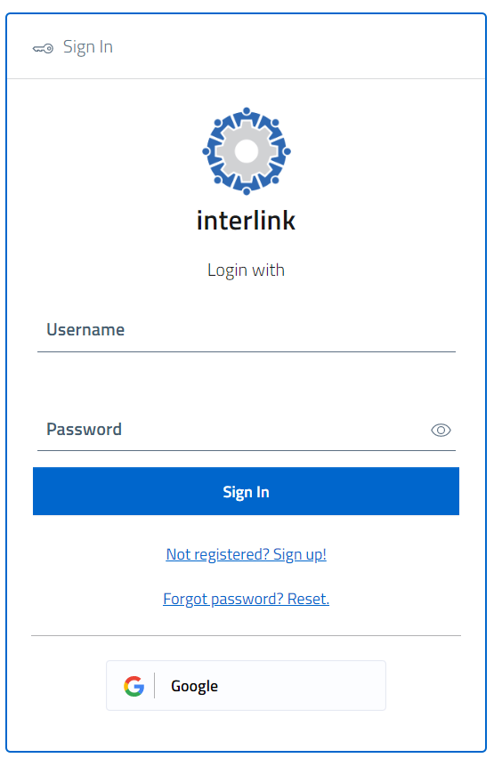
Input your registration data
After clicking on "“Not registered? Sign up!” you get access to the registration form
Insert your data, choose a password and click on the "Sign up" button

Slide 12
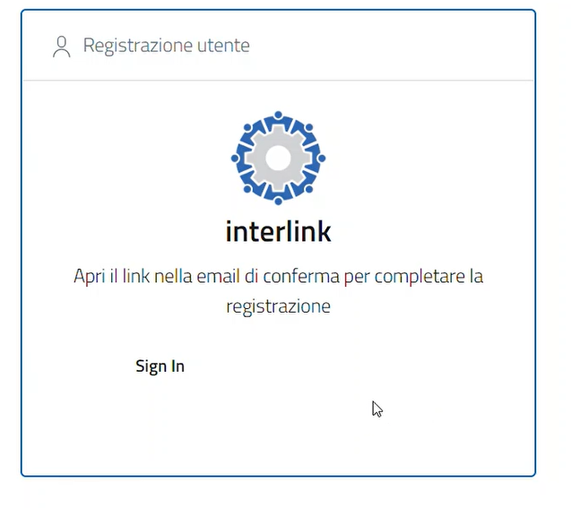
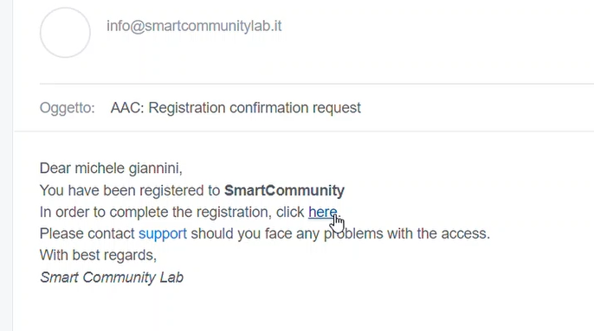
Confirm the registration
Per completare la registrazione e’ necessario aprire il link che verra’ mandato tramite email (controllare eventualmente la cartella SPAM)
A verification message will be sent to the provided email address (check also the spam folder)
Click on the valuation link included in the email message.
Now you can enter the platform with your new credentials.

Slide 13
First access to the portal

Slide 14
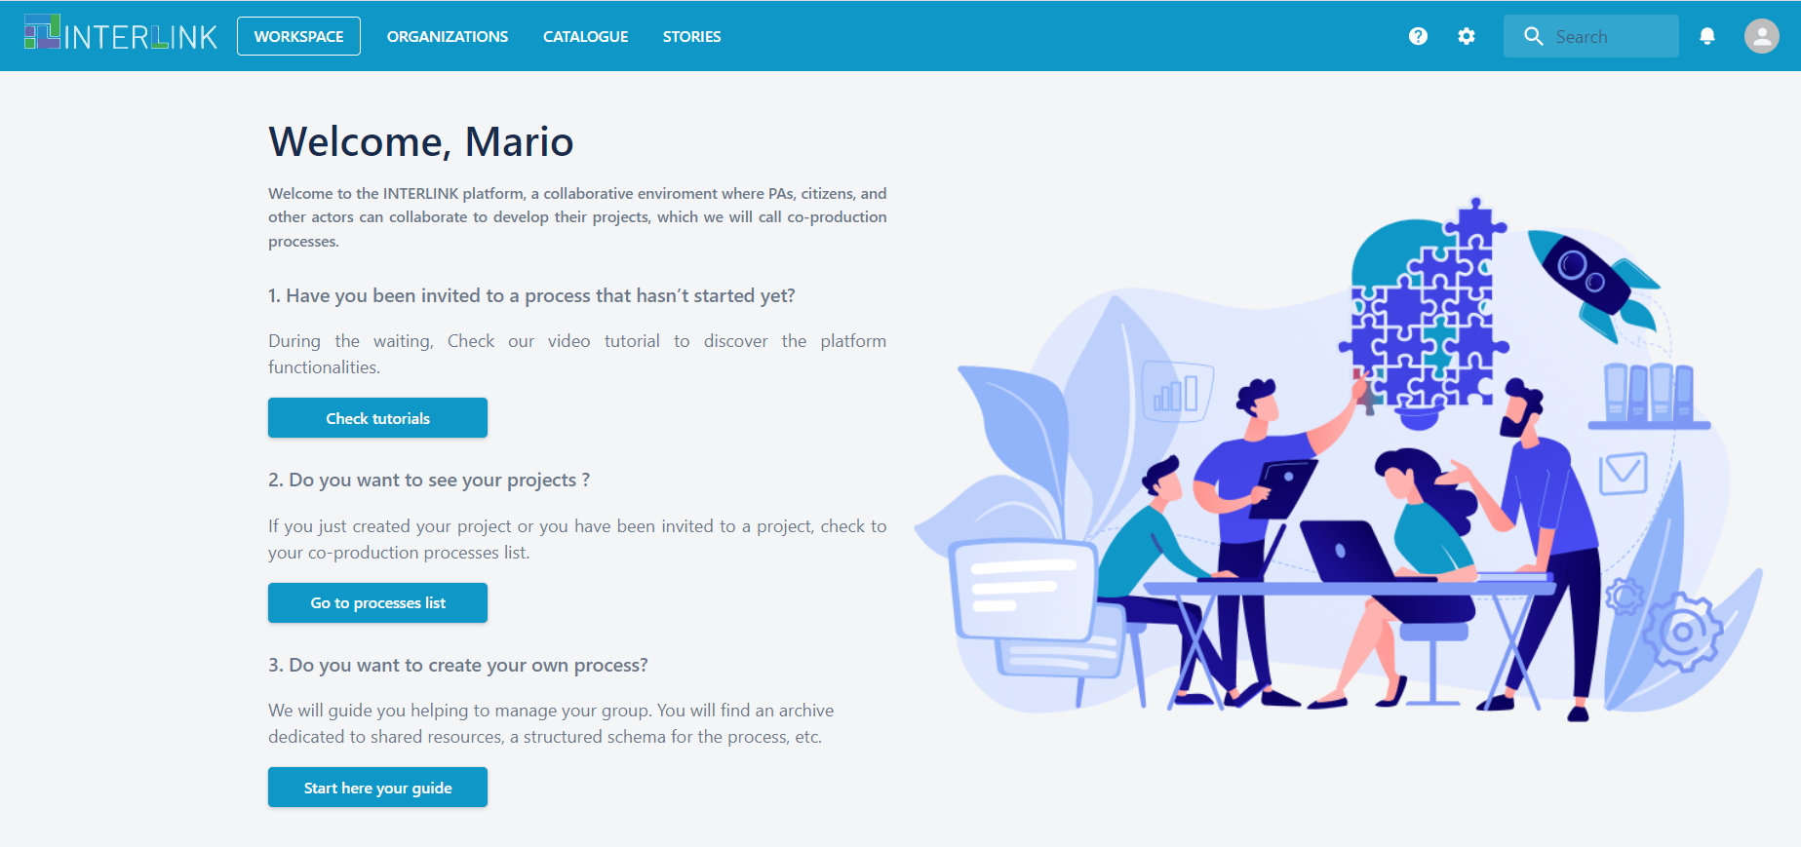
Personal workspace
At your first access, your workspace is empty. There is a welcome page that provides orientation information.

Slide 15
Access to the portal after having been invited to a co-production process

Slide 16
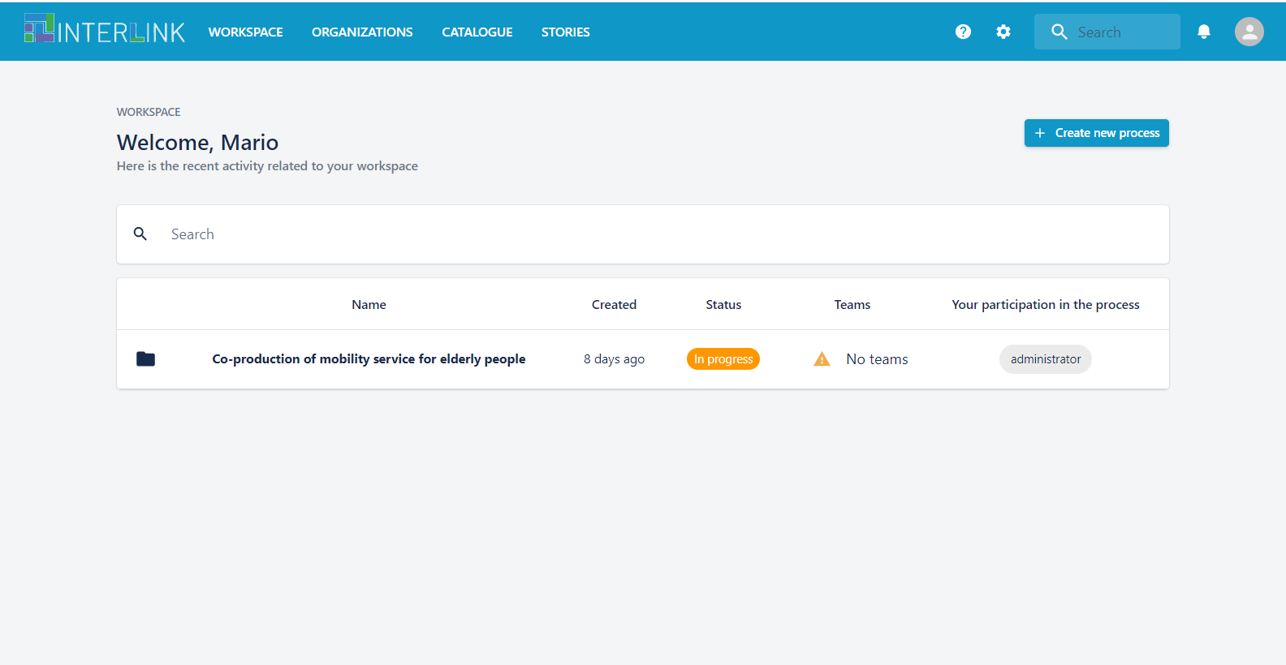
Co-production processes you work on
After having been invited to participate to a co-production process, your workspace contains the list of processes you can work on.

Slide 17
You are now ready to participate to the co-production of services !
FOR MORE INFORMATION, CHECK OUT
THE USER MANUAL OF THE INTERLINK PLATFORM

Slide 18

This document, prepared by the INTERLINK European project, is licensed under a Creative Commons Attribution-ShareAlike 4.0 International licence (CC BY-SA 4.0).

