Slide 1



BUSINESS MODEL
CANVAS
The Business Model Canvas is a one page overview that lays out both what you do (or want to do), and how you go about doing it; enabling structured conversations around management and strategy by laying out the crucial activities and challenges involved with your initiative and how they relate to each other. This visual format, first introduced by Osterwalder and Pigneur, is useful for both existing and new organisations and businesses. Existing programmes can develop new initiatives and identify opportunities while becoming more efficient by illustrating potential trade-offs and aligning activities. New programmes can use it to plan and work out how to make their offering real.
INSPIRED BY
CC BY-SA 4.0
“Business Model Canvas" by Development Impact and You by Nesta

Slide 2
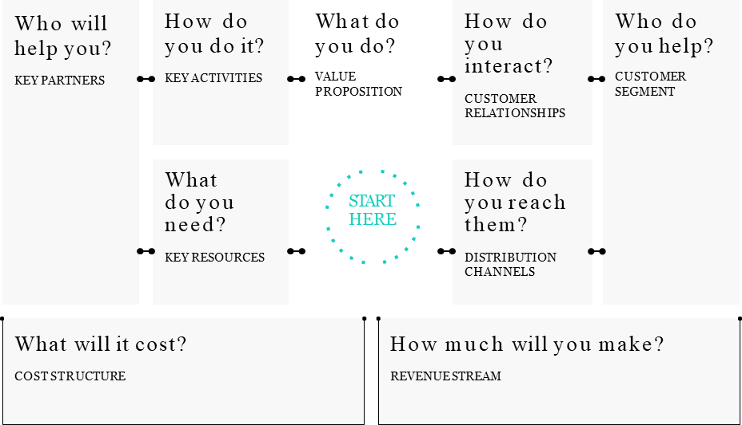
INSTRUCTIONS
To make a Business Model Canvas, the easiest way to start is by filling out what you do. This helps keep the focus on your main goal as you fill out the other building blocks of the canvas. From there you can build on that goal and see how it can be achieved by adding details about the other activities and resources you have.

Slide 3
TEMPLATE: I want to develop a clear plan on how to grow my idea into something bigger
who will help you? |  | How do you do it? |  | what do you do? |  | How do you interact? |  | who do you help?
KEY PARTNERS |  | KEY ACTIVITIES |  | VALUE PROPOSITION |  | AUDIENCE RELATIONSHIPS |  | AUDIENCE SEGMENTS
Who are your key partners/suppliers? What are the most important motivations for the partnerships? |  | What key activities does your value proposition require? What activities are most important for your distribution channels, customer relationships, revenue streams etc? |  | What core value do you deliver to your audience? Which needs are you satisfying? |  | What relationship does the target audience expect you to establish? How can you integrate that into your work in terms of cost and format? |  | Which groups are you creating value for? Who is your most important audience?
 |  | what do you need? |  |  |  | How do you reach them?
 |  | KEY RESOURCES |  |  |  | DISTRIBUTION CHANNELS
 |  | What key resources does your value proposition require? |  |  |  | Through which channel does your audience want to be reached? Which channels work best? How much do they cost? How can they be integrated into your and your audiences routines?
what will it cost?
COST STRUCTURE
How much will you make?
REVENUE STREAM
What are the most important costs in your work? Which key resources/ activities are most expensive?
For what value are your audiences willing to pay?
What and how do they recently pay? How would they prefer to pay?
How much does every revenue stream contribute to the overall revenues?

Slide 4
References and useful links
DIY Development Impact & You. PRACTICAL TOOLS TO TRIGGER & SUPPORT SOCIAL INNOVATION. Business Model Canvas. Retrieved on 14th February 2022.
Osterwalder, Alexander; Pigneur, Yves; Clark, Tim (2010). Business Model Generation: A Handbook For Visionaries, Game Changers, and Challengers. Strategyzer series. Hoboken, NJ: John Wiley & Sons. ISBN 9780470876411. OCLC 648031756. With contributions from 470 practitioners from 45 countries.

Slide 5
This document, prepared by the INTERLINK European project, is licensed under a Creative Commons Attribution-ShareAlike 4.0 International license (CC BY-SA 4.0).
This document remixes and builds upon material “Business Model Canvas" by Development Impact and You by Nesta. Retrieved 14 February 2022

