Slide 1



STAKEHOLDERS MAPPING
CANVAS
This resource will support your team to identify and select the stakeholders in the co-production team. This canvas can be used collaboratively, for instance, during a brainstorming or a focus group, to reflect on the different types of stakeholders that should be involved in the co-production process in order to represent the different target groups.
INSPIRED BY
CC BY-SA 4.0
“Stakeholder management" by Imperial College London

Slide 2
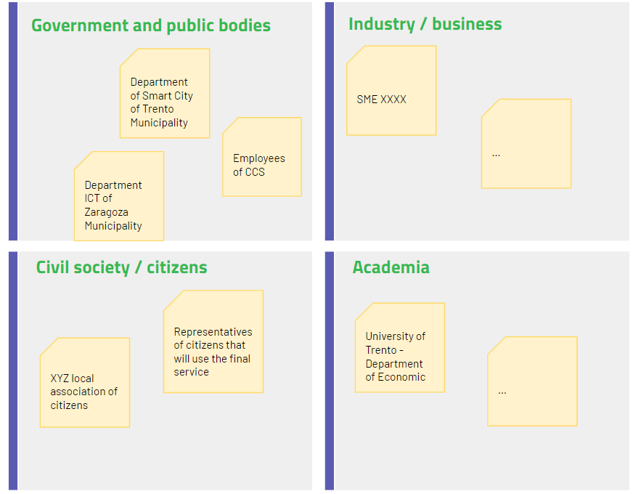
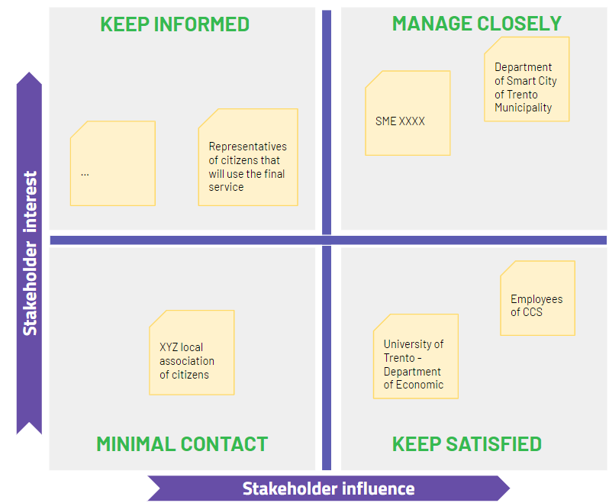
INSTRUCTIONS
You can use the following two canvas to refine your understanding about the stakeholders groups to be involved in the co-production process and analyse their level and interest to participate according to the interest-power matrix.
You can use these canvas during a brainstorming or a focus group.
1
Identify the type of stakeholders that should be involved in the service co-design and co-delivery
Identify all the stakeholders, both internal and external to an organization, both public and private and the place them on the map.
Don’t forget to reason about the beneficiaries and end-users of the service and how they might be involved in the co-design and co-delivery of the service.
Use this canvas to identify the different stakeholders you want to involve according to the different target groups
2
Analyse stakeholders Influence and interest
Stakeholders could play different role in the co-production process, they can have different levels of interest and power.
A common stakeholder management tool is the stakeholder analysis grid. This involves plotting stakeholders on a graph in terms of their influence over the project and their interest in the project.
You can then identify what kind of action you should take with them

Slide 3
1 | Map stakeholders groups
Government and public bodies
Industry / business
Civil society / citizens
Academia
Start from these questions
Who would participate to the definition of the service?
Who will use the service we want to develop?
Who would provide the service?
Who will be affected by the service?
…..
SME XXXX
Department of Smart City of Trento Municipality
…
Employees of CCS
Department ICT of Zaragoza Municipality
How to use this canvas?
You can edit the canvas that you can find in this page, print the blank canvas in the next page or use an online tool such as:
Google Jamboard
Miro
Mural
Representatives of citizens that will use the final service
University of Trento - Department of Economic
XYZ local association of citizens
…

Slide 4
1 | Map stakeholders groups - printable canvas
Government and public bodies
Industry / business
Civil society / citizens
Academia

Slide 5
2 | Influence-interest matrix
KEEP INFORMED
MANAGE CLOSELY
To fill the map try to understand the issues from the perspective of your stakeholders:
What really counts for them?
What are their major preoccupations?
What are their worries?
What are their aspirations?
What do they want or need?
How do they measure success?
What is their public attitude? How do they present themselves? How do they behave towards others?
High influence, less interested: Provide sufficient information to these stakeholders to ensure that they are up to date but not overwhelmed with data.
High influence, highly interested:
These are the stakeholders you must engage and make the greatest efforts with
Stakeholder interest
How to use this canvas?
Low influence, less interested: Provide these stakeholders with minimal communication.
Low influence, highly interested: Keep these stakeholders adequately informed, talk to them to ensure that no major issues arise.
You can edit the canvas that you can find in this page, print the blank canvas in the next page or use an online tool such as:
Google Jamboard
Miro
Mural
MINIMAL CONTACT
KEEP SATISFIED
Stakeholder influence

Slide 6
2 | Influence-interest matrix - printable canvas
KEEP INFORMED
MANAGE CLOSELY
Stakeholder interest
MINIMAL CONTACT
KEEP SATISFIED
Stakeholder influence

Slide 7
References and useful links
"Stakeholder management" (PDF). Imperial College London. 21 June 2017. Retrieved 6 July 2018.
"Stakeholder Management Plan" (PDF). Office of Government Commerce. 2006. Archived from the original (PDF) on 20 June 2008. Retrieved 6 July 2018.
Babou, S. (12 March 2008). "What Is Stakeholder Analysis?". The Project Management Hut. PM Hut. Archived from the original on 22 February 2015. Retrieved 6 July 2018.

Slide 8
This document, prepared by the INTERLINK European project, is licensed under a Creative Commons Attribution-ShareAlike 4.0 International license (CC BY-SA 4.0).
This document remixes and builds upon material in "Stakeholder management" by Imperial College London. 21 June 2017. Retrieved 4 February 2022

