Slide 1
metabolicMine.org
Mike Lyne
Adrian Carr
Richard Smith
Radek Stepan
Gos Micklem
Notes:
45 minutes + 15...

Slide 2
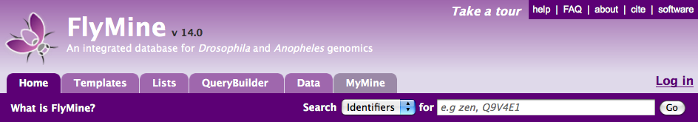
Team of ~7 since 2002
FlyMine - www.flymine.org
  30+ data sources, Drosophila & Anopheles
Yeast, Rat, Zebrafish MODs (interoperation)
  ratmine.mcw.edu
modENCODE - intermine.modencode.org
  whole genome scale C. elegans/D. melanogaster
InterMine is generic software used to build the above
Notes:
Developed for Fly, used for yeast, rat, zebrafish + modENCODE + maybe worm/mouse.
InterMine is generic core.
A lot of the features developed for the above are appropriate for medical focus.
With a view to making metabolic disease version did survey...

Slide 3
The Need for MetabolicMine
Key needs:
Information without having to visit several sites and formats
  Extremely time consuming
Genome region searches
Work with old/diverse identifiers
Summary information about collections
  eg. genes, SNPs
Export in a range of formats
Barroso (Sanger)
Cox (MRC Harwell)
Frayling (Exeter)
Froguel (Imperial)
McCarthy (Oxford)
O’Rahilly (Cambridge)
Vidal-Puig (Cambridge)
Notes:
collection of genes/SNPs
InterMine is well suited to address these needs

Slide 4
Common Tasks
Evaluate individual sequence variations
Investigate gene function
Examine properties of a collection

Slide 5
The Need for MetabolicMine
Key needs:
Information without having to visit several sites and formats (extremely time consuming)
Genome region searches
Work with old/diverse identifiers
Summary information about collections (eg. genes, SNPs)
Export in a range of formats
Common Tasks:
Evaluate individual sequence variations
Investigate gene function
Examine properties of a collection
Notes:
collection of genes/SNPs
InterMine is well suited to address these needs

Slide 6
metabolicMine Objectives
Reach information without having to visit several sites and formats
Examine properties of a collection
Investigate gene function
Evaluate individual sequence variations
Genome region searches
Work with old /diverse identifiers
Export in a range of formats
Link to other tools
Notes:
Different sites & formats: extremely time consuming!
collection of genes/SNPs
InterMine is well suited to address these needs

Slide 7
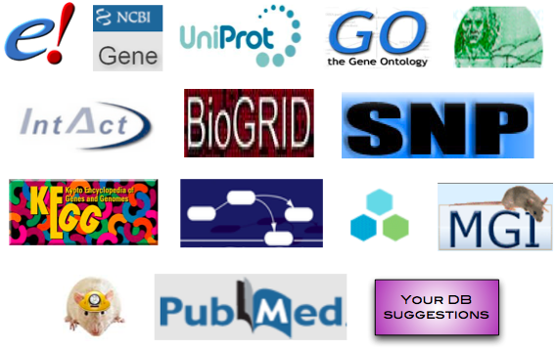
Data Sources
Search across information from many different sources and types including, Genes, Proteins, Diseases, SNPs, GWAS, Homologues, Pathways, Interactions and more!
Notes:
Experience with integration of data from varied sources & formats

Slide 8
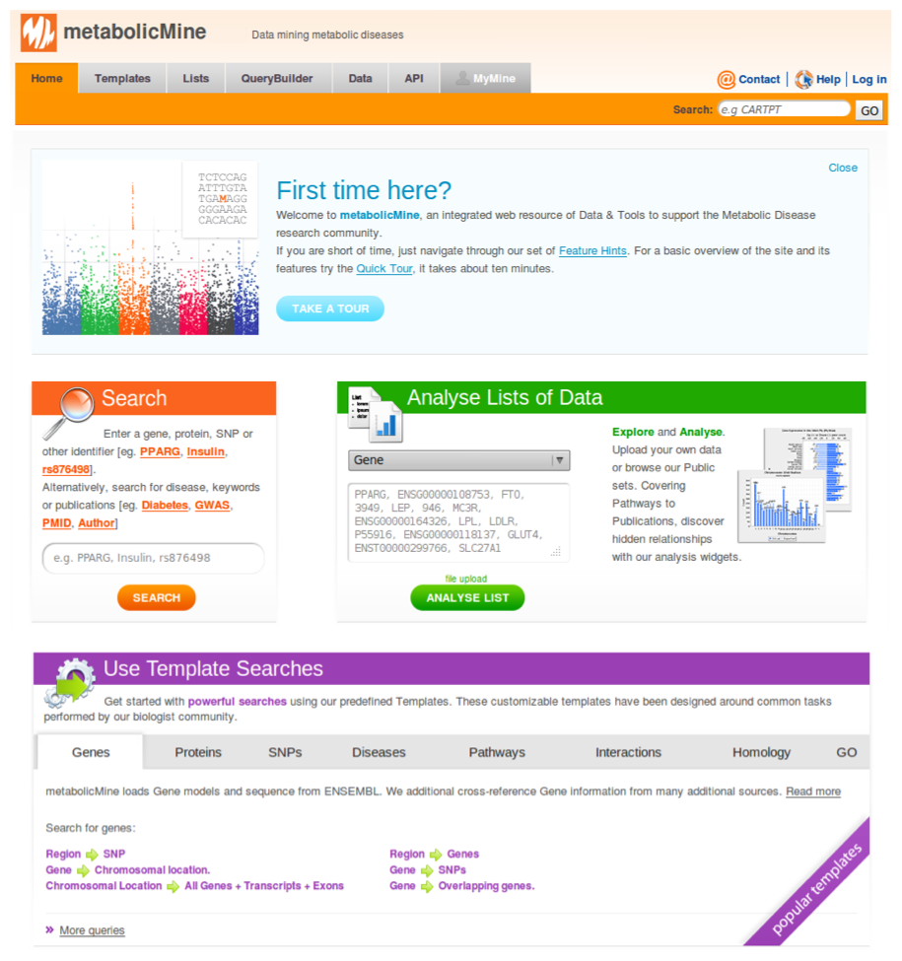
Notes:
Integrates broad-scale public data
Integrates more-specific data sets
gene expression / proteomics, user / community nominations, own lab data...
Library of relevant Template Searches
List Analysis tools / widgets
public List nominations
Web services
query APIs for bioinformaticians
interoperation with existing tools / databases
Comparative studies via interoperation with Model Organism Databases

Slide 9
metabolicMine Objectives
Reach information without having to visit several sites and formats
Examine properties of a collection
Investigate gene function
Evaluate individual sequence variations
Genome region searches
Work with old /diverse identifiers
Export in a range of formats
Link to other tools
Notes:
Different sites & formats: extremely time consuming!
collection of genes/SNPs
InterMine is well suited to address these needs

Slide 10
Notes:
Integrates broad-scale public data
Integrates more-specific data sets
gene expression / proteomics, user / community nominations, own lab data...
Library of relevant Template Searches
List Analysis tools / widgets
public List nominations
Web services
query APIs for bioinformaticians
interoperation with existing tools / databases
Comparative studies via interoperation with Model Organism Databases

Slide 11
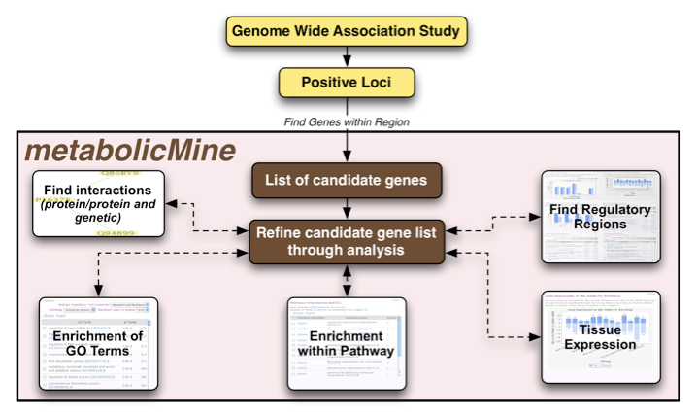
Examine the Properties of a Collection: List Analysis
Region or SNPs to Genes
Notes:
List Analysis provides an overview of your collection across a range of properties including GO terms, Pathways, Interactions, Publications and Expression.
Display 'widgets' highlight statistically enriched results.

Slide 12
Notes:
Integrates broad-scale public data
Integrates more-specific data sets
gene expression / proteomics, user / community nominations, own lab data...
Library of relevant Template Searches
List Analysis tools / widgets
public List nominations
Web services
query APIs for bioinformaticians
interoperation with existing tools / databases
Comparative studies via interoperation with Model Organism Databases

Slide 13
List Analysis
List Analysis provides an overview of your List across a range of properties including GO terms, Pathways, Interactions, Publications and Expression.
Display 'widgets' highlight statistically enriched results.

Slide 14
A Library of ‘Template’ Searches
Covers questions frequently asked by the research community...
Genes --> Proteins
Genes --> all SNPs
Genes --> Diseases
Gene --> Pathways
Proteins --> Protein Domains
Proteins --> Interactions
Proteins --> GO terms
Protein Domain --> all Proteins
Go term --> Proteins
SNPs --> GWA study
SNPs --> Type + Consequences
GWAS term --> SNPs
GWA study --> Genes
Region --> Genes
Region --> SNPs
Gene A --> Interactions <-- Gene B
Notes:
One of key features - ability to search across domains of knowledge

Slide 15
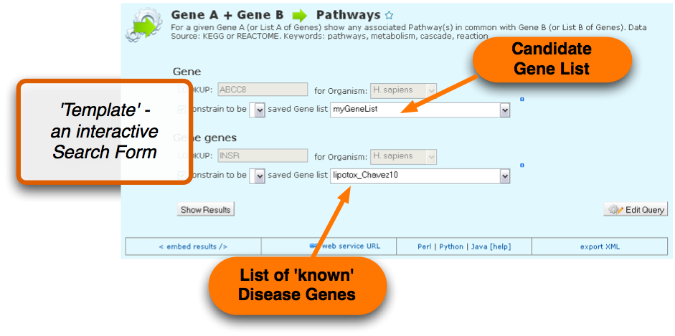
A Library of ‘Template’ Searches
Covers questions frequently asked by the research community...
Genes --> Proteins
Genes --> all SNPs
Genes --> Diseases
Gene --> Pathways
Proteins --> Protein Domains
Proteins --> Interactions
Proteins --> GO terms
Protein Domain --> all Proteins
Go term --> Proteins
SNPs --> GWA study
SNPs --> Type + Consequences
GWAS term --> SNPs
GWA study --> Genes
Region --> Genes
Region --> SNPs
Gene A --> Interactions <-- Gene B
Notes:
Complex searches are represented as pre-filled Search Forms

Slide 16
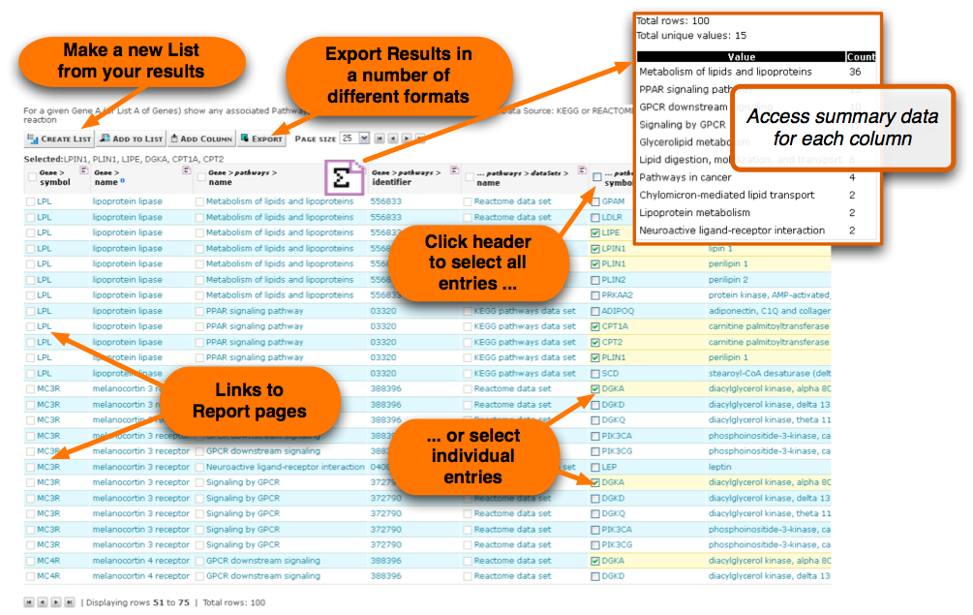
Notes:
Results are linked to database entries and can be a starting point for further analysis. Create Lists, Export in a number of formats and view summary statistsics.

Slide 17
metabolicMine Objectives
Reach information without having to visit several sites and formats
Examine properties of a collection
Investigate gene function
Evaluate individual sequence variations
Genome region searches
Work with old /diverse identifiers
Export in a range of formats
Link to other tools
Notes:
Different sites & formats: extremely time consuming!
collection of genes/SNPs
InterMine is well suited to address these needs

Slide 18
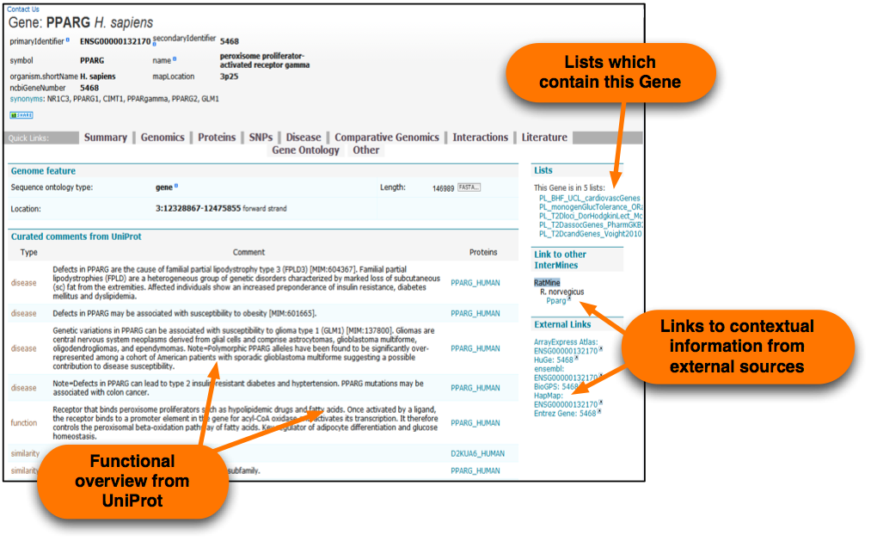
Notes:
Report pages combine data from varied sources. Summary data provides quick orientation on what is ‘known’.

Slide 19
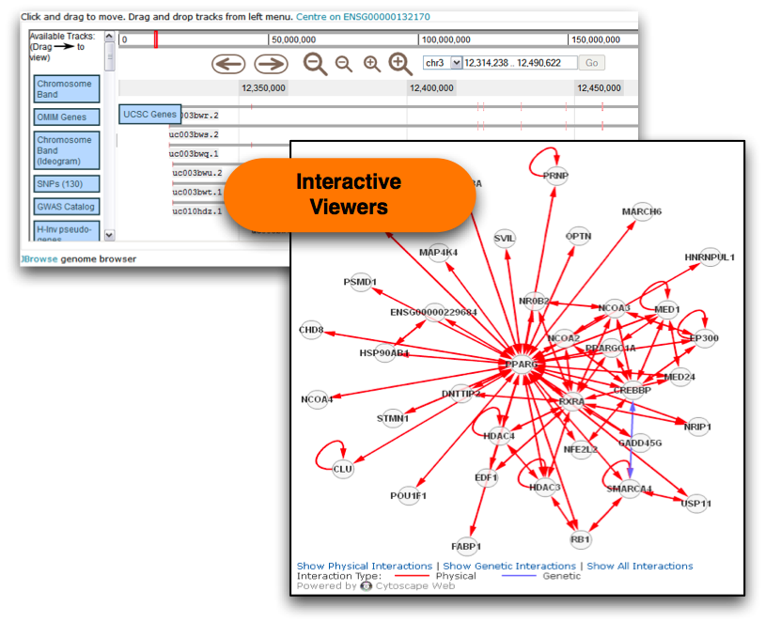
Notes:
Interactive viewers give a visual overview and provide several options t use data for further analysis.

Slide 20
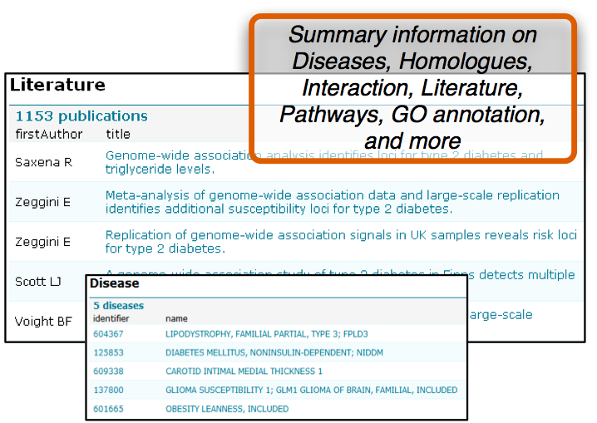
Notes:
Report pages draw together additional data to support inference and decision making.

Slide 21
metabolicMine...
Integrates broad-scale public data
Integrates more-specific data sets
  gene expression / proteomics, user / community nominations, own lab data...
Library of relevant Template Searches
List Analysis tools / widgets
  public List nominations
Web services
  query APIs for bioinformaticians
  interoperation with existing tools / databases
Comparative studies via interoperation with Model Organism Databases

Slide 22
metabolicMine Objectives
Reach information without having to visit several sites and formats
Examine properties of a collection
Investigate gene function
Evaluate individual sequence variations
Genome region searches
Work with old /diverse identifiers
Export in a range of formats
Link to other tools
Notes:
Different sites & formats: extremely time consuming!
collection of genes/SNPs
InterMine is well suited to address these needs

Slide 23
Evaluate Individual Sequence Variations
SNPs and Consequence predictions from dbSNP and Ensembl
Template Searches
    SNP to GWAS results
    Region or SNPs to nearest Gene(s)
List analysis & enrichment
Find features within chromosome intervals
‘Novel’ SNP upload & Consequence prediction

Slide 24
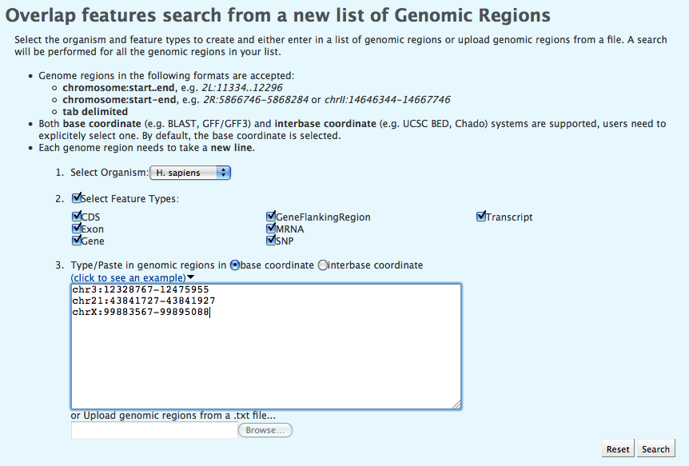
Evaluate Individual Sequence Variations
SNPs and Consequence predictions from dbSNP and Ensembl
Template Searches
    SNP to GWAS results
    Region or SNPs to nearest Gene(s)
List analysis & enrichment
Find features within chromosome intervals
‘Novel’ SNP upload & Consequence prediction

Slide 25
Summary

Slide 26
Beyond Metabolic Diseases
Data coverage is not limited to Metabolic Diseases
All data in metabolicMine are freely available
Data can be easily embedded into your own web pages!
    Present up-to-date data sets and information relevant to your genes
    No overhead of processing and integrating multiple data sources
    Less updating and storage of data held locally
What does this mean for you?

Slide 27
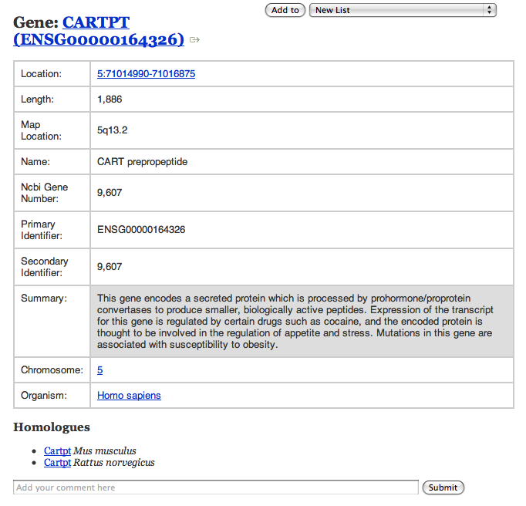
Embed Gene summary information

Slide 28
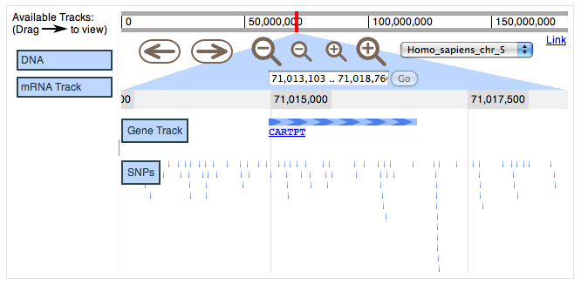
Embed Interactive viewers

Slide 29
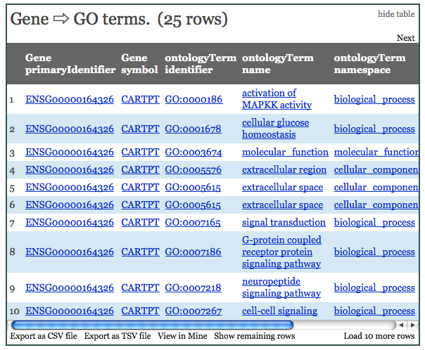
Embed Template Searches

Slide 30
How To Access the Data
Through a Java Script library allowing embedding into your own web pages
Through web services using Perl, Java & Python API
To find out more, visit:
API: metabolicmine.org/beta/api.do
Embedding tutorial: intermine.org/imbedding/
Test site: squirrel.flymine.org/neurogenes/

Slide 31
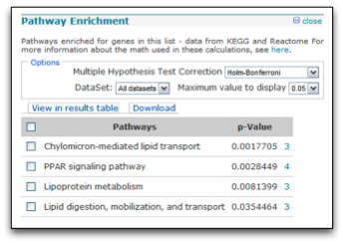
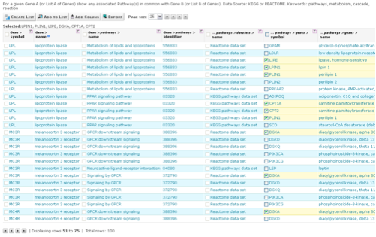
Mouse obesity candidate
genes
List Upload
metabolicMine
Weak enrichment for lipid processes & pathways
List Analysis
Template
Convert to
Orthologues
Human
candidate
genes
Template
Interactions
Results
'Known' Obesity genes
'Unknown' genes
Template
Gene To Gene Pathway Comparison
Notes:
RHS templates: two types of template. Interactions expand your List, Pathways refine.

Slide 32
Next steps...
- suggestions for new features tasks, tools & templates data sources links - suggestions for conferences to demo at - feedback on bits of interface that don't work as
expected/ are confusing/ are broken - suggestions for better documentation short training videos FAQ items
Notes:
Apply for medMine, re-apply after lab engagements -> metabolicMine
Applicable to other disease areas/ biomedical research in general...

Slide 33
Help to Improve metabolicMine
metabolicMine is a community resource!
In addition to using metabolicMine, you can also help by suggesting:
Datasets that you think we should include.
Publications with interesting Gene or SNP lists that could contribute to our 'known' Gene sets.
Even better, if you make a List from a publication please share it with us!
Tasks that we can turn into Template Searches to add to metabolicMine's Library.
Workflows and Functionality improvements.

Slide 34
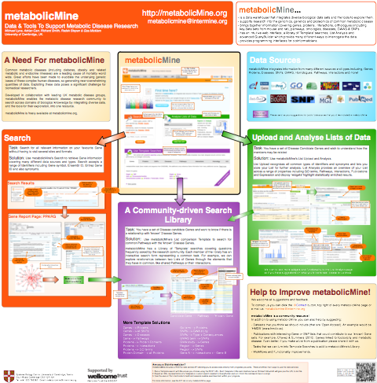

Slide 35
Come and see us...
Demonstrations: 12:30 & 4:00 pm, every day
Informal drop-in sessions: 12:00-5:00 pm
Poster: 245. Session 2, Tu May 17th

Slide 36
Acknowledgments
metabolicMine Team:
Mike Lyne, Adrian Carr, Richard Smith, Radek Stepan
InterMine Team:
Daniella Butano, Fenghuan Hu, Alex Kalderimis, Julie Sullivan, Dan Tomlinson
- Collaborators:Inês Barroso (WT Sanger Institute)Ewan Birney (EBI)Roger Cox (MRC Harwell)Tim Frayling (Peninsula Medical School)Philippe Froguel (Imperial College)Suzanna Lewis (LBNL)Ruth loos (MRC Epidemiology Unit)Mark McCarthy (WTCHG, Oxford)Stephen O'Rahilly (IMS MRL, Cambridge)Toni Vidal-Puig (IMS MRL, Cambridge)
Notes:
MetabolicMine just about to start...

Slide 37
How To Access the Data
Through a Java Script library allowing embedding into your own web pages
Through web services using Perl, Java & Python API
To find out more, visit:
API: metabolicmine.org/beta/api.do
Embedding tutorial: intermine.org/imbedding/
Test site: squirrel.flymine.org/neurogenes/

