Slide 1
Code Meetings
Checkstyle and Eclipse

Slide 2
Checkstyle
The FlyMine project has committed to certain code standards since the start of the project.
  One of the tools to improve code standards is Checkstyle.
  No code should be checked in if it doesn't pass Checkstyle.
  This will help later with code readability and maintainability, as well as preventing bugs.
  Eclipse can automatically monitor your code for Checkstyle errors as you type.

Slide 3
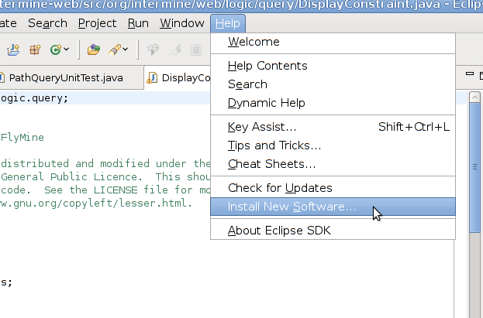
Eclipse Checkstyle Setup
Add software from http://eclipse-cs.sf.net/update/

Slide 4
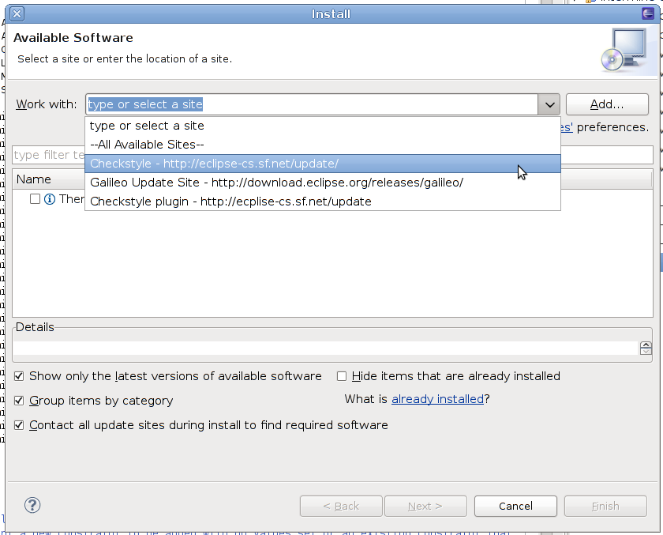
Eclipse Checkstyle Setup

Slide 5
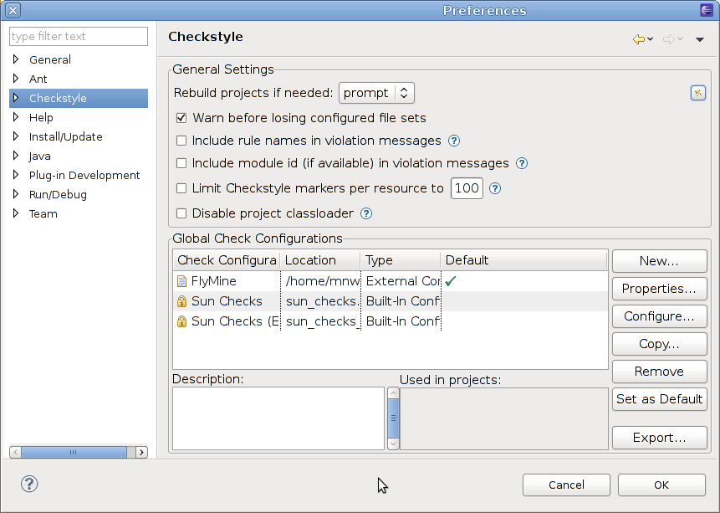
Eclipse Checkstyle Setup
Edit Window->Preferences, and select Checkstyle

Slide 6
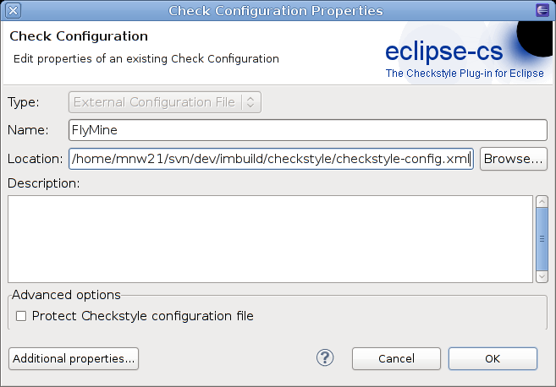
Eclipse Checkstyle Setup
Select “New...”, and configure an external configuration file:
  /whatever/imbuild/checkstyle/checkstyle-config.xml

Slide 7
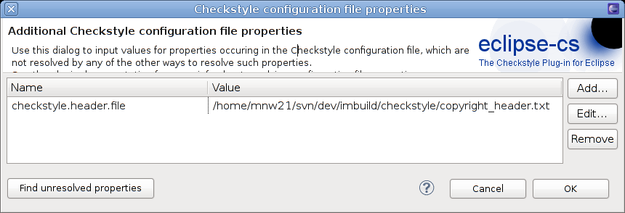
Eclipse Checkstyle Setup
Select “Additional Properties”
  We need to tell Checkstyle where to find the copyright header file.

Slide 8
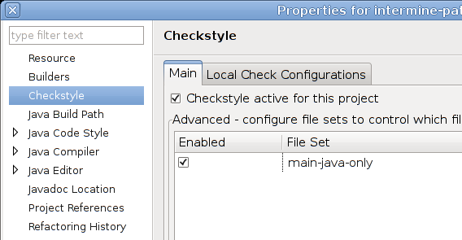
Eclipse Checkstyle Setup
All “main” projects should be checked by Checkstyle.
  But not the “test” projects
  Right-click on a project in the Project Explorer, and select “Properties”.
  Select “Checkstyle”
  and select
  “Checkstyle active
  for this project”.

Slide 9
Checkstyle
Checkstyle can (and should) be run manually every so often
  In a “main” project, from the command line, run “ant checkstyle”.
  The results are then available in HTML format in build/checkstyle/index.html
  This will check the whole project – we should aim to have no checkstyle errors on any of our projects.
    At least check that none of the files you have modified have any errors that you can fix.

Slide 10
Checkstyle Rules
RegexpHeader
  This makes sure that the file always starts with our copyright header.
/*
* Copyright (C) 2002-2010 FlyMine
*
* This code may be freely distributed and modified under the
* terms of the GNU Lesser General Public Licence. This should
* be distributed with the code. See the LICENSE file for more
* information or http://www.gnu.org/copyleft/lesser.html.
*
*/
  It gets updated every year, along with all the files.

Slide 11
Checkstyle Rules – Javadoc
We need full Javadoc on all of our public and protected elements – classes, methods, and variables.
Documentation should describe what the element is for, what it does, what its corner cases are, what arguments it takes, and what it returns.
Variables should include a description of the format.
Documenting unchecked exceptions can be useful.

Slide 12
Checkstyle Rules – Javadoc
The Javadoc is a contract for the code it describes.
  Unit tests should be written to test the claims in the Javadoc, not against the code inside.
Checkstyle will only check that Javadoc is present, not that it is useful.
  Checkstyle checks that there is some description for everything.
  It is entirely possible to trick Checkstyle with “dummy” entries. Don't do this!

Slide 13
Checkstyle Rules – Javadoc
Bad Javadoc:
/**
* Required for jsp
* @return
* a String.
*/
public String getNoConstraintsString() {
return toStringNoConstraints();
}
Does not describe the format of the return value.

Slide 14
Checkstyle Rules – Javadoc
Good Javadoc:
/**
* Returns the exact same value as toStringNoConstraints().
* This method is duplicated as JSP can only access methods
* starting with “get”.
*
* @return a String version of the Path, consisting of a
* class name and multiple field names separated by dots,
* without subclass constraints
*/
public String getNoConstraintsString() {
return toStringNoConstraints();
}

Slide 15
Checkstyle Rules – Javadoc
Debugging is twice as hard as writing the code in the first place. Therefore, if you write the code as cleverly as possible, you are, by definition, not smart enough to debug it.
Brian W. Kernighan
It is important to get the documentation right as soon as possible after writing the code, or even before writing the code.
  What seems obvious now may be really hard to work out in a couple of weeks.

Slide 16
Checkstyle Rules - Javadoc
Sun's Javadoc Recommendations:
  The first sentence appears in the summary. It should be a full brief description of the element.
  Further sentences should fully describe the element.
  The description should end in a full stop, and there should be a blank line before the parameters.
  Parameter descriptions should start on the same line as the parameter name, and should not end with a full stop.
  All funny characters must be HTML-encoded.

Slide 17
Checkstyle Rules
We should never import anything from the sun.*
Maximum class file length is 2200 lines, and the maximum method length is 211 lines.
Maximum line length is 100 characters.
Tabs must always be converted to spaces, and we indent by four spaces.
  Indentation is checked by Checkstyle.
Maximum number of method parameters is 11.
No line should end with a space.

Slide 18
Checkstyle Rules
All if, do, for, and while blocks must enclose their contents in braces.
We disallow a few common debugging snippets:
  System.out.println System.err.println
  LogMe System.exit
Any class which implements equals() must also implement hashCode() and vice-versa.

