Slide 1
Code Meetings
Java Compliance Level
and
JUnit Tests

Slide 2
Java Compliance Level
Sun/Oracle have been a bit dumb.
  The @Override annotation has changed meaning between Java 5 and Java 6.
    In Java 5, @Override could only be applied to a method that overrides an implementation in another class.
    In Java 6, @Override can be applied to methods that implement abstract methods and interfaces.
  By default, Eclipse will add @Override to everything, and then our code will not compile under Java 5.
    There is no warning!

Slide 3
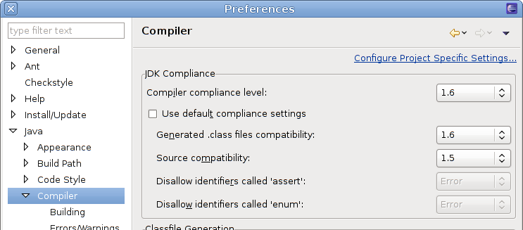
Java Compliance Level
We need to change an eclipse setting:
  Untick the “Use default compliance settings” option, and set “Source compatibility” to “1.5”.

Slide 4
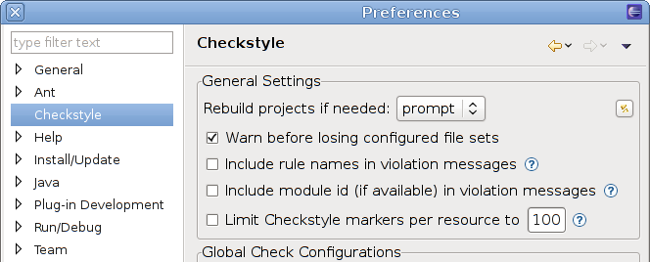
Checkstyle
By now, Eclipse Checkstyle should be working.
  Let me know if it isn't working correctly, and we can sort it out.
  I have added a few more rules, so do an svn update, and then click this button:

Slide 5
JUnit Tests
Part of code quality control is writing tests.
  We write tests for much of our codebase.
  We use the testing framework called JUnit.
  Most of our tests are unit tests, although we have some functional tests. Both are valuable, though we want to concentrate on the former.
  Some code is better tested than others – the sections of code that are relied on more are tested more thoroughly.

Slide 6
JUnit Tests
A unit test tests a particular small section of code.
  Try to exercise all the corner cases of the code.
  Remember you are testing the contract as defined in the Javadoc, not the code itself.
  Some people write the tests before the code!
To run tests, on the command line, change directory to a test directory (like intermine/objectstore/test) and run “ant”.
  Results will be put in build/test/results/index.html

Slide 7
JUnit Tests - Example
package org.intermine.util;
/*
* Copyright (C) 2002-2010 FlyMine
*
* This code may be freely distributed and modified under the
* terms of the GNU Lesser General Public Licence. This should
* be distributed with the code. See the LICENSE file for more
* information or http://www.gnu.org/copyleft/lesser.html.
*
*/
import junit.framework.*;
public class IntPresentSetTest extends TestCase
{
public IntPresentSetTest(String arg1) {
super(arg1);
}
public void test() throws Exception {
IntPresentSet set = new IntPresentSet();
set.set(42, true);
set.set(28673452, true);
assertEquals(2, set.size());
assertTrue(set.contains(42));
assertTrue(set.contains(28673452));
assertFalse(set.contains(63));
assertEquals("[42, 28673452]", set.toString());
set.set(42, true);
assertEquals(2, set.size());
assertTrue(set.contains(42));
assertTrue(set.contains(28673452));
assertFalse(set.contains(63));
assertEquals("[42, 28673452]", set.toString());
set.set(42, false);
assertEquals(1, set.size());
assertFalse(set.contains(42));
assertTrue(set.contains(28673452));
assertFalse(set.contains(63));
assertEquals("[28673452]", set.toString());
}
}

Slide 8
JUnit Tests
A unit test is a class that extends junit.framework.TestCase.
  You should create a single argument constructor.
  Any method with a name starting with “test” will be
  run as a test, but it should take no arguments and
  return no result.
  The results of the test are determined by whether the method throws any exceptions.
  TestCase provides several methods (like assertEquals) which will throw appropriate exceptions.

Slide 9
JUnit Tests
You can specify a setUp() and tearDown() methods to generate a test environment.
  These methods are called once per method test.
  We also have org.intermine.testing.OneTimeTestCase, which provides oneTimeSetUp() and oneTimeTearDown().
  If you alter a database in a setUp() method, make sure you put it back in the tearDown() method!

Slide 10
JUnit Tests
We have some TestCase classes that provide extra functionality for tests:
  ItemsTestCase – methods to compare Items.
  QueryTestCase – methods to compare queries.
  ObjectStoreQueriesTestCase – sets up a load of standard test queries.
  SetupDataTestCase – sets up some test data.
  StoreDataTestCase – stores test data in database.
Other tests use these to share test code.

Slide 11
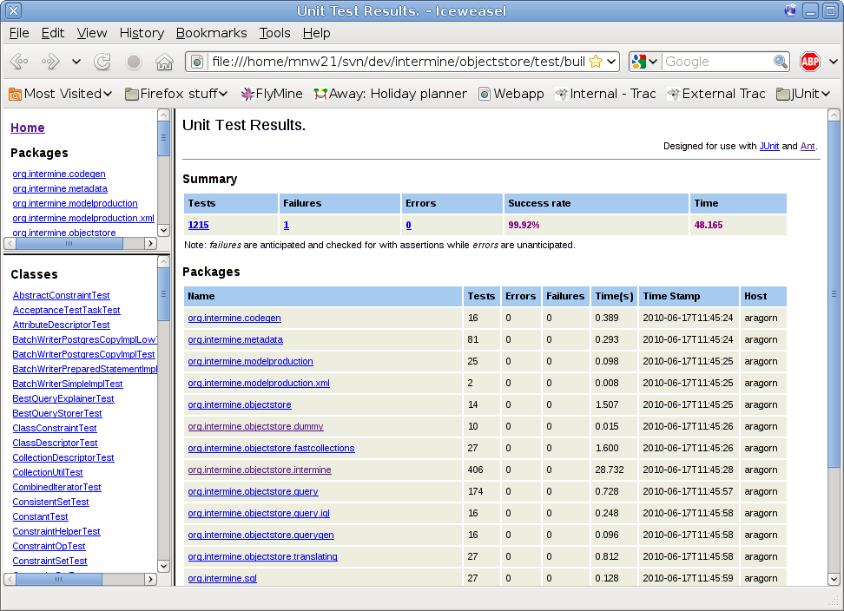
JUnit Tests

Slide 12
JUnit Tests – Coverage
We have also integrated EMMA code coverage.
  Edit your project.properties file and set “emma.enabled=true”.
  Run tests, and a code coverage report is placed at build/coverage/index.html
  Shows which lines of code have been touched by running the tests
    Green lines have been run
    Red lines have not been run
    Yellow lines have been partly run, for example one side of a condition but not the other

Slide 13
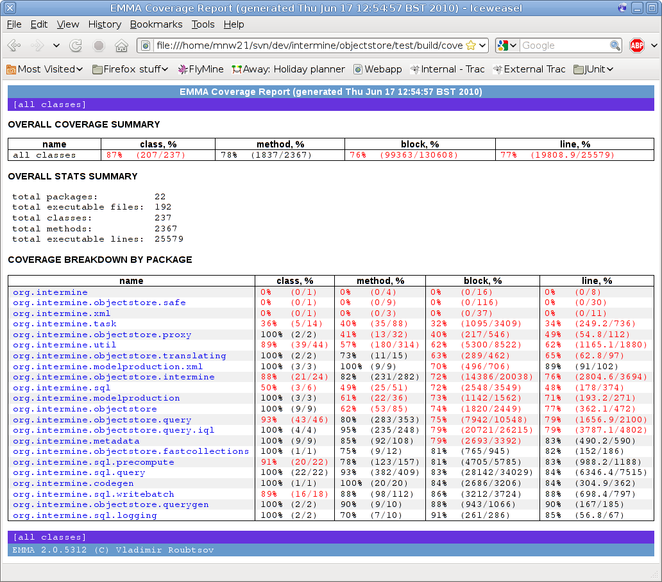
JUnit Tests – Coverage

Slide 14
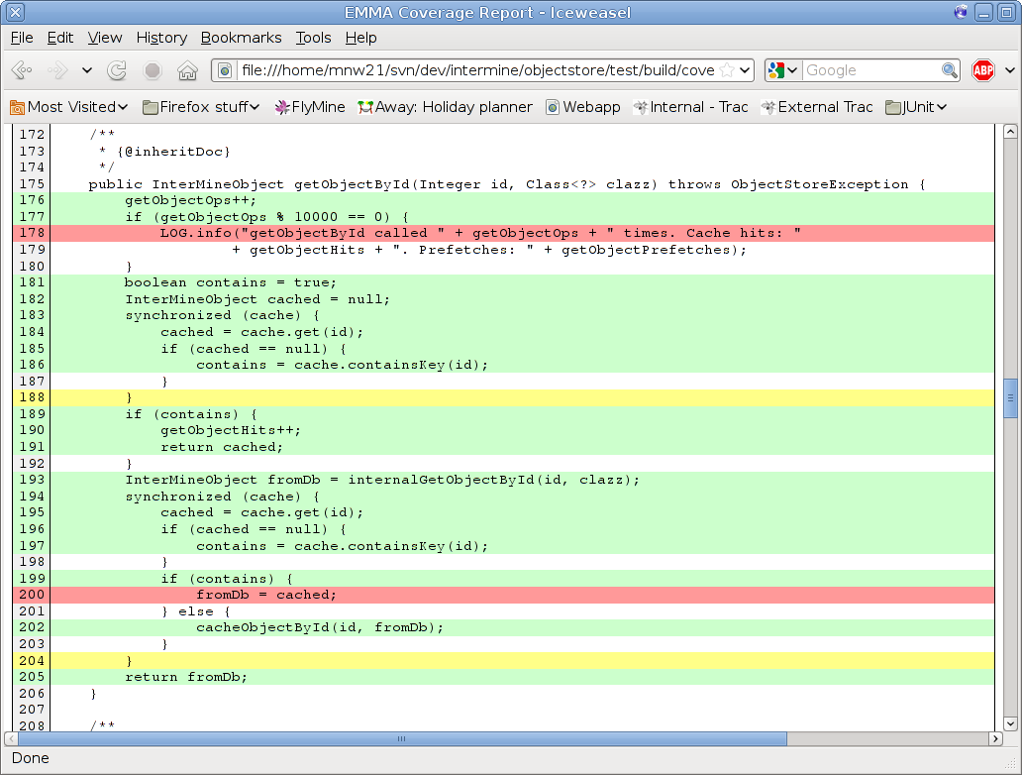
JUnit Tests – Coverage

Slide 15
JUnit Tests – Project Layout
Not all projects should be tested.
  Tested:
    intermine/api, intermine/integrate, intermine/objectstore, intermine/pathquery, intermine/web, intermine/webservice, bio/postprocess, sources
  Not tested:
    intermine/webapp, intermine/webtasks
  We also have a bio/test-all
  Mines generally don't have much testing, as they don't have much code.

Slide 16
JUnit Tests
Final comments:
  Test class names and test methods should be fairly descriptive (not test1(), test2(), etc).
  Usually have a one-line comment at the top of each test method saying what it tests if it is not obvious.
  Checkstyle is not applied to the tests, as we don't care as much about the style.
  Should test not only for results, but also that code throws the correct exceptions when provoked.

