Slide 1
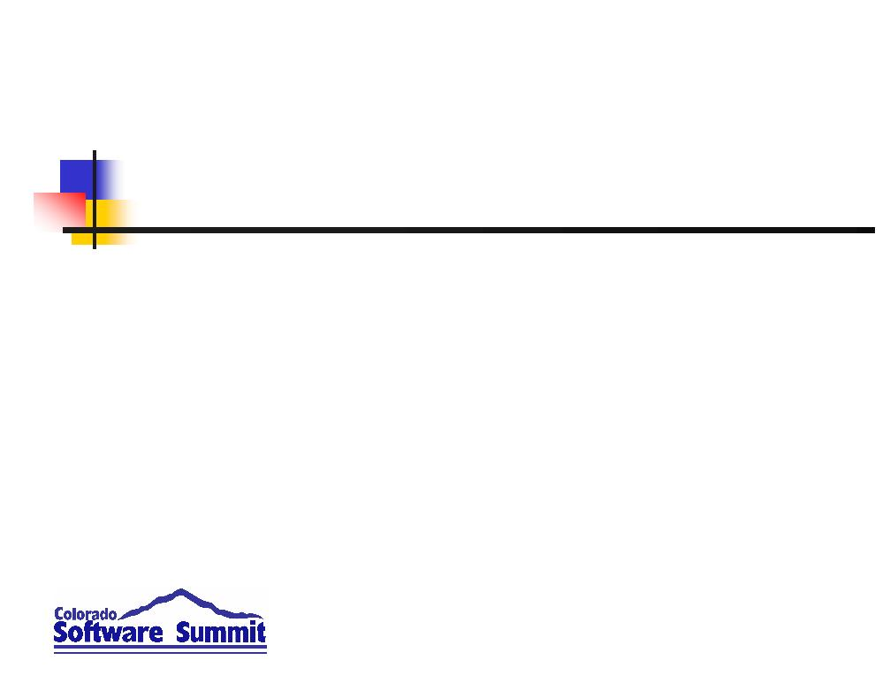
InterMine: An open source data warehousing tool, ready for prime time
  Matthew Wakeling
  FlyMine Group, Department of Genetics
  University of Cambridge
  matthew@flymine.org

Slide 2
Overview
InterMine's project architecture
The “objectstore” project
  Setting up a database
  Reading and writing
The “integrate” project
  Importing data
The web application
  Creating a user interface to the database

Slide 3
InterMine's project architecture
InterMine uses an ant-driven system of separate projects covering different areas of functionality.
  To create a new database, the easiest way is to create a new InterMine project and make use of the dependency system to pull in all the required code and ant rules for you.
  This talk will demonstrate how to do this, and give a tour of the existing projects and their functionality.

Slide 4
InterMine's project architecture
FlyMine
Your project
Web App
Path Query
Integration
ObjectStore
SQL

Slide 5
The ObjectStore project
The InterMine ObjectStore is a general-purpose object-oriented database.
  Backed by an SQL database (PostgreSQL).
  Performance optimised for reads and writes.
  Advanced query interface.
  Differs from Hibernate:
    Designed to take a object model and create an optimal SQL database, rather than mapping an object model onto a pre-set SQL database.
    Designed for bulk data and complex queries rather than online transaction processing.

Slide 6
The ObjectStore project
Prefetch
Manager
(threads)
Results
Query
ObjectStore
ObjectStoreWriter
SQL Generator
Temp
table
writer
Results
Converter
SQL Writer
(threads)
Optimiser
SQL

Slide 7
Creating a project
Make a directory for your project.
  Now we create a sub-project for the db.
  A project is an ant project, so we need a directory “dbmodel” with a build.xml.
<project name="tutorial" default="default" basedir=".">
<description>For CSS2008</description>
<import file=".../imbuild/objectstore.xml"/>
</project>
  Also need a project.properties file.
compile.dependencies = intermine/integrate/main
objectstore.name = os.tutorial
model.name = tutorialmodel
intermine.properties.file = csstutorial.properties
default.intermine.properties.file = ../default.intermine.integrate.properties

Slide 8
Defining a model
An object model is defined in XML.
  A file named tutorialmodel_model.xml
<model name="tutorialmodel" namespace="http://www.intermine.org/model/tutorialmodel#">
<class name=”tutorialmodel.HasName” is-interface=”true”>
<attribute name=”name” type=”java.lang.String”/>
</class>
<class name="tutorialmodel.Employee" extends=”tutorialmodel.HasName” is-interface="false">
<attribute name="fullTime" type="boolean"/>
<attribute name="age" type="int"/>
<reference name="department" referenced-type="tutorialmodel.Department" reverse-reference="employees"/>
</class>
<class name=”tutorialmodel.Department” extends=”tutorialmodel.HasName” is-interface=”false”>
<collection name="employees" referenced-type="tutorialmodel.Employee" reverse-reference="department"/>
</class>
</model>
Attributes can be of types:
  boolean, short, int, long, float, double, Boolean, Short, Integer, Long, Float, Double, String, Date, BigDecimal.

Slide 9
Building a database
A database is defined using properties.
db.tutorial.datasource.class=org.postgresql.jdbc3.Jdbc3PoolingDataSource
db.tutorial.datasource.dataSourceName=db.common-tgt-items
db.tutorial.datasource.maxConnections=10
db.tutorial.driver=org.postgresql.Driver
db.tutorial.platform=PostgreSQL
db.tutorial.datasource.serverName=server.flymine.org
db.tutorial.datasource.databaseName=tutorial
db.tutorial.datasource.user=fred
db.tutorial.datasource.password=whatever
An ObjectStore is defined from the db.
os.tutorial.class=org.intermine.objectstore.intermine.ObjectStoreInterMineImpl
os.tutorial.db=db.tutorial
os.tutorial.noNotXml=false
os.tutorial.model=tutorialmodel
os.tutorial.minBagTableSize=10000
osw.tutorial.class=org.intermine.objectstore.intermine.ObjectStoreWriterInterMineImpl
osw.tutorial.os=os.tutorial
  Put it in a file named ~/csstutorial.properties

Slide 10
Creating a project
Also need to create some empty files and directories:
Create a Postgres database called “tutorial” and run “ant build-db”.
  $ tree
  .
  |-- dbmodel
  | |-- build.xml
  | |-- lib
  | |-- project.properties
  | |-- resources
  | | `-- tutorialmodel_keyDefs.properties
  | |-- src
  | `-- tutorialmodel_model.xml
  `-- default.intermine.integrate.properties

Slide 11
Database Mapping
Each class and interface in the model is mapped onto a table in the database.
  The table contains a column for each field in the class, plus an “OBJECT” column containing the serialised object and a “class” column.
  Each object is stored in all the tables associated with classes and interfaces that the object extends.
    Multiple copies makes querying easier and faster, but storing slower.

Slide 12
Database Mapping
Several properties change the layout:
  Truncated tables merges several tables into one – all classes extending a given class are combined in one table.
  Missing tables are useful to reduce the storage overhead if it would not be queried.
  Missing NotXML removes the OBJECT column from all tables except the root table. This means each query needs to go to the database twice – once to run the query, and again to fetch the objects.

Slide 13
Database Mapping
test=# \d employee
Table "public.employee"
Column | Type | Modifiers
----------------------------+---------+-----------
object | text |
fulltime | boolean | not null
id | integer | not null
name | text |
age | integer | not null
departmentid | integer |
class | text |
Indexes:
"employee_pkey" UNIQUE, btree (id)

Slide 14
Accessing the database
Read access to the database is provided through the ObjectStore interface.
import org.intermine.objectstore.*;
ObjectStore os = ObjectStoreFactory.getObjectStore(“os.tutorial”);
  “os.tutorial” was set up using properties earlier.
Write access is provided by an ObjectStoreWriter – a sub-interface of ObjectStore.
ObjectStoreWriter osw = ObjectStoreWriterFactory.getObjectStoreWriter(“osw.tutorial”);

Slide 15
Accessing the database
To write an object to the database, use the ObjectStoreWriter.store() method:
import tutorialmodel.*;
ObjectStoreWriter osw = ObjectStoreWriterFactory.getObjectStoreWriter(“osw.tutorial”);
Employee e = new Employee();
e.setName(“Fred”);
e.setAge(5);
e.setFullTime(true);
System.out.println(“ID before storing: “ + e.getId());
osw.store(e);
System.out.println(“ID after storing: “ + e.getId());
To delete an object:
osw.delete(e);
  The object must be of the right class and have the ID filled in to delete properly.
null
872341

Slide 16
Accessing the database
Many to many collections are stored using an indirection table.
  When storing the object, many to many collections are updated.
  You can independently update collections:
osw.addToCollection(e.getId(), Employee.class, “collection”, other.getId());
One to many collections are managed by the reverse reference.
  To update them, store the object in the collection with a new reference back.

Slide 17
Accessing the database
Transactions are supported:
try {
osw.beginTransaction();
osw.store(e);
System.out.println(“In transaction: “ + osw.isInTransaction());
osw.commitTransaction();
} finally {
osw.abortTransaction();
}
There is also an asynchronous commit method:
osw.batchCommitTransaction();
  Forces a transaction commit and re-begin, but does not wait for the database.

Slide 18
Accessing the database
Performance-wise, transactions are good.
  Each write performed outside a transaction, and each transaction commit needs to wait for a round-trip to the database.
  If you write lots of objects in one transaction, the software will group the writes together and send them to the database later, in the background.
    For Postgres, we send the changes using a binary representation, to minimise conversion overheads.

Slide 19
Accessing the database
The ObjectStoreWriter uses a single connection to the database, in order to provide transaction support.
  The ObjectStore uses a pool of connections, for parallel access.
  Each ObjectStoreWriter is attached to an ObjectStore – accessed by getObjectStore().
To fetch an object from the database:
Employee e = os.getObjectById(872341, Employee.class);
  Results are cached.

Slide 20
Data Storage
InterMine is very flexible in storing data.
  All stored objects* inherit InterMineObject, which has the ID field.
  Will store any subclass of InterMineObject, whether it is in the model or not!
  The model dictates what you can search for, not what you can store.
osw.store(new Employee() {
private int extraField;
public void setExtraField(int extraField) {
this.extraField = extraField; };
public int getExtraField() { return extraField; };
});
* Except simple objects.

Slide 21
Querying the database
So far we have just accessed objects by ID. InterMine contains a powerful query interface.
  Similar to SQL, but object-oriented.
  You can select fields:
SELECT e.name FROM Employee AS e
  You can select whole objects:
SELECT e FROM Employee AS e
  You can add constraints:
SELECT e FROM Employee AS e WHERE e.name = 'Fred'

Slide 22
Querying the database
Queries can be written as text (IQL) or programmatically created in Java.
SELECT e.name FROM Employee AS e WHERE e.age > 25
  is the same as:
Query q = new Query();
QueryClass qc = new QueryClass(Employee.class);
q.addFrom(qc);
q.addToSelect(new QueryField(qc, “name”));
q.setConstraint(new SimpleConstraint(
new QueryField(qc, “age”),
ConstraintOp.GREATER_THAN, 25));
q.setDistinct(false);
  For conciseness I will use the text version.

Slide 23
Querying the database
The FROM list can contain multiple classes – even multiple copies of the same class.
  The tables are joined together, just like SQL. The results are then restricted by the WHERE clause.
  There is no SQL-like “JOIN” keyword – the classes are just listed separated by commas.
  Each class can be aliased using the “AS” keyword, just like SQL.

Slide 24
Querying the database
There are several types of constraint.
  SimpleConstraint:
  WHERE e.age > 25
  ContainsConstraint:
  WHERE e.department CONTAINS d
  A question mark can represent a parameter:
  WHERE e = ? (an InterMineObject)
  WHERE e IN ? (a collection of objects)
  WHERE e.name IN ? (a collection of Strings)
  Constraints can be combined with AND, OR, NOT, and brackets (ConstraintSet).

Slide 25
Querying the database
The SELECT list is a list of the columns you want in your results.
  May have more than one column, like SQL.
  You can put fields, whole objects, mathematical expressions, and aggregate functions (COUNT, MIN, MAX, etc.) on the SELECT list.
  If you use aggregate functions, you can set the GROUP BY list too, just like SQL.
  There is no HAVING though – that is merged with the WHERE clause.

Slide 26
Querying the database
The ORDER BY clause behaves exactly like SQL.
  Putting a class on the ORDER BY clause is like putting its ID on the ORDER BY.
The DISTINCT keyword also behaves exactly like SQL.
Subqueries can be put on the FROM list, and all the columns are available in the main query.

Slide 27
Querying the database
Path expressions are extra columns that are added to the SELECT list, but do not change the number of rows in the results.
SELECT d, d.employees FROM Department AS d
  Returns results with two columns, of types Department and Collection of Employee.
  The main query only involves Department.
  d.employees is a path expression – extra data added to the results afterwards, so it cannot be accessed elsewhere in the query.

Slide 28
Querying the database
However, a path expression has query elements in its own right:
SELECT d, d.employees(WHERE default.age > 25) FROM Department AS d
  Returns a table of Department against a Collection of Employees older than 25.
  Returns all Departments even if there are no Employees.
  A bit like an SQL “outer join”.

Slide 29
Executing queries
The ObjectStore provides two main methods for executing queries:
  ObjectStore.execute(Query q);
    Returns a List of rows, each of which is a List of columns.
  ObjectStore.executeSingleton(Query q);
    Returns a List of elements, each of which is the value of the only column of the Query.
  The List is a Results object – lazily-loaded from the database as it is accessed.
    Uses a separate thread to prefetch data.

Slide 30
Executing queries
The Results object provides a few extra methods beyond just a lazy List:
  Results.getInfo() returns an object containing estimates for how many rows there are, and how long the database will take to produce them all.
  Results.setNoOptimise() switches off the use of the QueryOptimiser.
  Results.setNoPrefetch() switches off the background prefetch thread.
  Results.setBatchSize() sets the fetch size.

Slide 31
Executing queries
Because the results are lazily fetched, the data may change half-way through.
  The Results object throws ConcurrentModificationException.
  If you want to modify or delete objects as you read them, then execute your query on the ObjectStore, and write the changes to an ObjectStoreWriter in a single transaction.
    The changes are only visible to the ObjectStore once you commit the transaction.

Slide 32
Executing queries
A helpful program is provided – IqlShell.
  Provides an interactive console connected to a database.
  You can type in queries and have them executed, optimised, or explained.
  You can also manipulate the Query Optimiser from the program.
  It is found in intermine/scripts/iql_shell
  Uses Java-Readline.

Slide 33
Query Optimiser
InterMine provides a generic SQL query optimiser.
  Precomputes the results of some common queries, and places the results into a table.
  This table can then be substituted into other queries to speed them up.
  Requires a suitable set of precomputed queries to make a difference.
  Can improve performance significantly for very complex queries.

Slide 34
Data Integration
InterMine provides an integration project containing code for loading data into the database.
  Will import data in several common formats.
  Additional converters can be plugged in.
  Will merge data from multiple sources.
    Identifies duplicated objects.
    Reconstructs object graphs.
    Resolves field value conflicts.

Slide 35
Data Integration
Integration is controlled by project.xml.
<project type="tutorial">
<property name="target.model" value="tutorialmodel"/>
<property name="common.os.prefix" value="common"/>
<property name="intermine.properties.file" value="csstutorial.properties"/>
<property name="default.intermine.properties.file"
location="../default.intermine.integrate.properties"/>
<sources>
<source name="source1" type="intermine-items-xml-file">
<property name="src.data.file" location="data/source1.xml"/>
</source>
</sources>
</project>
  Here we are specifying a source importing a file in InterMine data XML format.

Slide 36
Data Integration
Then, create an “integrate” sub-project with a build.xml file:
<project name="tutorial-int" default="default" basedir=".">
<description>perform integration</description>
<import file=".../imbuild/integrate.xml"/>
</project>
  Also need a project.properties file:
compile.dependencies = intermine/integrate/main,\
.../tutorial/dbmodel
intermine.properties.file = csstutorial.properties
default.intermine.properties.file = ../default.intermine.integrate.properties
extra.project.dependencies = .../tutorial/dbmodel

Slide 37
Data Integration
Need some more properties in ~/csstutorial.properties:
integration.production.class=org.intermine.dataloader.IntegrationWriterDataTrackingImpl
integration.production.osw=osw.tutorial
integration.production.datatrackerMaxSize=100000
integration.production.datatrackerCommitSize=50000
db.common-tgt-items.datasource.class=org.postgresql.jdbc3.Jdbc3PoolingDataSource
db.common-tgt-items.datasource.dataSourceName=db.common-tgt-items
db.common-tgt-items.datasource.maxConnections=10
db.common-tgt-items.driver=org.postgresql.Driver
db.common-tgt-items.platform=PostgreSQL
db.common-tgt-items.datasource.serverName=server.flymine.org
db.common-tgt-items.datasource.databaseName=common-tgt-items
db.common-tgt-items.datasource.user=fred
db.common-tgt-items.datasource.password=whatever
os.common-tgt-items-std.class=org.intermine.objectstore.intermine.ObjectStoreInterMineImpl
os.common-tgt-items-std.db=db.common-tgt-items
os.common-tgt-items-std.missingTables=InterMineObject
os.common-tgt-items-std.model=fulldata
os.common-tgt-items-std.minBagTableSize=10000
osw.common-tgt-items.class=org.intermine.objectstore.intermine.ObjectStoreWriterInterMineImpl
osw.common-tgt-items.os=os.common-tgt-items-std
os.common-tgt-items.class=org.intermine.objectstore.fastcollections.ObjectStoreFastCollectionsImpl
os.common-tgt-items.os=os.common-tgt-items-std
os.common-tgt-items.model=fulldata
os.common-translated-std.class=org.intermine.objectstore.translating.ObjectStoreTranslatingImpl
os.common-translated-std.model=tutorialmodel
os.common-translated-std.os=os.common-tgt-items
os.common-translated-std.translatorClass=org.intermine.dataconversion.ItemToObjectTranslator
os.common-translated.class=org.intermine.objectstore.fastcollections.ObjectStoreFastCollectionsForTranslatorImpl
os.common-translated.model=tutorialmodel
os.common-translated.os=os.common-translated-std

Slide 38
integration.production.class=
org.intermine.dataloader.IntegrationWriterDataTrackingImpl
integration.production.osw=osw.tutorial
integration.production.datatrackerMaxSize=100000
integration.production.datatrackerCommitSize=50000
Creates an “Integration Writer”.
  Provides more complex store methods
  than the ObjectStoreWriter, which
  merges object graphs properly.
  Includes a data tracker to track which
  data source data came from, so
  conflicts can be resolved.
integration
.production
osw
.tutorial
os
.tutorial
db
.tutorial

Slide 39
Data Integration
db.common-tgt-items.datasource.class=org.postgresql.jdbc3.Jdbc3PoolingDataSource
db.common-tgt-items.datasource.dataSourceName=db.common-tgt-items
db.common-tgt-items.datasource.maxConnections=10
db.common-tgt-items.driver=org.postgresql.Driver
db.common-tgt-items.platform=PostgreSQL
db.common-tgt-items.datasource.serverName=server.flymine.org
db.common-tgt-items.datasource.databaseName=common-tgt-items
db.common-tgt-items.datasource.user=fred
db.common-tgt-items.datasource.password=whatever
Defines an intermediate database.
  InterMine uses an intermediate
  database to store converted data
  while importing.
  Allows searches to be performed in
  order to reconstruct object
  graphs from flat data sources.
integration
.production
osw
.tutorial
os
.tutorial
db
.common
-tgt-items
db
.tutorial

Slide 40
Data Integration
os.common-tgt-items-std.class=org.intermine.objectstore.intermine.ObjectStoreInterMineImpl
os.common-tgt-items-std.db=db.common-tgt-items
os.common-tgt-items-std.missingTables=InterMineObject
os.common-tgt-items-std.model=fulldata
os.common-tgt-items-std.minBagTableSize=10000
osw.common-tgt-items.class=org.intermine.objectstore.intermine.ObjectStoreWriterInterMineImpl
osw.common-tgt-items.os=os.common-tgt-items-std
  Data is read from the data source and written to the intermediate table by the DataConverter.
  Converters exist for many file formats.
  Uses a special
  “flat mode”
  for
  performance.
integration
.production
osw
.tutorial
Converter
osw
.common
-tgt-items
os.common
-tgt
-items-std
os
.tutorial
db
.common
-tgt-items
Source
db
.tutorial

Slide 41
Data Integration
os.common-tgt-items.class=org.intermine.objectstore.fastcollections.ObjectStoreFastCollectionsImpl
os.common-tgt-items.os=os.common-tgt-items-std
os.common-tgt-items.model=fulldata
  Another implementation of ObjectStore
  is layered on top of the native one.
  Improves performance
  by fetching contents of
  collections in advance.
  ObjectStores
  can be quite
  diverse.
integration
.production
os
.common
-tgt-items
osw
.tutorial
Converter
osw
.common
-tgt-items
os.common
-tgt
-items-std
os
.tutorial
db
.common
-tgt-items
Source
db
.tutorial

Slide 42
Data Integration
os.common
-translated
Data
Loader
os.common-translated-std.class
=org.intermine.objectstore.translating.ObjectStoreTranslatingImpl
os.common-translated-std.model=tutorialmodel
os.common-translated-std.os=os.common-tgt-items
os.common-translated-std.translatorClass
=org.intermine.dataconversion.ItemToObjectTranslator
os.common-translated.class=org.intermine.objectstore.fastcollections
.ObjectStoreFastCollectionsForTranslatorImpl
os.common-translated.model=tutorialmodel
os.common-translated.os=os.common-translated-std
  Another layered ObjectStore
  translates database formats.
  Finally, another performance
  improvement
  layer.
os.common
-translated
-std
integration
.production
os
.common
-tgt-items
osw
.tutorial
Converter
osw
.common
-tgt-items
os.common
-tgt
-items-std
os
.tutorial
db
.common
-tgt-items
Source
db
.tutorial

Slide 43
Data Integration
The layers of ObjectStores and the IntegrationWriter take care of all translation and merging.
  The DataLoader is a simple loop, reading objects from the translated ObjectStore and storing them in the IntegrationWriter.
  For each object, the IntegrationWriter performs a query in the destination database to find an equivalent object, by primary key, and merges any existing objects with the object being stored.

Slide 44
Data Integration
We need to define the primary keys.
  This is done in tutorial_keyDefs.properties.
Department.key1=name
Employee.key1=name
  Multiple primary keys which can have multiple fields can be defined for each class.
We also need to declare which primary keys are used by this data source.
  This is done in source1_keys.properties
Department.key=key1
Employee.key=key1

Slide 45
Data Integration
Finally, we need some data:
<?xml version="1.0"?>
<items>
<item id="1" class="Employee">
<attribute name="name" value="Fred"/>
<attribute name="age" value="27"/>
<attribute name="fullTime" value="true"/>
<reference name="department" ref_id="2"/>
</item>
<item id="2" class="Department">
<attribute name="name" value="Marketing"/>
</item>
</items>
  This is the “InterMine data XML” format.
  The item IDs are only used to refer inside the file – they are renumbered on loading.

