Slide 1
NLP
Natural language processing (NLP) is the ability of a computer program to understand human language as it is spoken and written -- referred to as natural language. It is a component of artificial intelligence (AI)

Slide 2
NLP - Applications
Content Categorization: A linguistic document summary that includes content alerts, duplication detection, search, and indexing.
Topic Discovery and Modeling : Captures the themes and meanings of text collections and applies advanced analytics to the text.
Contextual Extraction: Automatically pulls structured data from text-based sources.
Sentiment Analysis: Identifies the general mood, or subjective opinions, stored in large amounts of text. Useful for opinion mining.
Text-to-Speech and Speech-to-Text Conversion: Transforms voice commands into text, and vice versa.
Document Summarization: Automatically creates a synopsis, condensing large amounts of text.
Machine Translation: Automatically translates the text or speech of one language into another.

Slide 3
NLP - Pipeline
1.Cleansing of the Text
HTML Characters ,Punctuations , hyphens (Regex based cleaning)
Lowercase
2.Removal of Stop words
Eg: to , the, an , for , with , etc
3.English Language words only (if considering only ENG)
Pretrained Model to help detect
4. Tokenization – Breaking sentences as word based tokens
5. Stemming of Words
Trimming words in different tenses to base word Eg- eating, eats, eaten is eat
6..Lemmatization of Words
Bringing words to their origination(lemma) Eg : was lemma is be , mice lemma is mouse
7..Bigrams / Trigrams formation
Forming pairs / triplets of words that appear together in the corpus using delimiter

Slide 4
Word Embedding techniques
Text content needs to be turned to a numerical representation before feeding into any models.For this ask , we turn towards Embedding techniques that preserves underlying semantics of the text structure while producing a concise and intuitive vectors or matrix which can be used in Models
Popular techniques are -
Bag of words
It’s a representation of text that describes the occurrence of words within a document
Involves keeping track of word counts and disregard the grammatical details and the word order
Any information about the order or structure of words in the document is discarded
TF-IDF
TF-IDF is a statistical measure that evaluates how relevant a word is to a document in a collection of documents
This is done by multiplying two metrics: how many times a word appears in a document, and the inverse document frequency of the word across a set of documents.

Slide 5
Topic Modeling
Objective :
To understand the theme/topic of text in a document
Approach
Unsupervised natural language processing technique which is used to represent a text document with the help of several topics, that can best explain the underlying information in a particular document
All topic models are based on the same basic assumption:
each document consists of a mixture of topics, and
each topic consists of a collection of words.
Two widely used approaches are -
1. Latent Semantic Indexing/Analysis (LSI/LSA)
2. Latent Dirichlet Allocation (LDA)

Slide 6
Latent Semantic Indexing
Understanding the term Latent
Topic models are built around the idea that the semantics (meanings) of our document are actually being governed by some hidden, or “latent,” variables that we are not observing
As a result, the goal of topic modeling is to uncover these latent variables — topics — that shape the meaning of our document and corpus
Core Idea behind LSI
Take a matrix of what we have — documents and term(words) — and decompose it into a separate document-topic matrix and a topic-term matrix.

Slide 7
Latent Semantic Indexing
 | Word 1 | Word 2 | …… |  | Word n
Doc 1 | TF-IDF score | TF-IDF score
Doc 2 | TF-IDF score | TF-IDF score
…..
Doc m
The above matrix is again quite sparse and redundant across many dimension
Thus , we use a dimensionality reduction technique , which reduces the dimensions i.e fields while preserving the information (variance) brought about by these field values
Truncated Singular Value Decomposition or SVD for short, is a matrix decomposition method for reducing a matrix to its constituent parts in order to make certain subsequent matrix calculations simpler
The result is a matrix with a lower rank that is said to approximate the original matrix

Slide 8
Latent Semantic Indexing
LSA is quick and efficient to use, but it does have a few primary drawbacks:
Lack of interpretable embeddings (we don’t know what the topics are, and the components may be arbitrarily positive/negative)
need for really large set of documents and vocabulary to get accurate results
less efficient representation

Slide 9
Latent Dirichlet Allocation
Latent: This refers to everything that we don’t know a priori and are hidden in the data. Here, the themes or topics that document consists of are unknown
Dirichlet: It is a ‘distribution of distributions’ . Dirichlet is the distribution of topics in documents and distribution of words in the topic
Allocation: This means that once we have Dirichlet, we will allocate topics to the documents and words of the document to topics.

Slide 10
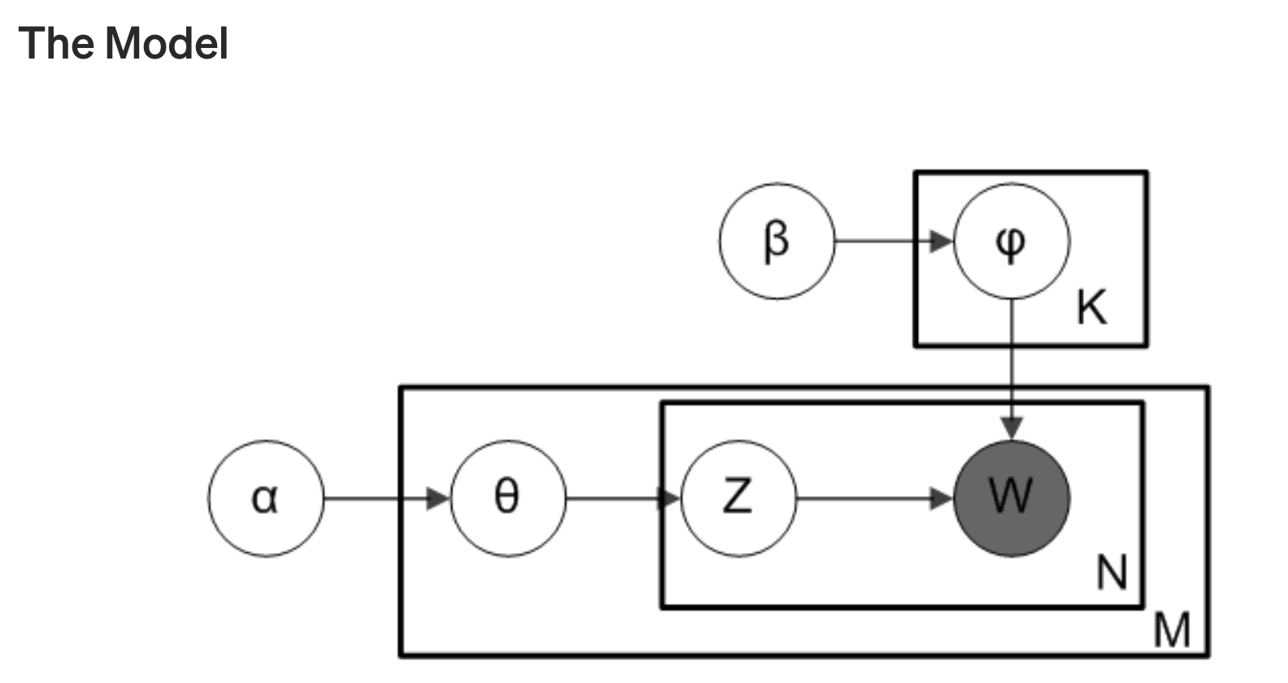
Latent Dirichlet Allocation
α is the per-document topic distributions, β is the per-topic word distribution, θ is the topic distribution for document m, φ is the word distribution for topic k, z is the topic for the n-th word in document m, and w is the specific word
Assume there are k topics across all of the documents
Distribute these k topics across document m by assigning each word a topic.
For each word w in document m, assume its topic is wrong but every other word is assigned the correct topic.
Probabilistically assign word w a topic based on two things: - what topics are in document m - how many times word w has been assigned a particular topic across all of the documents
Repeat this process a number of times for each document and you’re done!

Slide 11
Latent Dirichlet Allocation (LDA)
LDA Multicore model (Gensim) uses all CPU cores to parallelise and speed up model training.
Hyperparameters
chunksize – Number of documents to be used in each training chunk.
passes – Number of passes through the corpus during training
iterations – Maximum number of iterations through the corpus when inferring the topic distribution of a corpus
minimum_probability – Topics with a probability lower than this threshold will be filtered out:
alpha (Dirichlet hyperparameter alpha) : Adjusts the Document-Topic Density : 'symmetric' (default)
eta (Dirichlet hyperparameter beta) Configures the Word-Topic Density : 'auto' (default)
Optimal number of Topics
Topics , fundamentally a collection of highly related words ,that are produced by an LDA model is configurable.
Optimal number of Topics is evaluated based on high Topic Coherence Score.Let's first look at what does Topic Coherence imply

Slide 12
Latent Dirichlet Allocation (LDA)
Topic Coherence
A set of statements or facts is said to be coherent, if they support each other.An example of a coherent fact set is “the game is a team sport”, “the game is played with a ball”, “the game demands great physical efforts”
Topic Coherence measures the score of a single topic by measuring the degree of semantic similarity between high scoring words in the topic . A high Topic Coherence score implies that the words in the topic were found highly related in the documents and also there is less likelihood of seeing those words in other topics , implying topics are not overlapping

