Slide 1
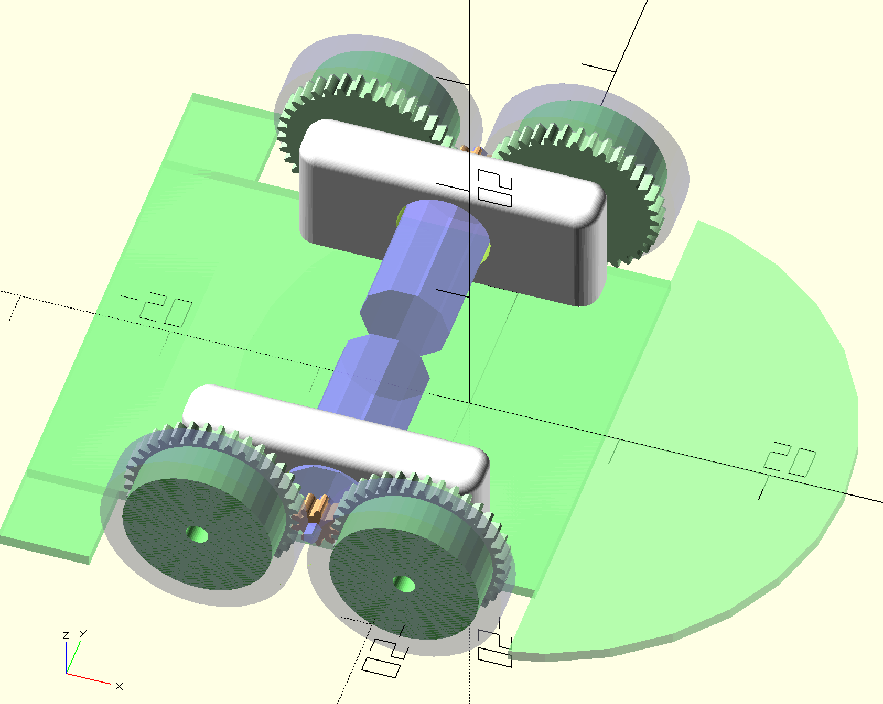
4 wheel concept

Slide 2
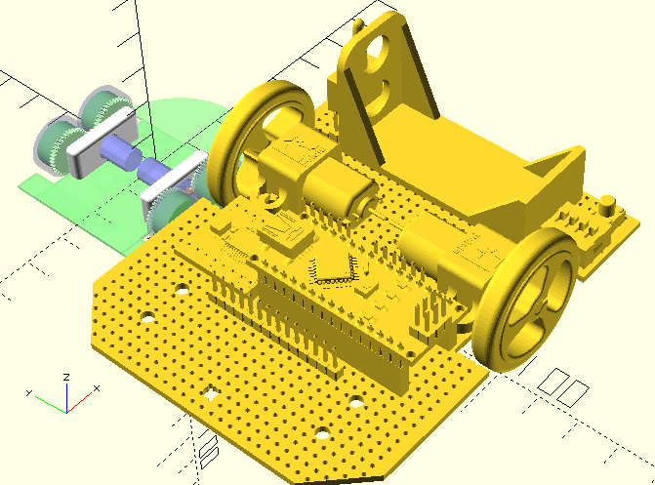
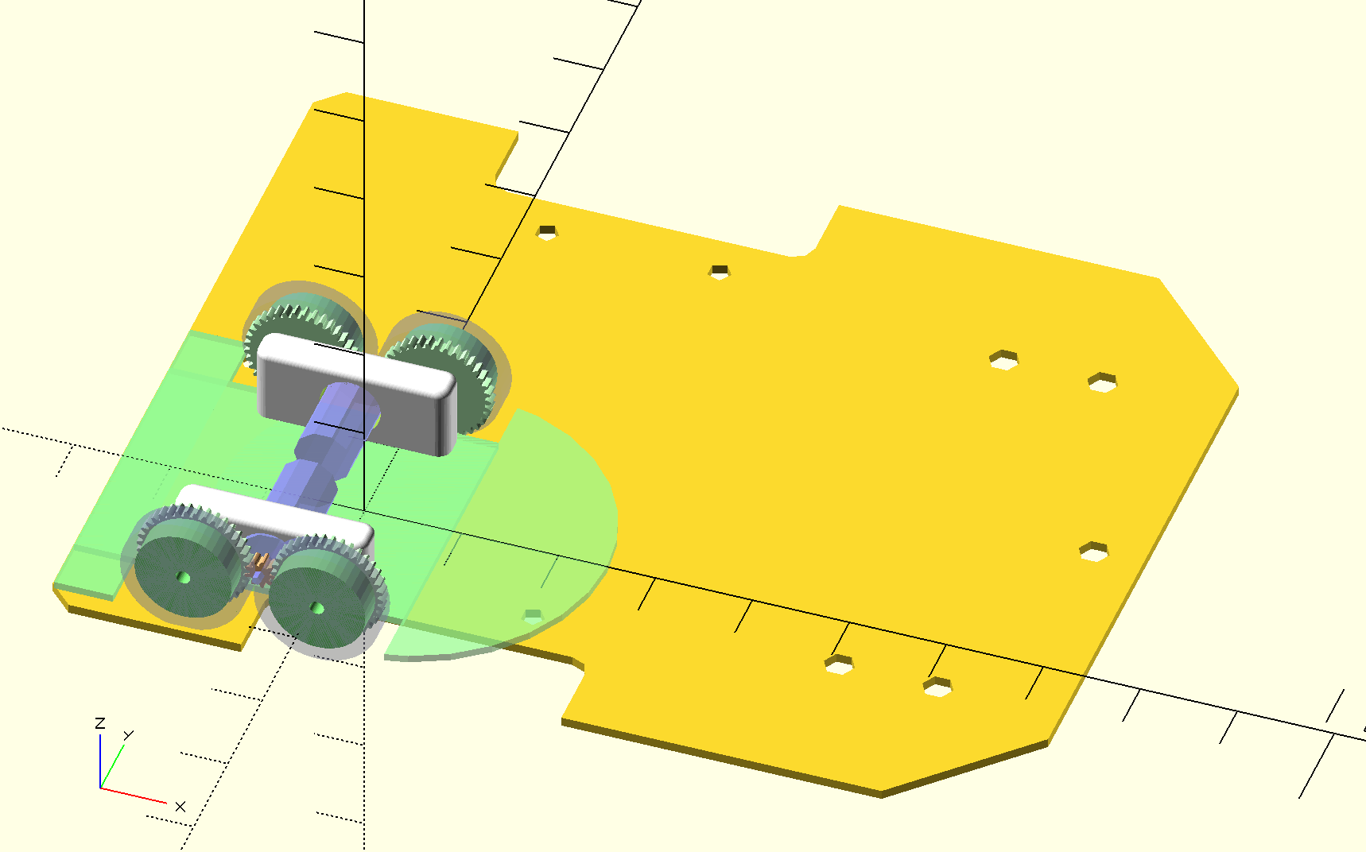
Size against ukmarsbot

Slide 3
4 wheel concept
Potential Problems
Wheels need to be 0.3 module – basically custom gears/wheels (supply) … and tyre availability.

Slide 4
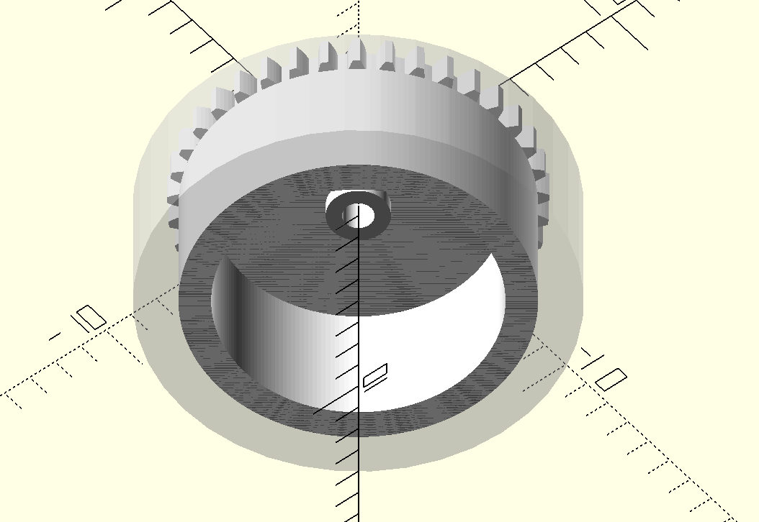
Wheels
Holes in rear face?

Slide 5
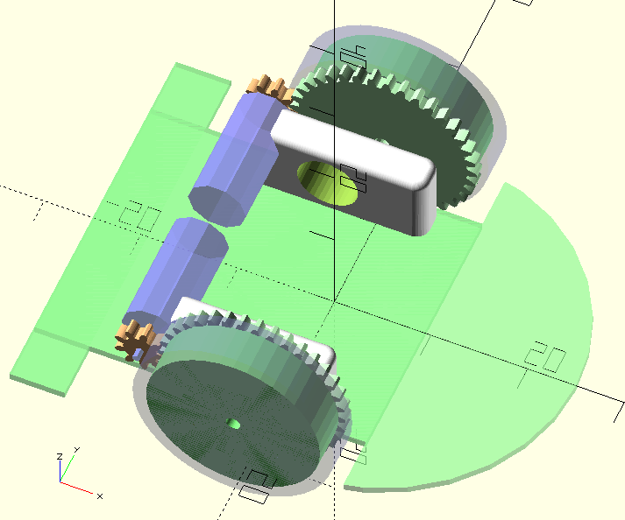
Two wheels from same PCB?
Maybe wheels could be standard 0.5 mod gear attached to wheel?
Potential Problems
Encoder position not the same
Extra motor keep outs PCB

Slide 6
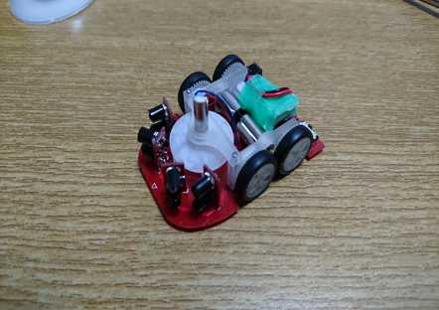
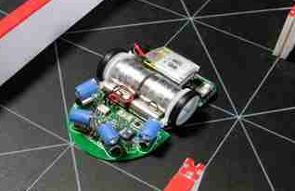
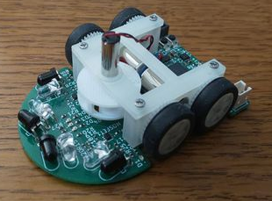
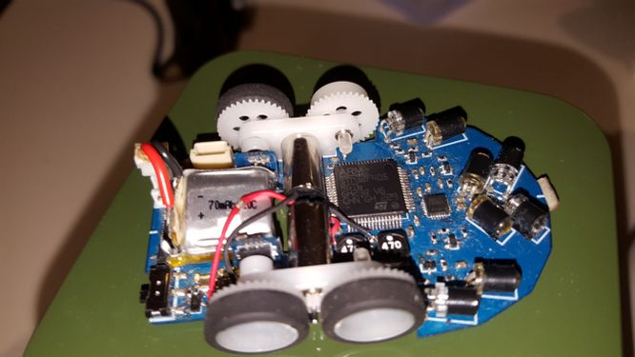
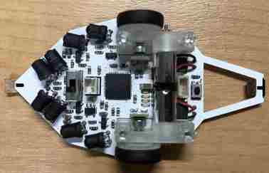
RTCorp
tennisyi mouse
Early BeeClone?
Matsui’s Sapphire
Matsui’s Zirconia (open design)

