Slide 1
Creating maps with google maps engine lite

Slide 2
Contents
Overview of Google Maps Engine
Mapping Gender-based Violence Services in Nairobi
Cleaning data
Uploading data
Choosing fields
Styling map
Info window
Embedding map
Presentation
Summary & Resources

Slide 3
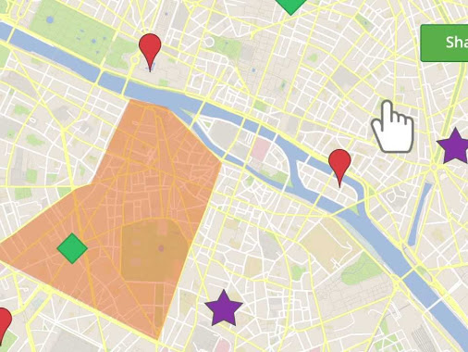
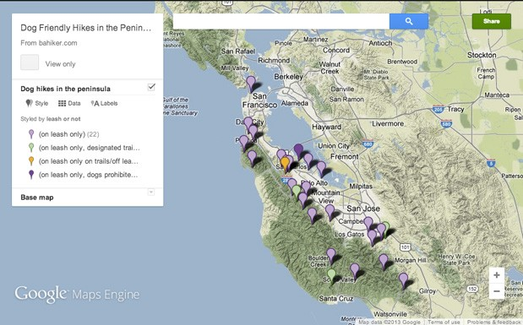

Slide 4
Contents
Overview of Google Maps Engine
Mapping Gender-based Violence Services in Nairobi
Cleaning data
Uploading data
Choosing fields
Styling map
Info window
Embedding map
Presentation
Summary & Resources

Slide 5
Creating Maps with Google Maps Engine Lite
Google Maps Engine Lite and Pro
Draw - Add lines, shapes, or placemarks on the map.
Import - Add a CSV file, XLSX file, My Map, or spreadsheet from Google Drive with geographically-specific data including addresses, place names, or lat/longs.
Layer - Hide or show different content to better understand your map.
Style - Make your point visually with different colors, placemark icons, and line widths.

Slide 6
Creating Maps with Google Maps Engine Lite
Google Maps Engine
Only accepts .csv files, not Excel
Limits to 100 rows of data
Does not allow filtering for items that fall into multiple categories
Limited functionality for embedding
Does not produce choropleth (color shaded) maps

Slide 7
Contents
Overview of Google Maps Engine
Mapping Gender-based Violence Services in Nairobi
Cleaning data
Uploading data
Choosing fields
Styling map
Info window
Embedding map
Presentation
Summary & Resources

Slide 8
Creating Maps with Google Maps Engine Lite
Open the CSV file “GBV Nairobi Maps Engine” and “GBV Service Providers Original”
Compare the two files. What has been changed?
How has the data been changed?

Slide 9
Contents
Overview of Google Maps Engine
Mapping Gender-based Violence Services in Nairobi
Cleaning data
Uploading data
Choosing fields
Styling map
Embedding map
Presentation
Summary & Resources

Slide 10
Creating Maps with Google Maps Engine Lite
Cleaning your data:
Where did the data come from?
Verify phone numbers
Change capitalizations and mispelling
Look for any strange formats or missing data
When in doubt, call to verify

Slide 11
Contents
Overview of Google Maps Engine
Mapping Gender-based Violence Services in Nairobi
Cleaning data
Uploading data
Choosing fields
Styling map
Info window
Embedding map
Presentation
Summary & Resources

Slide 12
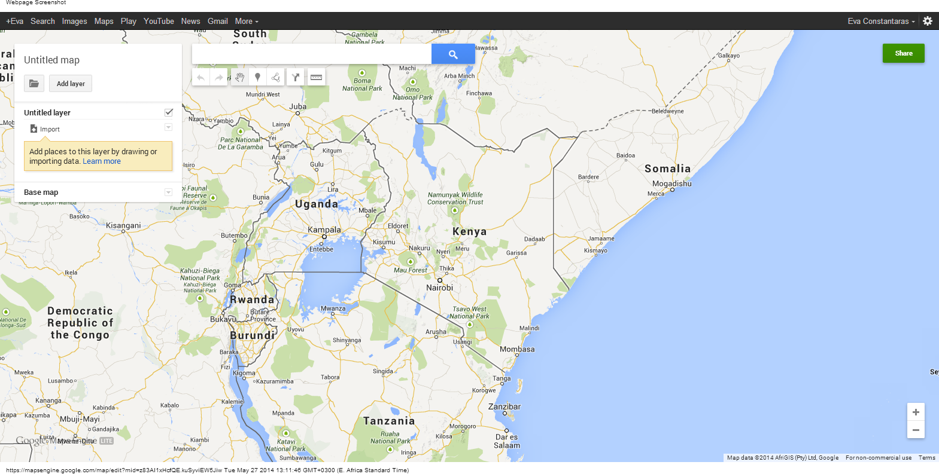
Creating Maps with Google Maps Engine Lite

Slide 13
Creating Maps with Google Maps Engine Lite
Open your google account.
Go to https://mapsengine.google.com/map/
Click “Create new map”
Click “Add New Layer” and “Import”
Change the name of “untitled layer” to “Service Providers”.
Import “GBV Nairobi Maps Engine”
I

Slide 14
Contents
Overview of Google Maps Engine
Mapping Gender-based Violence Services in Nairobi
Cleaning data
Uploading data
Choosing fields
Styling map
Info window
Embedding map
Presentation
Summary & Resources

Slide 15
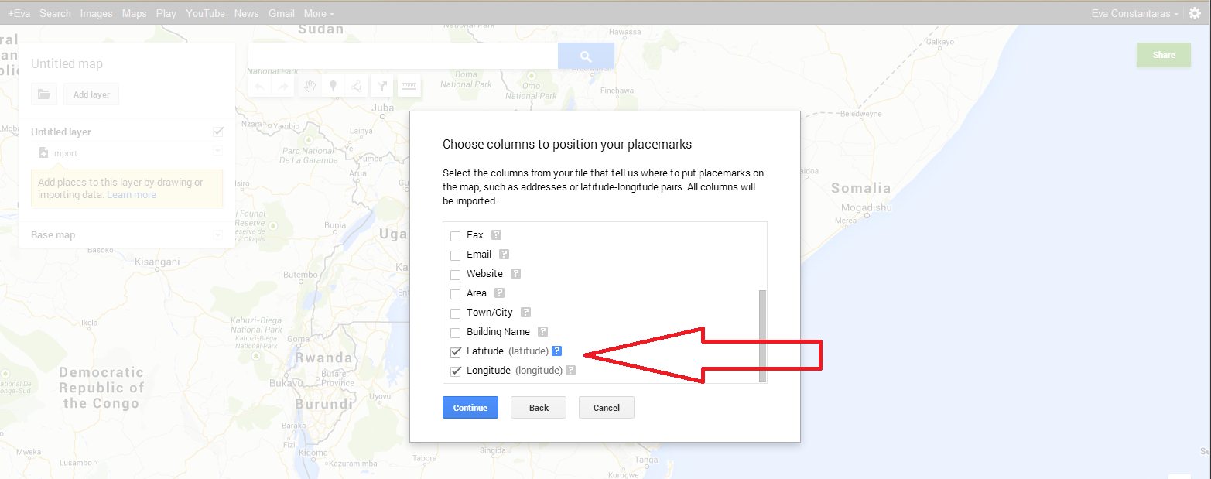
Creating Maps with Google Maps Engine Lite
Select the column of data that has geo-location data, in our case, Location: Latitude Longitude

Slide 16
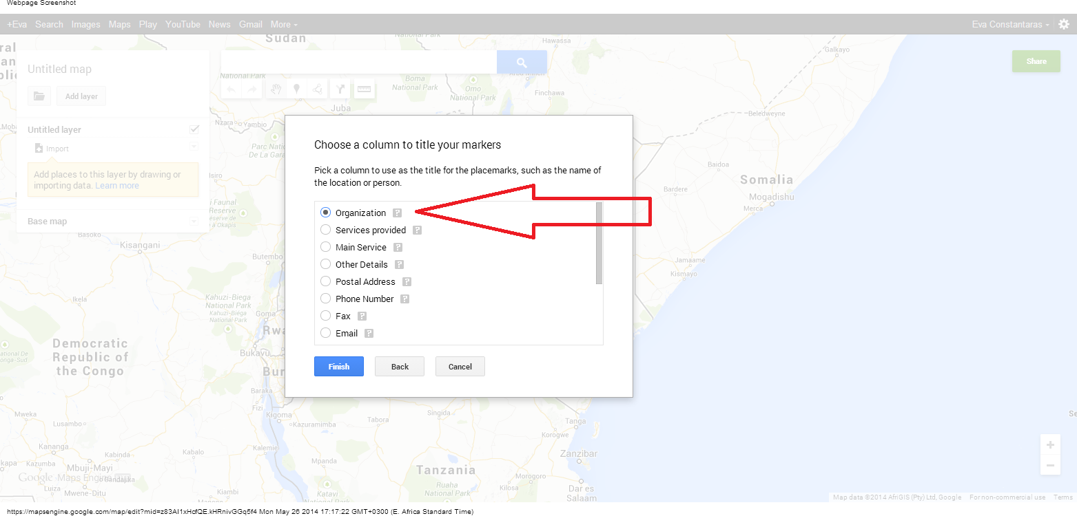
Creating Maps with Google Maps Engine Lite
2. Choose a column to title your markers (so when you click on a point, a title appears) ‘Organization’ is a good option.

Slide 17
Contents
Overview of Google Maps Engine
Mapping Gender-based Violence Services in Nairobi
Cleaning data
Uploading data
Choosing fields
Styling map
Info window
Embedding map
Presentation
Summary & Resources

Slide 18
Creating Maps with Google Maps Engine Lite
You should have a map with a bunch of red markers. Click on one to see the information that comes up.
To style your pointers, click on style and change from Uniform Style to one of the data columns.
You can change colors and shapes for each category in your data column
Add a name to your map

Slide 19
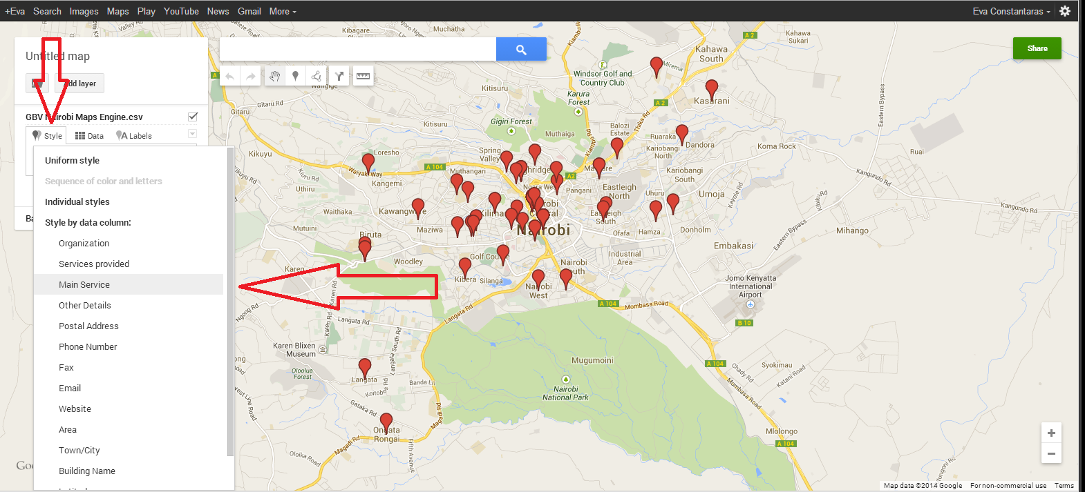
Creating Maps with Google Maps Engine Lite

Slide 20
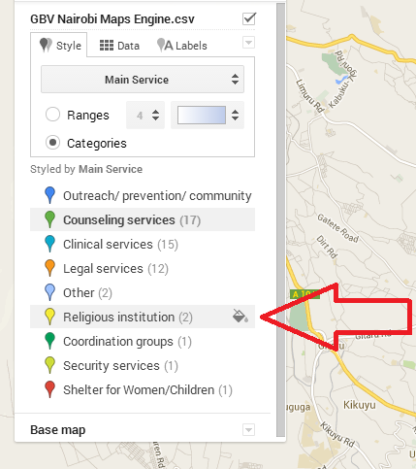
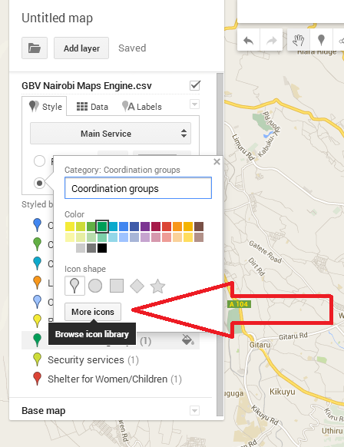
Creating Maps with Google Maps Engine Lite
Click on the small icon to the right of the label to change the marker style

Slide 21
Contents
Overview of Google Maps Engine
Mapping Gender-based Violence Services in Nairobi
Cleaning data
Uploading data
Choosing fields
Styling map
Info window
Embedding map
Presentation
Summary & Resources

Slide 22
Creating Maps with Google Maps Engine Lite
To change the information displayed in the info window, click on any of the markers and then the pencil in the bottom corner of the window.
Deselect the categories that you do not want to appear in the info window.
You can also edit the text if necessary and the data will update on the spreadsheet.
Finally, you can add photos.

Slide 23
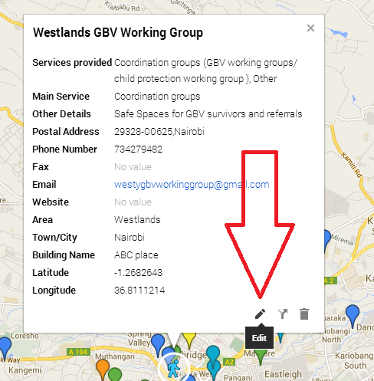
Creating Maps with Google Maps Engine Lite

Slide 24
Creating Maps with Google Maps Engine Lite
You need to Add Layer to add more information such as:
Points where police stations are located
Recent geo-located media coverage of domestic violence.
Polygons showing zones where many cases of domestic violence have been reported

Slide 25
Creating Maps with Google Maps Engine Lite
You need to Add Layer to add more information such as:
Points where police stations are located
Recent geo-located media coverage of domestic violence.
Polygons showing zones where many cases of domestic violence have been reported

Slide 26
Creating Maps with Google Maps Engine Lite
You need to Add Layer to add more information such as:
Points where police stations are located
Recent geo-located media coverage of domestic violence.
Polygons showing zones where many cases of domestic violence have been reported
Directions from one location to another.

Slide 27
Creating Maps with Google Maps Engine Lite
You need to Add Layer to add more information such as:
Points where police stations are located
Recent geo-located media coverage of domestic violence.
Polygons showing zones where many cases of domestic violence have been reported
Directions from one location to another.

Slide 28
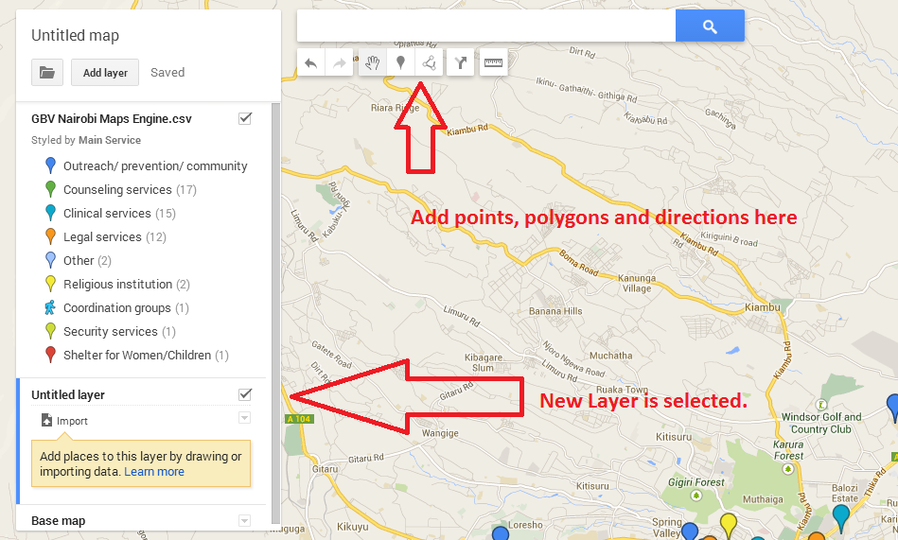
Creating Maps with Google Maps Engine Lite

Slide 29
Contents
Overview of Google Maps Engine
Mapping Gender-based Violence Services in Nairobi
Cleaning data
Uploading data
Choosing fields
Styling map
Info window
Embedding map
Presentation
Summary & Resources

Slide 30
Creating Maps with Google Maps Engine Lite
You can work together with others on this map by clicking on the green Share button in the top right corner.
Select “Public on the web” when you are ready to embed the map in your website.
Then, click on the folder icon and select Embed on my site

Slide 31
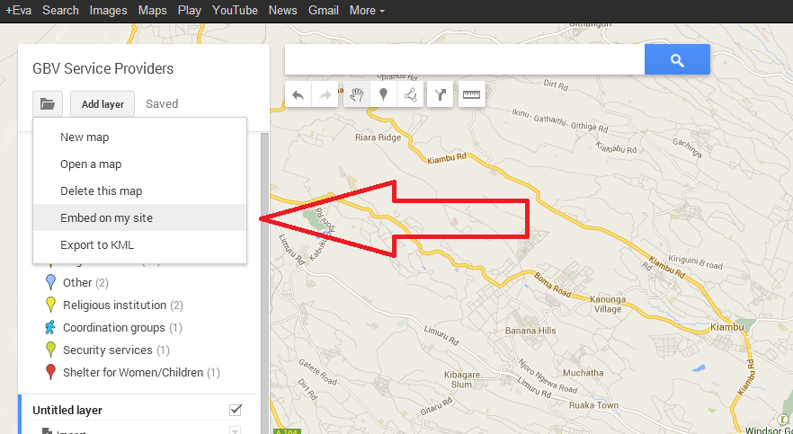
Creating Maps with Google Maps Engine Lite

Slide 32
Summary and Resources
Map created by the IRC and JPGewe
More advanced mapping tools:
Maps Engine
Google Fusion Tables
CartoDB
Kartography

