Slide 1
Finding Stories in Data

Slide 2
Contents
The Data Journalism Process
Data sources: recurring events
Exercise
Data sources: sent or leaked data
Data sources: breaking news
Data sources: theories to be explored
Exercise
Summary & References

Slide 3
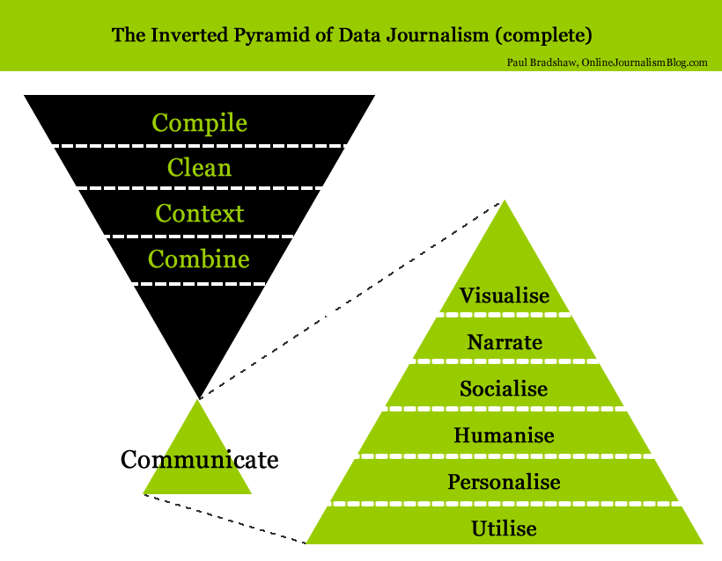
The Data Journalism Process

Slide 4
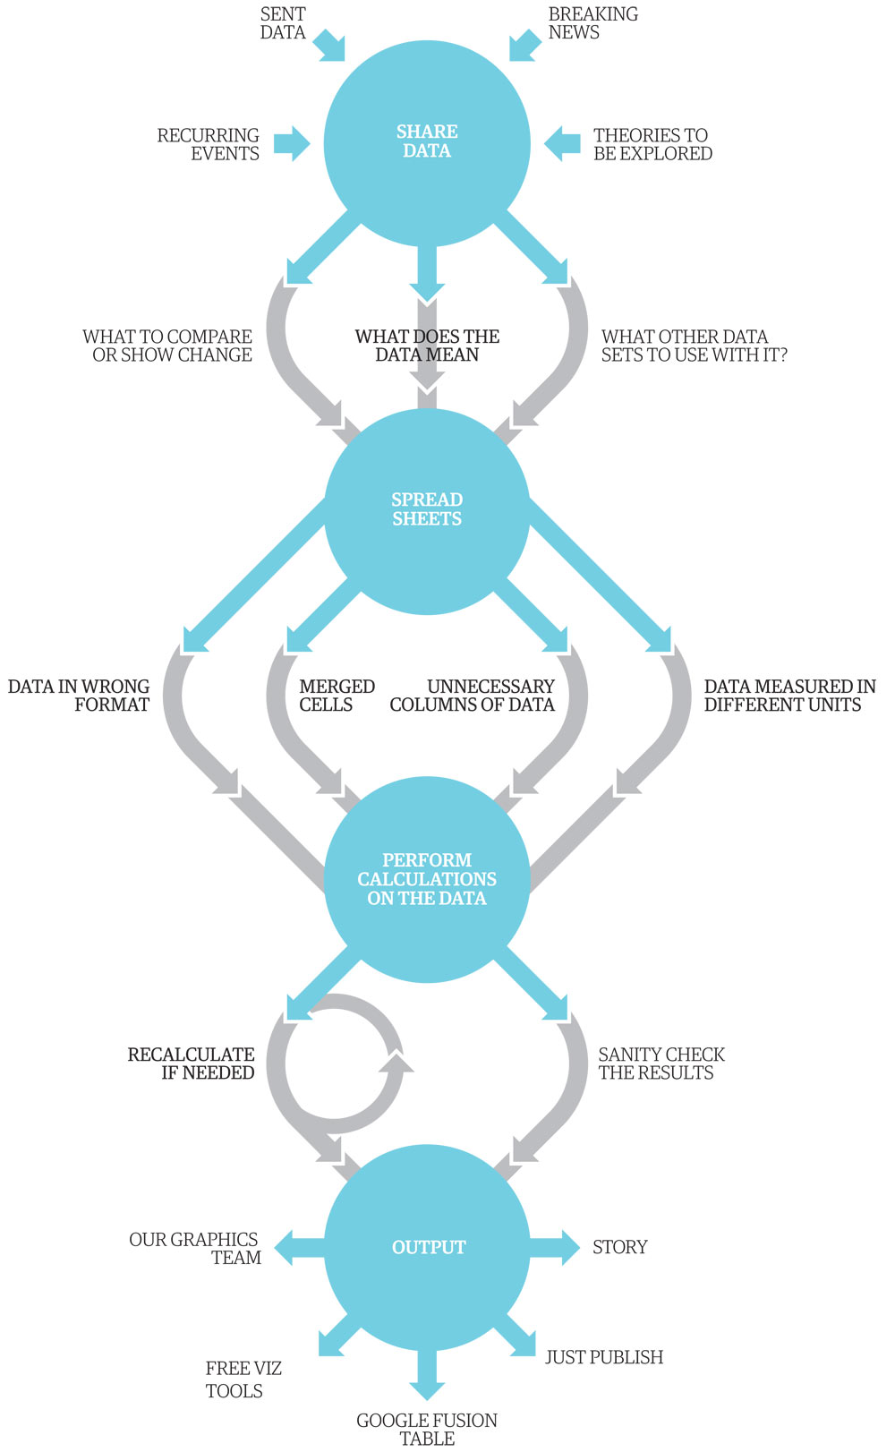
The Data Journalism Process The Guardian: 1. Share Data 2. Spread Sheets 3. Perform Calculations 4. Output

Slide 5
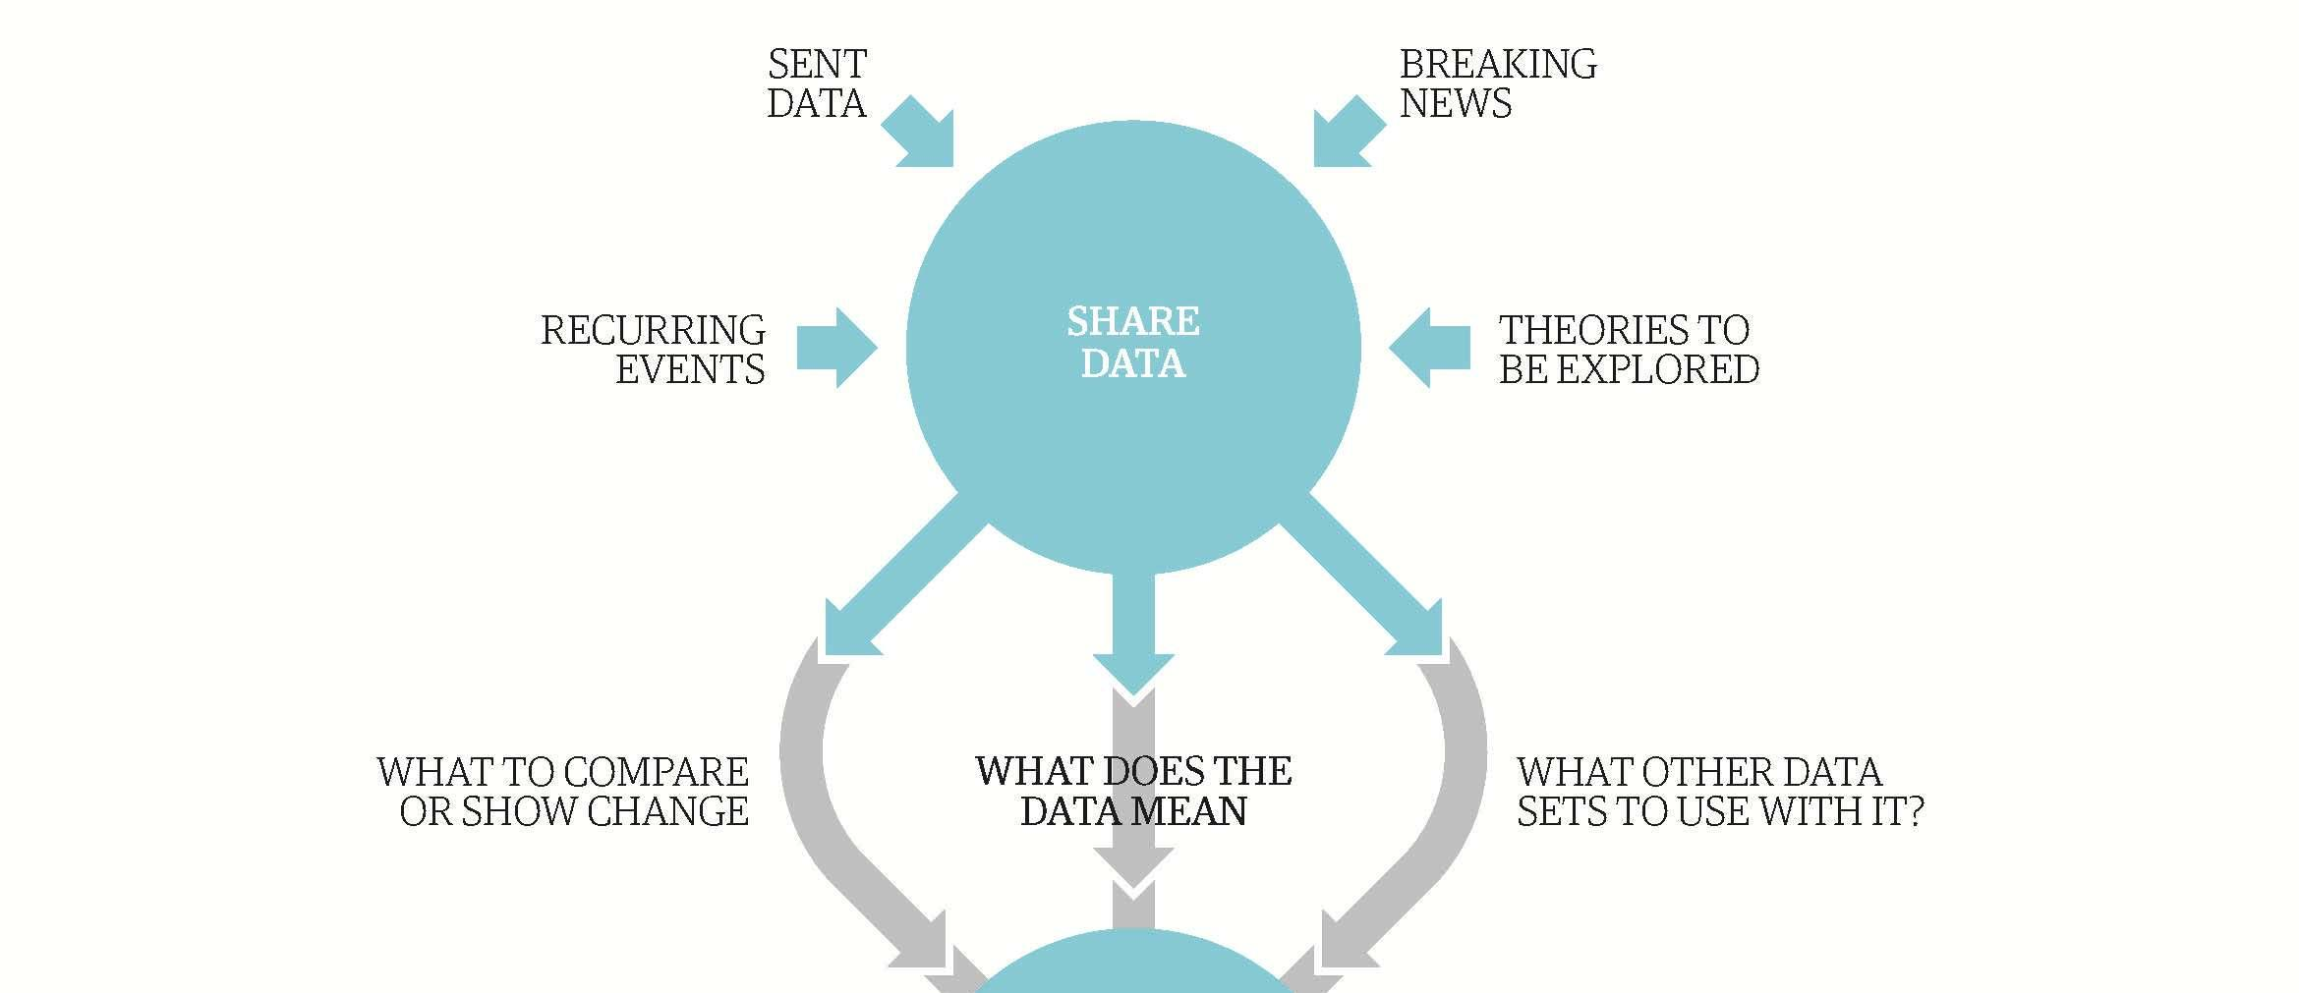
The Data Journalism Process

Slide 6
Data sources
Data sources: recurring events
Data sources: sent or leaked data
Data sources: breaking news
Data sources: theories to be explored

Slide 7
Data sources
Data sources: recurring events
Governance & Security Indicators
Economic Indicators & Budgets
Education Indicators
Human rights & Equality Indicators
Environmental Indicators
Health Indicators

Slide 8
Data sources
Data sources: recurring events
Governance & Security Indicators
Economic Indicators & Budgets
Education Indicators
Human rights & Equality Indicators
Environmental Indicators
Health Indicators

Slide 9
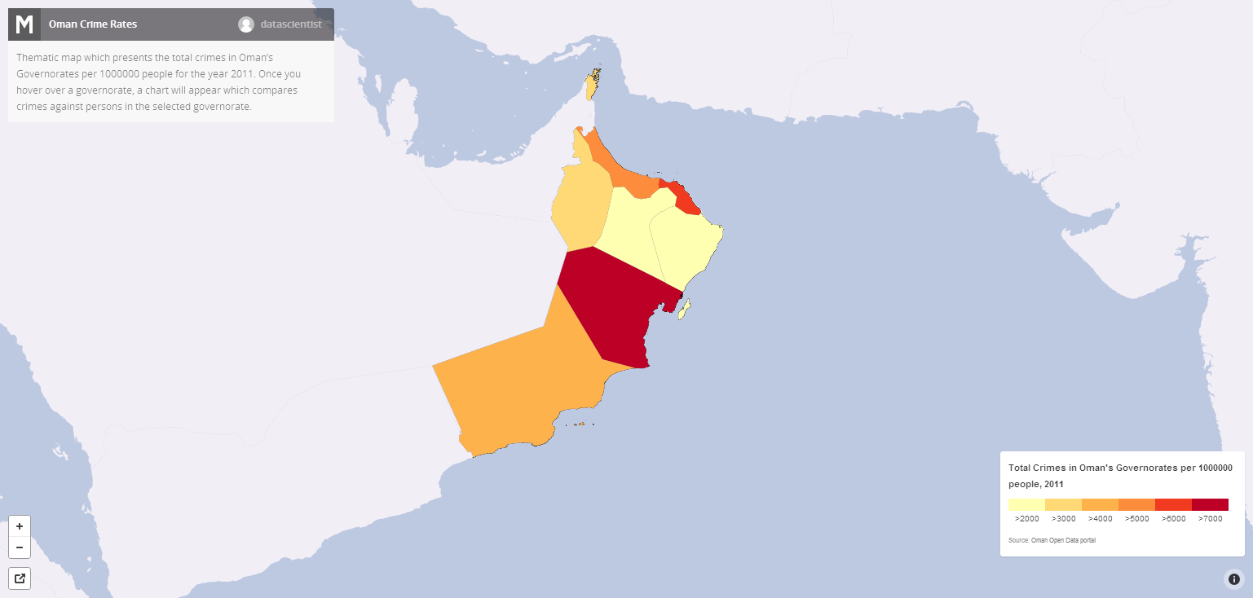
Data Sources: Recurring Events
Crime In Oman Visualized: For the first time, the government of Oman released crime data, which was visualized by a local blogger

Slide 10
Data Sources
Data Sources: recurring events
Governance & Security Indicators
Economic Indicators & Budgets
Education Indicators
Human rights & Equality Indicators
Environmental Indicators
Health Indicators

Slide 11
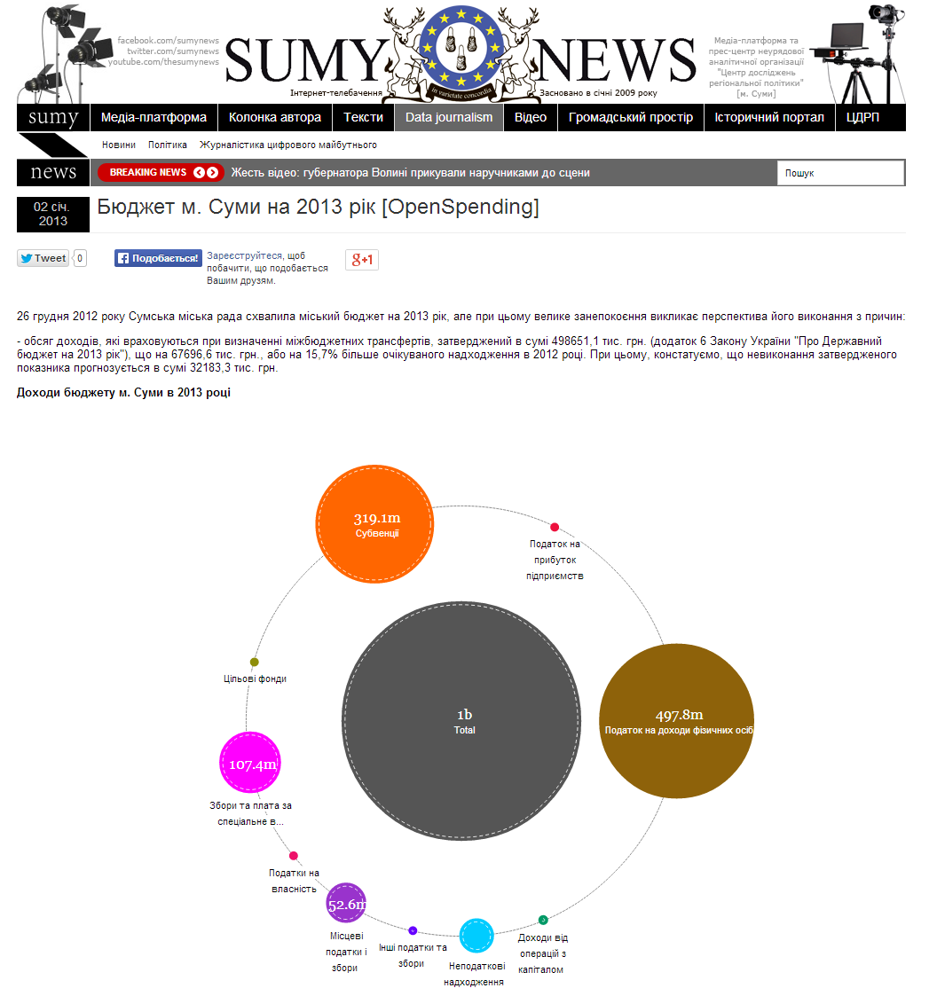
Data Sources: Recurring Events
Ukraine 2013 budget: A Ukrainian newspaper created an interactive data visualization when the government released its annual budget so that citizens could evaluate how the government is spending its tax dollars

Slide 12
Data Sources
Data Sources: recurring events
Governance & Security Indicators
Economic Indicators & Budgets
Education Indicators
Human rights & Equality Indicators
Environmental Indicators
Health Indicators

Slide 13
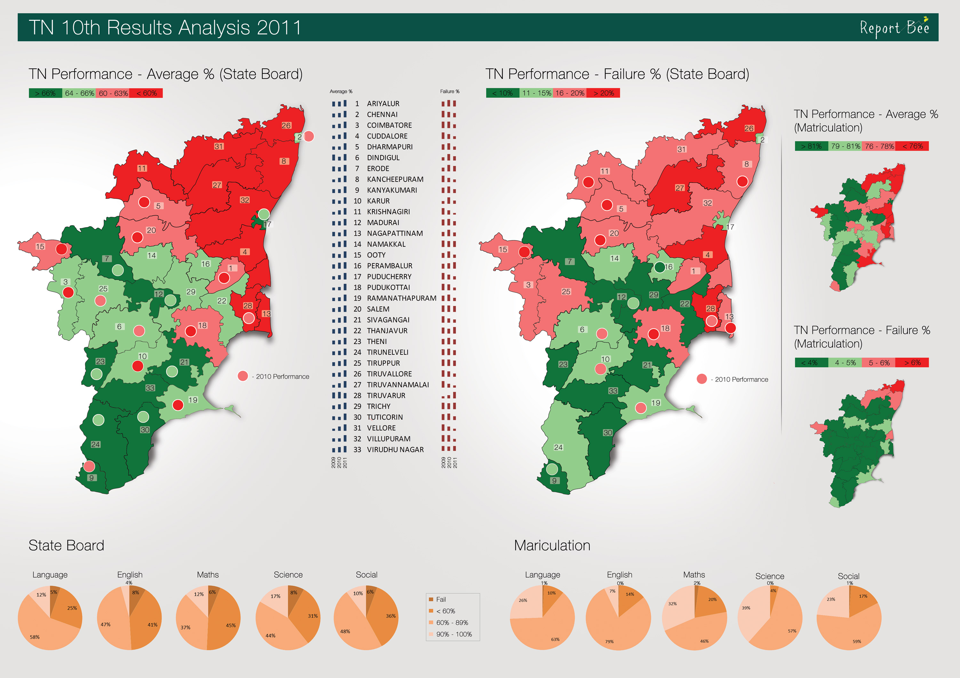
Data sources: Recurring Events
2011 Tamilnadu School Performance: India’s Reporter Bee visualized the performance of different school districts based on annual performance reports.

Slide 14
Data Sources
Data Sources: recurring events
Governance & Security Indicators
Economic Indicators & Budgets
Education Indicators
Human rights & Equality Indicators
Environmental Indicators
Health Indicators

Slide 15
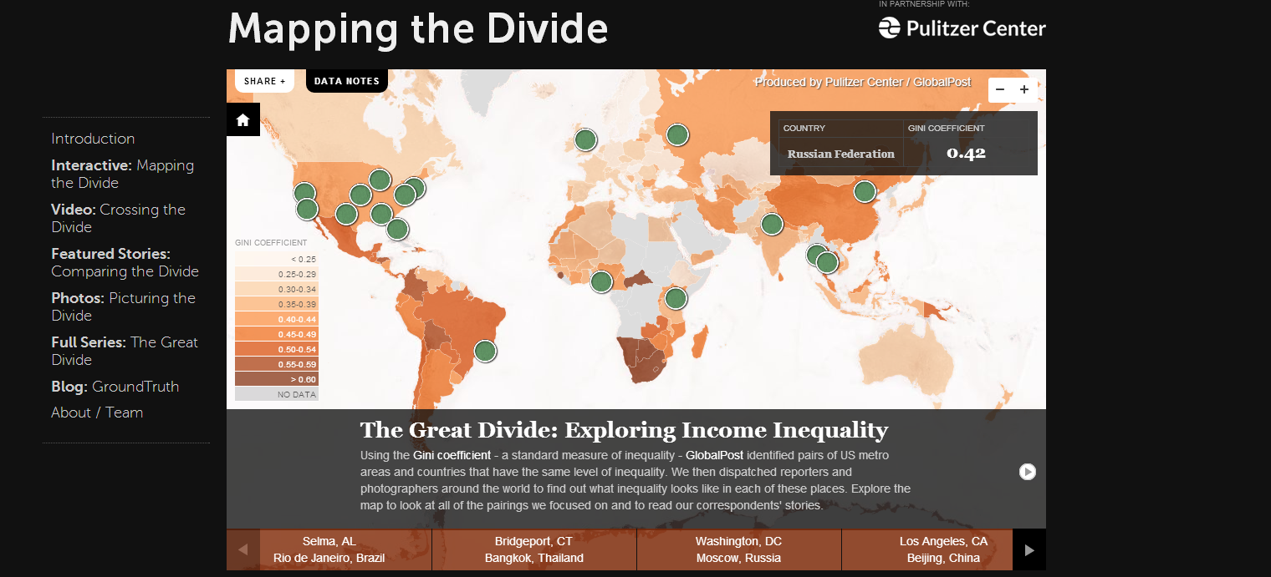
Data sources: Recurring Events
The Great Divide Global Income Inequality: The Global Post maps annual data on global inequality by country and compares cities with similar levels of inequality.

Slide 16
Data Sources
Data Sources: recurring events
Governance & Security Indicators
Economic Indicators & Budgets
Education Indicators
Human rights & Equality Indicators
Environmental Indicators
Health Indicators

Slide 17
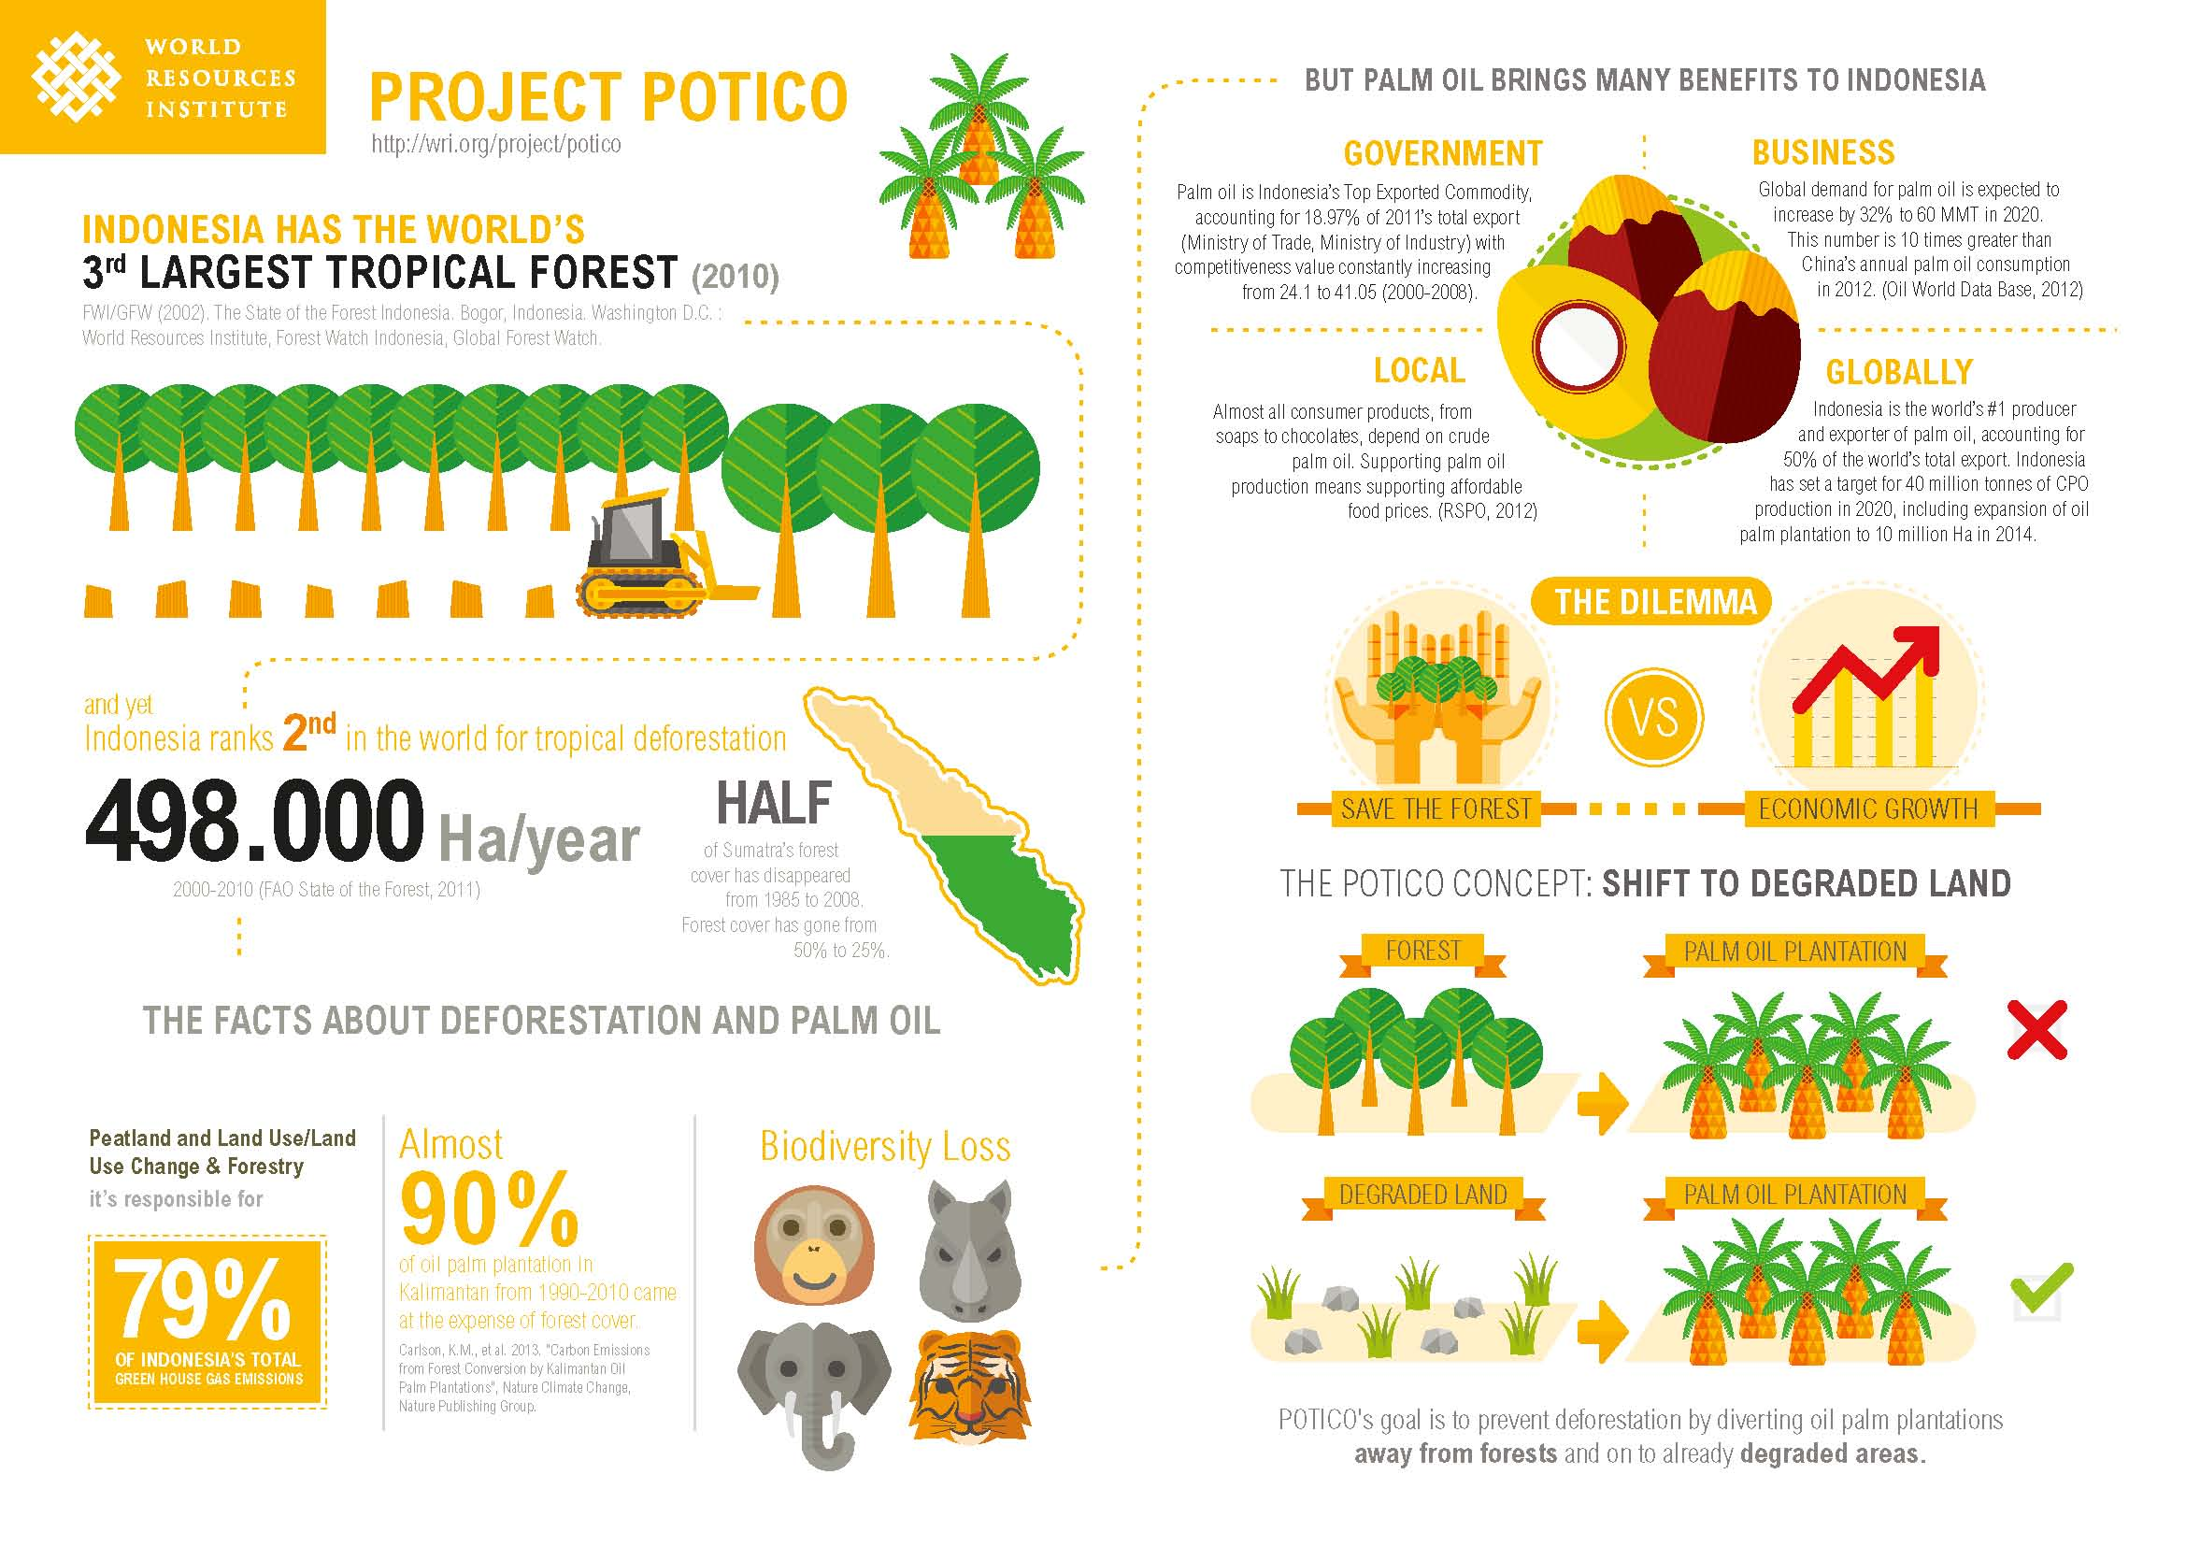
Data sources: Recurring Events
Project Potico: World Resource Institute explores deforestation in Indonesia

Slide 18
Data Sources
Data Sources: recurring events
Governance & Security Indicators
Economic Indicators & Budgets
Education Indicators
Human rights & Equality Indicators
Environmental Indicators
Health Indicators

Slide 19
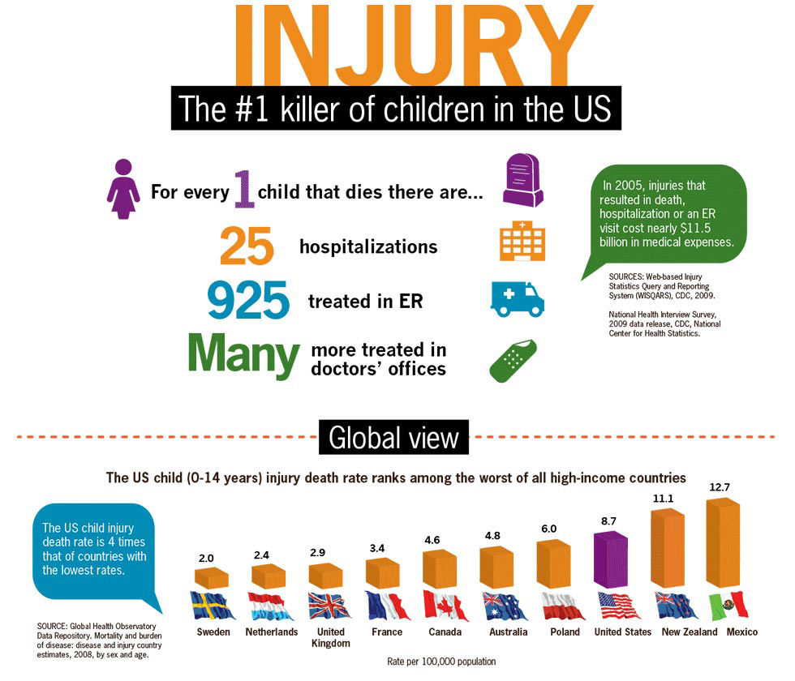
Sources of Data: Recurring Events
Child Injury: The Center for Disease Control in the United States created this infographic for journalists to draw attention to a major health risk for children

Slide 20
Contents
The Data Journalism Process
Data sources: recurring events
Exercise
Data sources: sent or leaked data
Data sources: breaking news
Data sources: theories to be explored
Exercise
Summary & References

Slide 21
Exercise
How could these recurring reports be used in your health reporting?
Disease burden by county
Economic growth data by sector
Maternal and child mortality reports
Other reports, press releases and data sent to your media?

Slide 22
Contents
The Data Journalism Process
Data sources: recurring events
Exercise
Data sources: sent or leaked data
Data sources: breaking news
Data sources: theories to be explored
Exercise
Summary & References

Slide 23
Data Sources: Sent or Leaked Data
Wikileaks in Kenya
The Looting of Kenya published by The Guardian in 2007.
Kennya: The Cry of Blood - Report on Extra-Judicial Killings and Disappearances - the Kenya National Commission on Human Rights (KNCHR) 2008.
Bringing international attention to corruption issues too dangerous to print in-country.
Project Potico: World Resource Institute explores deforestation in Indonesia

Slide 24
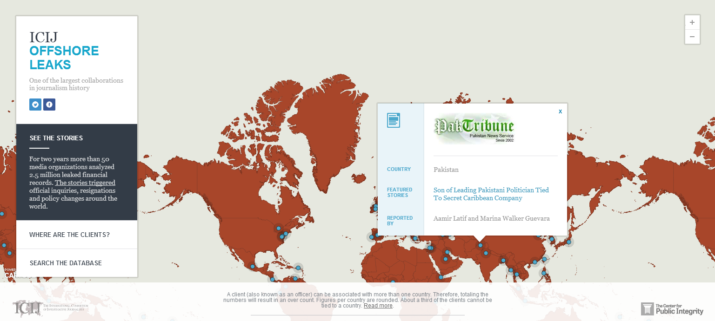
Data sources: sent or leaked data
Offshore Leaks: A leaked hard drive of 2.5 million documents about offshore bank accounts to the International Consortium of Investigative Journalists

Slide 25
Contents
The Data Journalism Process
Data sources: recurring events
Exercise
Data sources: sent or leaked data
Data sources: breaking news
Data sources: theories to be explored
Exercise
Summary & References

Slide 26
Data Sources: Breaking News
Data collection:
Crowd-sourcing via Ushahidi-type platforms
Citizen media contributions
Sensor data for environmental catstrophes
Risks:
Selection bias
Verification process
Context

Slide 27
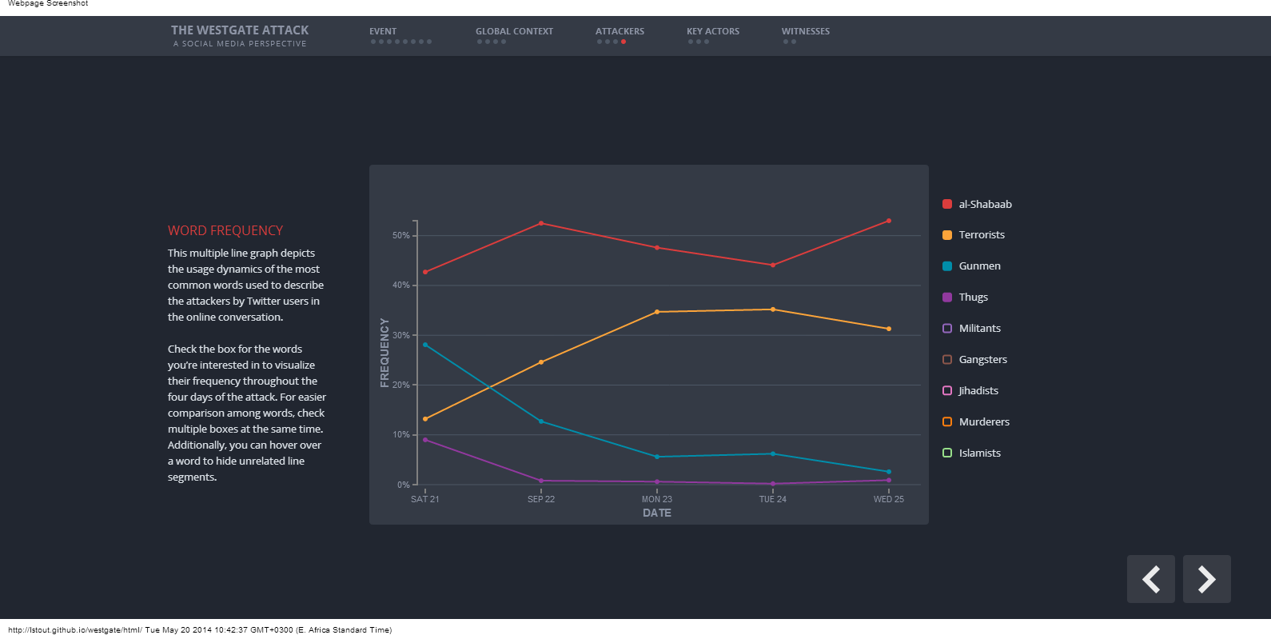
Data sources: breaking news
The Westgate Attack: A Social Media Perspective: An analysis of the events of Westgate driven by analysis of social media content.

Slide 28
Data Sources: Theories to be Explored
Global and open data catalogs
World Health Organization
United Nations
World Bank
DataCatalogs.org
The Guardian's world government data portal
Google's public data directory
The data hub
DBPedia Datasets
Factual
Free GIS data
List of open data resources
Energy data repositories
World Research Institute
Data wrangling
Quora thread: "Where can I find large datasets open to the public?"
Directory of APIs
Infochimps
Datamarket
Offshore Leaks
Investigative Dashboard
Open Corporates
Natural Earth data
UNEP Data
Transparency International Corruption Index
Land Ownership Database
Gapminder World

Slide 29
Data Sources: Theories to be explored
Kenyan Data Sources
Mars Group
Africa Open Data
Kenya National Bureau of Statistics
E-promis Kenya
International Budget Partnership County Budgets
Kenya Open Data Initiative
Kenya Health Data
World Bank Boost
Kenya Demographic Health Survey
Internews Data Dredger
Kenya Service Delivery Indicators

Slide 30
Exercise
Divide into two groups and read:
Tourism Players Want State to Wave Taxes
Kenya Bids to Revive Tourism as al-Shabaab Vows Broader War

Slide 31
Exercise
Answer
What is the journalist’s hypothesis?
What topics does the journalist cover in the story?
What are the most important impact in changing tourism revenue according to the story?
What does he or she want the reader to understand after reading the story?

Slide 32
Exercise
Answer
2. What is the journalist’s evidence for the story?
What data does he or she use to prove his hypothesis?
What experts does he or she quote?
Does the author use information from the national budgets or data on Kenya’s revenue sources to enrich the story?

Slide 33
Exercise
Answer
3. What information and data is missing?
What questions does the story not answer?
What other data about the budget, taxes, economics, etc. would add to the story?
What would your data angle for the story be?

Slide 34
Contents
The Data Journalism Process
Data sources: recurring events
Exercise
Data sources: sent or leaked data
Data sources: breaking news
Data sources: theories to be explored
Exercise
Summary & References

Slide 35
Summary & Resources
Data sources include recurring events, sent or leaked data, breaking news and theories to be explored.
Data from these stories can be used to enrich traditional reporting, find new angles on old stories, uncover corruption or engage citizens in the reporting process.
Data sources are all around us: NGOs, research institutions, government and ordinary people.

Slide 36




Summary & Resources

