Slide 1
Finding Data For Stories

Slide 2
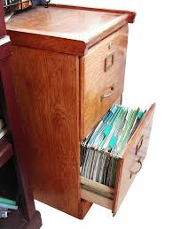
A very common data format …

Slide 3
Where is Data?
Data is Collected Every Time Something is:
Registered
Inspected
Purchased
Voted on
Surveyed

Slide 4
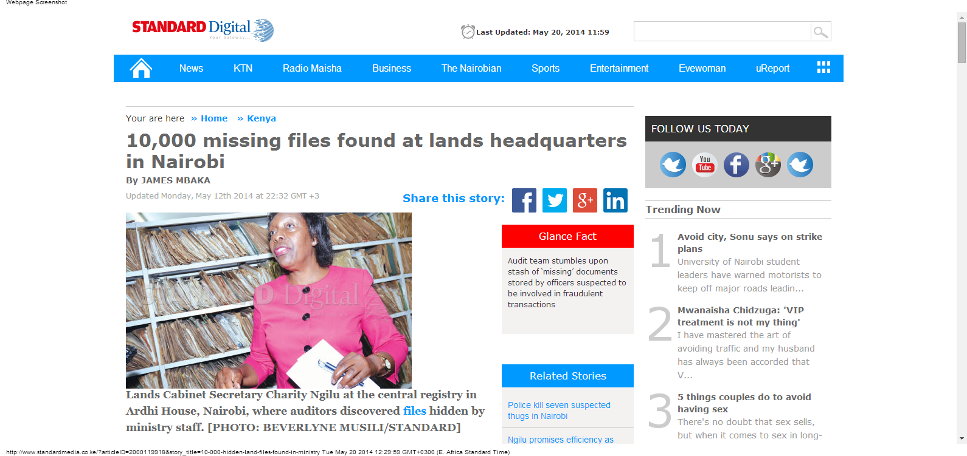
Where is Data?
The Standard, May 12, 2014

Slide 5
Contents
Understanding Data Formats
Machine readable and unstructured
Scanned and computer-generated
Exercise
Converting scanned images into useable formats
Exercise
Converting unstructured formats into machine readable formats
Summary & Resources

Slide 6
Contents
Understanding Data Formats
Machine readable and unstructured
Scanned and computer-generated
Exercise
Converting scanned images into useable formats
Exercise
Converting unstructured formats into machine readable formats
Summary & Resources

Slide 7
Understanding Data Formats
Machine readable
CSV (comma-separated values) or TSV (tab-separated values), Excel (.xls)
Unstructured
(PDF, Word) and bitmap images (GIF, JPEG, PNG, BMP)

Slide 8
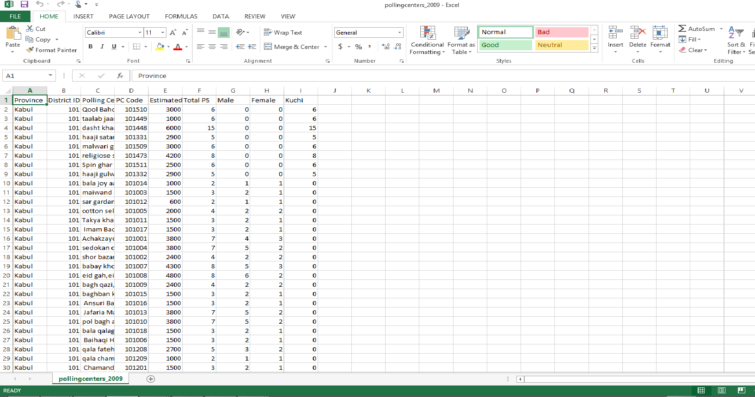
Understanding Data Formats: Machine Readable

Slide 9
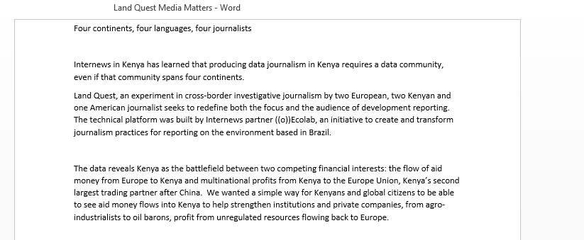
Understanding Data Formats Unstructured

Slide 10
Contents
Understanding Data Formats
Machine readable and unstructured
Scanned and computer-generated
Exercise
Converting scanned images into useable formats
Exercise
Converting unstructured formats into machine readable formats
Summary & Resources

Slide 11
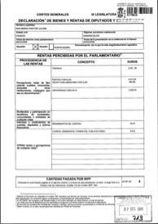
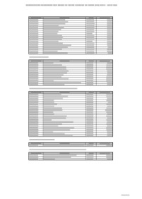
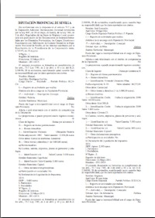
Understanding Data Formats
PDFs
Scanned Images (Unstructured, not searchable)
Computer-generated (searchable)
Tables (Structured, searchable)
Complex formats (Unstructured, searchable)

Slide 12
Understanding Data Formats: Machine-generated PDFs
Copying and pasting into Excel does not usually work
Free online tools for data in English:
cometdocs.com
pdftoexcelonline.com
zamzar.com
pdftoexcel.org
Free desktop software
tabula.nerdpower.org

Slide 13
Contents
Understanding Data Formats
Machine readable and unstructured
Scanned and computer-generated
Exercise
Converting scanned images into useable formats
Exercise
Converting unstructured formats into machine readable formats
Summary & Resources

Slide 14
Understanding Data Formats: Exercise
Open the File: Country Profile President’s Malaria Initiative (PMI) or Maternal Index
Go to www.zamzar.com
Upload your file
Select “Convert to” xlx.
Enter your e-mail address
You should receive an e-mail when your document is ready
Also try:
cometdocs.com
pdftoexcelonline.com
zamzar.com
pdftoexcel.org

Slide 15
Contents
Understanding Data Formats
Machine readable and unstructured
Scanned and computer-generated
Exercise
Converting scanned images into useable formats
Exercise
Converting unstructured formats into machine readable formats
Summary & Resources

Slide 16
Understanding Data Formats: Scanned Images
Optical Character Recognition Software
For documents that you can’t search or select text
Quality depends on quality of image, clarity of text
Adobe Acrobat Professional: paid
Google Docs: free
Document Cloud: free. Advantage is that it allows you to annotate and publish your document as part of a multimedia publication. Your media outlet must request an account.

Slide 17
Contents
Understanding Data Formats
Machine readable and unstructured
Scanned and computer-generated
Exercise
Converting scanned images into useable formats
Exercise
Converting unstructured formats into machine readable formats
Summary & Resources

Slide 18
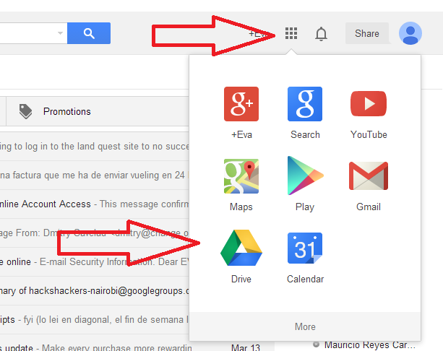
Understanding Data Formats: Scanned Images Exercise
Open Specimen Financial Statement
Open Google Drive (click on grid in the top right corner of G-mail and select Drive)

Slide 19
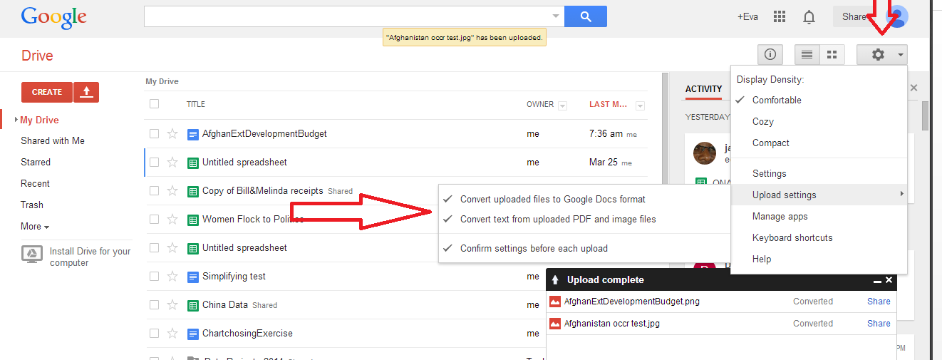
Understanding Data Formats: Scanned Images Exercise
3. Go to Setting and Upload Settings: Select all options

Slide 20
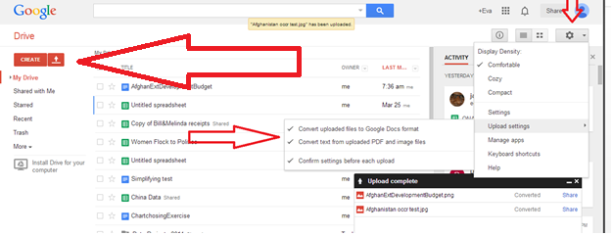
Understanding Data Formats: Scanned Images Exercise
4. Next to the Create button, click on the Upload button
5. Select your PDF or Image file
6. Once the file is uploaded it should appear on your drive with both the image and any text that Google was able to extract.

Slide 21
Contents
Understanding Data Formats
Machine readable and unstructured
Scanned and computer-generated
Exercise
Converting scanned images into useable formats
Exercise
Converting unstructured formats into machine readable formats
Summary & Resources

Slide 22
Understanding Data Formats: Unstructured
Columns, data divided among various lines, mixed with text
Automatic tools probably won’t work
The PDFs will have to be extracted and a programmer will use programming language to write a script to extract the data that you want

Slide 23
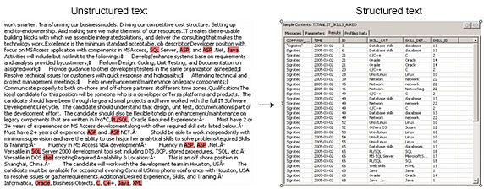
Understanding Data Formats: Unstructured
For example. A script might extract the text after “Name:” and put the text that follows into a column on a spreadsheet with the column header “Name”

Slide 24
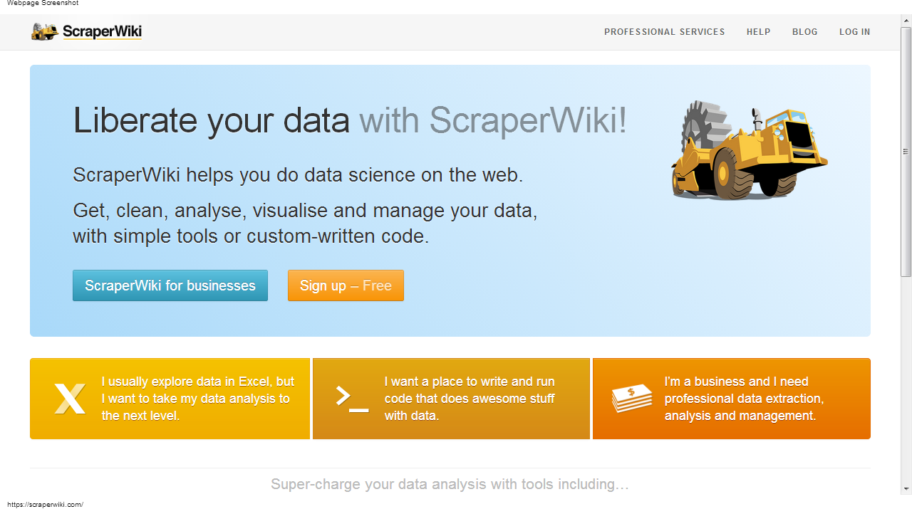
Understanding Data Formats: Unstructured: Scraper Wiki

Slide 25
Contents
Understanding Data Formats
Machine readable and unstructured
Scanned and computer-generated
Exercise
Converting scanned images into useable formats
Exercise
Converting unstructured formats into machine readable formats
Summary & Resources

Slide 26
Summary and Resources
Need help liberating your data?
Download Tabula tabula.nerdpower.org
Ask the School of Data
Join the data driven journalism listserve
Join the Hacks/Hackers Nairobi Google
group and go to the next meeting or post
your question and ask for volunteers
Visit the Internews data journalism team for
support
Join our session for data scraping without programming

