Slide 1
Finding Data On the web

Slide 2
Finding Data on the Web
Data Sources Online
Twitter!
Think tanks, NGOs and academics and government
Advanced Google Searches
Exercise
Summary & Conclusions

Slide 3
Finding Data on the Web
Data tweets
@Kresearcher
@ColdTusker
@OxfamEAfrica
@IHubResearch
@VirtualKenya
@AfricaReview
@AidData
@AlexAwiti

Slide 4
Finding Data on the Web
Data Sources Online
Twitter!
Think tanks, NGOs, academics and government
Advanced Google Searches
Exercise
Summary & Conclusions

Slide 5
Finding Data on the Web
Kenyan think tanks, NGOs and academics
Mars Group
Africa Open Data
International Budget Partnership County Budgets
Institute of Economic Affairs
Kenyan Government Sources
Kenya National Bureau of Statistics
E-promis Kenya
Kenya Open Data Initiative
National Treasury

Slide 6
Finding Data on the Web
Get an alert every time a webpage is updated with new data:
www.changedetection.com/
Update Scanner

Slide 7
Finding Data on the Web
Global and open data catalogs
World Health Organization
United Nations
World Bank
DataCatalogs.org
The Guardian's world government data portal
Google's public data directory
The data hub
DBPedia Datasets
Factual
Free GIS data
List of open data resources
Energy data repositories
World Research Institute
Data wrangling
Quora thread: "Where can I find large datasets open to the public?"
Directory of APIs
Infochimps
Datamarket
Offshore Leaks
Investigative Dashboard
Open Corporates
Natural Earth data
UNEP Data
Transparency International Corruption Index
Land Ownership Database
Gapminder World

Slide 8
Finding Data on the Web
Data Sources Online
Twitter!
Think tanks, NGOs, academics and government
Advanced Google Searches
Exercise
Summary & Conclusions

Slide 9
Finding Data on the Web:
Data Formats for Download
Portable Document Format (PDF): charts that contain data but are saved in a unified document with text
Excel file (xls): data is saved as a table readable by Microsoft Excel
Comma separated values (CSV): Plain text file with each data separated by a comma

Slide 10
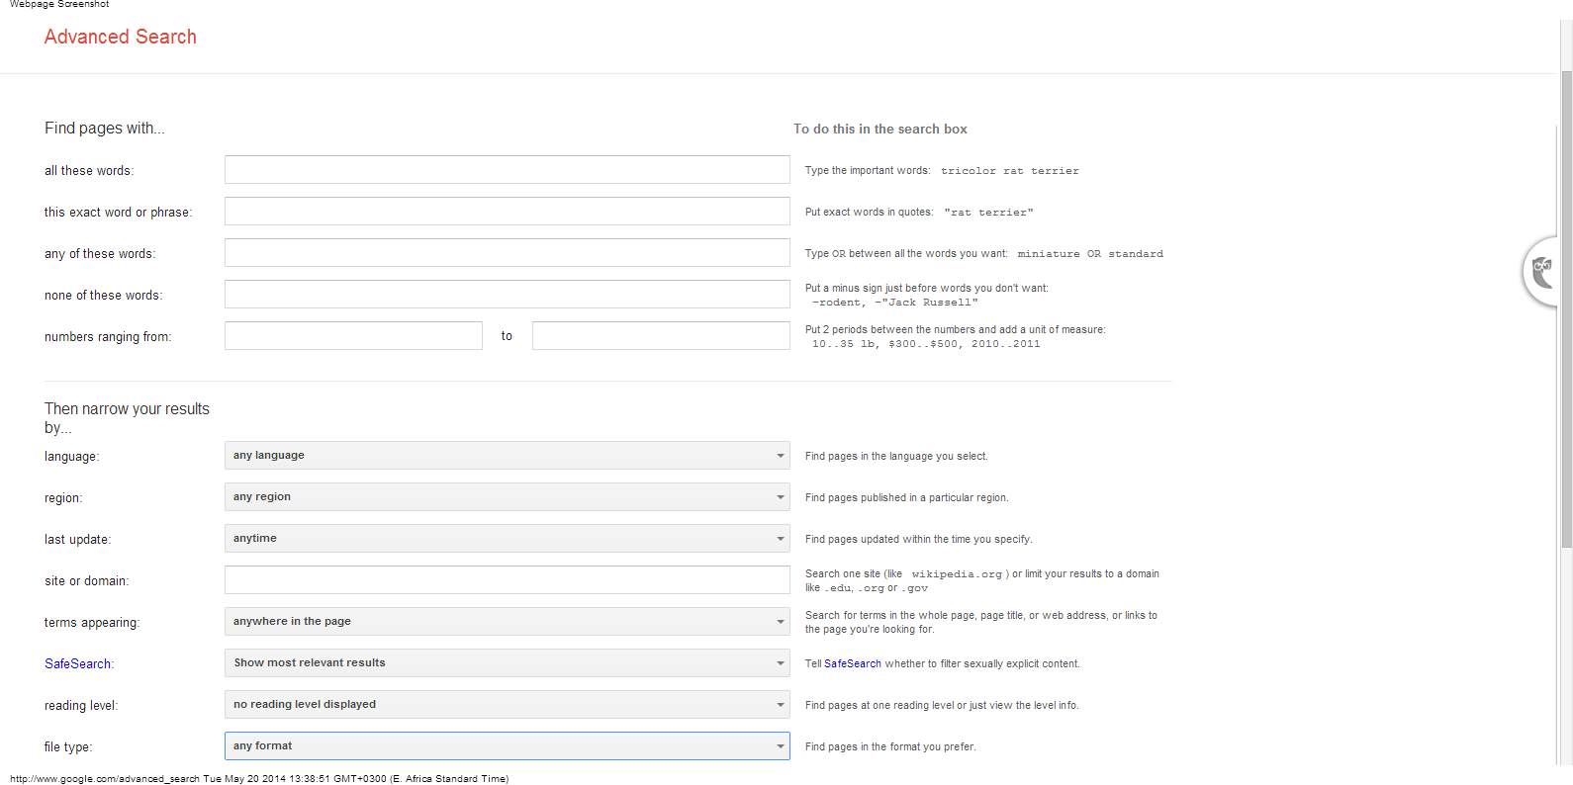
Finding Data on the Web:
Google Advanced Searches

Slide 11
Finding Data: Advanced Google Searches Shortcuts
Type OR to find variations of the same search: Kenya “tourism” OR “tourists” OR “visitors”
Use quotes to search for phrases “Kenya National Bureau of Statistics”
Narrow search to specific website: “site:url” Example “site:www.tourism.go.ke”
Narrow search to filetype: “Filetype:[extension]”
Example: site:www.tourism.go.ke filetype:xls
Also try http://www.google.com/advanced_search
Google alerts: get notified about your beat

Slide 12
Finding Data on the Web: Exercise
Get back into your two groups:
Tourism Players Want State to Wave Taxes
Kenya Bids to Revive Tourism as al-Shabaab Vows Broader War

Slide 13
Finding Data on the Web: Exercise
Return to your lists of data that would enrich Kenyan tourism coverage
Search for data using databases and advanced searches.
Categorize the data you have by story angle

Slide 14
Finding Data on the Web: Exercise
How feasible is it for tourists from the East to replace tourist from the West?
What are the current numbers of Asian tourists to Kenya versus the top five Western countries?
What is the impact to the economy if there is a significant drop in number of tourists?

Slide 15
Finding Data: No Excuses!
“We don’t have that data on a computer.”
High fees
Delay tactics
“Your request was unclear.”
Sending the wrong data
“Our database is too complicated to give you access.”
“Our database software is proprietary.”
“That information is protected by privacy law.”

Slide 16
Summary & Resources
Data is available in many different formats and almost always you will need to convert data to an Excel or csv file.
Every day, more data is available online and accessible through searches
If you can’t find it online, don’t give up!

