Slide 1
MODULE 4: DEALING WITH MESSY DATA
BY AGGREY MUTIMBA – DATA RESEARCHER
13TH JUNE, 2014

Slide 2
Introduction
Before you can analyze the data, you often need to clean it up (for Human and Non human errors) especially when you have imported the data from a database, text file, or a Web page i.e. (xml, *.dta, *.csv, tab, *.sav, defined formats, dump.sql).
Data that is not clean could have the following:
Missing data.
Spaces before and after values.
Outliers - data that is beyond range.
Inconsistency.
Different encoding.

Slide 3
Figure 1: Data Journalism
Data Scrapping
Data Cleaning
Story telling
Data Analysis
Data Visualization
Publishing

Slide 4
Tools used for cleaning data;
Spreadsheets like MS Excel
Open Refine (also called Google Refine)
Statistical tools: SPSS, SAS, R, STATA.
Writing code using scripting languages like Ruby, Perl and Python.

Slide 5
Contents
In this lesson, we are going to focus on the following;
Removing duplicate rows
Finding and replacing text
Removing spaces and nonprinting characters from text
Fixing numbers and number signs
Transforming and rearranging columns and rows
Cleaning big data (Crowdsourcing)
Navigating through Open Refine.
Always create back-up before you embark on data cleaning

Slide 6
Removing duplicate rows
Duplicate rows are a common problem when you import data. It is a good idea to filter for unique values first to confirm that the results are what you want before you remove duplicate values.
Download data from here.
Click in any cell in the worksheet.
Click on “remove duplicates” button as shown below.
Check columns that may have duplicates.

Slide 7
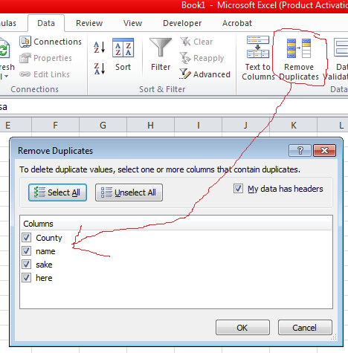
Figure 2: Removing duplicate rows

Slide 8
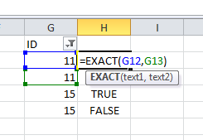
Figure 3: Using EXACT() to remove duplicates
Sort the column you want to check for duplicates from lowest to highest.
Use exact function to check values that are repeated as shown.

Slide 9
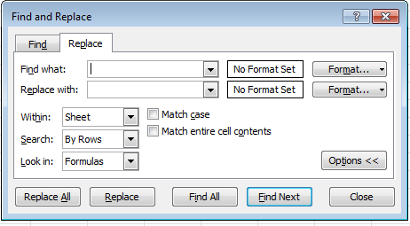
Figure 4: Finding and replacing texts
The most common way to find and replace is to press Ctrl + F on your computer.

Slide 10
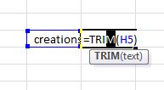
Figure 5: Removing spaces from text using TRIM()
Using TRIM removes white spaces

Slide 11

Figure 6: Removing nonprinting characters from text
Adding CLEAN removes nonprinting characters i.e. CHAR(7) shown.

Slide 12
Fixing number formats
One of the main issues with numbers that may require you to clean the data is when the number was inadvertently imported as text.
How to change it is shown in Figure 7.

Slide 13
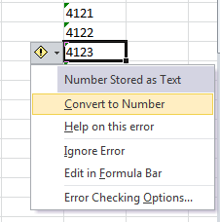
Figure 7: Fixing number formats

Slide 14
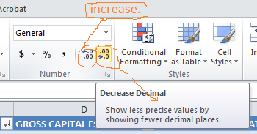
Figure 8: Changing the number of decimal places
Highlight the column you want to increase or reduce the decimal places and click on the buttons shown.

Slide 15
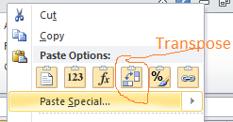
Figure 9: Transforming and rearranging columns and rows
Sometimes you may want to change rows to columns or change columns to rows. You therefore have to transpose:
=TRANSPOSE(array)

Slide 16
Cleaning Big Data: (CROWDSOURCING)
Asking crowd to clean existing data for you;
Always provide clear instructions otherwise data will be messed up! Examples of where this method is being used.
Free the Files: Help ProPublica Unlock Political Ad Spending (ProPublica)
Crowdsourcing app for data collection and cleaning - Login required (ProPublica)

Slide 17
Navigating through Open Refine

Slide 18
THANK YOU FOR YOUR TIME
ANY QUESTIONS???

