Slide 1
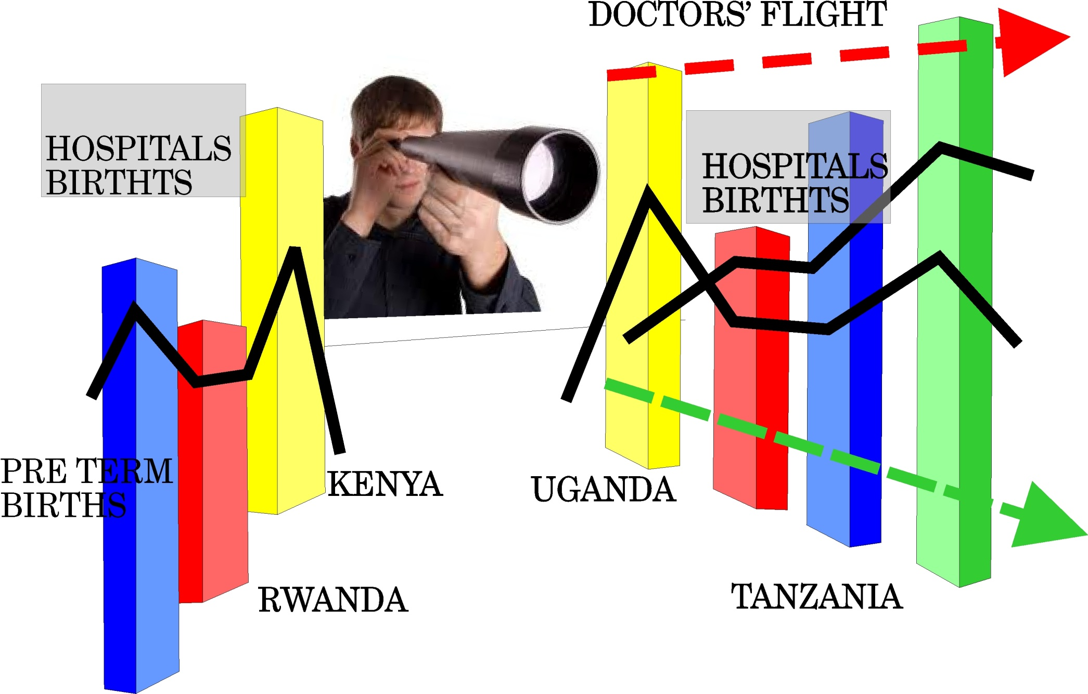
Finding interrelationships in data
1
11

Slide 2
At its best data journalism involves analyzing
different datasets to reveal something new.
Whenever you receive or locate data on a
certain issue always ask if you can
relate it from other data to reveal more insights.

Slide 3
Physician emigration dataset
Exercise
Find the total number of doctors emigrating from the represented African countries.
How many doctors have emigrated from Kenya?
Which country the highest number of doctors who have emigrated? Which country has the least?
What is Kenya’s rank?

Slide 4
What other datasets would your consider if you were to write a story about cost of doctors emigration to Kenya?
Mine at least three of those datasets.

Slide 5
Life expectancy
Dataset: Life expectancy versus GDP
Give the life expectancy and GDP rank for each
country?
Is there any link between life expectancy and
GDP?
Hans Rosling playback.

