Slide 1
Creating compelling visuals
Nairobi, 28 May 2014

Slide 2
At the end of this session you will be able to:
List five types of charts and graphs and match the appropriate chart for different sorts of data.
Present data in the simplest form.
Appreciate the value visuals adds to a story.
Write a data brief for your graphic designer.

Slide 3
DATA VISUALS?

Slide 4
Visual presentation
of information and data.

Slide 5
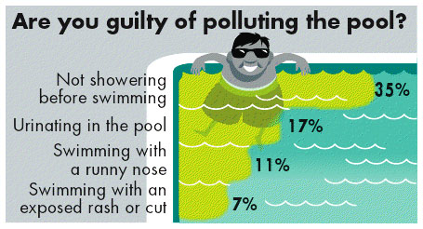
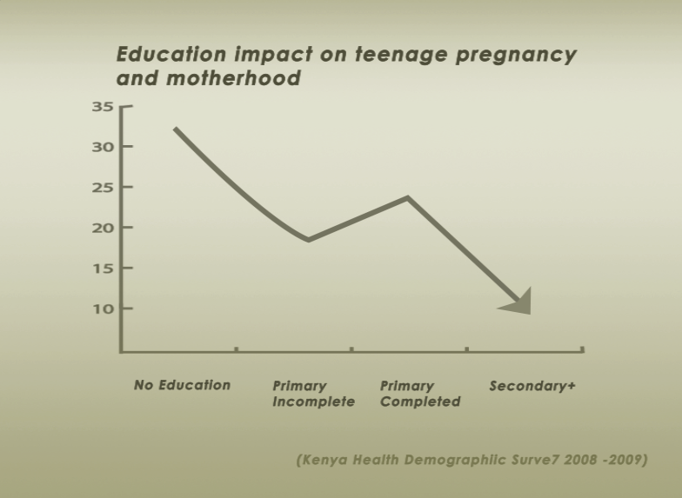

Slide 6
WHY?

Slide 7

Verbal communication

Slide 8

Visual communication

Slide 9
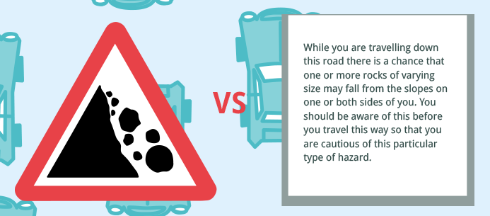
Visual communication

Slide 10




The brain likes images.
Makes the data easier to understand
Grabs the audience attention
Increase website hits

Slide 11


Data
What’s the point?
What is the information you want
the reader to “take home”?
Simplify the data!
7% = 100/7= 14.3 = 1 out of 14
But when comparing, the share need to be out of the same unit.
20% = 1 in 5 2 in 10
50% = 1 in 2 5 in 10

Slide 12
Story
Make the angle clear!
Your grandmother should care!
Set the scene!
The brain likes images…

Slide 13
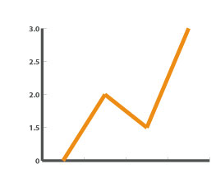
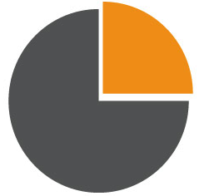
Chart
Line graphs
Change over time, Trends
E.g. Change in crime rate in Mombasa compared to Nairobi 2009-2014.
Pie chart
Share of whole
E.g. Causes of deaths among newborns.

Slide 14


Bar chart
Comparing results
E.g. Case load of stunted children
per province.
Bubble chart
Comparing quantity by volume
E.g. Overview of Health budget compared to military budget.

Slide 15
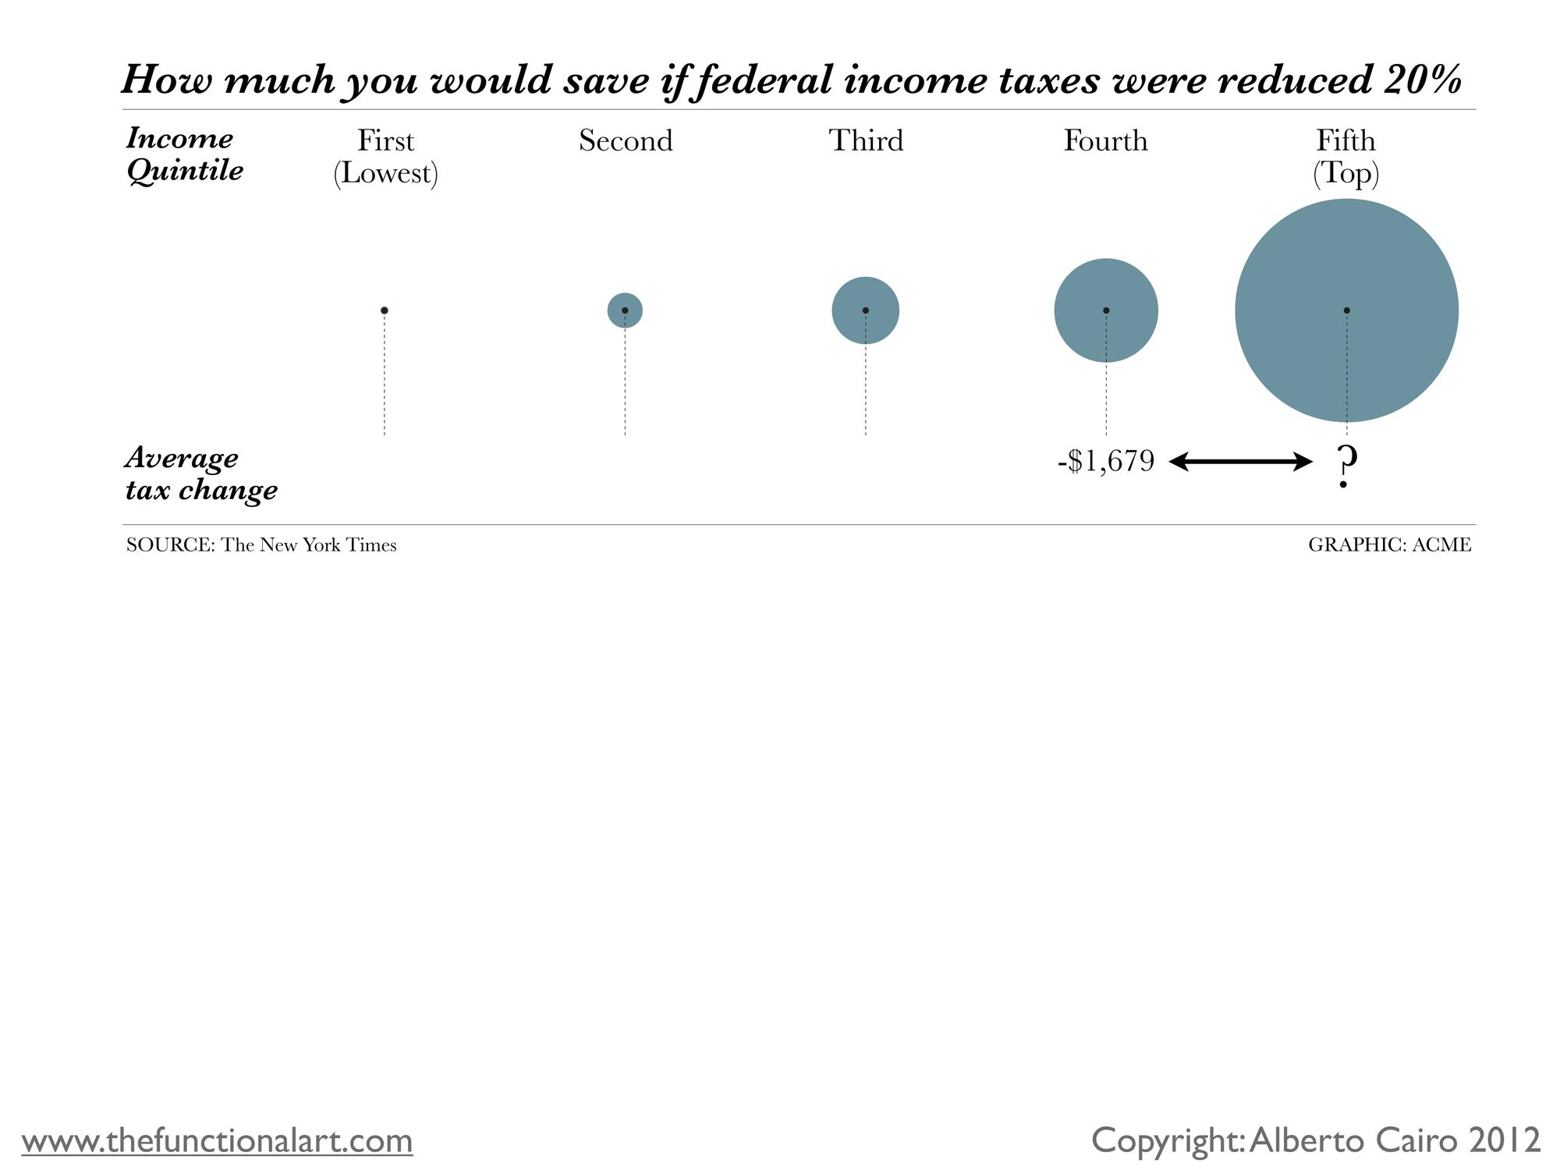
Flaws of bubble charts (borrowed from Alberto Cairo)

Slide 16
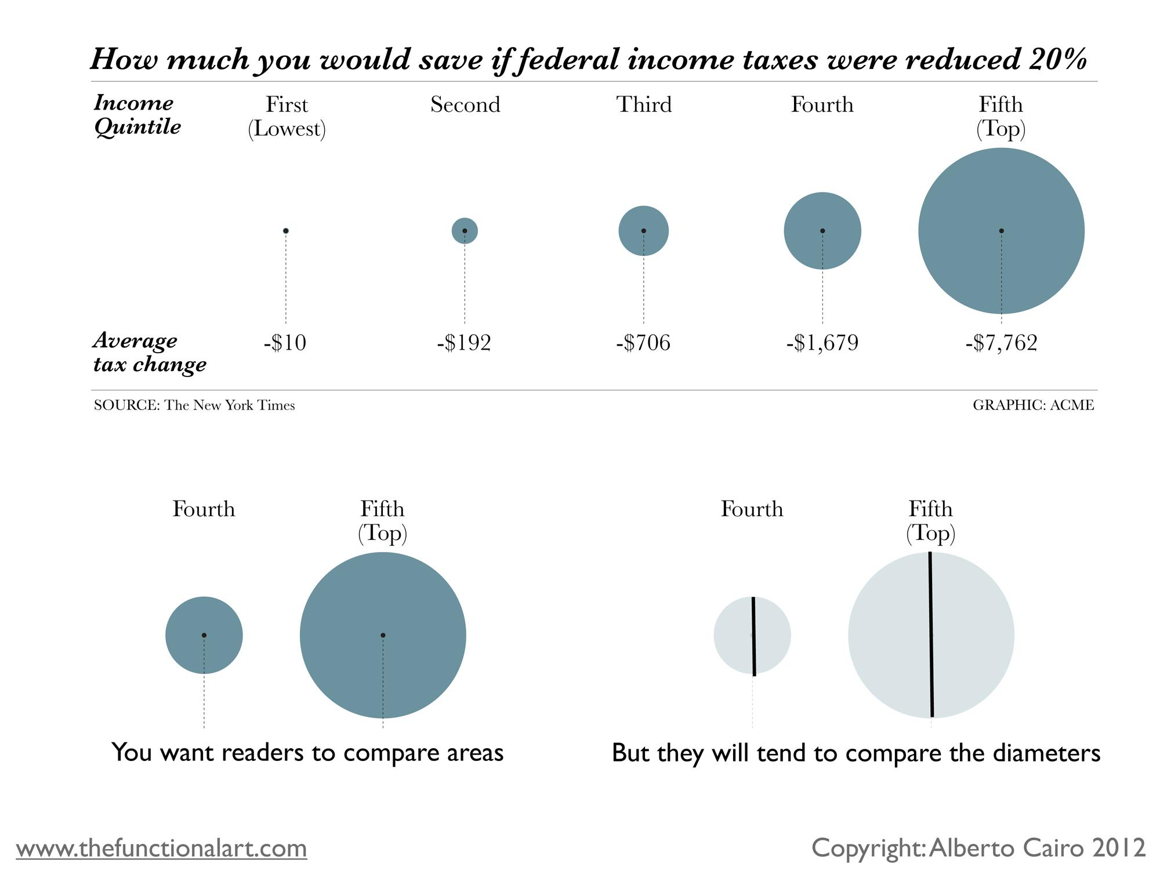
Flaws of bubble charts (borrowed from Alberto Cairo)

Slide 17
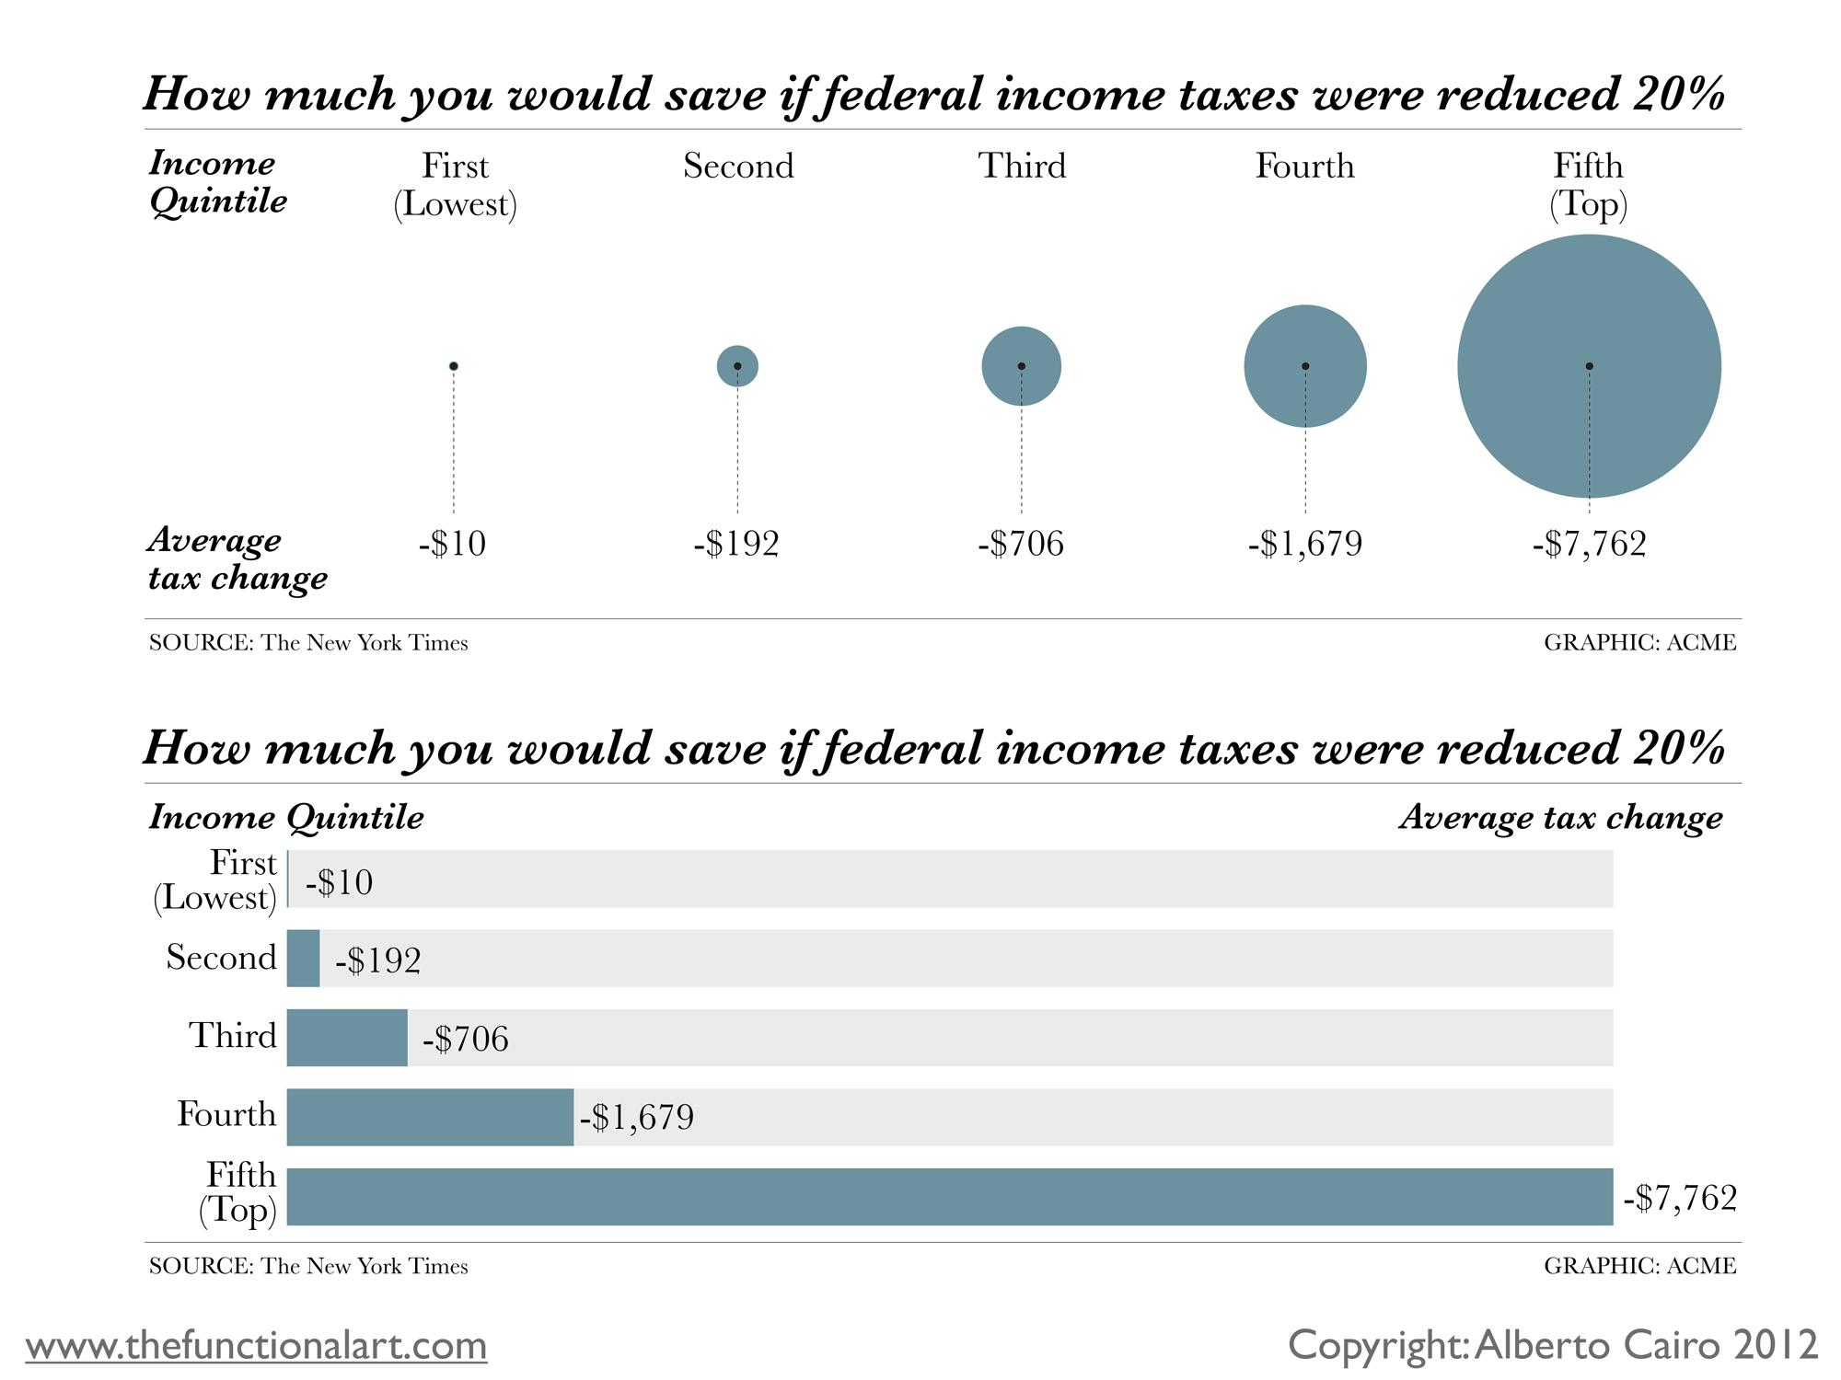
Flaws of bubble charts (borrowed from Alberto Cairo)

Slide 18
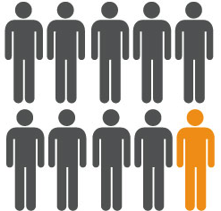
Pictorial chart
Ratio per population
E.g. Percentage of children under 5
in Kenya that are stunted

Slide 19

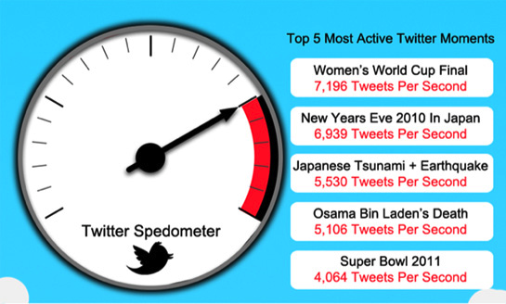
Design
Hierarchy - Hook it up!
All visualizations need
a focus point.
Show don’t tell!
Keep the text simple and short.

Slide 20
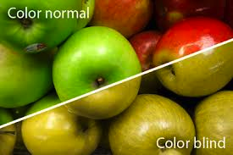
Be careful with colors!
To many colors is confusing.
Some colors are not seen by colorblind.
Stay on style!
Keep the same style throughout the visualization.

Slide 21
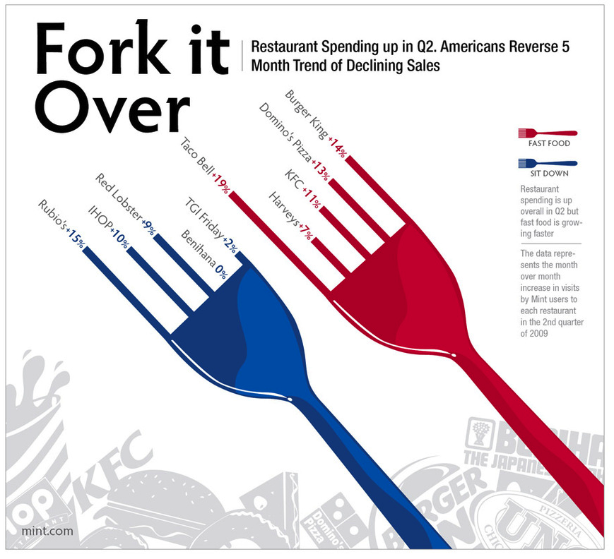
Be creative!
Play around and try to present data in the most fun way.
What makes you interested
is likely to also make
the audience interested.

Slide 22
Briefing a graphic designer
It should address the following questions:
What is the story?
Which data is most important/should get most space?
What kind of charts should by used?
Is there any other information/fact that need to be illustrated or presented with the data?

