Slide 1
Architectures for monitor distribution
Jonas Magazinius, Daniel Hedin, Andrei Sabelfeld
Chalmers University of Technology
-
WebSand meeting
2013-04-26

Slide 2
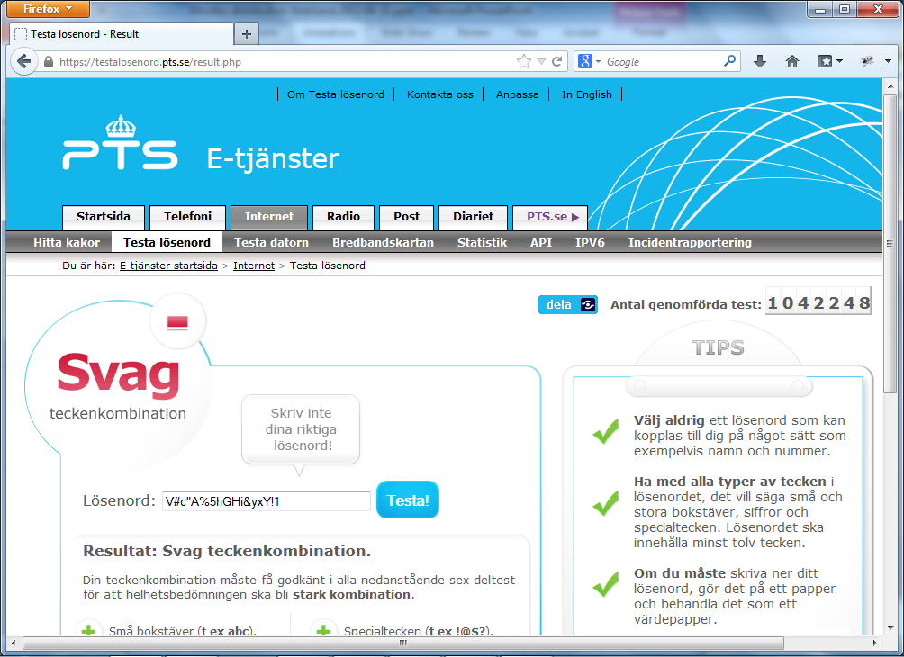




Scenario
User inputs password
Computes password strength
Reports result

Slide 3





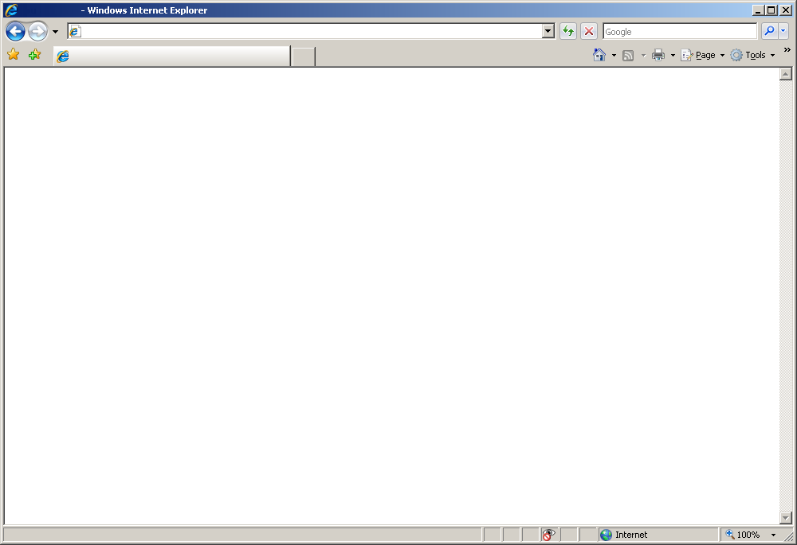

Hand over your passwords!

Slide 4

Browser extension
Replace the JavaScript Engine

Slide 5
Browser extension
Replace the
JavaScript Engine

Slide 6
Browser extension
Replace the browser’s JavaScript engine
Turn off the engine
Traverse the page
Monitor interprets all scripts in order
Hook all events
Implemented as an extension for Firefox

Slide 7
Browser extension
Pros
Cons
Direct control over policies
Cannot be bypassed
JavaScript engine is turned off
Protocol agnostic (HTTP/HTTPS)
Execution order must match
Modifies the browser
Runs with privilege of the browser
One implementation per browser

Slide 8




Web proxy
Deployment affects policy control:
Reverse proxy
Client side proxy
.evaluate( )
Notes:
Rewrite all pages on-the-fly
Include the monitor
Wrap all inline scripts and event handlers to execute in the monitor
Rewrite all scripts on-the-fly
Wrap source to be executed by the monitor
Implemented in Node.js

Slide 9
Web proxy vs. extension
Pros
Cons
Browser independent
Rewriting is the same regardless of the browser
Minimally intrusive to the browser
Unmodified browser
Simple client configuration
Fairly intrusive to HTML
Failing to identify JavaScript compromises the monitor
Special considerations required for HTTPS
Higher overhead

Slide 10

Suffix proxy
Wildcard DNS
*.monitor.com
google.com.monitor.com
pts.se.monitor.com
pts.se/image.gif
sj.se
Notes:
Specialization of the web proxy
Wildcard DNS-names
Can decide what to proxy
NodeJS

Slide 11
Suffix proxy vs. web proxy
Pros
Cons
Not intrusive to the browser
No modification
No configuration
Resource specific proxying
Reduced load
Decreased overhead
Separation between proxied and unproxied origins
Even more intrusive to HTML
Failing to identify JavaScript compromises the monitor
Special considerations required for HTTPS

Slide 12
Integrator driven
.evaluate( )

Slide 13
Integrator driven vs. the rest
Pros
Cons
Site specific policies
Deliberately intrusive to HTML
Not intrusive to the browser
No modification
No configuration
Transparent to the user
Developer understanding
Rudimental communication

Slide 14
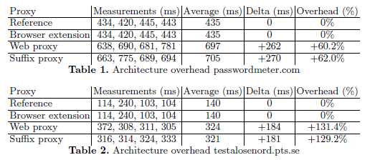
Performance overhead
Measuring added overhead of including the monitor – not the monitor itself

Slide 15
Conclusion
Four architectures evaluated
Relative pros and cons
Great flexibility
Reasonable overhead

