Slide 1
Architectures for monitor distribution
Jonas Magazinius, Daniel Hedin, Andrei Sabelfeld
Chalmers University of Technology
WebSand meeting
2013-04-25

Slide 2






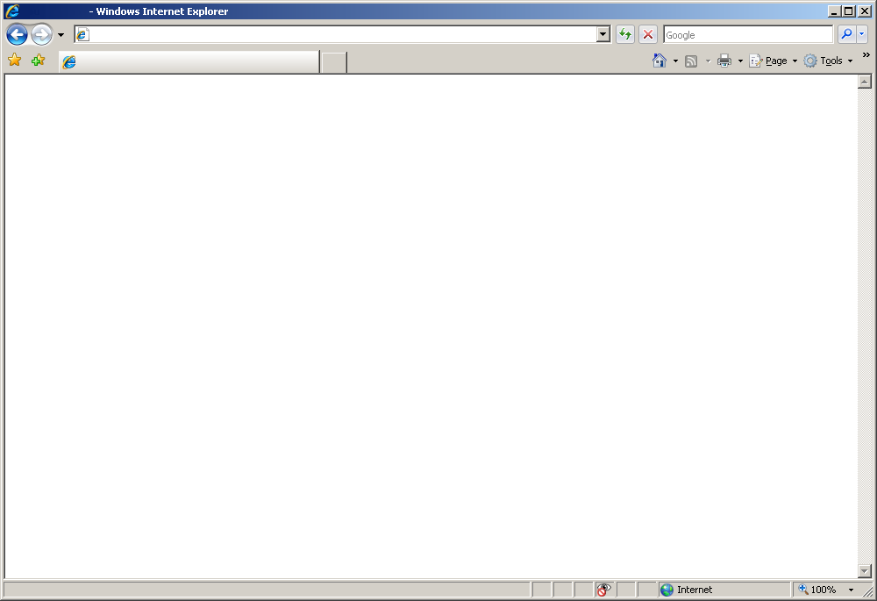

Hand over your passwords!

Slide 3
Browser extension
Replace the browsers JavaScript engine
Turn off the engine
Traverse the page
Monitor interprets all scripts in order
Hook all events
Implemented as an extension for Firefox

Slide 4
Browser extension
Pros
Cons
Direct control over policies
Cannot be bypassed
JavaScript won’t execute since engine is turned off
Protocol agnostic (HTTP/HTTPS)
Execution order must match
document.write
Must run with privilege of the browser

Slide 5
Web proxy

Slide 6
Web proxy
Pros
Cons

Slide 7
Suffix proxy

Slide 8
Suffix proxy
Pros
Cons

Slide 9
Integrator driven

Slide 10
Integrator driven
Pros
Cons

