Slide 1
These slides:
https://tinyurl.com/lrjf4nz

Slide 2
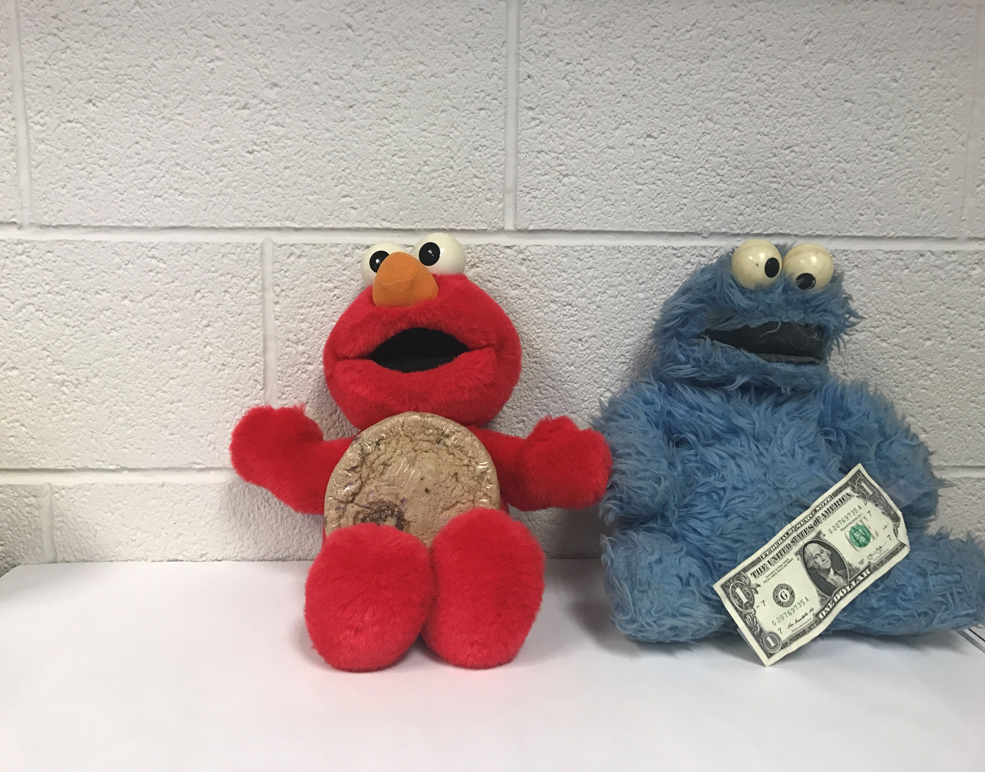

Our evolution with REA
From Elmo and Cookie Monster
to new economic ecosystems
Bob Haugen and Lynn Foster http://mikorizal.org

Slide 3
Enterprise Value Chain (non-legacy ERP)
Counting Artifacts
Paper-Based Accounting Systems (A = L + OE)
File-Based Accounting Systems (A = L + OE)
Enterprise Value Chain (legacy ERP)
Financial
Other
Reporting View
Views of
Enterprise
jar
source document
Event-chains
memorandum
Where Bob
came into
this picture
Journal
transactions & master files
A/
Rec
….
Sales…
notched stick
Ledger
.
oo
Financial Statements

Slide 4
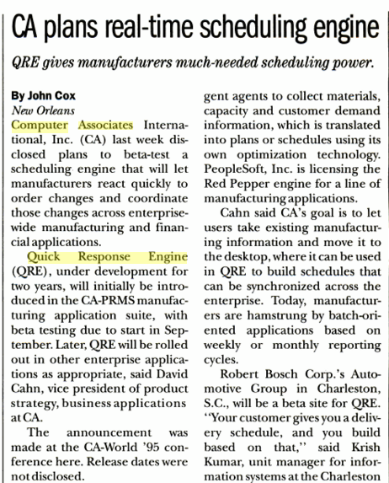
skunkworks

Slide 5
Searching for a good supply chain model…
1997

Slide 6
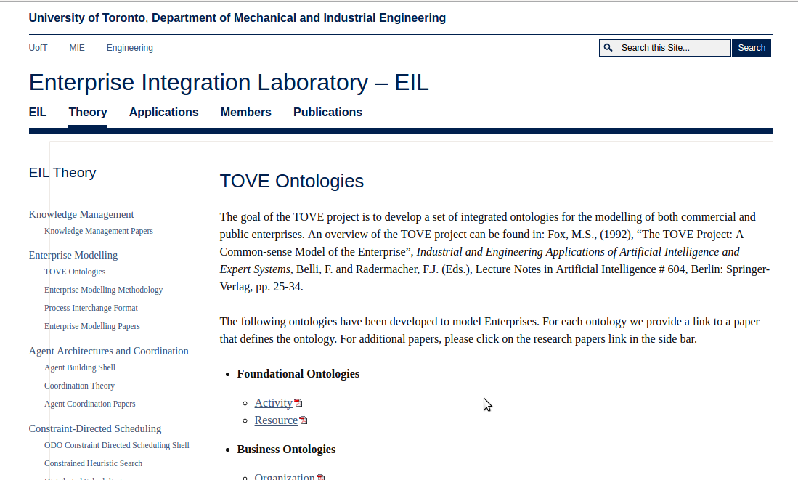
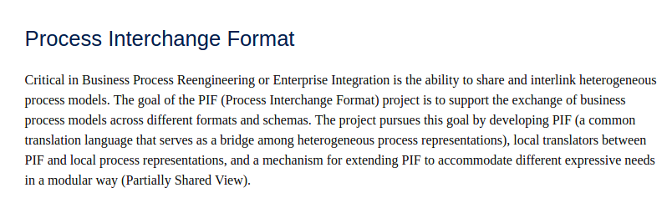
One candidate

Slide 7
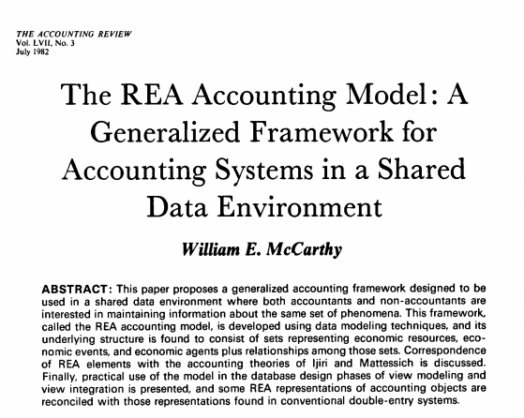
better candidate

Slide 8
REA was presented as an enterprise accounting model. But it could also connect individual enterprises into larger economic formations.
The REA Ontology quotes Ijiri: "...the economic activities of an entity are a sequence of exchanges of resources - the process of giving up some resources to obtain others." Those exchanges of resources do not stop at the boundaries of a single company.

Slide 9
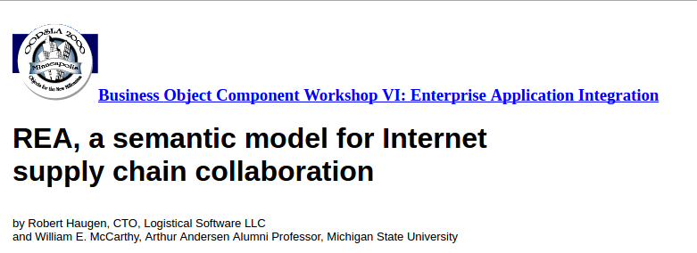
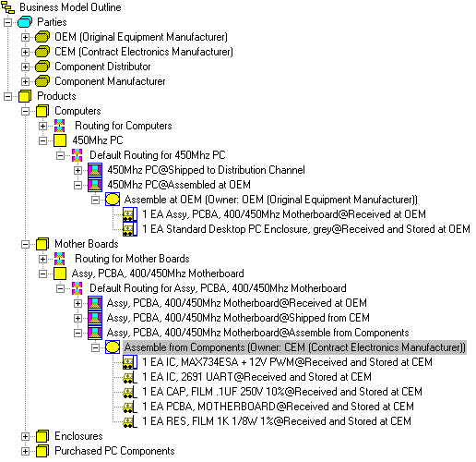
Failed supplychain
startup

Slide 10
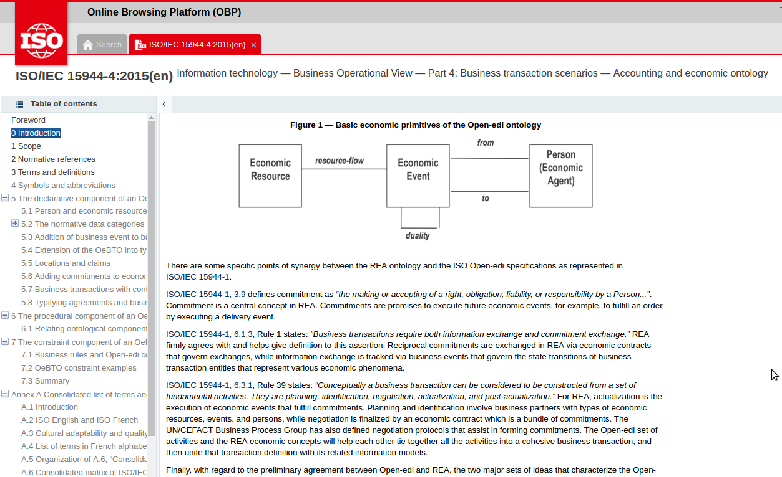
ISO Standard

Slide 11
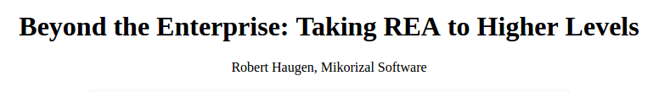
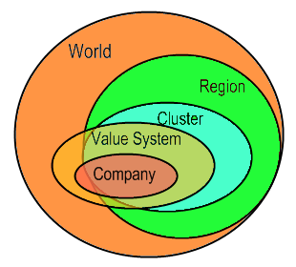
REA-25 2005

Slide 12
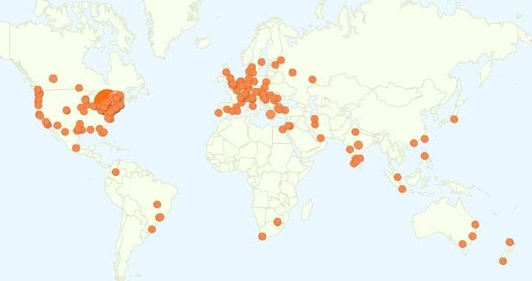
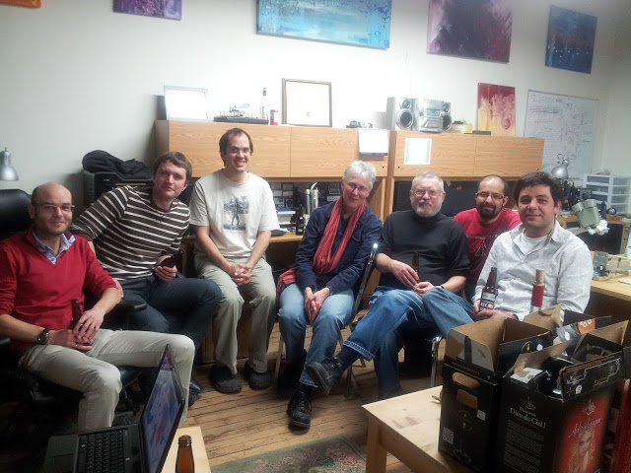
The Sensorica Open Value Network
Where Lynn came into the picture...

Slide 13
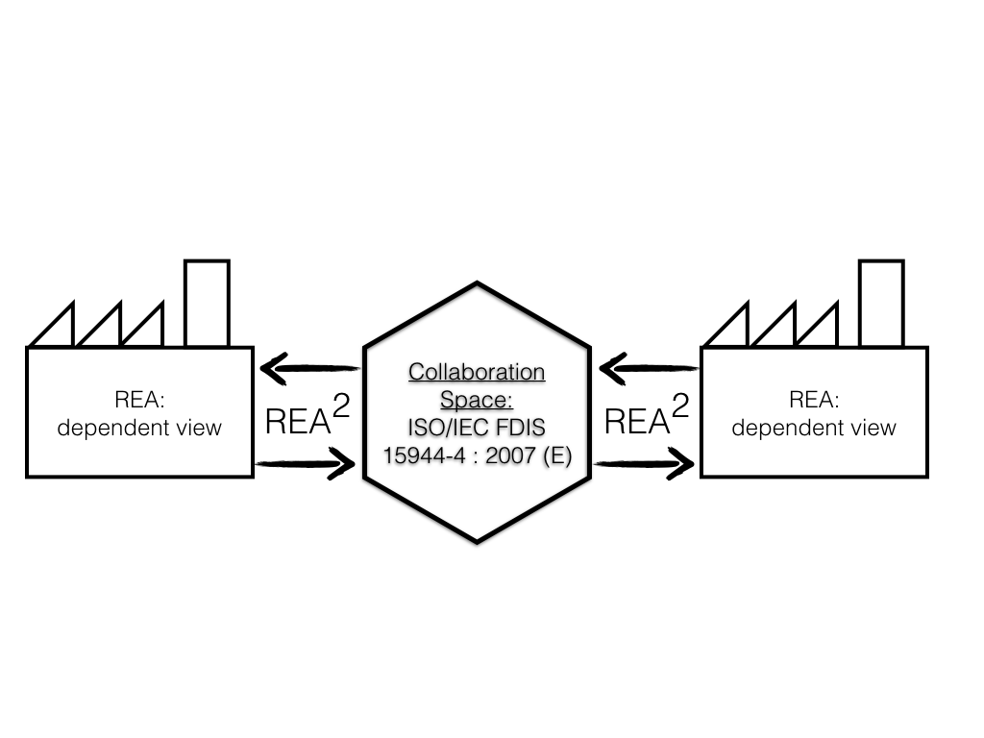
Collaboration Space:
Wim Laurier , Jesper Kiehn, and Simon Polovina

Slide 14



cash
Object Enterprise
Object Enterprise Employees
Enterprise E1
(Financier)
cash
Business
Process1
cash
employee services
Enterprise E2
(Supplier)
Enterprise E4
(Customer)
Business
Process2
Business
Process
(source)
Business
Process
(source)
Business
Process3
Business
Process
(make)
raw materials
Business
Process
(make)
finishedgoods
Business
Process4
cash
Business
Process
(deliver)
Business
Process
(deliver)
advertising services
Business
Process5
cash
cash
Enterprise E3
(Supplier)
Business
Process6
finished goods
Enterprise E5
(Customer)
cash
REA Modeling at the Value Network level

Slide 15
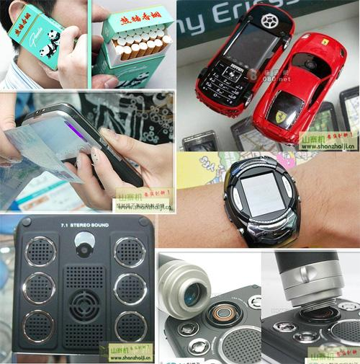
Shanzai
Chinese open manufacturing networks
“a culture of sharing information“

Slide 16
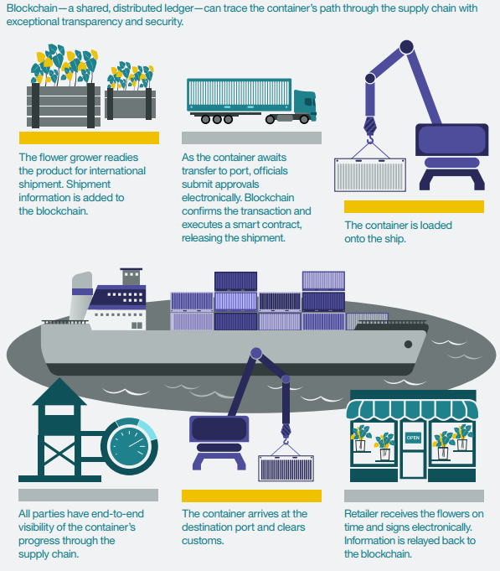
blockchains

Slide 17
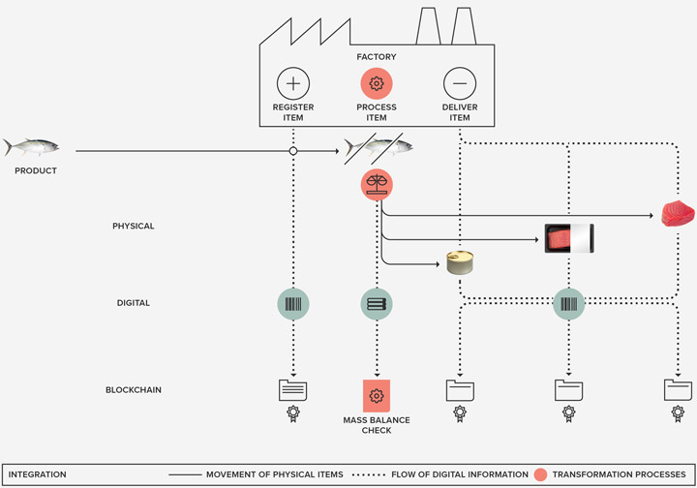
blockchains

Slide 18


A vocabulary for the distributed economic networks of the next economy

Slide 19
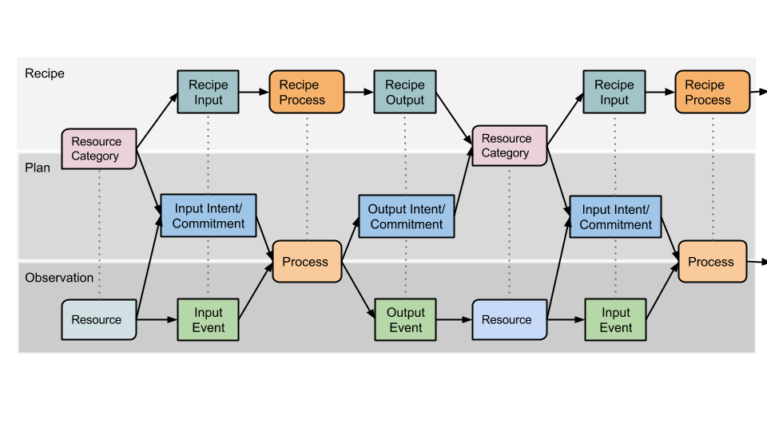
3 levels of Value Flows
Almost but not exactly the same as
3 levels of REA

Slide 20
Main differences between Value Flows REA and “classical” REA
“Classical” REA:
Economic Resources are (1) scarce and (2) under the control of an enterprise.
Value Flows REA:
Intellectual creations like designs are not scarce, yet they are economic resources. They only become scarce when legally restricted.
Air and water are economic resources, but they are not under the control of an enterprise unless they are legally restricted.

Slide 21
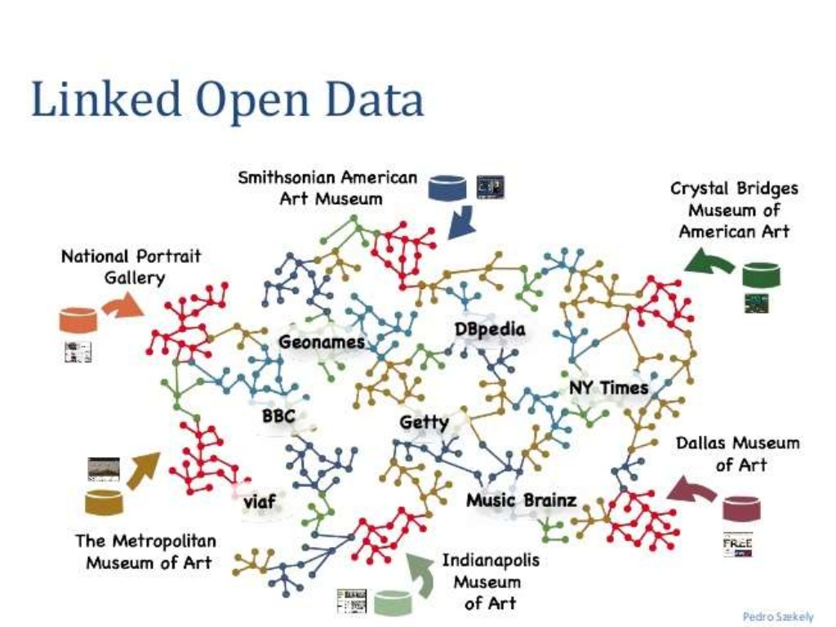

Slide 22
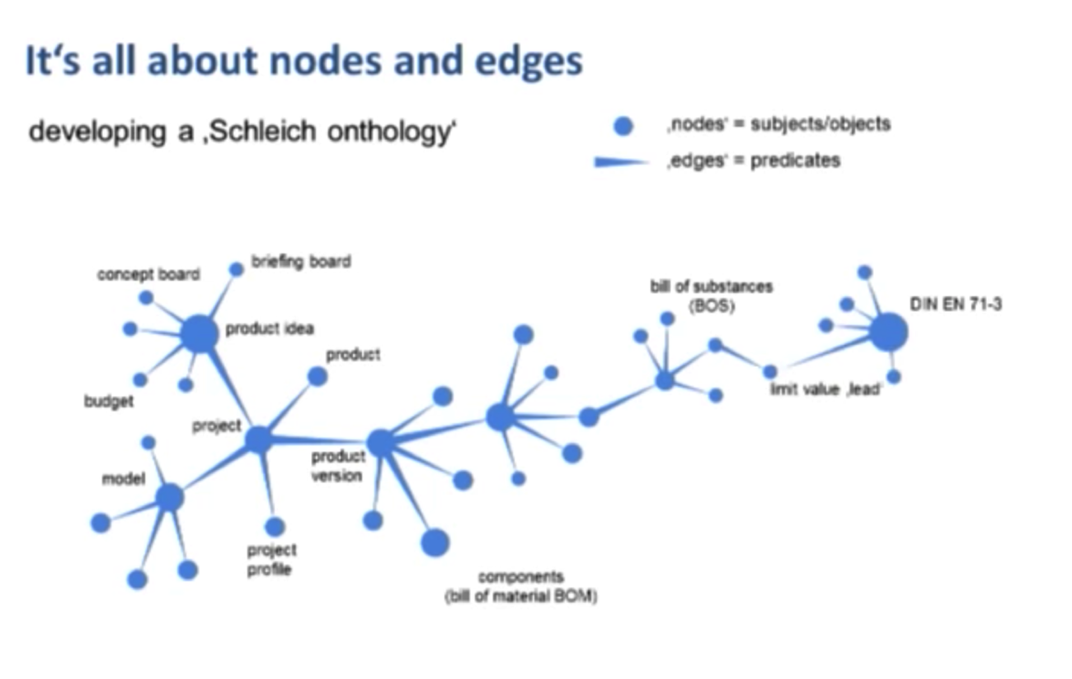

Slide 23
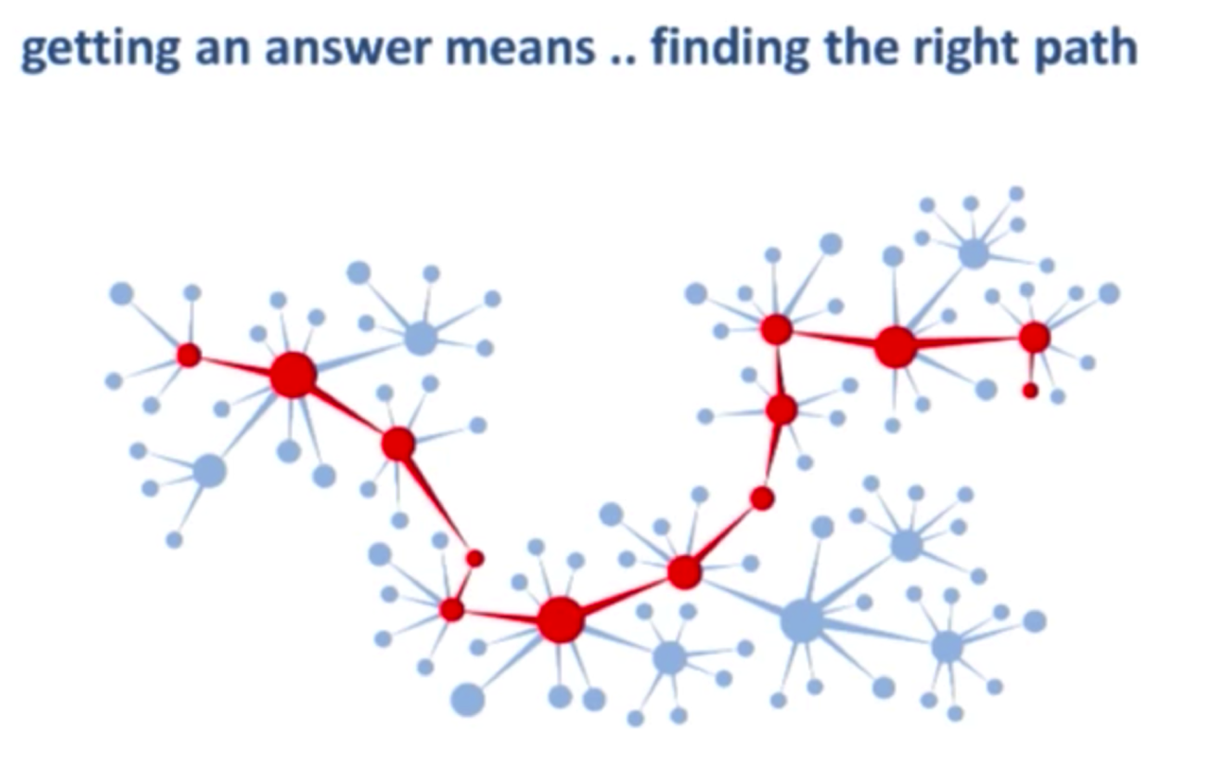

Slide 24
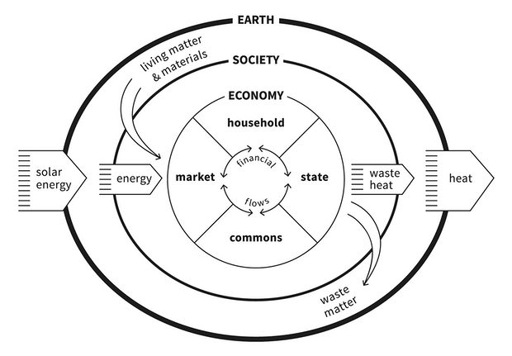

Slide 25
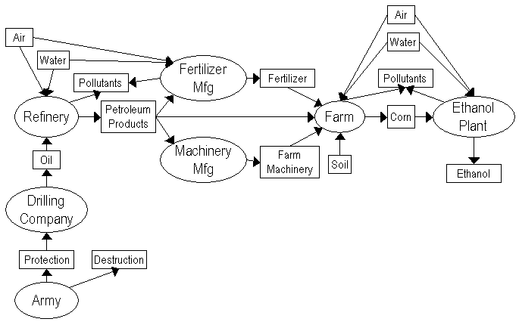

Slide 26
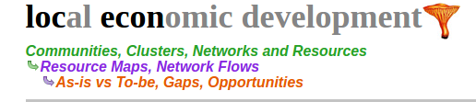


Slide 27
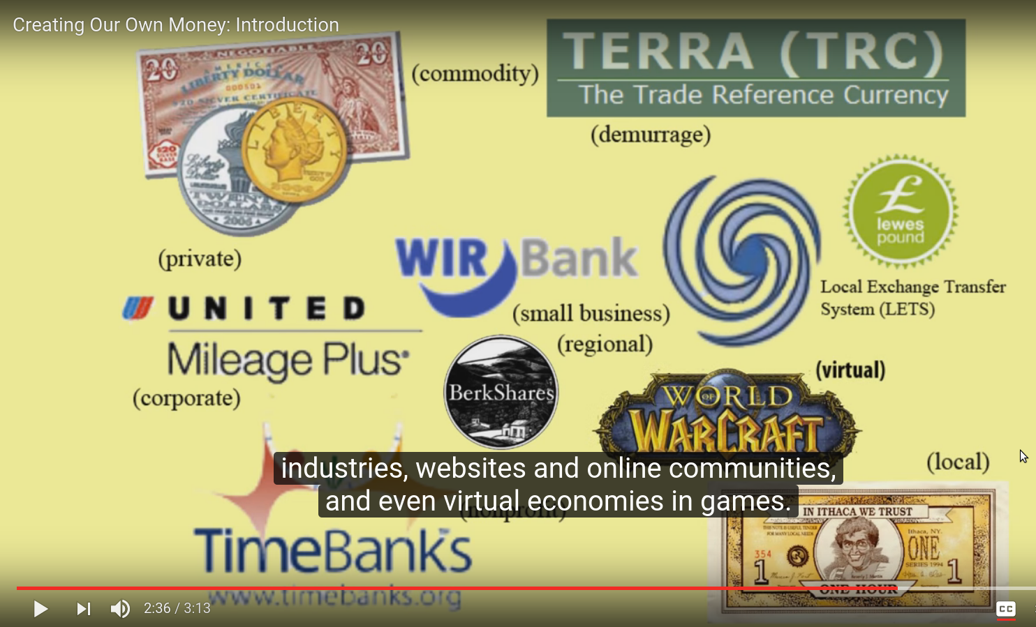
Mutual Credit
Creating our own money

Slide 28
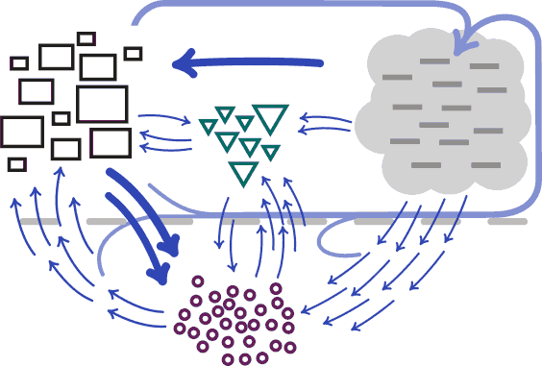
Mutual Credit
Creating our own money

Slide 29
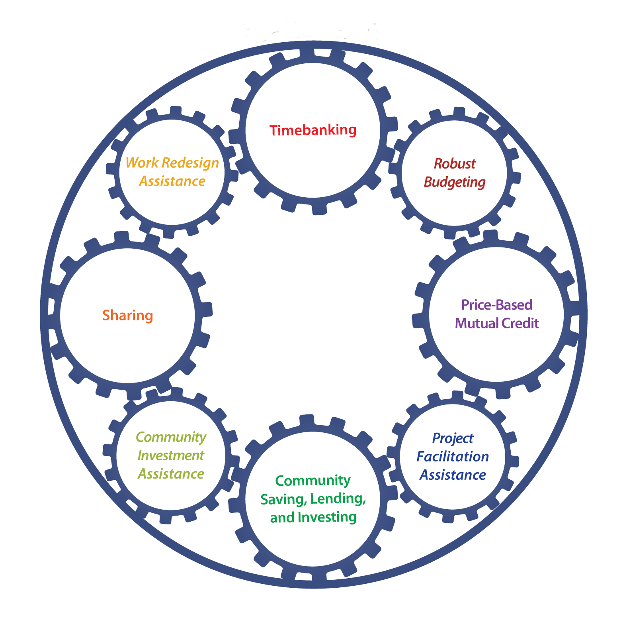


Slide 30
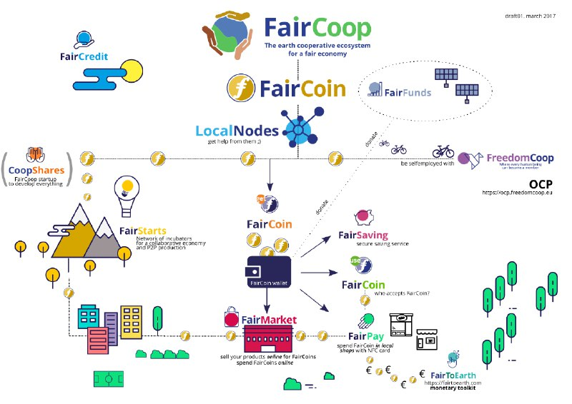

Slide 31
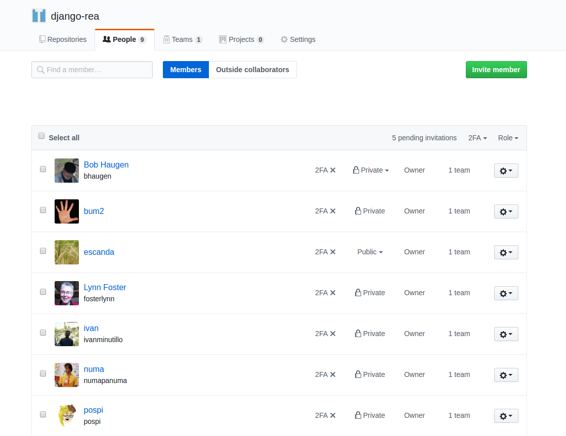
New REA software project
a set of building blocks for apps
US
Spain
Spain
US
Italy
Argentina
Australia

Slide 32
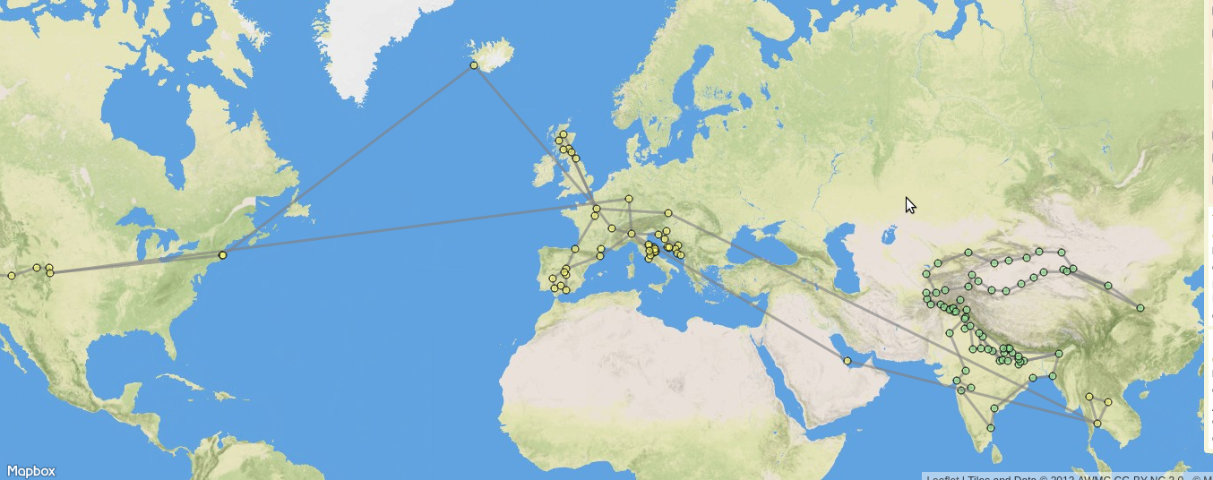
WWHEE
World Wide Holonic Economic Ecosystem.
Like the World Wide Web, for economic interactions.
Same as Bill’s World Wide Semantic Accounting System.

Slide 33
Links
http://mikorizal.org/BeyondTheEnterprise.html
http://www.zdnet.com/article/ibm-maersk-aim-to-speed-up-shipping-with-blockchain-technology/
https://www.provenance.org/
https://neo4j.com/blog/semantic-pdm-graph-data-model-schleich/
https://www.theguardian.com/commentisfree/2017/apr/12/doughnut-growth-economics-book-economic-model
https://www.valueflo.ws/
https://locecon.org/
http://linkeddata.org/
https://fair.coop/
https://youtu.be/YvegNqKcQ-g (mutual credit video)
http://www.mutualaidnetwork.org/
http://rea-project.readthedocs.io/en/latest/intro.html

