Slide 1
Algorithmic Recourse: from Counterfactual Explanations to Interventions By Kamiri, Schölkopf, and Valera
Presentation by Catherine Huang, Christina Xiao, Kelly Zhang

Slide 2


Algorithmic Recourse
Increasingly algorithms are used to make consequential decisions for individuals
Recourse: “Systematic process of reversing unfavorable decisions made by algorithms and bureaucracies”
Promoting agency and trust
Notes:
Defendent awaiting trail should be released on bail

Slide 3
Paper’s Main Contributions
Insufficiencies of previous problem formulations → Motivates causal approach to recourse (Kelly)
Structural Causal Model approach to recourse (Catherine)
Discuss examples motivated by real-world problems and future directions (Christina)

Slide 4
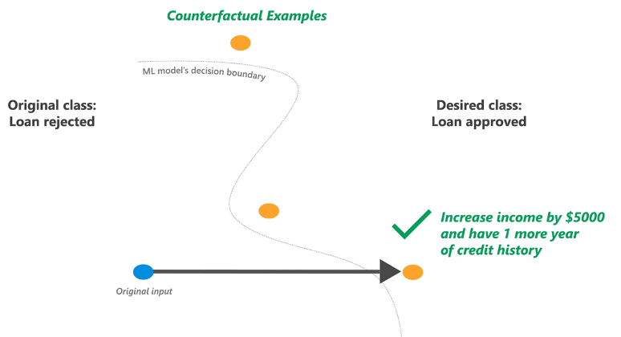
Nearest Counterfactual Explanations
For a person with features x^{F} who was denied a loan, find the “nearest neighbor” x who was granted a loan
Difference between x^{F} and x is an “explanation” for the loan denial for x^{F}

Slide 5
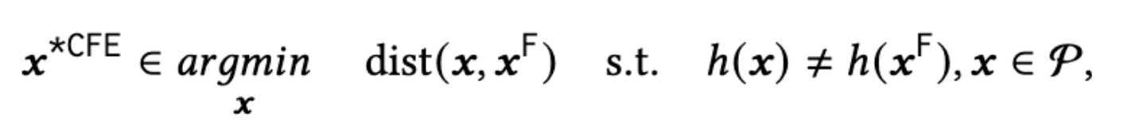
Nearest Counterfactual Explanation (CFE)
Finding nearest counterfactual explanation as an optimization problem
x^{*CFE} is the Counter Factual Explanation
Function h is the classifier
Distance metrics
Lp norm; L1 norm divided by median absolute deviation; etc

Slide 6
Why are counterfactual explanations not ideal for recommendations for recourse?
Counterfactual Explanations provide understanding but do not necessarily lead to optimal action recommendations
Notes:
Conflating explanations with recommendations / actions

Slide 7
Why are counterfactual explanations not ideal for recommendations for recourse?
Don’t account for person’s difficulty or “cost” of changing dimensions of x^{F} (addressed by Ustun et al.)
Don’t account for downstream “causal” impact of taking actions (addressed by this work)
Notes:
Conflating explanations with recommendations / actions

Slide 8
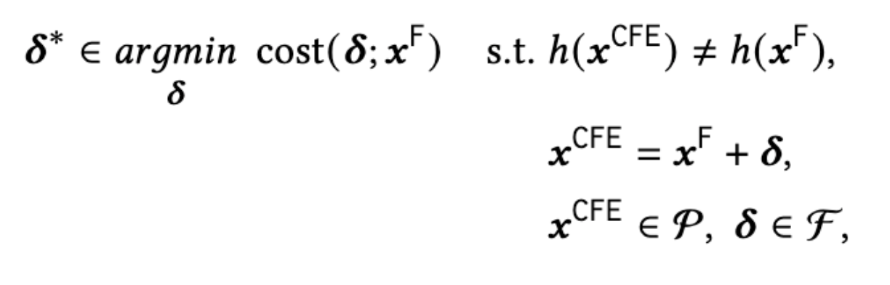
Accounting for the “Cost” of Actions (Ustun et al.)
𝛿* restricted to the set of “feasible changes”
Consider linear impact of changes 𝛿
Non-trivial to choose costs that reflect people's’ true objective functions

Slide 9
Insufficiencies of Ustun et al. Formulation
Marginal cost of changing a feature is constant
Example: Cost of going from salary $0 to $100k equals cost to go from salary $800k to $900k

Slide 10
Insufficiencies of Ustun et al. Formulation
asdf
Doesn’t consider downstream “causal” impact of actions
Example: Loan decision for individual changed if “salary” reaches 100k (+33%) or “bank balance” reaches 30k (+20%). 20% change seems easier.
However, best action recommendation is to increase salary by 14% when 30% of salary automatically saved to bank.
Notes:
Example: Loan decision for individual changed if “salary” reaches 100k (+33%) or “bank balance” reaches 30k (+20%).
Increasing bank balance seems easier since only increase of 20% is needed.
However, 30% of salary automatically saved, so increasing salary increases bank balance as well.
So best action recommendation is increasing salary. Since 14% increase leads to reaching bank balance target.

Slide 11
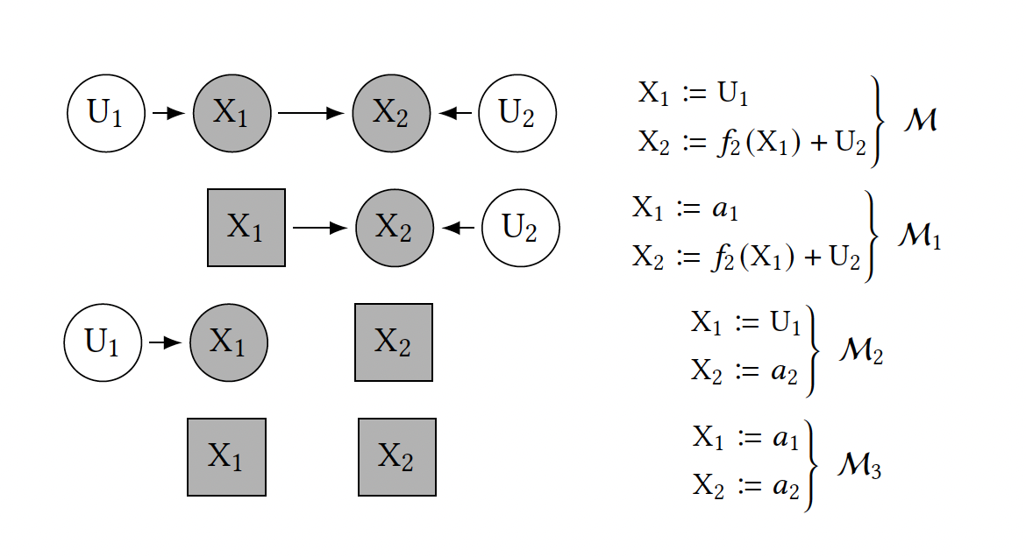
Actions as Interventions: Structured Causal Model (SCM)
Setup
𝑀 (𝑀 ∈ 𝛱) = ＜𝐹, 𝑋, U＞ : SCM
𝑋: endogenous (observed) variables
U: exogenous (unobserved) variables
𝐹: U → 𝑋, structural equations
A (𝛱 → 𝛱): structural interventions, i.e. transformations between SCMs
of the form A := do({𝑋_{i} := a_{i}}_{i∈I})
Structural Interventions
𝑀: true world model
observation: 𝑀₁ ≠ 𝑀₂ ≠ 𝑀₃
Notes:
SCM: captures all inter-variable causal dependencies in the real world
structural interventions example
severing graph edges incident on an intervened variable, X_i

Slide 12
Actions as Interventions: Structural Counterfactuals
What will individual 𝑥^{F} ‘s feature vector be after the individual
performs action set A in world 𝑀?
Assumptions: (1) no hidden confounders (true SCM), (2) full access to invertible 𝐹
Idea: once we know 𝐹, 𝑋 (endogenous variables) can be uniquely determined given U (exogenous variables)
Compute 𝐹 ⁻¹(𝑥^{F})
Takeaway: we can compute any structural counterfactual query for individual 𝑥^{F}:
𝑥^{SCF} = 𝐹_{A}(𝐹 ⁻¹(𝑥^{F})).
Notes:
Result: we can determine 𝐹 ⁻¹(𝑥^{F}): the exogenous variables that give rise to a particular realization of endogenous variables 𝑋

Slide 13
Limitations of CFE-Based Recourse: Formalism
Setup: 𝑥^{F} (individual features), 𝛿* action recommendation (Ustun et al. solution), I (set of indices of acted-upon observed variables: I = {i | 𝛿*_{i} ≠ 0})
Definition (CFE-Based Actions): a set of structural interventions A^{CFE} := do({𝑋_{i} := 𝑥_{i}^{F} + 𝛿*}_{i∈I})
Proposition: A^{CFE} ⟶ 𝑥^{SCF}= 𝑥^{*CFE} := 𝑥^{F} + 𝛿* (i.e. recourse is guaranteed) if and only if I’s descendants = {}.
Corollary: if the true world 𝑀 is independent—if all the observed features are root-nodes of 𝐺—then CFE-based actions always guarantee recourse.
gives rise to

Slide 14
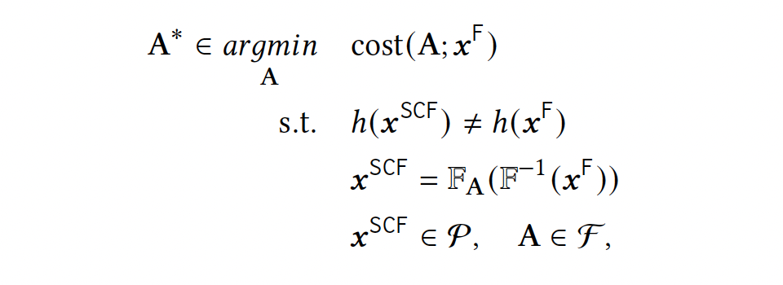
Algorithmic Recourse via Minimal Interventions: Setup
Formulation
Remarks
finding minimal shift of features → finding minimal cost action set that yields favorable label
A* ∈ ℱ = set of feasible actions with minimally costly recourse
cost( ᐧ ; 𝑥^{F}): ℱ x 𝑋 → ℝ₊
𝑥^{*SCF}: 𝐹_{A*}(𝐹 ⁻¹(𝑥^{F})): resulting counterfactual
𝑥^{*SCF} ≠ 𝑥^{*CFE} (from Ustun et al.)!

Slide 15
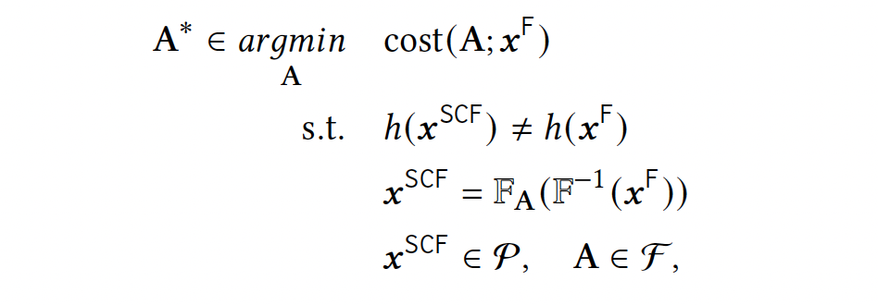
Algorithmic Recourse via Minimal Interventions: Formalism
(from the last slide)
Proposition:
A^{CFE} : Counter Factual Explanation-based action
A* : Minimal Intervention Solution (blue box above)
cost(A*;𝑥^{F}) ≤ cost(A^{CFE};𝑥^{F})

Slide 16
Algorithmic Recourse via Minimal Interventions: MINT
Recourse through Minimal Interventions (MINT) idea:
Required: that we can compute structural counterfactual of an individual in the world given any feasible action
Focus on the case where the SCM is an additive noise model
⇒ Abduction-action-prediction technique (Pearl et al.) to compute 𝑥^{SCF}: 𝐹_{A}(𝐹 ⁻¹(𝑥^{F}))

Slide 17
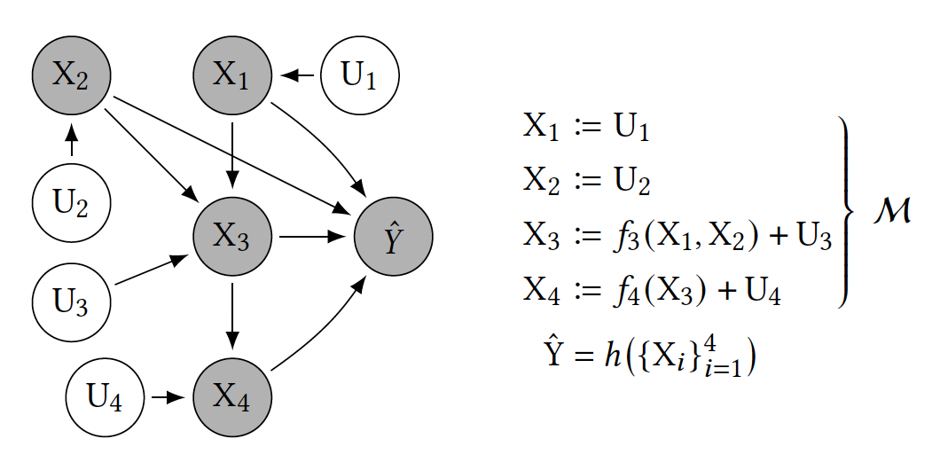
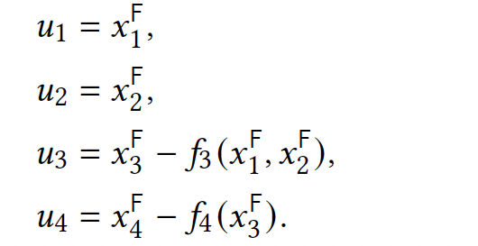
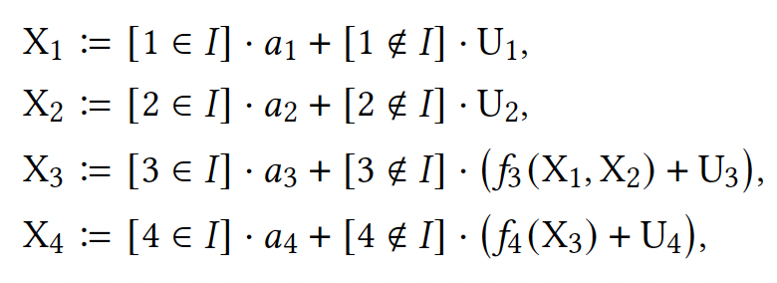
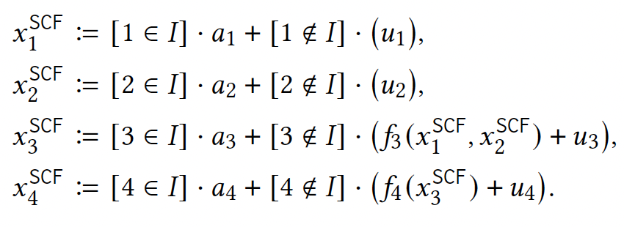
Abduction-Action-Prediction to obtain 𝑥^{SCF}
𝐹𝑭𝑿𝑋𝑀𝓜ℳ𝕄𝑴𝕏𝑥𝒙UUuАΑA𝐹𝛱Ⲡ𝜫∈∊𝐺𝑔𝛿𝜹≠⋃∪ℱ𝑥I𝛿*𝑥^{𝐹}A^{CFE}
Abduction: compute exogenous variables
Action: modify SCM with interventions
Prediction: recursively compute endogenous variables based on (1) and (2)
{U_{i}}⁴_{i=1}: mutually independent, exogenous
{f_{i}}⁴_{i=1}: structural equations
𝑥 = [𝑥₁^{F}, 𝑥₂^{F}, 𝑥₃^{F}, 𝑥₄^{F}]^{T}: observed factual features
Notes:
Solve for U’s using F and X
Modify X’s you’re interested in
Compute Y using graph and Us

Slide 18
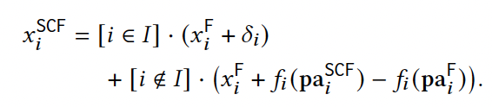

General Formulation and Solving the Optimization Problem
General Formulation
Remarks
𝑥_{i}^{F} + 𝛿_{i}: intervention
𝑓_{i}(pa_{i}^{F}): factual values of 𝑥_{i}’s parents
𝑓_{i}(pa_{i}^{SCF}): counterfactual values of 𝑥_{i}’s parents
new closed-form expression for 𝐹_{A*}(𝐹 ⁻¹(𝑥^{F})) ⇒ use optimization methods

Slide 19
Experimental Setup
Synthetic setting:
Generate data following causal generative process
Real-world setting:
Use existing German credit dataset to learn structural causal model equations, by fitting a linear regression
Cost for both is ℓ₁ norm over normalized feature change

Slide 20
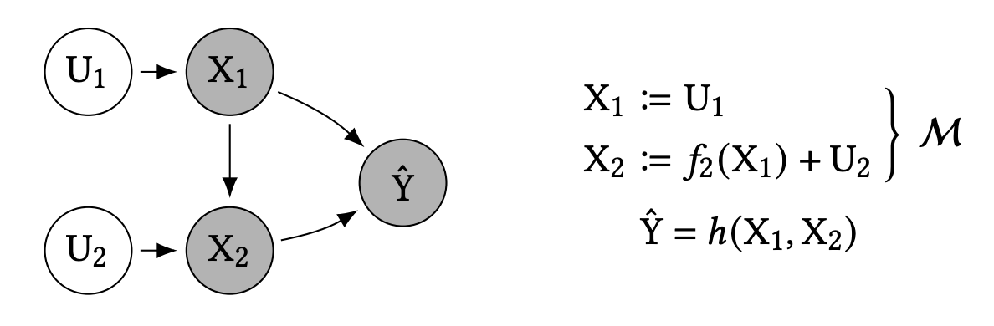
Experimental Setup: Synthetic Setting
annual salary
U₁ ~ $10000 ⋅ Poisson(10), U₂ ~ $2500 ⋅ N(0,1)
X₂ := 3/10 ⋅ X₁ + U₂
eligibility to receive loan
h = sgn(X₁ + 5 ⋅ X₂ – $225000)
bank balance
Casual Generative Process

Slide 21
Experimental Results: Synthetic Setting
[annual salary, bank balance]
x^{F} |  | [$75000, $25000]^{T}
Karimi et al.’s formulation | A* | do(X₁ := x₁^{F} + $10000)
 | x*^{SCF} | [$85000, $28000]^{T}
Prior formulation | 𝛿* | [$0, +$5000]^{T}
 | x*^{CFE} | [$75000, $30000]^{T}

Slide 22
Experimental Results: Synthetic Setting
x*^{SCF} further dist from x^{F} than x*^{CFE}
BUT
cost(𝛿*; x^{F}) ≈ 2 cost(A*; x^{F})
[annual salary, bank balance]
x^{F} |  | [$75000, $25000]^{T}
Karimi et al.’s formulation | x*^{SCF} | [$85000, $28000]^{T}
Prior formulation | x*^{CFE} | [$75000, $30000]^{T}

Slide 23
Experimental Setup
Synthetic setting:
Generate data following causal generative process
Real-world setting:
Use existing German credit dataset to learn structural causal model equations, by fitting a linear regression
Cost for both is ℓ₁ norm over normalized feature change

Slide 24
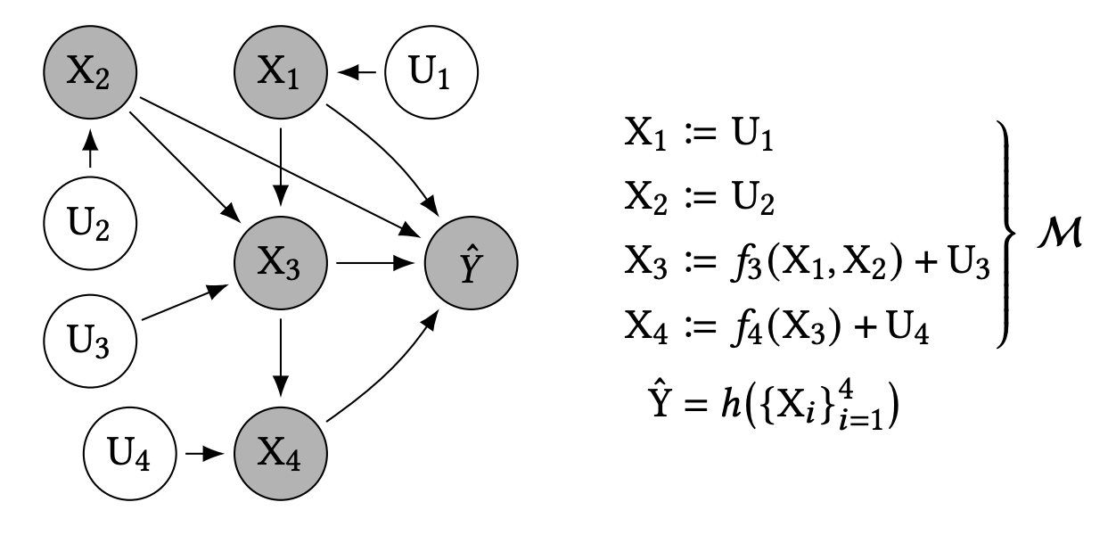
Experimental Setup: Real-World Setting
age (actionable, only increases)
gender (immutable)
credit given by bank (non-actionable)
customer risk
h can be logistic regression or decision tree
repayment duration of credit (non-actionable, mutable)
Structural Causal Model

Slide 25
Experimental Results: Real-World Setting
[gender, age, credit given, credit repayment duration]
x^{F} |  | [Male, 32, $1938, 24]^{T}
Karimi et al.’s formulation | A* | do({X₂ := x₂^{F} + 1, X₃ := x₃^{F} – $800})
 | x*^{SCF} | [Male, 33, $1138, 22]^{T}
Prior formulation | 𝛿* | [N/A, +6, $0, 0]^{T}
 | x*^{CFE} | [Male, 38, $1938, 24]^{T}

Slide 26
Experimental Results: Real-World Setting
42% decrease in cost using Karimi et al.’s formulation
Averaged over 50 test individuals, 39 ± 24% and 65 ± 8% decrease in cost, for h as logistic regression and decision tree, respectively
[gender, age, credit given, credit repayment duration]
x^{F} |  | [Male, 32, $1938, 24]^{T}
Karimi et al.’s formulation | x*^{SCF} | [Male, 33, $1138, 22]^{T}
Prior formulation | x*^{CFE} | [Male, 38, $1938, 24]^{T}

Slide 27
Future Work: Extended Kinds of Interventions

Slide 28
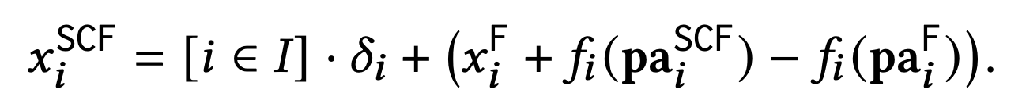
Future Work: Extended Kinds of Interventions
Forms
Structural/hard (actions in Karimi et al.): unconditionally sever all edges incident on intervened node
Additive/soft: do not sever incident edges

Slide 29
Future Work: Extended Kinds of Interventions
Forms
Structural/hard (actions in Karimi et al.): unconditionally sever all edges incident on intervened node
Additive/soft: do not sever incident edges
Feasibility
Can encode as constraints to amend to A ∈ F
Immutable: closed under ancestral relationships; [i ∉ I] = 1 recursively necessitates fulfillment of [j ∉ I] = 1 for all j ∈ pa_{i}
Mutable but non-actionable: [i ∉ I] = 1 is sufficient
Actionable and mutable: contingent on (a) pre-intervention value of variable (b) pre-intervention value of other variables (c) post-intervention value of variable (d) post-intervention value of other variables

Slide 30
Future Work: Extended Kinds of Interventions
Forms
Structural/hard (actions in Karimi et al.): unconditionally sever all edges incident on intervened node
Additive/soft: do not sever incident edges
Scopes
Karimi et al. assumes action = intervention on endogenous variable
Fat-hand/non-atomic: confounded/correlated interventions
Feasibility
Can encode as constraints to amend to A ∈ F
Immutable: closed under ancestral relationships; [i ∉ I] = 1 recursively necessitates fulfillment of [j ∉ I] = 1 for all j ∈ pa_{i}
Mutable but non-actionable: [i ∉ I] = 1 is sufficient
Actionable and mutable: contingent on (a) pre-intervention value of variable (b) pre-intervention value of other variables (c) post-intervention value of variable (d) post-intervention value of other variables

Slide 31
Future Work: Current Limitations
Reliance on true causal model of the world

Slide 32
Future Work: Current Limitations
Reliance on true causal model of the world
True for any approach suggesting actions to be performed in the real world?

Slide 33
Future Work: Current Limitations
Reliance on true causal model of the world
True for any approach suggesting actions to be performed in the real world?
Study potential inefficiencies from partial/imperfect causal model

Slide 34
Concluding Thoughts
Overall an interesting work bridging counterfactual explanations (previous week’s papers) and algorithmic recourse (next week’s papers), clarifying their differences
Tradeoff between generalizability of setting and hardness of optimization problem
Ustun et al. pursue algorithmic recourse in a specific linear setting
Karimi et al. pursue algorithmic recourse in general settings, require true causal model of world
Open question: where do we stand on this tradeoff? Consider the origins of counterfactual explanations in Wachter et al.

Slide 35
Limitations of CFE-Based Recourse: Idea
Feature-wise counterfactual (𝛿* = 𝑥*^{CFE} - 𝑥^{F}) directly translates to action set (A^{CFE}), where if we perform actions in A^{CFE}, we go 𝑥^{F} → 𝑥*^{CFE}
2. 1-1 mapping between dist(ᐧ,ᐧ) and cost(ᐧ,ᐧ): actions involving higher distance (to decision boundary) incur higher cost
Restrictions:
Independent world assumption (sub-optimality)
Breaking dependencies between features (lack of feasibility)
Tradeoff between the two restrictions

