Slide 1

Counterfactual Explanations Without Opening the Black Box
Paper by: Sandra Wachter, Brent Mittelstadt, & Chris Russell
Presented by: Alex, Chelse, & Usha

Slide 2
Outline
Motivation
Summary of contribution
Related work
Preliminaries and background
Approach
Key Results
Experimental
Empirical
Conclusion
Notes:
25 minutes + 5 minutes Q/A
Outline
Motivation
Summary of contribution
Related work
Preliminaries and background [intuition about any underlying concepts]
Approach (intuition first)
Key experimental results
Conclusion

Slide 3
Introduction + Motivation
EU General Data Protection Regulation (2018)
“the toughest privacy and security law in the world”
Article 13-14, regarding automated decision-making: “meaningful information about the logic involved”
Recital 71: “the right to obtain an explanation of the decision reached and to challenge the decision”
4 key problems
Not legally binding
Only applicable in limited cases
Explainability is technically very challenging
Competing interests of data controllers, subjects, etc

Slide 4
Unconditional Counterfactual Explanations
Authors propose
3 aims for explanations
Inform and help the subject understand “why”
Provide grounds to contest decisions
Understand options for recourse
CFEs
Fulfill the above goals
Overcome challenges w.r.t. current interpretability work
Can bridge the gap between interests of data subjects and data controllers
Do you buy this?

Slide 5
Unconditional Counterfactual Explanations
Definition:
A statement of how the world would have to be different for a desirable outcome to occur
Because of features {x₁, x₂}, x’s outcome was label y₁
If x = {x₁ + δ₁, x₂ + δ₂}, then y₂.
Example:
“You were denied a loan because your annual income was $30000. If your income has been $45000, you would have been offered a loan”
Notes:
No one unique CF
Need to consider actionability (mutability of variables)
Providing several diverse CFEs may be more useful than simply the closest/shortest one

Slide 6
Background + Related Work
Historic context of knowledge
Prior explainability work
Adversarial examples/perturbations
Causality/Fairness

Slide 7
Background: Historic Context of Knowledge
In order to know something, it is not enough to simply believe that it is true: rather, you must also have a good reason for believing it
If q were false, S would not believe p
Note:
This statement only describes S’s beliefs, which might not reflect reality
This statement can be made without knowledge of the causal relationship between p and q
Q: who is S? The user? The model? Us?

Slide 8
Background: Previous Explanations in AI/ML
Previously: providing insight into the internal state of an algorithm, human-understandable approximations of the algorithm
Three-way tradeoff between
quality of approximation
ease of understanding the function
size of the domain for which the approximation is valid
CFEs:
Minimal amount of information
Require no understanding of internal logic of model
No approximation (although might not always be minimum length)
Con: May be overly restrictive

Slide 9
Background: Adversarial Perturbations
Small changes to a given image can result in the image being assigned to a different class
Very similar to CFEs but the changes aren’t necessarily sparse
Often not human perceptible
Authors propose that this is because the new images lie outside the “real-image” manifold
Emphasize the importance of solutions/CFEs being possible as well as close
Further research into structure of high-D data is structured before CFEs can be useful/reliable in those domains

Slide 10
Background: Causality and Fairness
Can provide evidence that models/decisions are affected by protected attributes
If CFEs change one’s race, the treatment of that individual is dependent on race
Is the converse true?

Slide 11
Summary of Contributions
Highlights the difficulties with conveying the inner workings of modern ML algorithms to users
Complexity
Lack of utility (except for “builders”)
Introduces an algorithmic approach to counterfactuals
Rooted in adversarial machine learning
Connects counterfactuals to the GDPR
Demonstrates advantages over other interpretability methods from a policy perspective

Slide 12
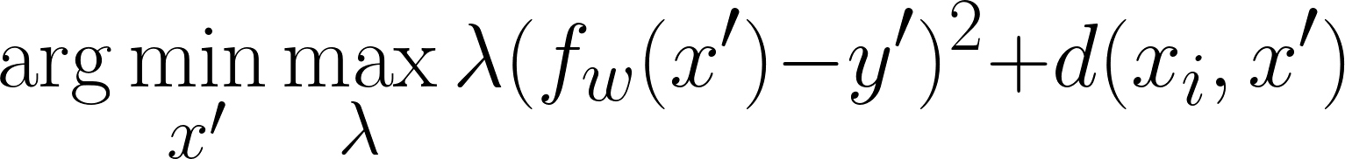
Approach: Counterfactual Optimization
Minimize:
Squared error with desired (counterfactual) label
Distance to perturbed point
While maximizing weight on squared error term
We want to have the prediction change more than we want the point to be close
Iteratively: solve for x’, then maximize lambda
Settings:
Tabular Data
Regression
Notes:
Optimized with ADAM

Slide 13
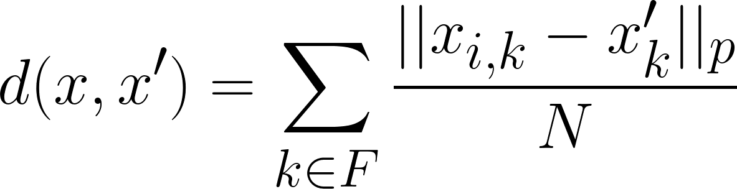
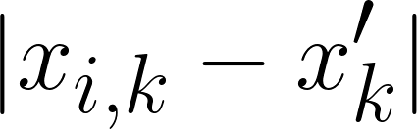
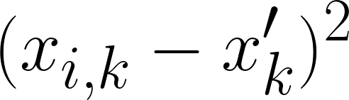
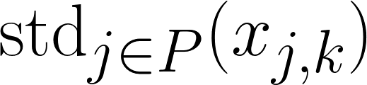
Approach: Distance Metrics
Norms
Normalizing Factors
Notes:
Norms: L1 > sparsity > interpretability
L2 > classic
Factors: MAD > robust to outliers
STD > standardizes over features of differents scale (hopefully MAD does this to a similar extent)

Slide 14
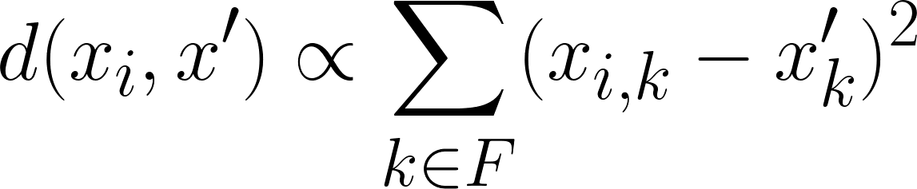
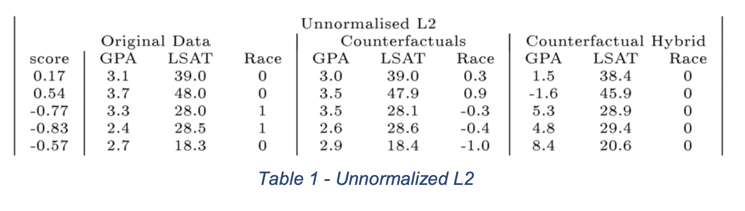
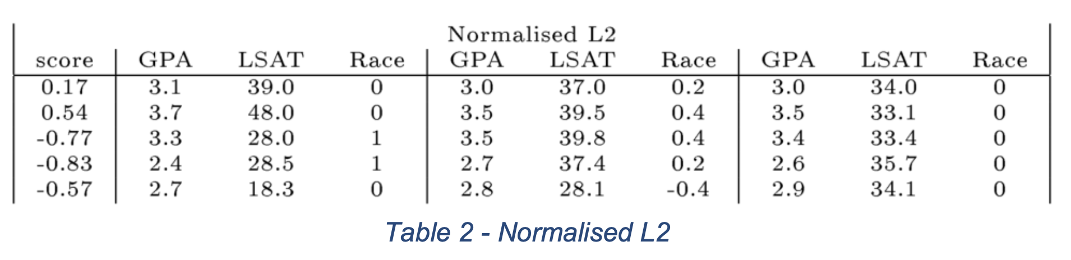
Experimental Results: LSAT

Slide 15
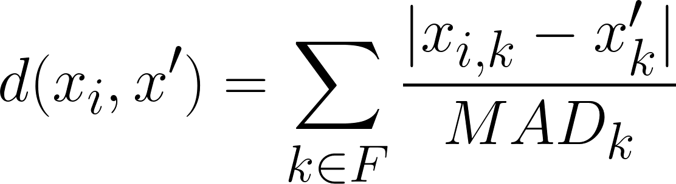
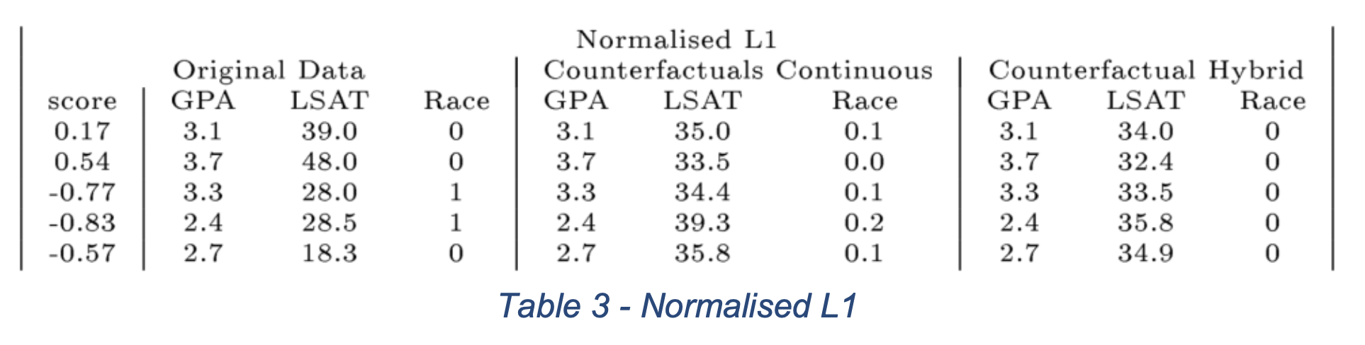
Experimental Results: LSAT

Slide 16
Experimental Results: Discussion
Realistic (or achievable) counterfactual values
Clipping and Clamping
Counterfactual Targets
LSAT: Avg. Grade 0
Students would want to know how to improve their average grade
PIMA: Risk Score of 0.5
Patients would want to know how to achieve a lower risk score
Notes:
This is a set of talking points or critiques about design choices. First, they have to clamp discrete or clip continuous variables to realistic values (ie keep race to either 0 or 1, or limit GPA between 0 and 4). This is where I was going to ask the class if they had any thoughts, its pretty cool and makes sense but also could have some downsides.
Next, I was going to point out the fact that instead of counterfactuals of say, targeting a really high Law School grade or a really low risk score, the counterfactuals are just trying to get users towards the middle. Esp for PIMA risk, why not look at results for patients wanting to lower their risk score much below 0.5, which would be more realistic?

Slide 17
Explanations and The GDPR
GDPR Requirements: Recital 71
Implement suitable safeguards against automated decision-making
Include specific information to the data subject and the right to obtain human intervention
To express their point of view
To challenge the decision
To obtain an explanation of the decision reached after such assessment
Does not require opening the “black box” to explain the internal logic of decision-making systems
Does not explicitly define requirements for explanations of automated decision-making

Slide 18
Counterfactual Explanations and The GDPR
Legislators wanted to clarify that some type of explanation can voluntarily be offered after a decision has been made
Many aims for explanations are feasible
Emphasis of GDPR is on protections and rights for individuals

Slide 19
Advantages of Counterfactual Explanations
Bypass explaining the internal workings of complex machine learning system
Simple to compute and convey
Provide information that is both easily digestible and practically useful
Understanding the reasons for a decision
Contesting decisions
Altering future behaviour to receive a preferred outcome
Possible mechanism to meet the explicit requirements and background aims of the GDPR

Slide 20
Broader Possibilities with the Right of Access
Explanations to understand decisions
Art 15.
Confirm whether or not personal data used
Provide information available after a decision has been made
Avoid disclosing personal data of other data subjects
Balance interest of the subject and controller
Potential to contravene trade secrets or intellectual property rights

Slide 21
Broader Possibilities with the Right of Access
Explanations to understand decisions
Counterfactuals
Data of other data subjects or detailed information about the algorithm does not needs to be disclosed
Disclose only the influence of select external facts and variables on a specific decision
Less likely to infringe on trade secrets or privacy

Slide 22
Understanding Through Counterfactuals
Explanations to understand decisions
Art 12(1)
Requires information to be conveyed in a “concise, transparent, intelligible and easily accessible form”
CFEs align with this requirement by providing simple “if-then” statements
CFEs provide greater insight into the data subject’s personal situation as opposed to an overview tailored to a general audience
Minimally burdensome and disruptive technique to understand the rationale of specific decisions

Slide 23
Legal Information Gaps on Contesting Decisions
Art. 16
Data subject has the right to correct inaccurate data used to make a decision, but does not need to be informed of which data the decision depended
Art. 22
Data subjects do not need to be informed of their right not to be subject to an automated decision

Slide 24
Contesting Through Counterfactuals
Lead to greater protection for the data subject than currently envisioned by the GDPR
Align with Article 29 Working Party
Understanding decisions + knowing legal basis is essential for contesting decisions
Reduce burden on data subject
Understand most influential data (instead of vetting all collected data)
Compact way to convey dependencies

Slide 25
Explanations to Alter Future Decisions
GDPR
Explanations not explicitly mentioned as a guide to altering behavior to receive a desired automated decision
Article 29 Working Party
Provide suggestions on how to improve habits and receive better outcome
Counterfactual explanations
Can address the impact of changes to more than one variable on a model’s output at the same time
Can be used in a contractual agreement between data controllers and data subjects

Slide 26
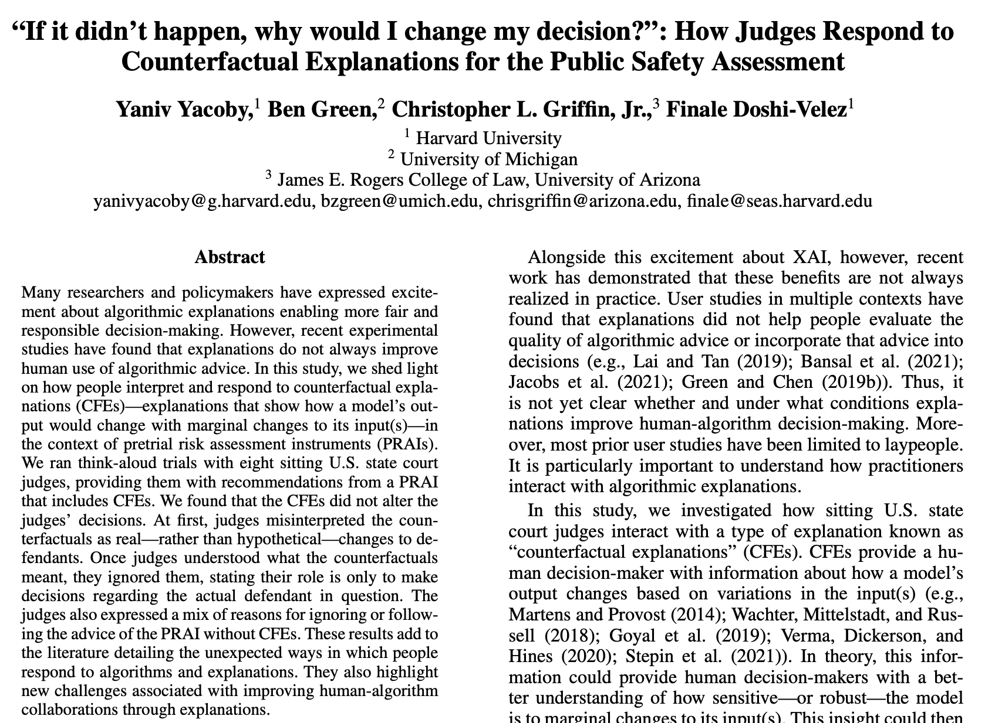
Discussion
Who do these explanations serve?
Developers, Data subjects, and Lawmakers
Do you think they are misinterpreted?
Causality
Optimizing for sparsity may not reflect reality
Priors and desired outcomes
Notes:
How Judges Respond to CFE: https://arxiv.org/pdf/2205.05424.pdf

