Slide 1
Probabilistically Robust Recourse:
Navigating the Tradeoffs Between Costs and Robustness in Algorithmic Recourse
Authors: Martin Pawelczyk, Teresa Datta, Johannes van-den-Heuvel, Gjergji Kasneci, Himabindu Lakkaraju (2022)
Presentation: Dan Ley, Tessa Han, Yasha Ektefaie

Slide 2
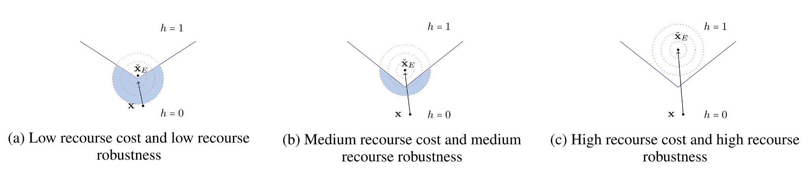
Motivation
Algorithmic recourse aims to provide users with actionable changes to move from a negative to a positive prediction in a machine learning (ML) model
Typically, the minimum cost change is computed
In the real-world, these changes are often implemented noisily
E.g. an individual who was asked to increase their salary by $500 may get a promotion which comes with a raise of $505 or even $499.95
Or, as seen on Monday, changing certain factors may cause others to change
Notes:
W

Slide 3
Related Work
Counterfactual Explanations and Recourse
A plethora of papers including Wachter et al. (2018)
Summarised in Verma et al. (2020)
Type of the underlying predictive model (e.g. tree based vs. differentiable classifier)
Whether they encourage sparsity in counterfactuals (i.e. a small number of features)
Whether counterfactuals should lie on the data manifold
Whether the underlying causal relationships should be accounted for when generating counterfactuals
Robustness to model/data shift:
ROAR - Robust Algorithmic Recourse, Upadhyay et al. (2021)
Robustness to input perturbations:
Causal Algorithmic Recourse, Dominguez-Olmedo et al. (2022)
All approaches generate recourses assuming that the prescribed recourses will be correctly implemented by users

Slide 4
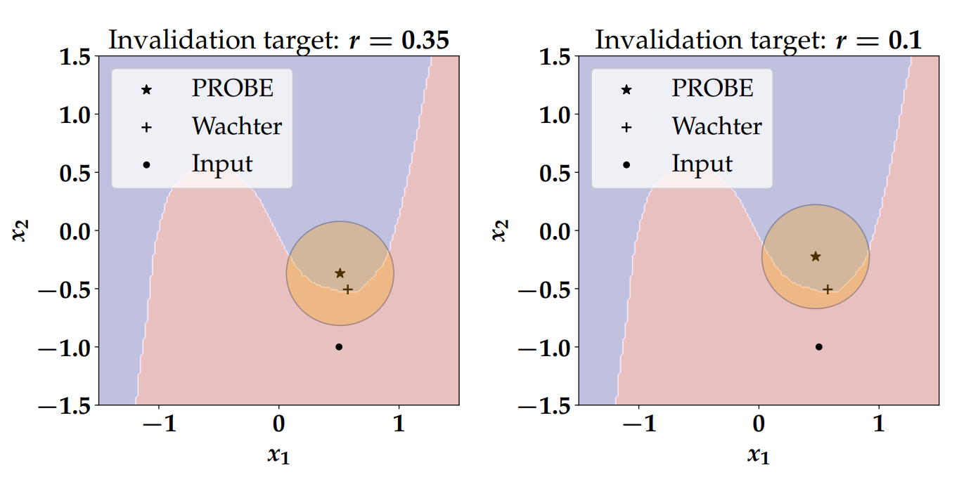
Solution
PROBE - Probabilistically Robust Recourse
Allows users to manage the recourse cost vs. robustness trade-offs
Users can choose the recourse invalidation rate
Probability with which a recourse could get invalidated
Baselines include:
Upadhyay et al. (2021) - ROAR, targeting recourses that are robust to model changes
Dominguez-Olmedo et al. (2022) - targeting recourses that are robust to input changes
PROBE recourses are, compared to the baselines:
Less costly than previous methods
More robust to noisy implementations
Able to provide recourses at various invalidation rates

Slide 5






Notation
input space
output space
0: unfavourable outcome
1: favourable outcome
classifier
inputs → logits
logits → binary labels

Slide 6
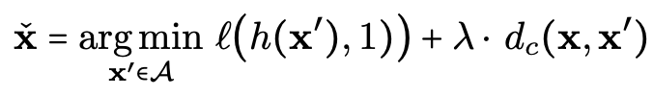
General formulation of algorithmic recourse
make CF have favourable outcome
low cost
Accounts for CF having favourable outcome and low cost
Does not account for potential noise in the implemented counterfactual
Addressed by this paper

Slide 7
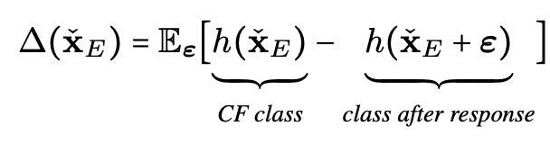




Recourse invalidation rate
where
→ probability distribution that captures noise in response
e.g.

Slide 8
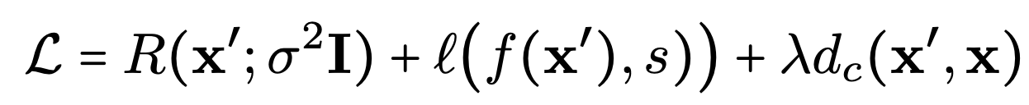
Recourse invalidation rate aware objective function
make IR of CF close to target IR
(new term)
make CF have favourable outcome
(seen before)
low cost
(seen before)
where
CF’s IR
target IR

Slide 9

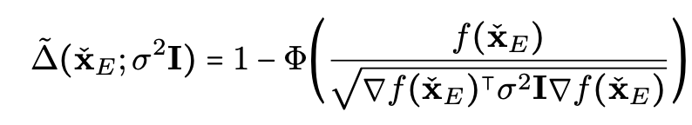


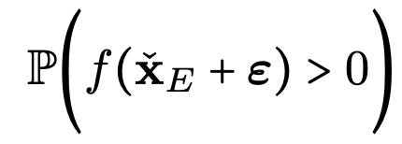
Approximation of recourse invalidation rate (Theorem 1)
Problem: is not differentiable (used in objective function)
Solution: use a first order approximation of
where
: counterfactual
: logit at counterfactual
Proof sketch:
1. solve
2. Use first order Taylor series to approximate logit
3. Calculate probability that normal r.v. is less than a value → CDF

Slide 10
Approximation of recourse invalidation rate (Theorem 1): further analyses
Proposition 1 — Wachter et al. (2018) method for logistic regression
Derive closed form solution for IR of CF
Show how to make CF more robust
Proposition 2 — PROBE recourse incurs an additional cost (linear regression)
Proposition 3 — Upperbound on IR

Slide 11
Experimental Evaluation: Datasets considered
Adult Dataset: Predict whether an individual has an income greater than 50,000 USD/year
Give Me Some Credit: Predict whether an individual will experience financial distress within the next two years or not
COMPAS: Predict if criminal is high or low risk of re-offending

Slide 12
Experimental Evaluations: Baselines considered
Baseline Methods
Growing Spheres (GS)
Random search algorithm: generate observations until decision boundary is crossed then move greedily toward decision boundary
AR (-LIME) Local interpretable model-agnostic explanations (LIME)
Actional Recourse in Linear Models (AR) → use integer programming
Diverse Counterfactual Explanations (DICE)
Promote diversity of counterfactual explanations
Gradient
General formulation of algorithmic recourse
Adversarial Minmax Objectives Methods
Robust Algorithm Recourse (ROAR)
Recourse robust to model changes by generating counterfactuals that minimize worst-case loss over plausible model shifts
Adversarial Robustness of Casual Algorithmic Recourse (ARAR)
Recourse robust to features of individual (in the time individual seeks implement recourse other features may change)

Slide 13
Experimental Evaluation: Measures Used
Average Cost (AC): Average cost for all prescribed recourses for the test set (implemented as l1-norm)
Recourse Accuracy (RA): For all prescribed recourses what fraction results in the desired prediction
Average IR (AIR): Average recourse invalidation rate for all prescribed recourses in test set

Slide 14
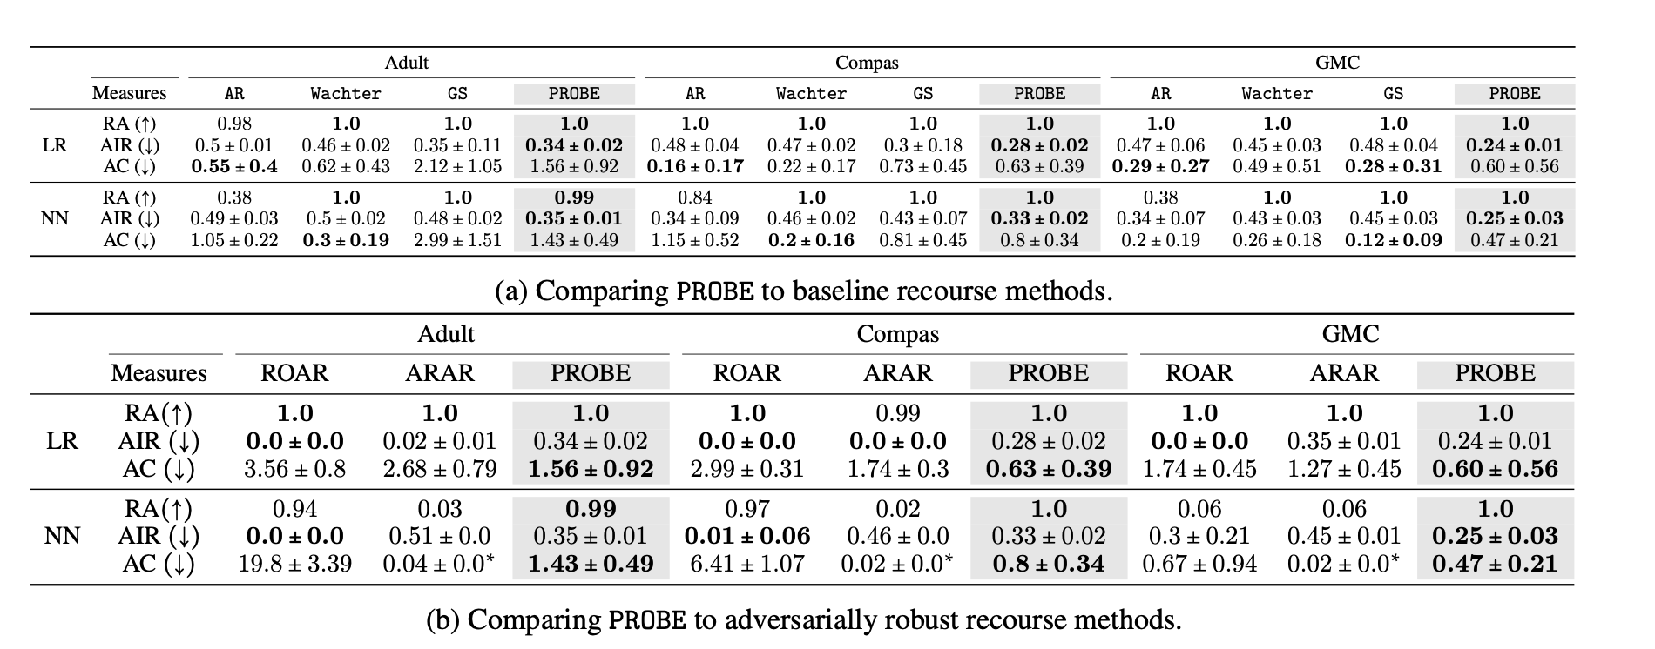
Experimental Evaluation: Results

Slide 15
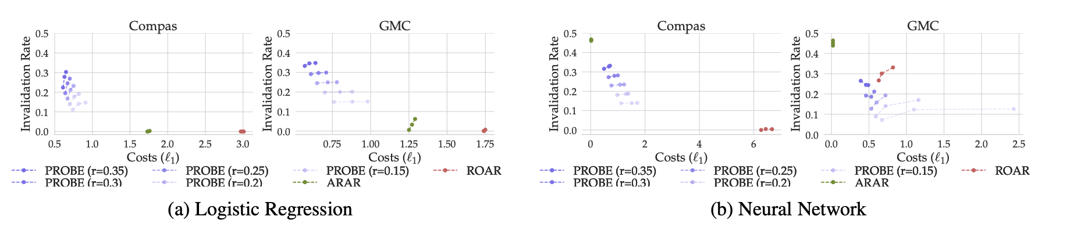
Experimental Evaluation: Results

Slide 16
Conclusions, Future work
First work to navigate tradeoff between recourse cost and robustness, give control to the user
Experimental evidence demonstrates usefulness of framework and the existence of tradeoff
Future work: generate recourse that is simultaneously robust to noise in inputs and shifts in model parameters

Slide 17
Discussions/Limitations
“Generate recourse that is simultaneously robust to noise in inputs and shifts in model parameters”
Is there not a tradeoff still? Would the user have to provide different robustness thresholds for the different aspects the method is robust with respect to? Or is there one threshold to rule them all?
Would users be okay with this risk of defining r% invalidation? Bias? How does recourse relate to bias?
In general this idea of cost being described as l1 distance across methods seems to be a major limitation. Not all features incur similar contributions to cost (i.e. getting a degree versus putting more money into your savings account, one is harder than the other). Cost is a difficult concept to quantify.

