Slide 1
Towards Robust and Reliable Algorithmic Recourse
Sohini Upadhyay, Shalmali Joshi, Hima!

Slide 2
Motivation
Algorithmic Recourse
ML models are deployed in high stakes scenarios
If you receive an unfavorable outcome as a result of a prediction, how can you reverse it?
Ex: A bank might tell you to increase your salary by $10,000
Model Updates
In practice, data collectors are (hopefully) frequently updating their datasets
Models are updated to reflect dataset changes
Current algorithms to generate counterfactuals assume models are static

Slide 3
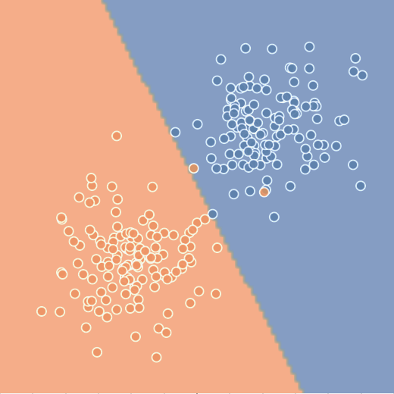
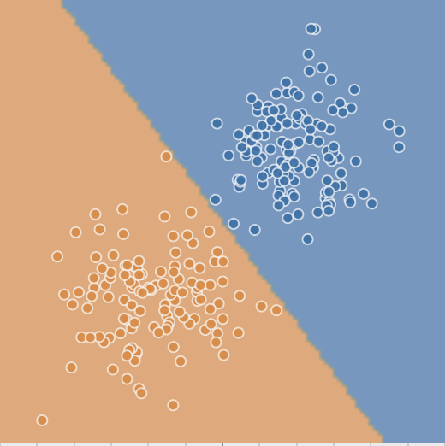

Motivation: An Example
Model trained on data₁
Overlaid
Original suggested recourse for the datapoint no longer crosses the decision boundary when the model is updated/retrained
Model trained on data₂

Slide 4
Summary of Contributions
Outline model + data shifts that people should consider
Temporal shift
Geospatial shift
Data correction shift
Propose a method for finding RObust Algorithmic Recourse (ROAR)
Introduces a novel minimax objective that can be used to construct robust actionable recourses while minimizing the recourse costs
Theoretical analysis
How bad are regular counterfactuals under model shifts?
How much does the proposed method increase the cost of recourses when compared to normal CFs?
Experimental analysis

Slide 5
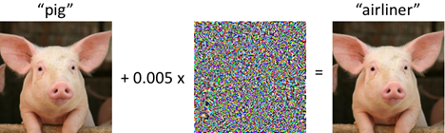
Related work
Algorithmic recourse
[Can i still trust you?: Understanding the impact of distribution shifts on algorithmic recourses]: recourses generated by state-of-the-art algorithms are readily invalidated due to model shifts resulting from different kinds of dataset shifts
Adversarial Training
Optimizes a minimax objective that captures the worst-case loss over a given set of perturbations to the input data
At each gradient step, computes the gradient at worst-case perturbation
Recent work explores the construction of other kinds of explanations (feature attribution and rule based explanations) that are robust to dataset shifts

Slide 6
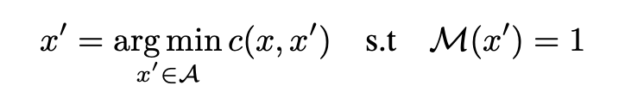
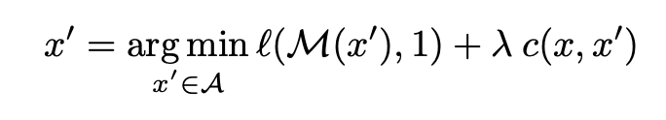
Background: Recourse/Counterfactuals
Optimal CF:
Notation Notes:
x: specific data point
x’: counterfactual
M: model (or linear approximation of model around point x)
C: cost function (how hard is it to achieve the counterfactual)
A: actionable/possible counterfactuals
Unconstrained and differentiable relaxation:

Slide 7
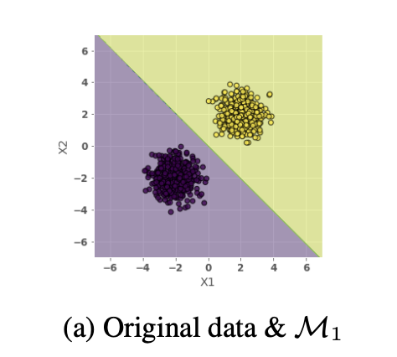
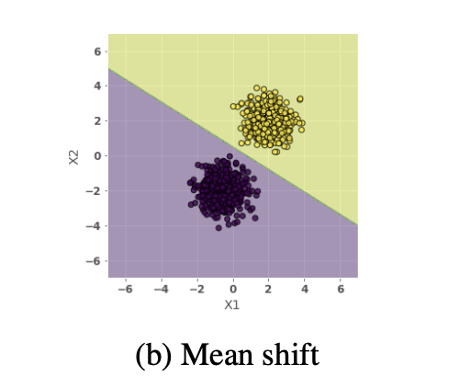
A Primer?
Model₁ parameters
How to compare these models?
(especially if they are nonlinear and high-dimensional)
Model₂ parameters

Slide 8
Approach (Intuition)
Adversarial Training
Perturb inputs slightly (maximize training loss)
Gradient descent step on perturbed inputs (minimize training loss)
Robust Actional Recourse (ROAR)
Perturb model slightly (maximize recourse loss)
Gradient descent step on perturbed model (minimize recourse loss)

Slide 9
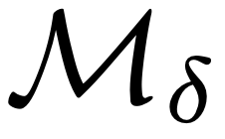
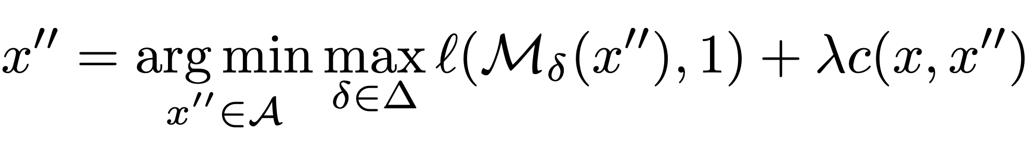
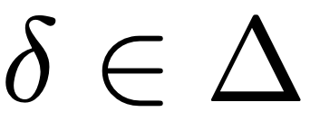
Approach (Intuition)

Slide 10
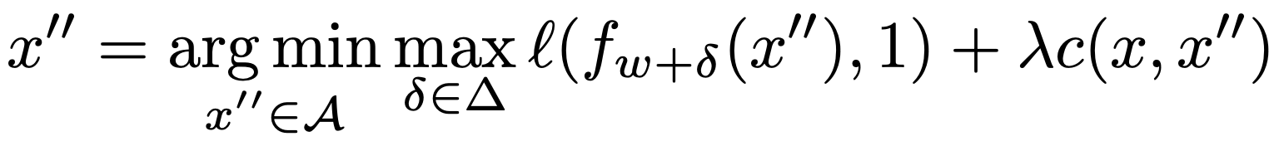
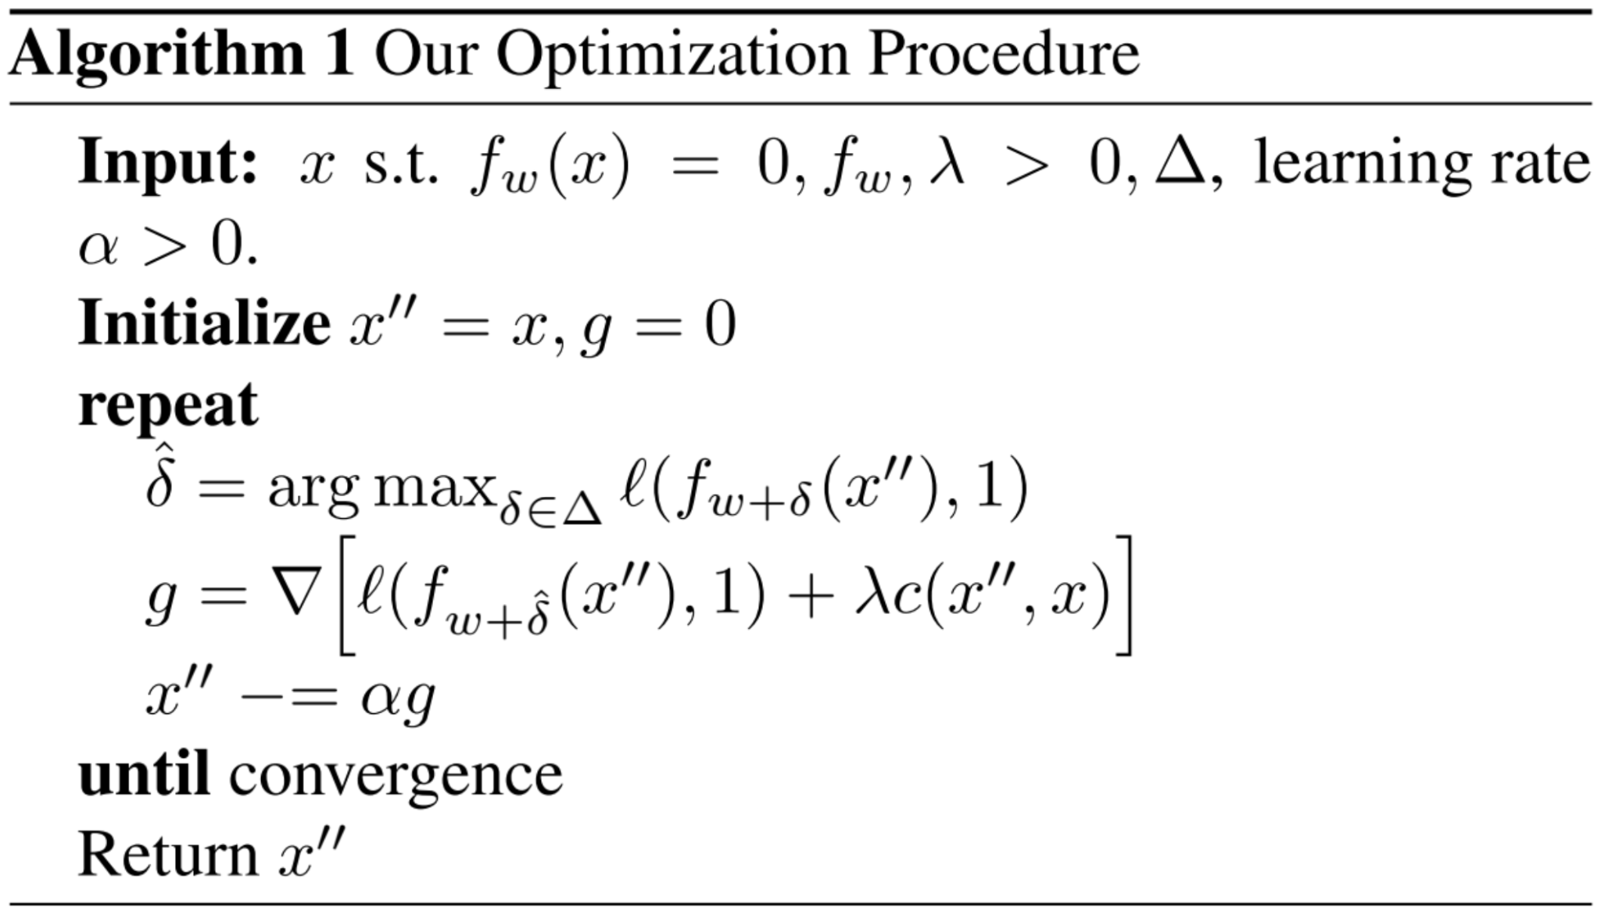
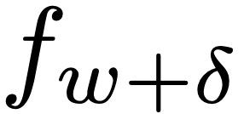
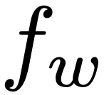
Approach (Details)
Notes:
Talk through lime approximation

Slide 11
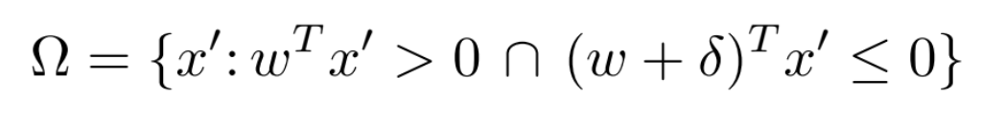

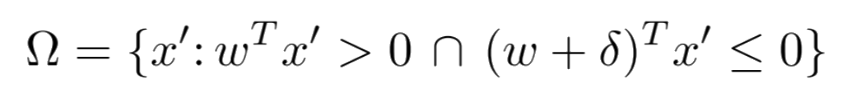
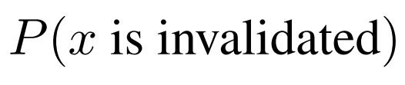
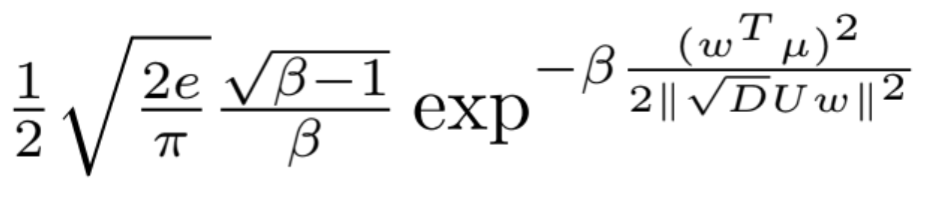
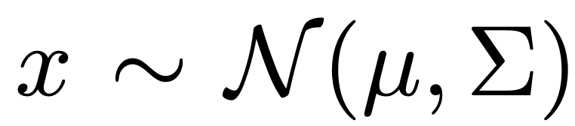
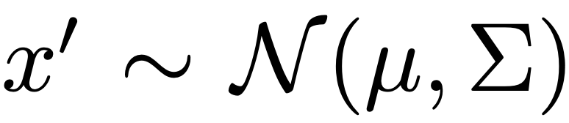
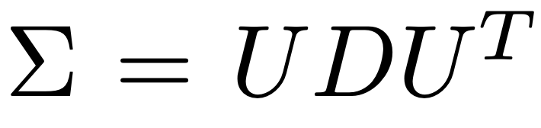
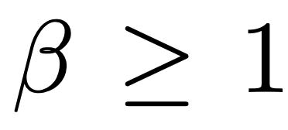
Proofs
Theorem 1
…
Assumptions

Slide 12
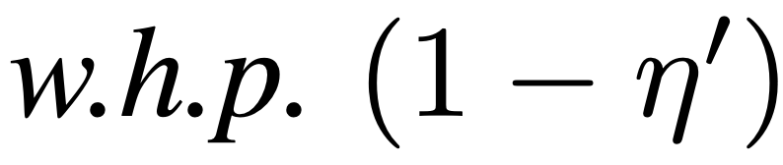
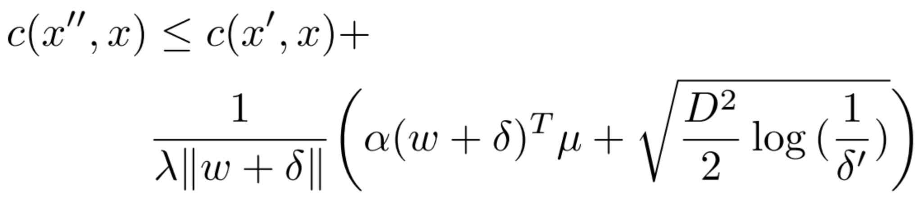
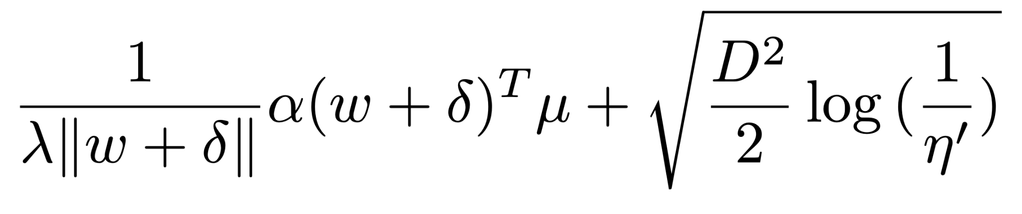
Proofs
Theorem 2
Assumptions
Log-loss + simple model
Optimal solution for x’’
D is a bound for the “diameter” of dataset (l2)

Slide 13
Experimental results
Real World Datasets
German Credit
Data Correction Shift
Small Business Administration
Temporal Shifts
Portuguese Student Performance
Geospatial Shift
Models
LR
SVM
3 Layer Deep NN
Cost (Distance) Functions
L1
Pairwise Feature Comparison (PFC)
Bradley Terry Comparison to parametrize p(i,j) = probability that feature i is less actionable than feature j
Metrics:
Cost
How close is our counterfactual?
Validity
When undertaking recourse, (after a model shift) does it actually work?
Synthetic Datasets
2 Gaussians
Mean Shift
Variance Shift
Mean & Variance Shift

Slide 14
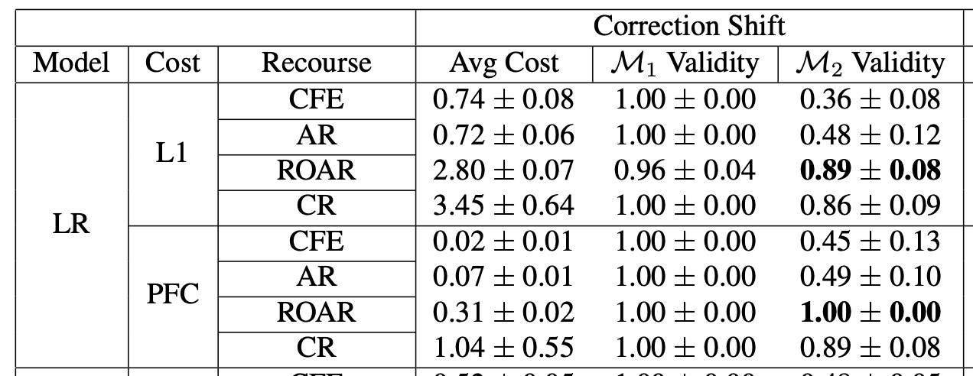
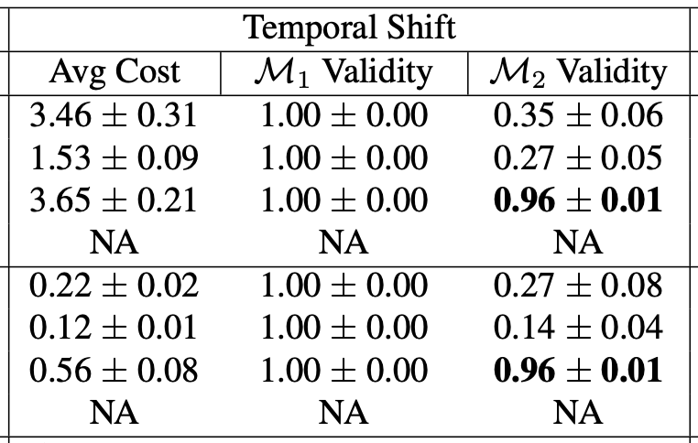
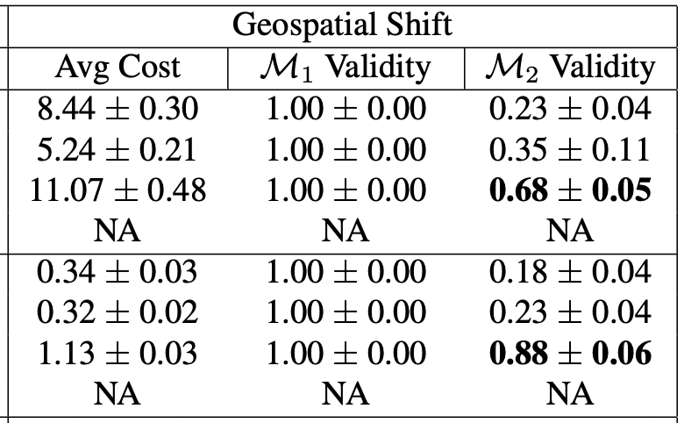
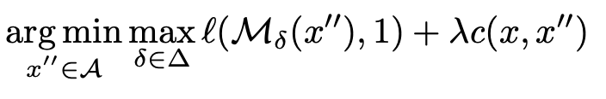
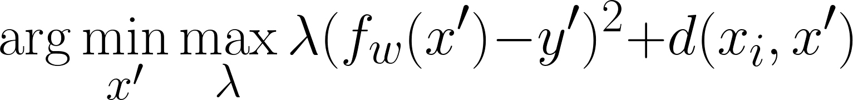
Experimental Results: Logistic Regression
Notes:
CFE: Classic Counterfactual Explanations
AR: Actionable Recourse is a fancy integer programming / constrained optimization approach
CR: Approach using causal networks, only applicable to the first dataset (german credit)

Slide 15
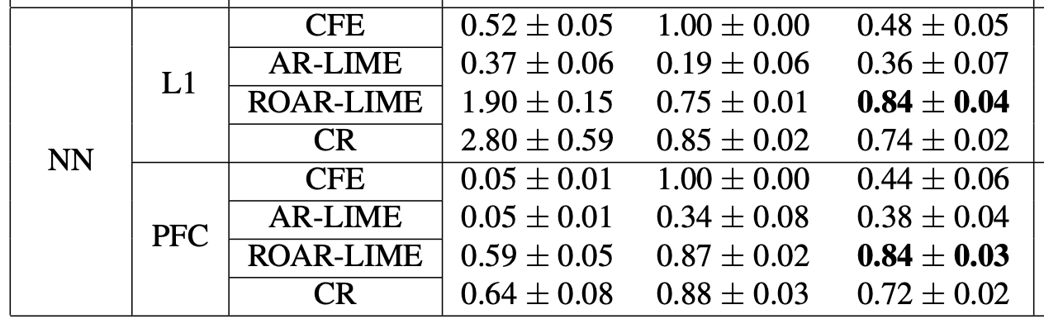
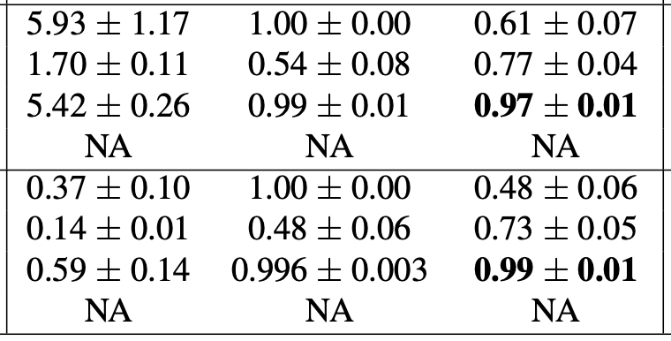
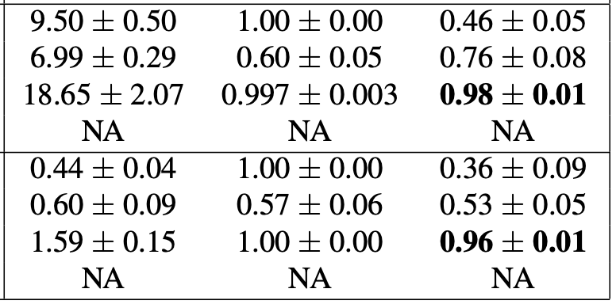
Experimental Results: Deep NN

Slide 16
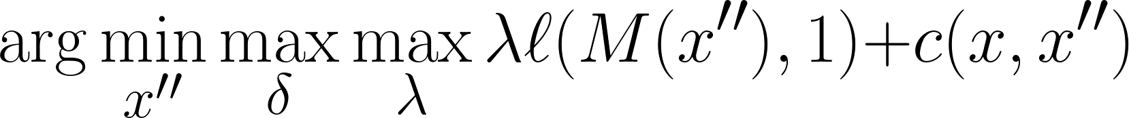
Takeaways
Cost increases with robust recourse in general
The authors bound this!
Linear approximations to complex models harms M1 validity
Robustness can actually helps!
We can optimize for M1 validity by making our loss function more complex

Slide 17
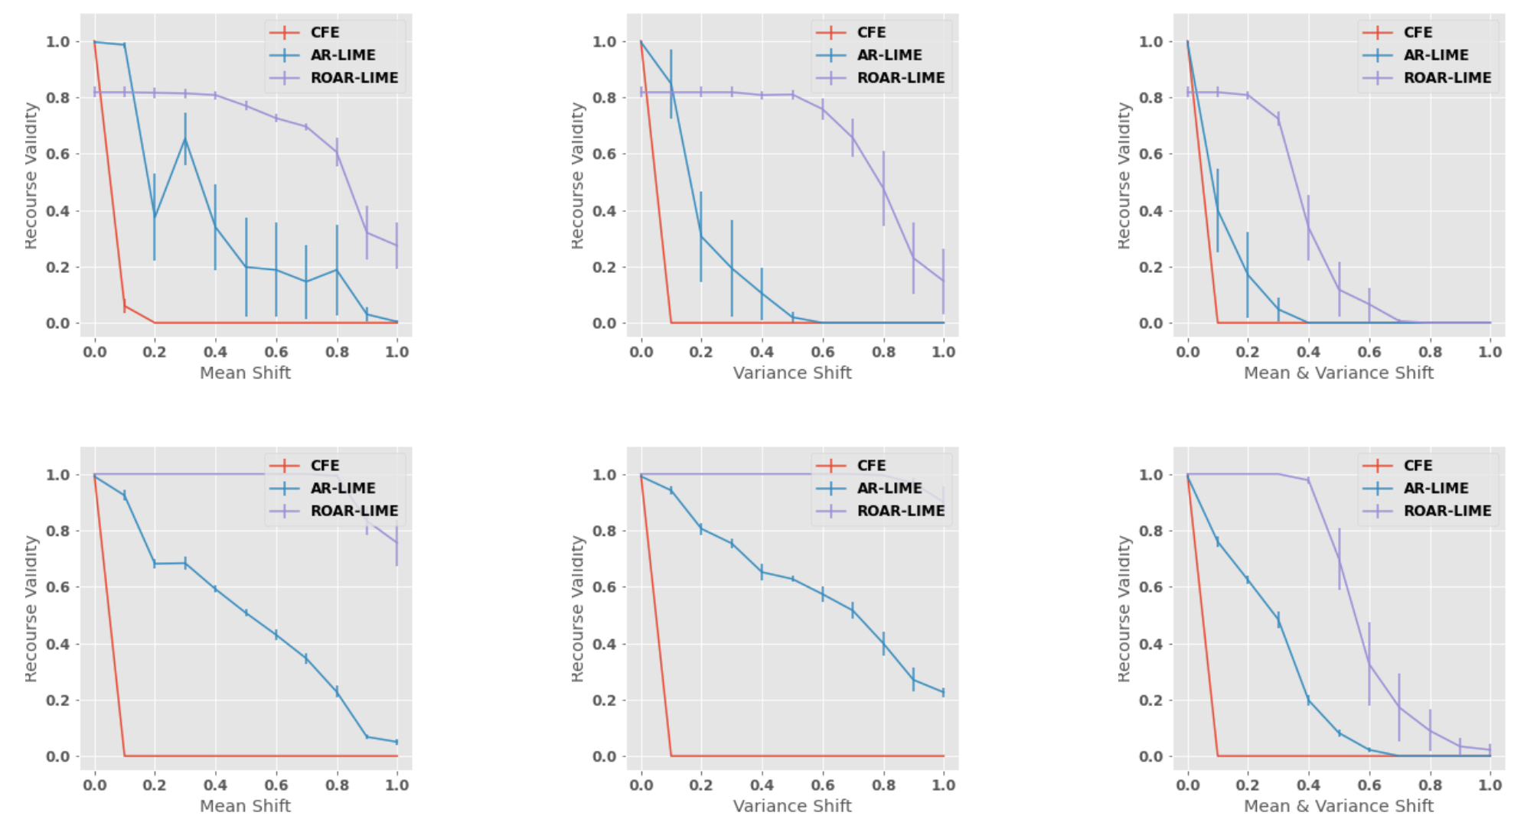
Experimental Results: Shift and Validity
L1:
PFC:
Notes:
Add takeaways to each of these slides

Slide 18
Conclusions
Novel minimax objective and optimization strategy
Bounds on error for non-robust counterfactuals under data shifts
Bounds on cost of robust optimization
Empirical results in both real world and synthetic scenarios validating method

Slide 19
Questions/Discussion
Do you think this problem should be worked on more from the CS/ML side or more from the policy side?
Do you think other types of explanations (that are not recourse motivated) need to be similarly robust?
What happens if model architecture/training dynamics change?
What incentive is there for companies/data controllers to implement this?

