Slide 1
Explainable Prediction of Medical Codes from Clinical Text
Authors: J. Mullenbach, S. Wiegreffe, J. Duke, J. Sun, and J. Eisenstein
Presented by: Leo Benac, Chelse Swoopes, and Kelly Zhang

Slide 2
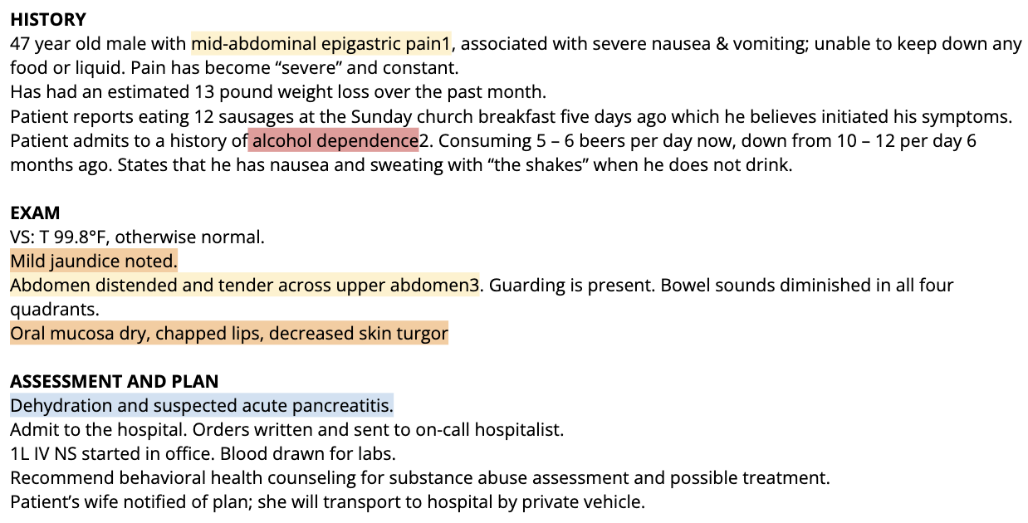
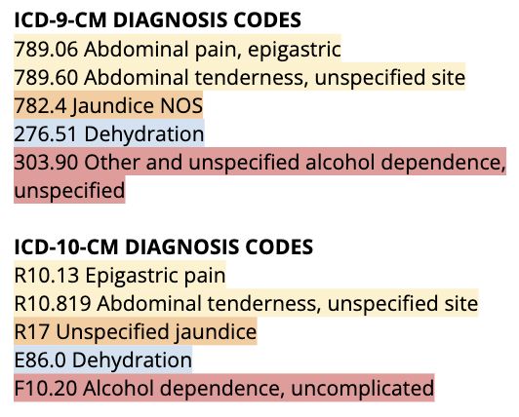
Introduction
Clinical notes
Free text narratives generated by clinicians during patient encounters
International Classification of Diseases (ICD) codes
Metadata codes that accompany clinical notes
Standardized way of indicating diagnoses and procedures
Multiple use cases (billing, predictive modelling)
Scenario reference: https://www.practicefusion.com/icd-10/clinical-concepts-for-family-practice/icd-10-clinical-scenarios/

Slide 3
Motivation
Limitation of ICD code annotation
Labor intensive
Coders read between 720 and 1,440 pages of Clinical Documentation per day²
Prone to error
Lack of connection bridging text and code
Challenges+complexity of automatic coding
Features of clinical text
Irrelevant information, misspellings, non-standard abbreviations, large medical vocabulary
Label space

Slide 4
Summary of Contributions
Convolutional Attention for Multi-Label classification (CAML)
Attentional convolutional network
CNN + per-label attention mechanism
Important information correlated with a code’s presence may be in short snippets anywhere in the document
Decision support setting (clinical demain)
Accuracy Evaluation
Used open-access MIMIC datasets
Outperformed previously proposed approaches
Interpretability Evaluation
Physician rated the informativeness of a set of automatically generated explanations

Slide 5
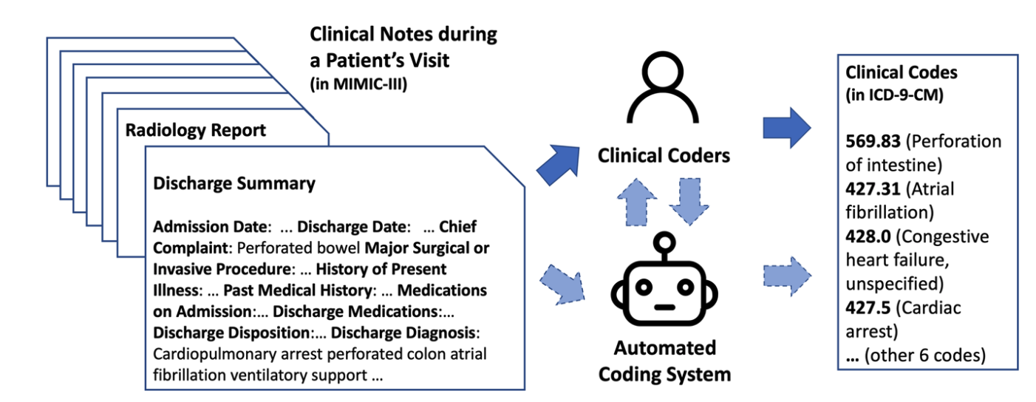
Related Work: Automatic ICD Coding
Structured text v. unstructured text
Datasets
Subset of the full ICD label space (Wang et al., 2016)
Subset of medical scenarios (Zhang et al., 2017)
Death certificates in English + French (Névéol et al., 2017)
Private datasets (Subotin and Davis, 2016)
Approaches
Recurrent networks with HA-GRU to classify ICD9 diagnosis codes (Baumel et al. (2018)
Character-aware LSTMs to generate sentence representations (Shi et al. 2017)
Memory networks to predict top-50 and top-100 Codes (Prakash et al. 2017)
Grounded Recurrent Neural Network to predict the presence of individual labels (Vani et al., 2017)
Image reference: https://www.nature.com/articles/s41746-022-00705-7.pdf
The CAML architecture yields stronger results across all experimental conditions.

Slide 6
Related Work: Explainable Text Classification
Model “rationales” through a latent variable (Lei et al., 2016)
Tag each word as relevant to the document label
Compute salience of individual words (Li et al., 2016)
Use attention to highlight salient features of the text (Rush et al., 2015; Rocktäschel et al., 2016)
Lack interoperability evaluations of features selected by the attention mechanism

Slide 7
Related Work: Attentional Convolution for NLP
CNNs have been applied to tasks such as sentiment classification (Kim, 2014) and language modeling
Convolution and attention
Allamanis et al., 2016, Yin et al., 2016, dos Santos et al., 2016
Yin and Schütze, 2017
Most relevant work (Yang et al. 2016 and Allamanis et al. 2016)
Use context vectors to compute attention over specific locations in the text
Differentiation
Goal is to select locations in a document which are most important for predicting specific labels
Compute separate attention weights for each label in the label space

Slide 8
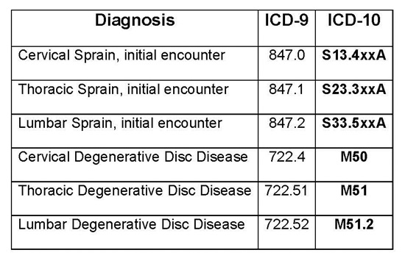
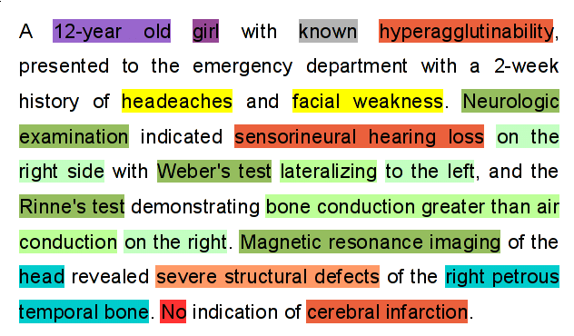

ICD Code Prediction Problem
Clinical Text
ICD Codes
Multi-Label Classification Problem
“Match” snippets of clinical text to a label
Use code descriptions to help make text snippets relevant to the predicted codes (esp. for labels with little data)

Slide 9
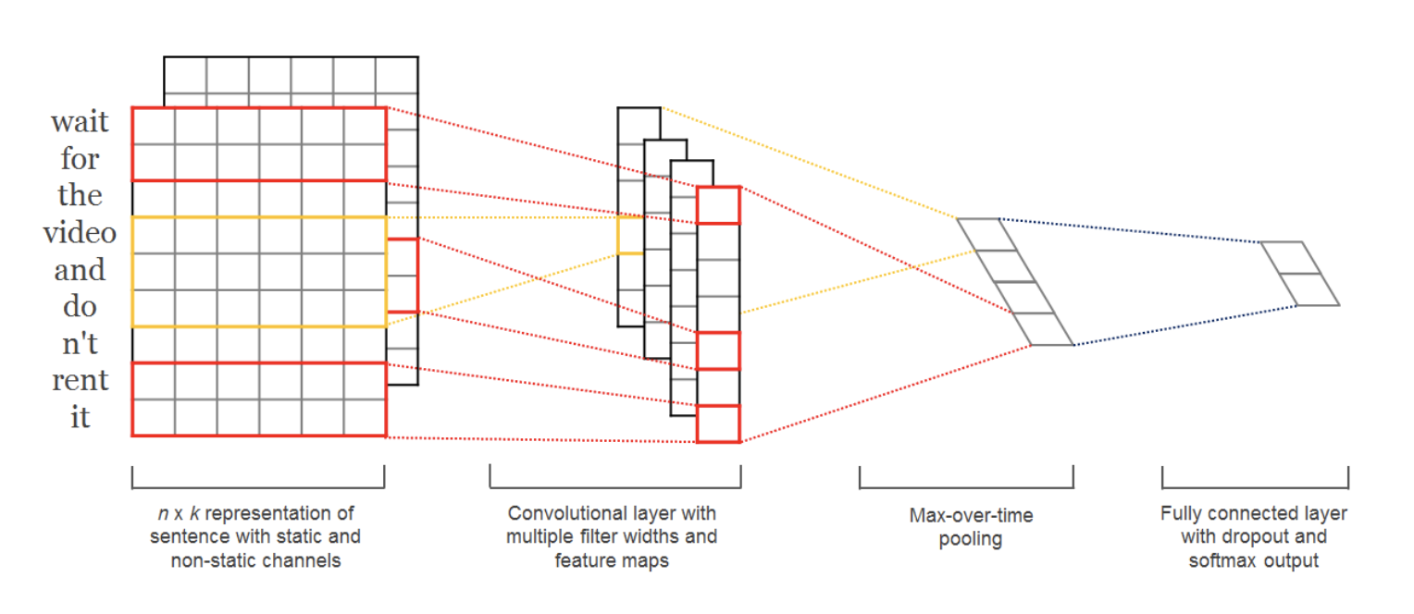
Typical Convolutional N-Gram Model
Word embeddings
Convolutional filter of “N” consecutive words (N-gram)
Each convolutional filter “detects” certain “word snippet” motifs
Image taken from https://people.csail.mit.edu/yoonkim/data/sent-cnn-slides.pdf

Slide 10
Typical Convolutional N-Gram Model
Max pooling → Was the “N-gram” detected at all in this piece of text?
Word embeddings
Convolutional filter of “N” consecutive words (N-gram)
Each convolutional filter “detects” certain “word snippet” motifs
Image taken from https://people.csail.mit.edu/yoonkim/data/sent-cnn-slides.pdf

Slide 11
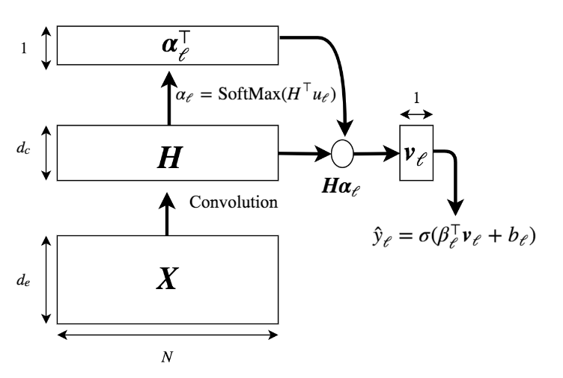
Convolutional Attention Model
N-Gram Embeddings
Text Word Embeddings
Length of Text

Slide 12
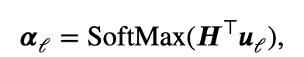

Convolutional Attention Model
Weight representing “match” between n-grams in document (H) and label embedding
N-Gram Embeddings
Text Word Embeddings
Length of Text

Slide 13
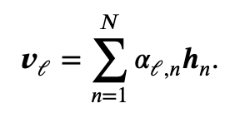
Convolutional Attention Model
Weight representing “match” between n-grams in document (H) and label embedding
N-Gram Embeddings
Text Word Embeddings
N-grams weighted by weights alpha form document vector v
Length of Text

Slide 14
Convolutional Attention Model
Weight representing “match” between n-grams in document (H) and label embedding
N-Gram Embeddings
Text Word Embeddings
N-grams weighted by weights alpha form document vector v
Length of Text

Slide 15
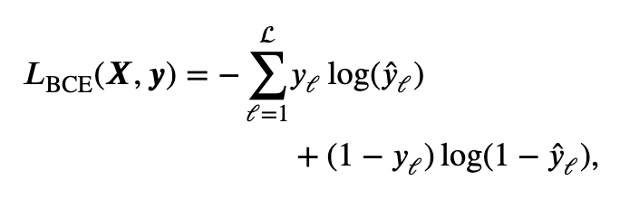
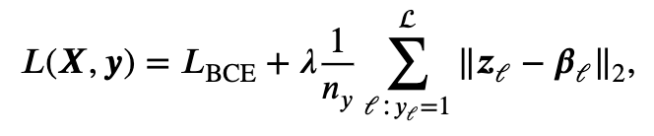
Training Loss Function
Binary Cross-Entropy Loss
Binary classification for each possible label
Regularize to make Labels Representations Close to Code Descriptions

Slide 16
Training Loss Function
Binary Cross-Entropy Loss
Binary classification for each possible label
Regularize to make Labels Representations Close to Code Descriptions
Number of true labels for data example
Representation of label based on code description
Representation of label learned by model

Slide 17
Dataset
MIMIC 3
Input: Sequence of words describing the stay of a patient in the ICU (Max length of 2500 words)
Output: ICD-9 codes describing diagnoses and procedures
9,000 unique ICD-9 codes:
7,000 diagnosis codes and 2,000 treatment codes
Preprocessing (100 dimension embeddings)

Slide 18
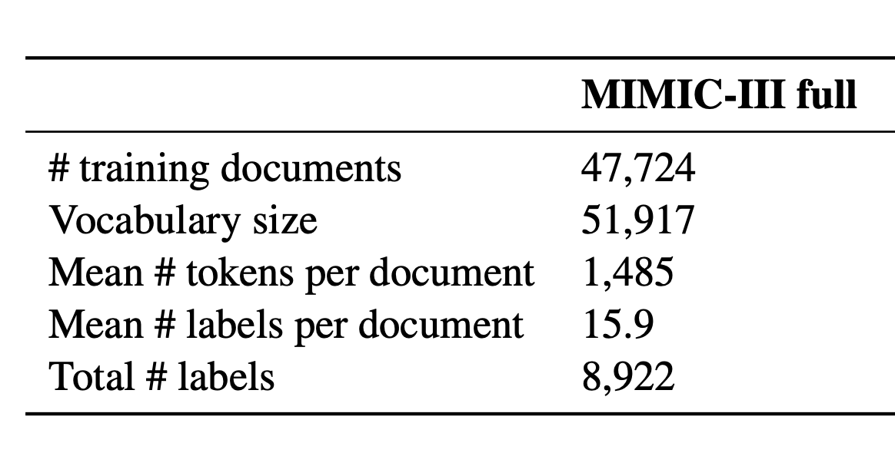

Slide 19
Baselines
Single Layer CNN
Logistic Regression
Bidirectional Gated Recurrent Unit

Slide 20
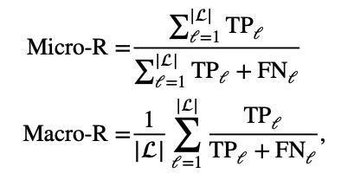
Evaluation Metrics
Micro-averaged and Macro-averaged F1 and AUC
Precision@n
(Most common n labels in the ground truth data)
Notes:
The macro-averaged metrics place much more emphasis on rare label prediction.

Slide 21
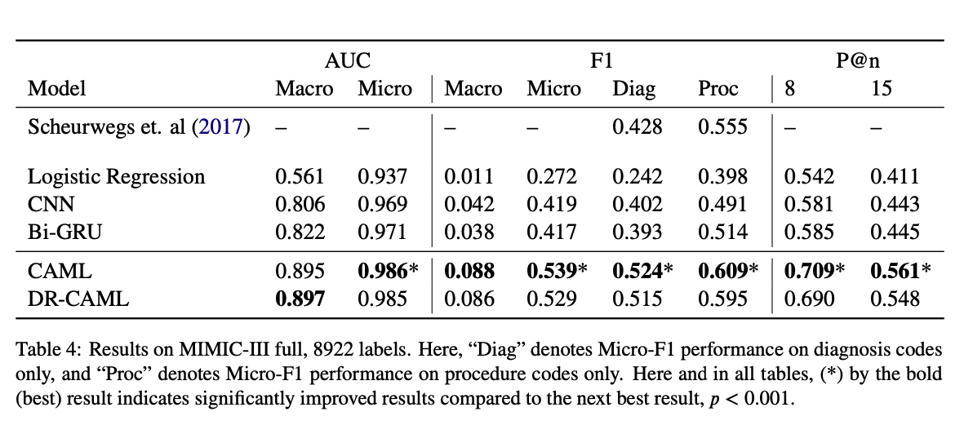
Results
Dataset:
The CAML model gives the strongest results on all metrics
DR-CAML is the regularized version using lambda = 0.01
The Bi-GRU architecture is comparable to the vanilla CNN
Logistic Regression worse than all neural architectures.
Notes:
Lambda = 0.01

Slide 22
Interpretability Evaluation
Sample of 100 predicted codes
Using he most important 𝑘-gram (k=4) + five words on each side for context
Asked the Physician how informative it is

Slide 23
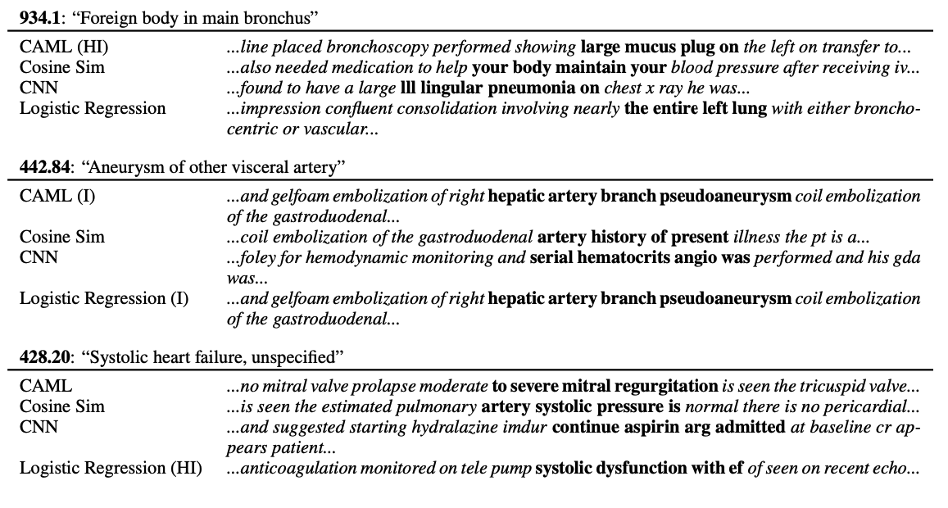

Slide 24
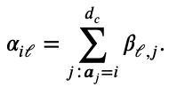


How to pick the most influential 4-gram for each label?
CAML Looks at the SoftMax output 𝜶𝓁 to get the best 4-gram for a code prediction 𝓁
Logistic regression takes the sum of the coefficients of the weight matrix for 𝓁, over the words in the 𝑘-gram. The top-scoring 𝑘-gram is then returned.
Code descriptions calculate a word similarity (cosine similarity) metric between each stemmed 𝑘-gram and the stemmed ICD-9 code description.
Max-Pooling CNN

Slide 25
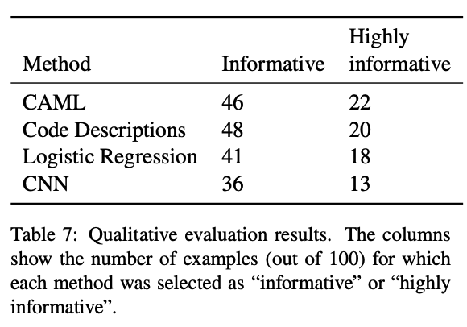
CAML selects the greatest number of “highly informative” explanations, and selects more “informative” explanations than both the CNN baseline and the logistic regression model.
Cosine Similarity metric also performs well the examples in Table 1 demonstrates the strengths of CAML.

Slide 26
Conclusion
Concluding Thoughts
Yields strong improvements over previous metrics across several formulations of the ICD-9 code prediction task
Provides satisfactory explanations for its predictions per stakeholder evaluation
Future Work
Extensible
To other multi-label document tagging task
Linguistic perspective
Integrate document structure of discharge summaries in MIMIC-III
Better handle non-standard writing and other sources of out-of-vocabulary tokens
Application perspective
Build models that leverage hierarchy of ICD codes
Predict codes for future visits

Slide 27
Discussion
What are potential limitations of CAML?
The explanations provided from the attention mechanism are in the form of extracted snippets of text from the input document. Does this provide enough information? What else could be provided with this explanation?
Strengths and weaknesses of their evaluation and results (for both accuracy and interpretability)
What additional applications could CAML be useful for?

Slide 28
References
Mullenbach, James, et al. "Explainable prediction of medical codes from clinical text." arXiv preprint arXiv:1802.05695 (2018).
Scriven, Sarah. “An Introduction to Clinical Coding.” Federation for Informatics Professionals (FEDIP), FEDIP, 14 Mar. 2022, https://www.fedip.org/post/what-is-clinical-coding.

