Slide 1
Explainable Active Learning (XAL):
Toward AI Explanations as Interfaces for Machine Teachers
Ghai et al. (2020)
Presented by Lucia Gordon, Matthew Nazari, and Catherine Yeh
March 22, 2023
Notes:
Start with concrete scenario/example (e.g., predict salary) to explain active learning
Introduce main question: goal of paper is to understand, can explanations improve active learning process?
To test this, show experimental design (key slide!!) + different conditions/stages
Then show results (talk about questions along with results)
Questions after experimental design
Related work at end (or just skip)

Slide 2
Motivation
There’s more and more machine learning but still few machine teachers
Current ML development processes are bottlenecked by
resources and expertise
how, where, and when we can leverage human knowledge
Active learning and democratized data science are hot right now
Notes:
What is machine teaching and active learning “predict somebody’s salary. this is a process where a model is uncertain and solicits oracle advice”
Example, “this model is learning but it is uncertain about certain things so it will solicit advice from a human that it will take as ground-truth”
What are the bottlenecks
Can explanations help in machine teaching? “In this process, can explanations help out to smooth this process”
In order to test this, this is the empirical study (see Experimental Design)
What are the reason we are looking at 3 fields of related work

Slide 3
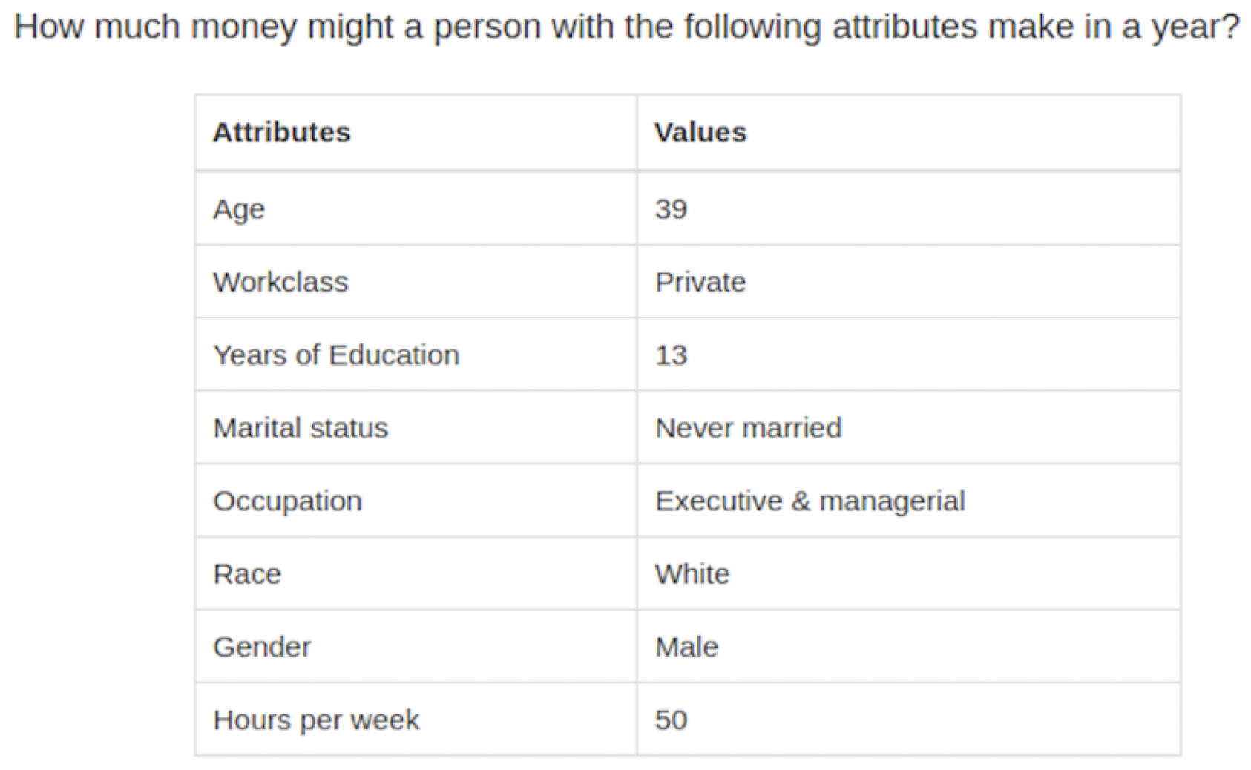
Prediction Task
Dataset: Adult Income
Binary prediction: whether the annual income of an individual is > or < $80k
Linear model: logistic regression with L2 regularization
Customer profile
Notes:
Lucia
With the wide adoption of machine learning technologies, there has been growing demand for people to train ML models. Let’s look at an example of the development process for doing so.
Consider this binary prediction task. Given the following demographic features of an individual, predict whether this person either makes below or above $80k per year. And let’s imagine we use a logistic regression model with some regularization to do this.
The most common approach to training such a model would be with Supervised learning, where a team of domain experts would produce a labelled datasets. These domain experts input their human knowledge in the form of these labels.
So if these demographic attributes are collected for 60,000 individuals, then data scientists would have to obtain 60,000 additional labels from the domain experts whether these each of these individuals are making at least $80k per year.

Slide 4
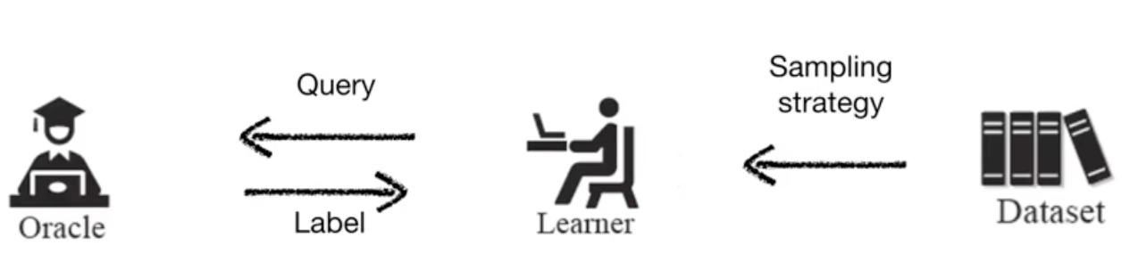
Active Learning
Current ML development processes are bottlenecked by
resources and expertise
how, where, and when we can leverage human knowledge
Notes:
This kind of approach to the development process has its bottlenecks, two especially.
First and most significant, producing such a large amount of instance labels is at best tedious for the machine learning engineers who could be occupied by other priorities, and at worst extremely difficult and resource intensive in terms of both time and money.
Secondly, if we are to think abstractly for a moment, the human knowledge that our model is obtaining is confined to only one particular part of the development process.
To overcome these kinds of problems, another paradigm, active learning, suggest an alternative training procedure. Active learning, or AL, is very widespread and you have probably heard about it. The purpose of AL is to reduce the labeling workload by having a model select instances for a human annotator to label. The principle is that the model can identify which labels would be most salient or useful to know and so solicits the annotator as an oracle with perfect labels.

Slide 5
Active Learning in Prediction Task
Participants judge the income level of data points queried by the model
Query method: uncertainty sampling
The annotations could be faulty
BUT… explanations might be able to help reveal faulty model beliefs
Customer profile
Notes:
Lucia
Describe in context of task
Looking back to our previous context, now if we are to train this model, we can start with no labels or very few labels. Using a query method such as uncertainty sampling, the model will solicit labels for data points it is unsure of, predicted 50/50. And eventually, once a stopping criteria is met, the training is complete and only .
“We can view same before in al context …
Arent assuming… human judges the income level… model picking points to be labelled this way…
In binary, things that are closest to 0.5 get solicited… but labels may be incorrect…

Slide 6
Problem Statement
Active learning interfaces remain minimal and opaque
annotator cannot monitor training progress
annotator is unaware of the effectiveness of their teaching
Explanations show potential for better active learning
Notes:
These problems make active learning interfaces minimal and opaque.
Clearly, there are also some problems with active learning. Namely, the training process requires this annotation process, but the interfaces for annotations remain minimal and opaque. The annotator is unable to monitor the model’s learning progress. And it is unclear of the effectiveness of their labelling on the learning of the model. AL is not always so smooth.
In the real world, a human student would generate an explanation for why they give a certain answer, and this explanation helps us gauge whether the student is learning or whether there was a misunderstanding.
To this end, the paper words towards answering the big question:
Clarify problem statement before going into related work: “can explanations help in machine teaching?” -> big question paper is trying to solve
Emphasize “machine teaching” phrase & explain b/c a lot of people might not know about it
Talk about what the bottleneck is there

Slide 7
Big Question:
Can explanations improve the active learning process?
Notes:
Motivate need for XAL more?

Slide 8
Summary of Contributions
Provide insights into explainable AI as an interface for active learning
Propose a novel active learning paradigm: explainable active learning (XAL)
Conduct an empirical study using the prediction task we described to investigate the impact of explanations on annotation experience
Notes:
In investigating this question, the paper also elicited a study to explore how people naturally want to teach learning models.
So in all, there were three major contributions:
The paper provides insights into and articulates why explainable AI be an interface for active learning.
The paper then proposes a new active learning paradigm called explainable active learning, that addresses model transparency in the annotation experience through explanation methods
Lastly, the paper conducts an empirical study using this prediction tasks we’ve already described and described the impact of local explanations experienče and quality

Slide 9
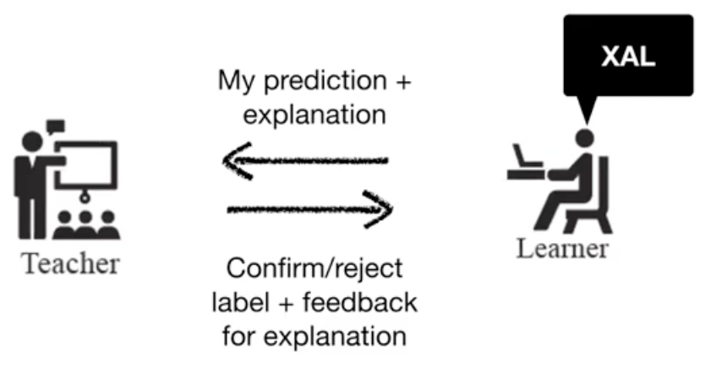

Explainable Active Learning (XAL)
Mimics how humans teach and learn
Explanations can make it easier to reject an incorrect prediction
Explanations can inform the feedback

Slide 10
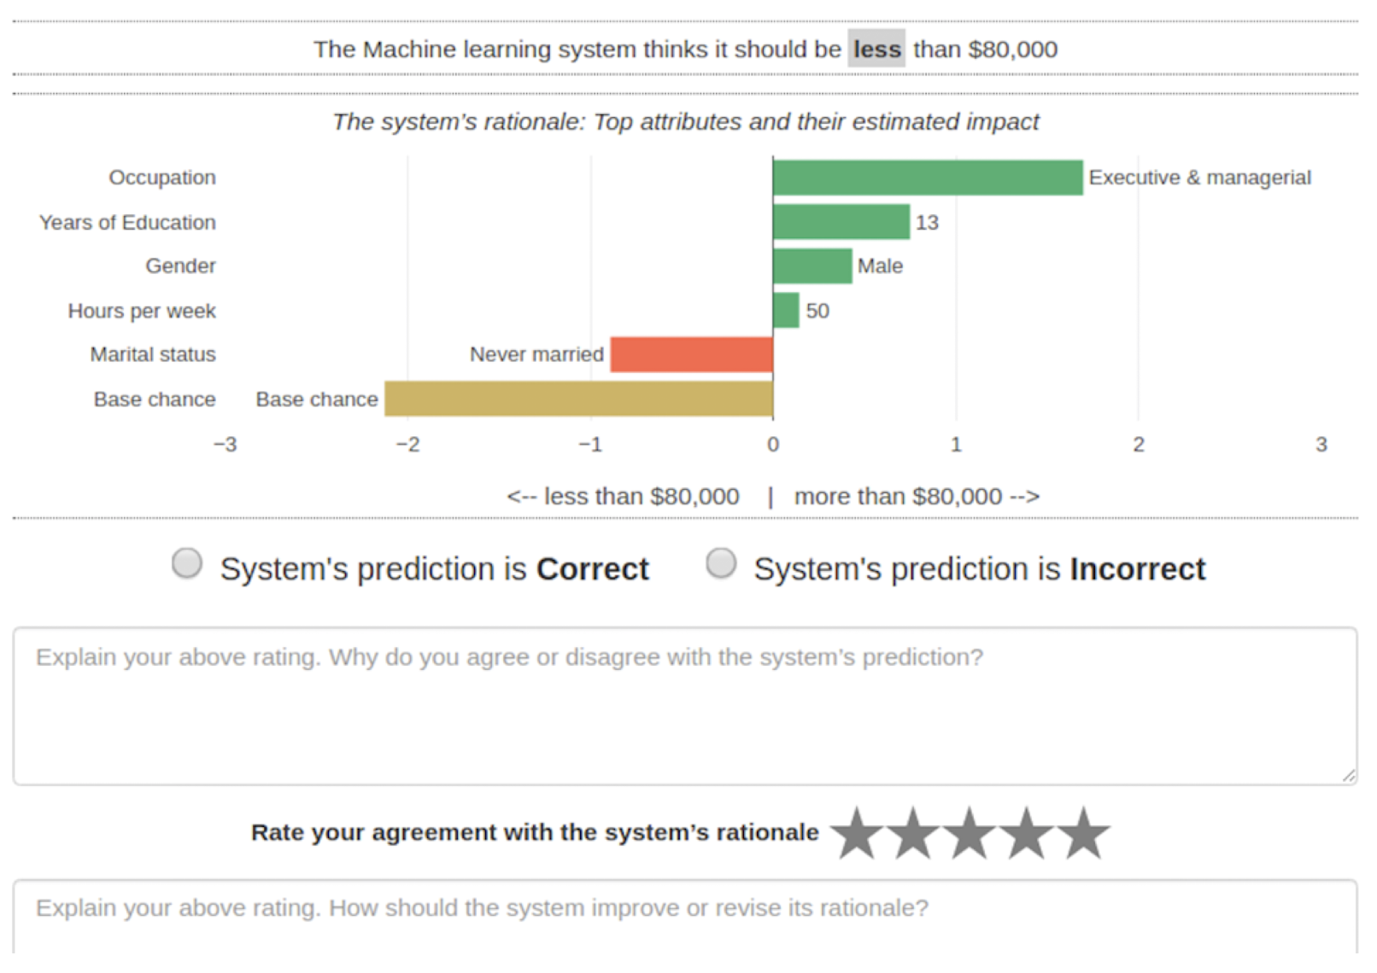
Presentation of Prediction + Explanation
Design choices
Explain AL with local feature importance
Present local feature importance with visualization
Features were sorted by their importance
Top 5 most important features were included in the visualization
Green = positive features
Red = negative features
Base chance = model intercept
Prediction
Explanation
Feedback

Slide 11
Presentation of Prediction + Explanation
Prediction
How it differs from previous work
Presents the model’s reasoning rather than requesting global feature weights
Goes beyond text-based models
Explanation
Feedback

Slide 12
Explainable Active Learning (XAL)
They design a study to explore how people naturally want to teach a model with explanations in the form of a local feature importance visualization

Slide 13
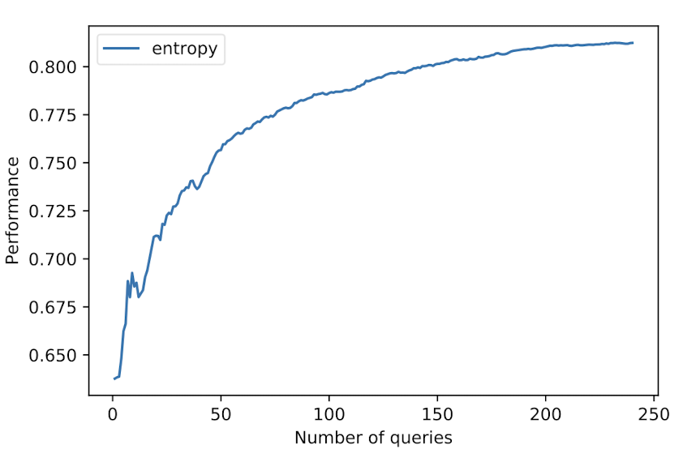
Active Learning Simulation
Wanted to examine the effect of explanations at different stages of AL
Used a simulation to define “early-stage” and “late-stage” models
Queried instances were annotated using ground-truth labels in the simulation
Accuracy

Slide 14
Active Learning Simulation
Early stage → 0 queries
Late stage → 200 queries (where accuracy plateaus)
Accuracy
Early stage
Late stage

Slide 15
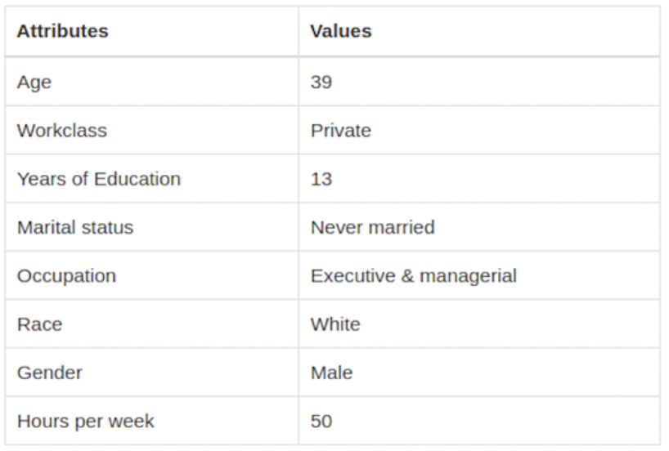

Experimental Design
Amazon Mechanical Turk: 36 participants
Three conditions (each participant assigned to one)
AL: customer profile presented
CL: customer profile + model prediction presented
XAL: customer profile + model prediction
+ explanation
Two learning stages (each participant completed both)
Early
Late
20 annotations per experiment (condition + stage)
Domain knowledge training (statistics, practice trials, $2 bonus for consistency with ground-truth)
+
+
+

Slide 16

Experimental Design
How does explanation impact annotators’ subjective experiences (RQ2)? → survey
“How much do you trust the model to be deployed?”
“How satisfied are you with the annotation experience?”
“How mentally demanding was the annotation task?”
Notes:
Show this with the results

Slide 17
Experimental Design
How do individual differences affect the annotation experience (RQ3)?
Task knowledge inferred from practice trial performance
Survey → “How much do you know about AI or ML?”
Survey → “How strong is your tendency to engage in thinking and cognitively complex activities?”

Slide 18
Research Question 1
How do local explanations impact the annotation and training outcomes of AL?
Notes:
Ask people for their thoughts about this

Slide 19
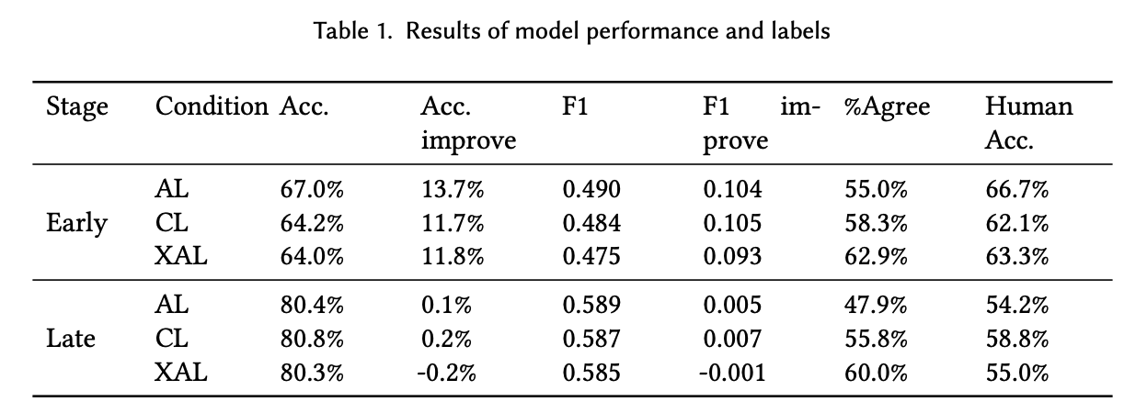
Results: Annotation + Learning Outcomes
Active (AL)
Coactive (CL)
Explainable (XAL)
Compare to initial model performance (before 20 queries)
RQ1: Overall, human accuracy and % agreement decrease in the later stage, while model accuracy increases.
Notes:
Introduce questions before showing results, ask class what they think first
First, authors examine model learning outcomes in the different conditions (active learning, coactive learning, explainable active learning) to answer these two research questions.
Look at typical performance metrics (accuracy/F1 scores) + improvements, also look at human accuracy, and agreement between the human labels and model predictions.
They say the model learning stage had an significant main effect for all metrics reported here. In general, as model accuracy goes up, we see human accuracy and % agreement go down, so the late stage task was harder for participants.

Slide 20
Research Question 2
How do local explanations impact annotator experiences?
Hypotheses
Explanations support trust calibration
Explanations improve annotator satisfaction
Explanations increase perceived cognitive workload

Slide 21
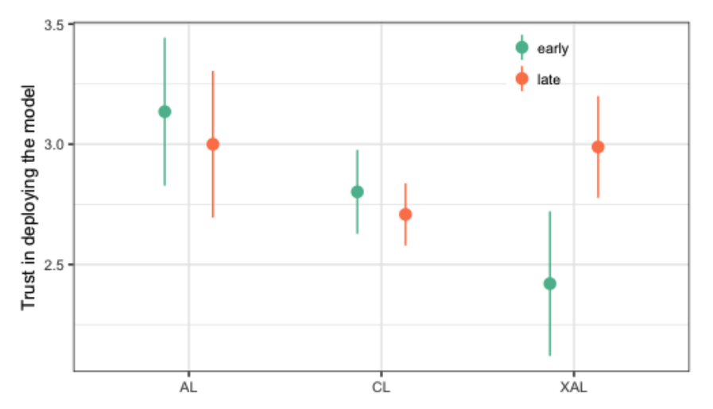

Results: Annotator Experience
H1: Explanations support trust calibration
RQ2: Trust in XAL condition is low early on, but increases with later stage model.
Notes:
Next, the authors look at how self-reported annotator experiences differed across conditions to address RQ2 and 3.
In the early stages, participants in the XAL condition had significantly lower trust, but trust increased in the later stage model, proves H1 as we don’t see this effect in the other two conditions
Ask people what might happen when we show the question

Slide 22
Research Question 3
How do individual factors, specifically task knowledge, AI experience, and need for cognition, impact annotation and annotator experiences with XAL?
Hypotheses
Annotators with lower task knowledge benefit more from XAL
Annotators inexperienced with AI benefit more from XAL
Annotators with lower need for cognition have a less positive experience with XAL

Slide 23
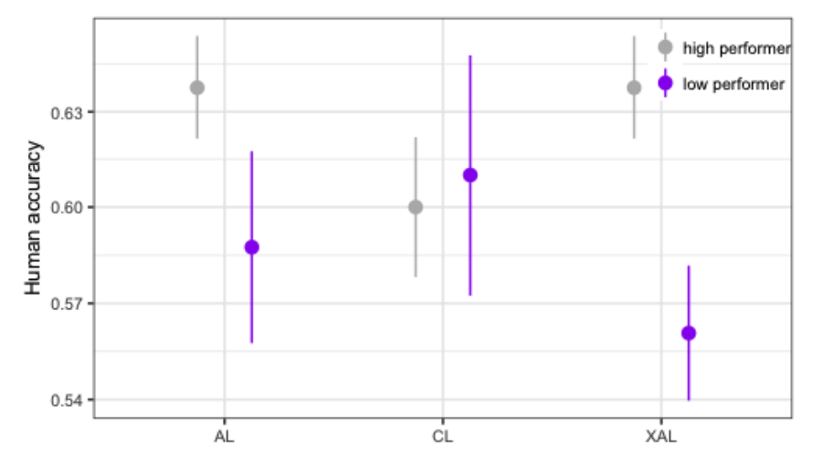
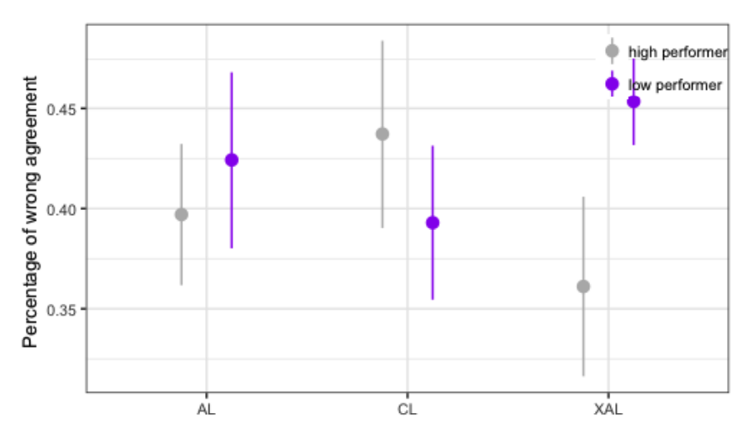
Results: Annotation + Learning Outcomes
Determined by accuracy on training task
RQ3: Participants with less task knowledge had lower accuracies and higher blind trust in XAL condition.
Notes:
Interestingly the authors find a significant interactive effect between condition and participants’ task knowledge, which was determined by their accuracy on the training task.
They see that explanations helped those with high task knowledge, but hurt those with low task knowledge and similarly, it appears that explanations increase the percentage of wrong answers for those with low task knowledge but decrease it for those with high task knowledge. So there seems to be some sort of negative anchoring effect where low performers are more inclined to agree with model predictions.
(bars represent +/- 1 standard error)
Wasn’t an effect if we look at model disagreement (instead of agreement)

Slide 24

Results: Annotation + Learning Outcomes
H4: Annotators with lower task knowledge benefit more from XAL
RQ3: Participants with less task knowledge had lower accuracies and higher blind trust in XAL condition.
Notes:
So overall, this analysis disproved hypothesis 4, and in generally, the authors also saw that it became harder for annotators to make correct judgements and improve the model performance as the model matured.

Slide 25
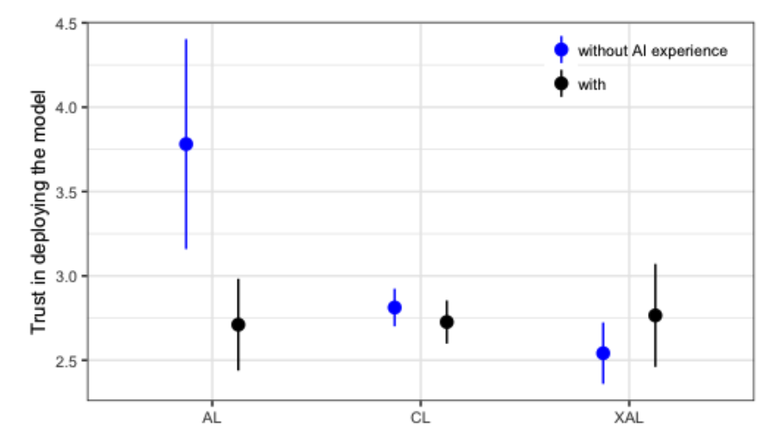
Results: Annotator Experience
H5: Annotators inexperienced with AI benefit more from XAL
RQ3: Explanations helped calibrate trust for those without AI experience.
Notes:
They also find a two-way interaction between XAL condition and participant experience with AI on trust in model deployment. We see that those without AI experience have disproportionately high blind trust in the AL condition, but with XAL, they show a more appropriate level of trust, which supports H5

Slide 26
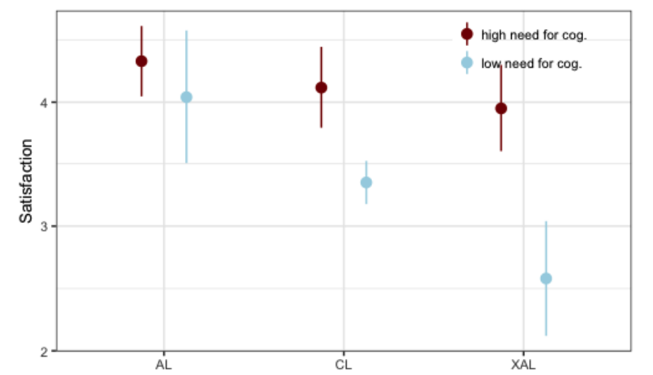
Results: Annotator Experience
H2: Explanations improve annotator satisfaction
H6: Annotators with lower need for cognition have a less positive experience with XAL
RQ3: Explanations have a significant negative effect on satisfaction for those with low need for cognition.
Notes:
We see that explanations negatively impact satisfaction, but only significant for those with low need for cognition
(higher satisfaction for those w/ high task knowledge)
Disproved H2, but supports H6

Slide 27
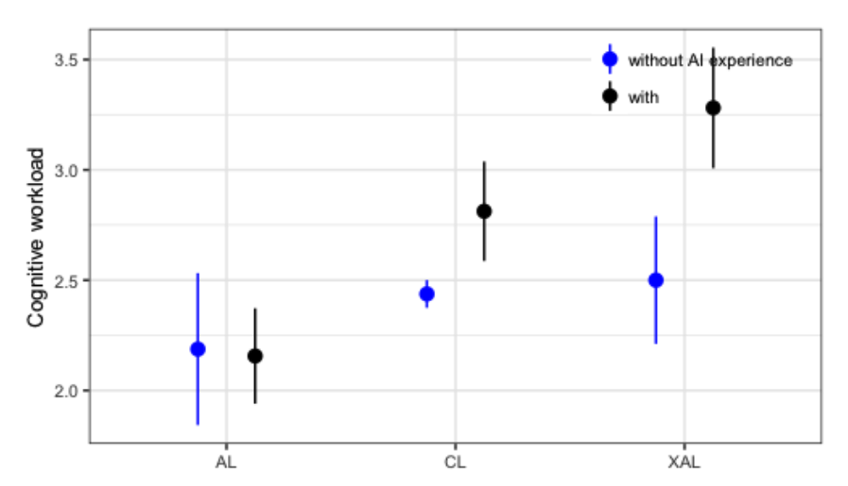
Results: Annotator Experience
H3: Explanations increase perceived cognitive workload
RQ3: XAL induces significantly higher workload for those with AI experience.
Notes:
And for cognitive workload, we see XAL induces higher workload, but only significant for those with AI experience
Kind of supports H3

Slide 28
Research Question 4
What kind of feedback do annotators naturally want to provide upon seeing local explanations?

Slide 29
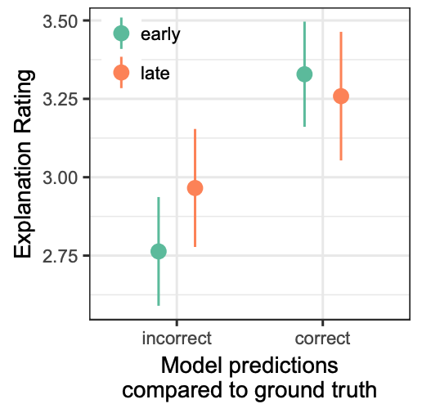
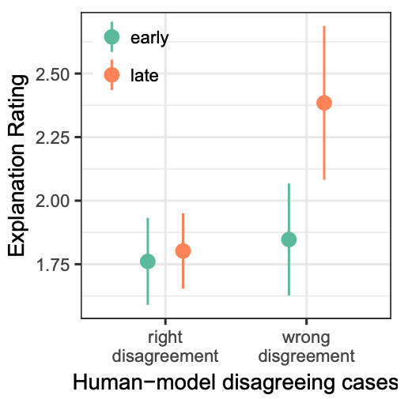
Results: Feedback for Explanation
Explainable (XAL) condition
RQ4: Explanation ratings are higher when model is correct and when annotators wrongly disagree with the model in later stage tasks.
Notes:
Finally, the authors looked into RQ4 and what insights are revealed by their explanation ratings, focusing on the XAL condition.
First, they saw that there was a significant effect of Model Correctness, showing that participants could distinguish between the explanations of correct and incorrect model predictions. Specifically, explanation ratings were higher across both stages when the model was correct.
The authors also investigate how ratings differ in cases where the annotator disagreed with the model prediction, finding that when they wrongly disagreed with the model, they tended to give higher explanation ratings, especially in the later stage which may be correlated with the observed increased model trust.
Also collected some open form feedback from participants
Which overall identified opportunities to adapt local explanations during the learning process by directly incorporating annotator input into the system

Slide 30
Results: Feedback for Explanation
Open Form Feedback
Tuning weights (N = 81)
Removing, changing direction of, or adding features (N = 28)
Ranking or comparing multiple feature weights (N = 12)
Reasoning about combination and relations of features (N = 10)
Logic to make decisions based on feature importance (N = 6)
Changes of explanation (N = 5)
Notes:
The authors also collected some open form feedback, which fell into the main categories listed here
Most feedback was about the weight bar visualizations in the explanation and expressing disagreements or wanting to adjust the weights
Other comments were about wanting to remove, change the direction of or add features
Some participants mentioned the ranking or comparison of different features,
or wanted the model to account for combined or relational effects of features
Finally, a few comments discussed confusing logic in the model’s explanations
And also changes in the model’s explanations overtime, which is a unique property of the AL setting
Overall, participant feedback identified opportunities to adapt local explanations during the learning process by directly incorporating annotator input into the system

Slide 31
Related Work: Active Learning
Many AL paradigms have been developed, and the paper lists many
Very little or no attention has been given to understanding or improving how humans interact with AL algorithms
In human-robot interaction, a natural language interface was developed (Cakmak et. al)
They identify the need to study annotation interactions with real-time AL algorithms
Notes:
Obviously this work expands upon the existing active learning research community. The authors note that no work has tried using explanations during the annotation process. The closest example they could find was a human-robot interactions paper where a natural language interface was developed, but this was quite different in nature and only sought to understand the learning process after the fact and not during.

Slide 32
Related Work: Interactive ML
AL is sometimes considered to be within interactive machine learning (iML)
iML approaches value transparency over performance
There have been empirical studies demonstrating iML techniques lower need for data, but little else
iML approaches are esoteric, but explanations as interfaces could help non-ML experts
Notes:
Active learning itself is in many ways a superset of active learning, and asks more general often empirical questions. The authors did not find any work that was similar to the empirical study they performed.

Slide 33
Related Work: Explainable AI
The paper describes explainable AI (XAI) from a broad overview
Recent XAI studies find users’ understanding of AI systems improved by explanations
There are still many unknowns to how explanations cold reduce knowledge barriers to train ML models
Notes:
And lastly, obviously, this paper relates to explainable AI and what we have been looking at in class. And they did not identify much relevant literature.

Slide 34
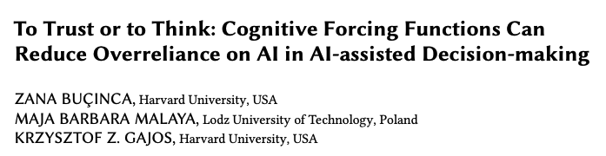
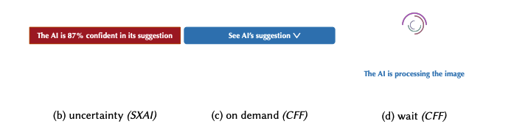
Future Work
Explanations for Active Learning
Alternative designs to mitigate anchoring effect
Explaining model progress
CSCW ‘21
Notes:
This paper had a pretty comprehensive discussion of future work, so I’ll just share a few of the key directions I found interesting here
First, shared some implications for designing explanations for active learning
E.g., use a partial explanation that doesn’t reveal model’s judgment or have people make own judgment before seeing the explanation
This idea reminded me of this paper, which explores the impact of cognitive forcing functions during AI-assisted decision making, so they had different conditions where it would display the model’s uncertainty, force the user to click to see the AI’s suggestion, or ask the user to wait before seeing the explanation so they had to make their own prediction first
And they did find that CFC reduced overreliance, especially for participants with high need for cognition, but it also lowered ratings about the AI system
Idea of explaining model progress and showing changes in model logic as it learns is cool too; could be a great opportunity for visualization here

Slide 35
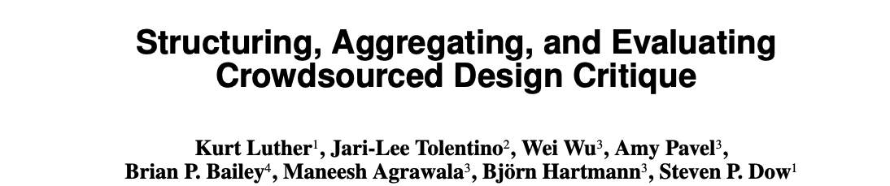
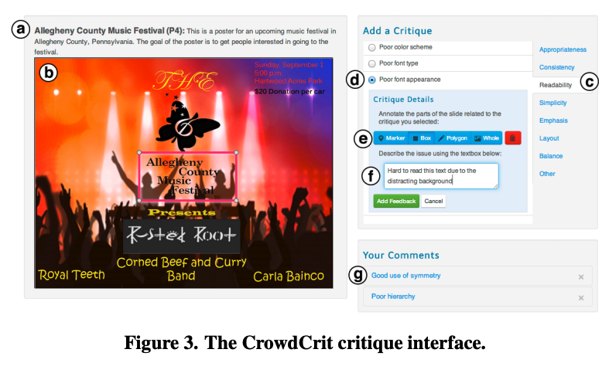
Future Work
CSCW ‘15
Learning from explanation based feedback
Scaffolding the elicitation of high-quality, targeted feedback
Notes:
Second, emphasize the opportunity for incorporating user feedback back into system to improve model predictions
However, user feedback tends to be noisy– and it’s often imprecise and incomplete
Thus it might be worth looking into how we can scaffold this feedback elicitation process, which is actually the focus of a lot of interactive machine learning work
I also think there’s a lot to learn from the design and cognitive science community, for example this paper (also from CSCW) scaffolds by preauthoring some critique statement examples in different categories and also allows users to draw boxes/specifically highlight parts of the design they want to give feedback on, so perhaps a similar idea could be applied to XAL

Slide 36
Conclusions
Key contributions
New approach for machine teaching: XAI + AL = XAL
Limitations
If domain experts are usually the ones doing the labeling, why not survey them?
Small number of participants
Only tried uncertainty sampling (but other strategies may have different impacts on annotator experiences)
Only tried one explanation method with a highly interpretable model - how would the results change under different explanation methods or more black-box models?
What if the number of relevant features is larger (such as pixels in an image?)
Notes:
In conclusion, this paper studies the interaction between annotator and active learning system. He proposes explainable active learning to utilize popular local explanation methods as an interface for Al algorithms.
There were limitations to the paper that the authors note. For example, annotators were recruited on Mechanical Turk, which is a biased selection because in the real world domain experts would be annotators and they would be held accountable for the consequences of the model. They also identify that both their lab study and their datasets were on the smaller side.
We’ve identified a few more limitations, for example, the paper only tried uncertainty sampling, and don’t investigate whether this would impact the annotator experience.
Likewise, they only tried one explanation method and with a highly interretable model, and don’t address what would happen in any different situation.

Slide 37
Discussion Questions
Has anyone used AL in the past? If so, do you think adding explanations would have been helpful? Why or why not?
What applications of XAL are you most excited about? Or, any particular scenarios that you think it would work especially well/poorly in?
Do you think XAL is feasible with less inherently interpretable models or other explanation methods? How do you think the annotations and the annotation experience would change?
Notes:
What if the accuracy of explanation varies. Some are accurate some are not, would that influence what is happening here?

