Slide 1
Do Input Gradients Highlight Discriminative Features?
Authors: Harshay Shah, Prateek Jain, Praneeth Netrapalli Presenters: Karly Hou, Eshika Saxena, Kat Zhang

Slide 2
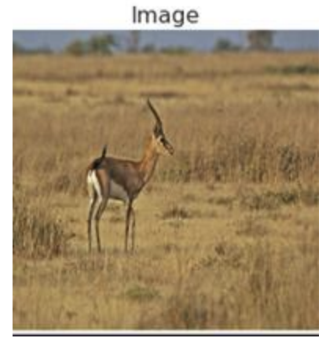
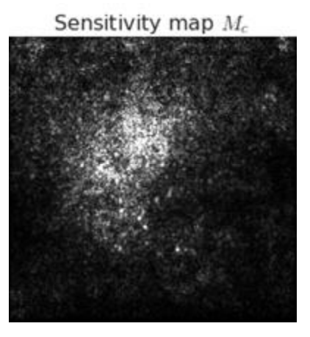
Introduction
Instance-specific explanations of model predictions
Input coordinates are ranked in decreasing order of input gradient magnitude
Assumption (A): Larger input gradient magnitude = higher contribution to prediction
Notes:
Commonly seen for image prediction
Common assumption among attribution methods such as SmoothGrad and Integrated Gradients, but it may not be true

Slide 3
Key Contributions
New evaluation framework DiffROAR for evaluating Assumption (A) on real datasets
compares the top-ranked and bottom-ranked features
Evaluate input gradient attributions for MLPs and CNNs
Found that standard models violate Assumption (A)
Some adversarially trained models might satisfy it
Notes:
Uses the remove and retrain (ROAR) framework, which takes out the important features, trains the model on what is left, and then compares the accuracy with/without these features. DiffROAR compares the prediction power of the top-ranked and bottom-ranked features
Specifically, adversarial models that are robust to L2 and L-Infinity perturbations seem to satisfy Assumption (A).

Slide 4
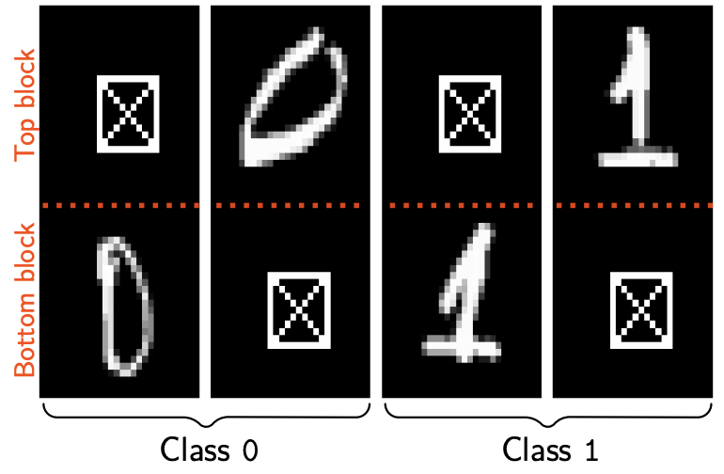
Key Contributions: BlockMNIST Dataset
Each datapoint contains two images, a signal (the actual digit), and a null block (a blank square)
Want to see if the classification is actually occurring as a result of the block with the information
Notes:
Part of the problem with ROAR is that there is a lack of certainty about what the ground-truth discriminative features are. Thus, the authors create BlockMNIST, which contains inherent ground-truth features.

Slide 5
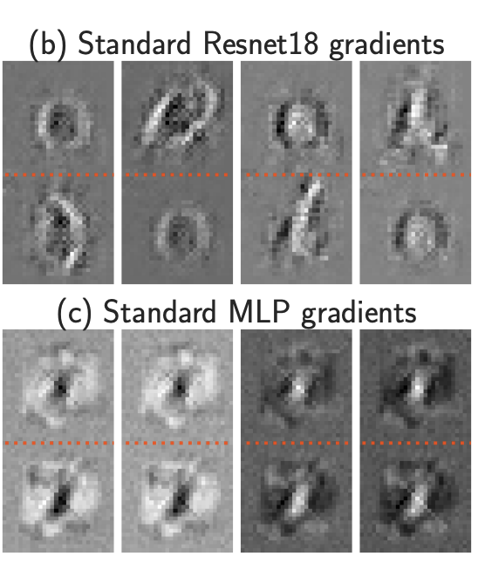
Key Contributions: BlockMNIST Dataset
Feature leakage is a potential reason why Assumption (A) is violated
Feature leakage is shown empirically and proved theoretically
Notes:
Feature leakage: when the input gradients of one instance highlights the location of discriminative features in other datapoints in the dataset.
This may be why, when we look at the standard gradients, all of the boxes are highlighted – since each tdatapoint has the discriminative feature in a different location, there may be some feature leakage

Slide 6
Related Work
Sanity checks for explanations
Visual assessments are unreliable
Other well-known gradient-based attribution methods fare worse in these sanity checks
Evaluating explanation fidelity
Evaluations traditionally performed without knowing the ground-truth explanations
Usually evaluated using masking or ROAR
Input gradients lack explanatory power and are as good as random attributions

Slide 7
Related Work
Adversarial Robustness
Adversarial training can improve the visual quality of input gradients
Adversarial model gradients are more stable than standard ones
Are they also more faithful?
Notes:
Recent works hypothesize that adversarial training improves the visual quality of input gradients by suppressing irrelevant features [31] and promoting sparsity and stability [32] in explanations. Kim et al. [33] use the ROAR framework to conjecture that adversarial training “tilts” input gradients to better align with the data manifold.
. That is, stability does not imply fidelity. For example, an input-agnostic constant explanation is stable but lacks fidelity. Conversely, fidelity does not imply stability—if the underlying model is itself unstable, then any correct high-fidelity explanation of that model must also be unstable.
Bansal et al. [52] and Chen et al. [58] identify and explain why input gradients of adversarially trained models are more stable compared to those of standard models. In contrast, our work focuses on identifying and explaining why input gradients of adversarially trained models have more fidelity compared to those of standard models

Slide 8
DiffROAR Evaluation Framework
Notes:
First, we will describe the evaluation framework proposed in this paper to evaluate assumption A. The DiffROAR framework is the first primary contribution of the paper and builds on the ROAR methodology to test whether feature attribution methods satisfy assumption A on real world datasets.
Note that while our empirical findings strongly suggest that standard models violate assumption (A), conclusively testing (A) is harder without knowledge of ground-truth discriminative features learned by models on real data

Slide 9


Setting
Standard classification setting with each independently drawn data point as a pair of (instance, label):
x^{(i)}_{j} denotes jth coordinate/feature of x^{(i)}
Feature attribution scheme maps a d-dimensional instance x to a permutation of its features
e.g. Input gradient attribution scheme takes input instance x, predicted label y, outputs ordering [d] that ranks features in decreasing order of input gradient magnitude
Notes:
Standard classification setting with instance,label pairs that are drawn independently from a distribution
Feature attribution scheme: maps an instance with d features to a permutation of the features
This permutation corresponds to the feature importance. So, for input gradient, the output would be an ordering that ranks the features in decreasing order of input gradient magnitude

Slide 10
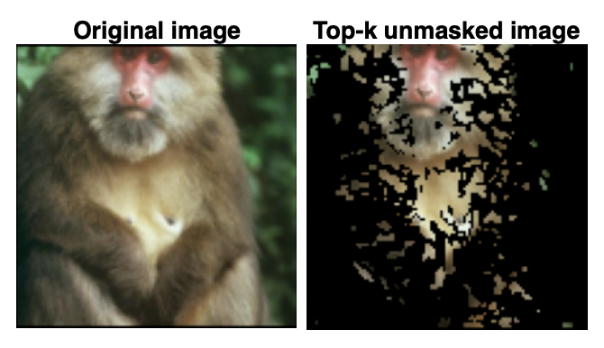

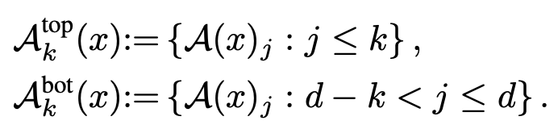
Unmasking Schemes
Unmasked instance x^{S} zeroes out all coordinates not in subset S
Unmasking scheme maps instance x to subset A(x) of coordinates to obtain unmasked instance x^{A(x)}
Top-k and bottom-k unmasking schemes:
Notes:
Now that we have attribution schemes, we next look at unmasking schemes.
An unmasked instance xS series out all coordinates not in subset S
So, an unmasking scheme maps instance x to subset A(x) of coordinates, which is the subset to obtain an unmasked instance
There are two possible unmasking schemes that result:
Top-k: top k most important coordinates
Bottom-k: bottom k (least important coordinates)
See the figure for an example of a top-k unmasked image. This means we keep the top 25% most important pixels with higher ranks (which are in the foreground), and zero out the remaining pixels (in this case, the background)

Slide 11
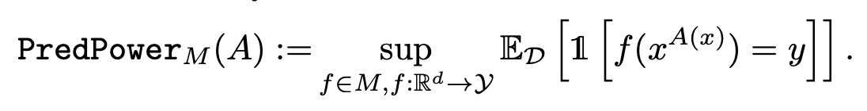
Predictive Power of Unmasking Schemes
Predictive power: best classification accuracy that can be attained by training a model with architecture M on unmasked instances that are obtained via unmasking scheme A
Estimate predictive power in two steps:
Use unmasking scheme A to obtain unmasked train and test datasets that comprise data points of the form (x^{A(x)}, y)
Retrain a new model with the same architecture M on unmasked train data and evaluate its accuracy on unmasked test data
Notes:
Predictive power of an unmasking scheme is the best classification accuracy that can be attained by training a model with architecture M on unmasked instances that are obtained via unmasking scheme A
We can’t use models M trained on original data to estimate the PredPower(A) because masking induces a distribution shift in the data.
So, following the ROAR framework, we retrain models on unmasked data because if the model architectures are the same the classifier will also be similar.
Then, we estimate the pred power in two steps (click):
Use unmasking scheme A to obtain unmasked train and test datasets that comprise data points of the form (xA(x), y)
Retrain a new model with the same architecture M on unmasked train data and evaluate its accuracy on unmasked test data
The best classification accuracy obtained from this process is the pred power.

Slide 12
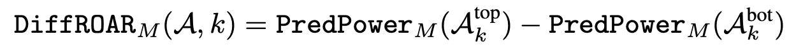
DiffROAR Metric
Interpretation of the metric:
Sign of the metric indicates whether the assumption is satisfied (> 0) or violated (< 0)
Magnitude of the metric quantifies extent of separation of most and least discriminative coordinates into two disjoint subsets
Notes:
So, to satisfy assumption A, we assume that the attribution scheme places coordinates that are more important for model prediction higher up in the attribution order. To measure if this is the case, the authors propose the DiffROAR metric, which is the difference between the predictive power of the top-k and bottom-k unmasking schemes.
The sign indicates whether the attribution scheme satisfies or violates assumption A. Less than 0 implies a violation of the assumption because features with higher attribution ranks have worse predictive power
The magnitude quantifies extent of separation of most and least discriminative features into two disjoint subsets.
Note that a random attribution scheme should have an expected value of the DiffROAR metric to be 0 for any architecture M.
—-----------CUT—---------
The authors highlight that simply testing the pred power of topk is not enough to determine whether A is satisfied. Instead, we want to determine whether input features with higher attribution ranks are more important for model prediction than coordinates with lower rank, which is why the DiffROAR metric is needed.

Slide 13
Experiment 1: Image Classification Benchmarks
Notes:
In the first experiment, the authors use DiffROAR to evaluate whether input gradient attributions of standard and adversarially robust MLPs and CNNs trained on four image classification benchmarks satisfy assumption (A).

Slide 14
Setup: Datasets and Models
Datasets: SVHN, Fashion MNIST, CIFAR-10, ImageNet-10
Models: Standard and adversarially trained two-hidden-layer MLPs and Resnets
Adversarial: l_2 and l_∞ epsilon-robust models with perturbation budget epsilon using PGD adversarial training
Notes:
Four benchmark image classification datasets
Models:
PGD (projected gradient descent) attempts to find the perturbation that maximises the loss of a model on a particular input while keeping the size of the perturbation smaller than a specified amount referred to as epsilon. This constraint is usually expressed as the L² or L∞ norm of the perturbation and it is added so the content of the adversarial example is the same as the unperturbed sample

Slide 15
Procedure: Computing DiffROAR Metric
As a function of unmasking fraction k, compare input gradient attributions of models to baselines of model-agnostic and input-agnostic attributions:
Train a standard or robust model with architecture M on the original dataset and obtain its input gradient attribution scheme A.
Use attribution scheme A and level k (i.e., fraction of pixels to be unmasked) to extract the top-k and bottom-k unmasking schemes: A top k and A bot k

Slide 16
Procedure: Computing DiffROAR Metric
Apply A top k and A bot k on the original train & test datasets to obtain top-k and bottom-k unmasked datasets respectively (unmask individual image pixels without grouping them channel-wise)
Estimate top-k and bottom-k predictive power by retraining new models with architecture M on top-k and bottom-k unmasked datasets respectively and compute the DiffROAR metric.
Average the DiffROAR metric over five runs for each model and unmasking fraction or level k

Slide 17
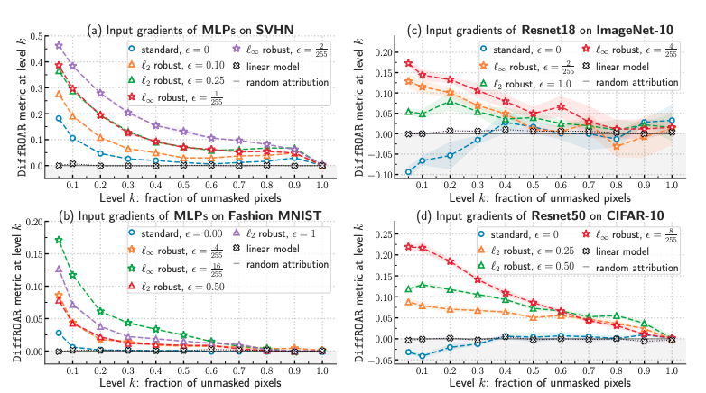
Results
Notes:
We present results on the four datasets, with one model per dataset.
Input gradient attributions of standard MLPs trained on SVHN satisfy assumption (A), as the DiffROAR metric in Figure 3(a) is positive for all values of level k < 100%. Subplot (a) indicates that adversarially robust MLPs consistently and considerably outperform standard MLPs on the DiffROAR metric for all k < 100%
Subplot (b) shows that for most unmasking fractions k, standard MLPs trained on Fashion MNIST, unlike robust MLPs, fare no better than model-agnostic random attributions and input-agnostic attributions of linear models.
Furthermore, and rather surprisingly, the shaded area in Figure 3(c) and Figure 3(d) shows that when level k < 40%, DiffROAR curves of standard Resnets trained on CIFAR-10 and Imagenet-10 are consistently negative and perform considerably worse than model-agnostic and input-agnostic baseline attributions. These results strongly suggest that on CIFAR-10 and Imagenet-10, input gradients of standard Resnets grossly violate assumption (A) and suppress discriminative features. In other words, coordinates with larger gradient magnitude have worse predictive power than coordinates with smaller gradient magnitude.
Models that are -robust to `2 and `∞ adversarial perturbations fare considerably better than standard models on the DiffROAR metric. For example, in Figure 3(a), when level k equals 10%, robust MLPs trained on SVHN outperform standard MLPs on the DiffROAR metric by roughly 10-30%. The DiffROAR curves of adversarially robust MLPs in Figure 3 are positive at every level k < 100%, which strongly suggests that input gradient attributions of robust MLPs satisfy assumption (A). Similarly, robust resnet50 models trained on CIFAR-10 and ImageNet-10 satisfy assumption (A) reasonably well and, unlike standard resnet50 models, starkly highlight discriminative features.
Furthermore, we observe that increasing the perturbation budget in `2 or `∞ PGD adversarial training [15] amplifies the magnitude of DiffROAR across k and for all four datasets. That is, the adversarial perturbation budget determines the extent to which input gradients differentiates the most and least discriminative coordinates into two disjoint subsets.

Slide 18
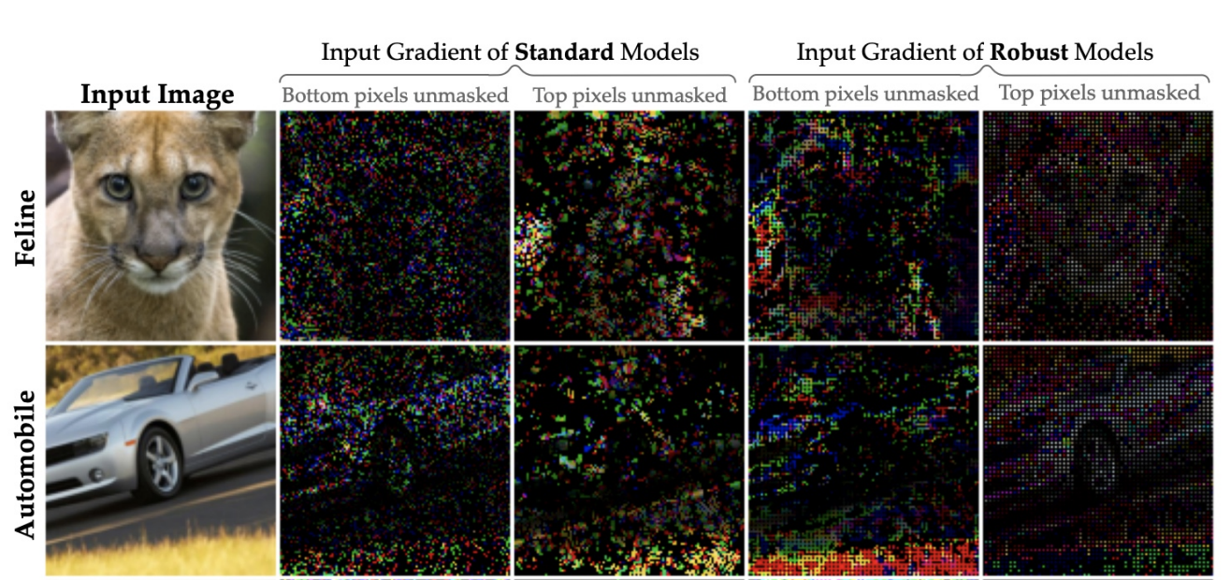
Results - Qualitative Analysis
Notes:
We can qualitatively verify that the difference between the top and bottom unmasked in the standard and robust models is quite noticeable.
There’s much more overlap between the top and bottom pixels in the standard models compared to the robust.

Slide 19
Experiment 2: BlockMNIST Data

Slide 20
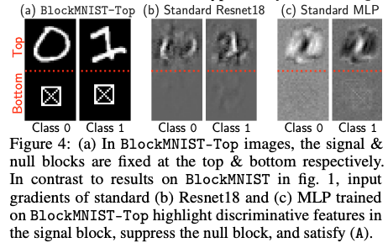
Analyzing input gradient attributions: BlockMNIST data
Dataset design based on intuitive properties of classification tasks:
Object of interest may appear in different parts of an image
Object of interest and the rest of the image often share low-level patterns like edges that are not informative of the label on their own
Standard + adversarially robust models trained on BlockMNIST data attain 99.99% test accuracy.
Notes:
Common challenge: don’t know ground truth for which features are most important in classification
Design a dataset that by design encodes a priori knowledge of ground-truth discriminative features
Further verify by noting that predictions of trained model remain unchanged on almost every instance even when all pixels in null block set to zero

Slide 21
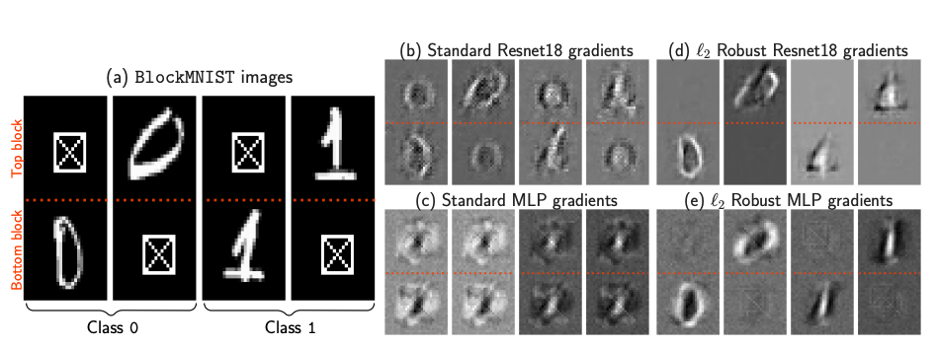
Do gradient attributions highlight signal block over null block? Not always!
Notes:
Standard MLP (multilayer perceptron), Resnet gradients highlight signal and null block
L2 robust MLP, Robust MLP gradients exclusively highlight MNIST, suppress null block

Slide 22
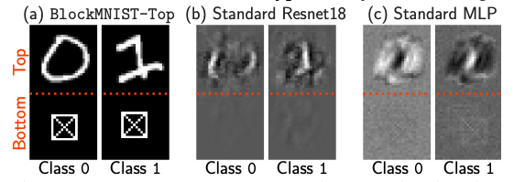
Feature leakage hypothesis
When discriminative features vary across instances (e.g. signal block at top vs bottom), input gradients of standard models may not only highlight instance-specific features but also leak discriminative features from other instances
Altered datasets: BlockMNIST-Top → now gradients of standard Resnet18, MLP highlight discriminative features in signal block and suppress null block

Slide 23
Proof 3: Feature Leakage

Slide 24

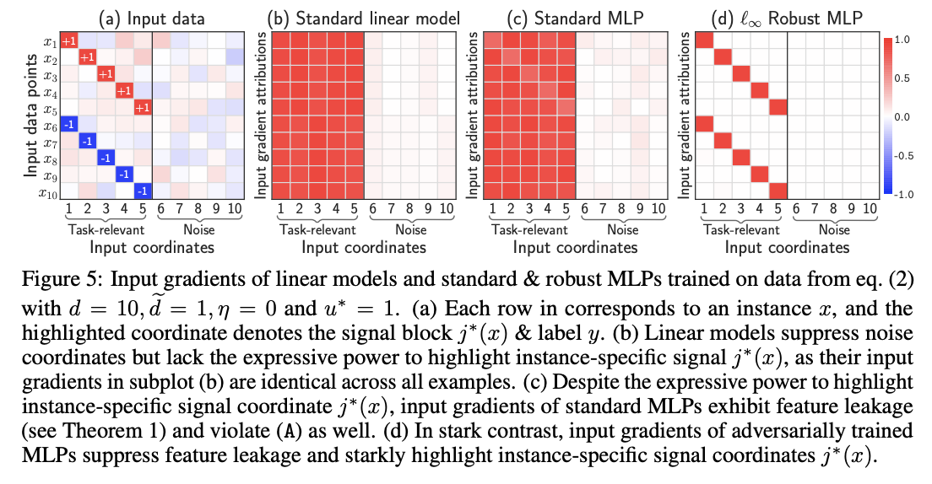
Dataset
Simplified version of BlockMNIST
Draw sample
eta = noise parameter
g_i drawn uniformly at random from the unit ball
Let d even so that d/2 is an integer
We can think of each x as a concatenation of blocks {x_1…x_d}
The first d/2 blocks are task-relevant: each example contains an instance-specific signal block that is informative of its label
The remaining blocks are noise blocks that don’t contain task-relevant signal
At a high level, these correspond to the discriminative MNIST digit and null square patch in BlockMNIST :

Slide 25
Model
Consider one-hidden layer MLPs with ReLU nonlinearity
Given an input instance, the output logit f and cross-entropy loss L are (for given layer width m)
As m → infinity, the training procedure equivalent to gradient descent on infinite-dimensional Wasserstein space
Wasserstein space: network interpreted as probability distribution nu with output score, CE loss:

Slide 26


Theoretical analysis
Prior research shows that if gradient descent in the Wasserstein space converges, it does to a max-margin classifier:
S = surface of Euclidean unit ball
P(S) = space of probability distributions
Intuitively, our results show that on any data point (x, y) ~ D, the input gradient magnitude of the max-margin classifier v* is equal over all task-relevant blocks and zero on noise blocks

Slide 27
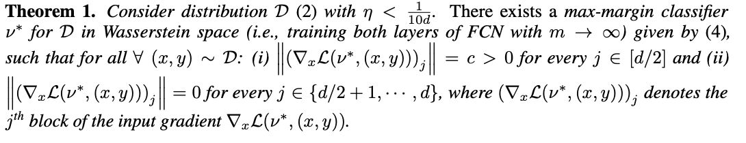
Theorem
Guarantees existence of max-margin classifier such that the input gradient magnitude for any given instance is a nonzero constant on the task-relevant blocks, and zero on noise blocks
However, input gradients fail at highlighting the unique instance-specific signal block over the task-relevant blocks
Feature leakage: input gradients highlight task-relevant features that are not specific to the given instance

Slide 28
Empirical results
One-hidden-layer ReLU MLPs with width 10000
All models obtain 100% test accuracy
Due to insufficient expressive power, linear models have input-agnostic gradients that suppress noise but do not differentiate instance-specific signal coordinates

Slide 29
Conclusion & Discussion

Slide 30
Discussion and Limitations
Assuming that the model trained on the unmasked dataset learns the same features as the model trained on the original dataset
When all features are equally informative, ROAR/DiffROAR can’t be used
This work only focuses on “vanilla” input gradients
Why does adversarial training actually mitigate feature leakage?

Slide 31
Conclusion
Assumption (A): Larger input gradient magnitude = higher contribution to prediction
Assumption (A) is not necessarily true for standard models
Adversarially robust models satisfy Assumption (A) consistently
Feature leakage is the reason why Assumption (A) does not hold

Slide 32
Discussion Questions
After seeing that the fundamental assumption regarding the correspondence between input gradients and feature importance may not hold, do we still find post-hoc explanations for individual or groups of data points convincing?
What are other major assumptions in explainability that we’ve discussed that you think could benefit from a sanity check with an approach similar to this paper?
Do you have any additional doubts about any of the approaches taken in this paper?

