Slide 1
Explain Yourself!
Leveraging Language Models for Commonsense Reasoning
Authors: Nazneen Fatema Rajani, Bryan McCann, Caiming Xiong, Richard Socher Presenters: Karly Hou, Eshika Saxena, Leonard Tang, Kat Zhang

Slide 2
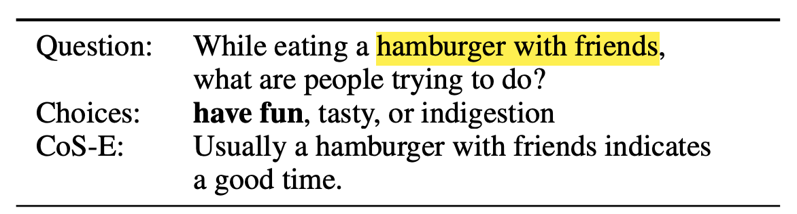
Introduction
Commonsense reasoning: making human-like presumptions and judgements about ordinary situations
Modern ML methods struggle with commonsense reasoning
Explanations help verbalize reasoning that models learn while training
Common sense Question Answering (CQA) dataset
How do these models perform reasoning and to what extent is that reasoning based on world knowledge?
Notes:
Commonsense reasoning is a challenging task for modern machine learning methods (Zhong et al., 2018; Talmor et al., 2019). Explanations are a way to verbalize the reasoning that the models learn during training. Common sense Question Answering (CQA) is a multiple-choice question answering dataset proposed for developing natural language processing (NLP) models with commonssense reasoning capabilities

Slide 3
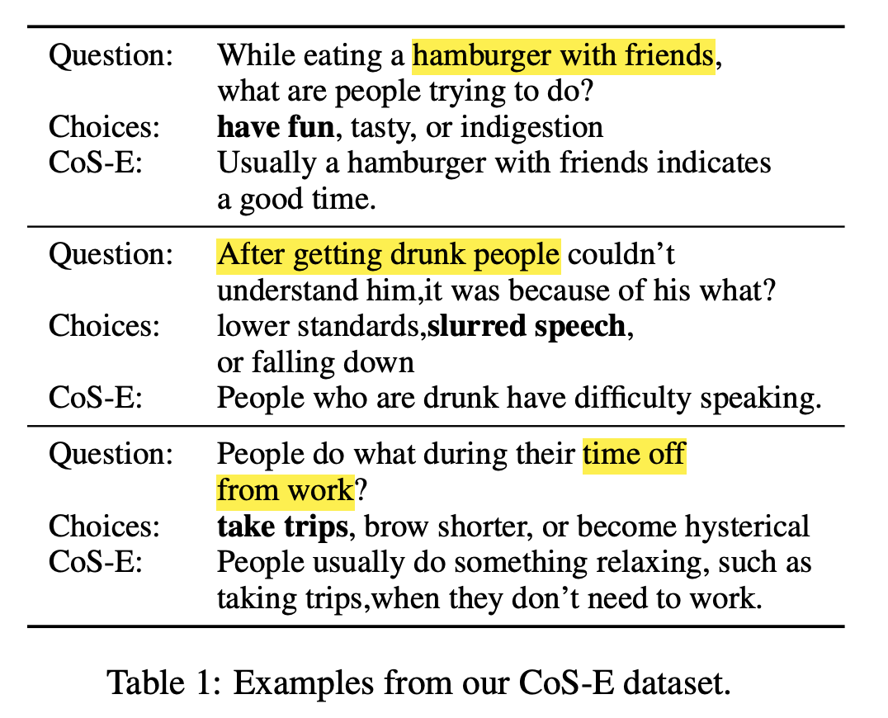
Key Contributions
Common Sense Explanations (CoS-E): Collected human explanations (annotations and natural language explanations) to build on top of CQA

Slide 4
Key Contributions
Common Sense Explanations (CoS-E)
Commonsense Auto-Generated Explanations (CAGE)
CAGE outperforms best baseline by 10% and produces explanations to justify its predictions
Explanation transfer on two out-of-domain datasets

Slide 5
Related Work: Commonsense reasoning
Commonsense reasoning datasets:
Story Cloze: predicting story ending from a set of plausible endings
Situations with Adversarial Generations (SWAG): predicting next scene based on initial event
Models achieve human-level performance on some datasets
Models struggle with understanding how pronouns resolve between sentences and world knowledge
CQA addresses this by requiring models to infer from the question
Language models perform poorly compared to human participants on CQA
Unclear: Do models actually do common-sense reasoning?

Slide 6
Related Work: Natural language explanations
Rationale generation by highlighting complete phrases in input text that are sufficient to predict desired output (Lei et al., 2016)
Human-generated natural language explanations to train a semantic parser to generate noisy labeled data and train a classifier for generating explanations (Hancock et al., 2018)
Interpretability comes at the cost of loss in performance on Stanford Natural Language Inference dataset (Camburu et al., 2018)
Multi-modal: Ensemble explanations and visual explanations improve performance (Rajani and Mooney, 2018 and 2017)
Do explanations for CQA lead to improved performance?

Slide 7
Related Work: Knowledge transfer in NLP
Reliance on transfer of knowledge through pre-trained word vectors (e.g. Word2vec, GloVe) and contextualized word vectors (more refined with general encoding)
Language models trained from scratch on large amounts of data and fine-tuned on specific tasks perform well
Only a few parameters need to be learned from scratch
Perform well on small amounts of supervised data
Gap: Fine-tuned language models don’t perform as well on CQA
Can we leverage these models to generate explanations and show that these explanations capture common sense?
Notes:
Discuss what the gap is on each related work slide

Slide 8
Common Sense Explanations (CoS-E)

Slide 9
Dataset Structure/Creation
Based on the CQA dataset
CoS-E provides natural-language explanations for the correct answer choice and highlights important words in the question
Explanations generated using MTurk
Goal: To show whether models are performing reasoning correctly
CQA
CoS-E
Notes:
CQA is a multiple choice dataset that poses questions that seek to establish common-sense knowledge. Models can be trained to pick the right choice in this dataset.
Turkers are prompted with the following question: “Why is the predicted output the most appropriate answer?” Annotators were instructed to highlight relevant words in the question that justifies the ground-truth answer choice and to provide a brief open-ended explanation based on the highlighted justification could serve as the commonsense reasoning behind the question.

Slide 10
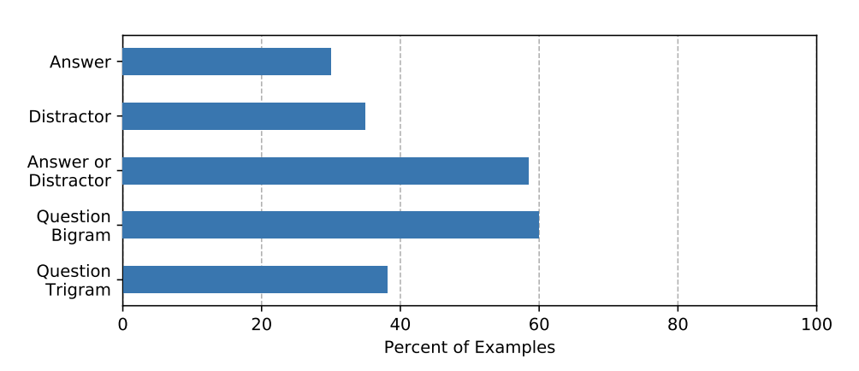
Dataset Considerations
CoS-E-selected refers to the highlighted words, CoS-E-open-ended refers to the explanations
Quality control was performed on the annotations and explanations
Even explanations that don’t discuss the ground truth answer are useful
Notes:
Annotators cannot move forward if they do not highlight any relevant words in the question or if the length of explanations is less than 4 words. We also check that the explanation is not a substring of the question or the answer choices without any other extra words. We collect these explanations from only one annotator per example, so we also perform some post-collection checks to catch examples that are not caught by our previous filters. We filter out explanations that could be classified as a template. For example, explanations of the form “ is the only option that is [correct|obvious]” are deleted and then reannotated.
We can see in this table the composition of the dataset – how many explanations include the answer, a distractor choice, one of the two, or sequences of two or three words from the question. 58% of answer choices include the ground truth.
Empirical results show that even when using only those explanations that do not have any word overlap with any of the answer choices, performance exceeds that of baselines that do not use CoS-E at all.
Many explanations are written as a “process of elimination,” which explains the high proportion of distractors in the dataset.

Slide 11
Commonsense Auto-Generated Explanations (CAGE)
Notes:
Now, we turn to the actual language model that is being used to generate explanations. The paper first discusses how the CAGE framework can be used to generate commonsense reasoning about a question or rationalize a correct answer to a common-sense question.

Slide 12
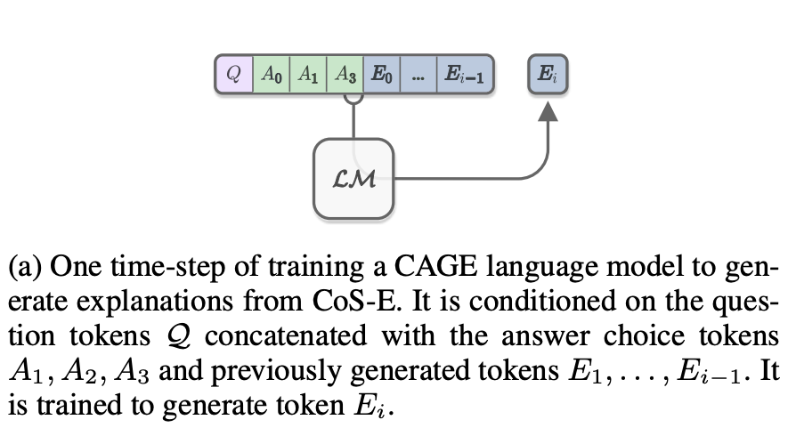
CAGE Phase 1
Commonsense Auto-Generated Explanations (CAGE) Phase 1:
Provide CQA example alongside corresponding CoS-E explanation to a language model
Train model to generate the CoS-E explanation

Slide 13
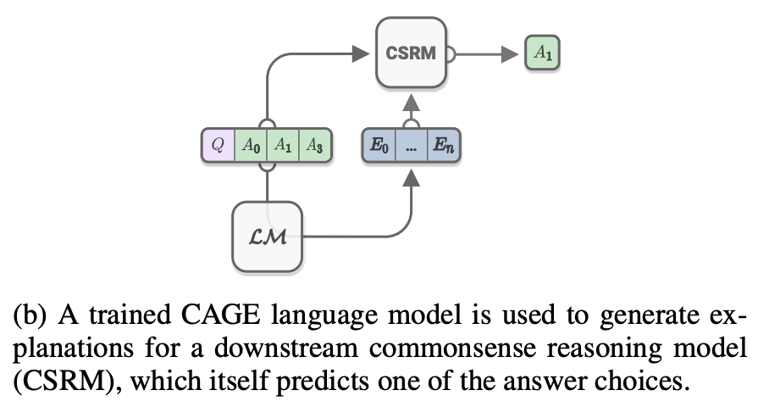
CAGE Phase 2
Commonsense Auto-Generated Explanations (CAGE) Phase 2:
Use language models to generate explanations for each example in the training and validation sets of CQA
Provide CAGE explanations to a second model by concatenating it to the original input (question, answer choices, and language model output)

Slide 14
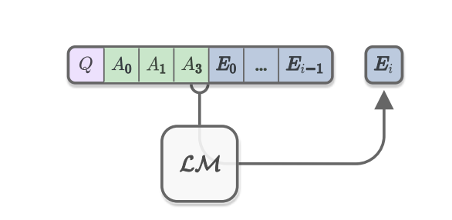
CAGE Phase 1: Intuition
One training step for CAGE
Notes:
On the left side, we see a training step for reasoning – concatenate the question to the answer choices and tokens E_0 - E_{i - 1} of the explanations. Train it to generate E_i.

Slide 15
How is CAGE trained?
Language Model trained to generate explanations from question-answer choice pairs
Use pretrained OpenAI GPT
Fine-tuned on the CQA and CoS-E dataset combination
Two possible settings: explain-then-predict (reasoning) and predict-then-explain (rationalization)
Notes:
OpenAI GPT is a multi-layer transformer decoder

Slide 16
CAGE Notation
Question
Answer choices
Correct answer
CoS-E explanation
CAGE predict explanation

Slide 17
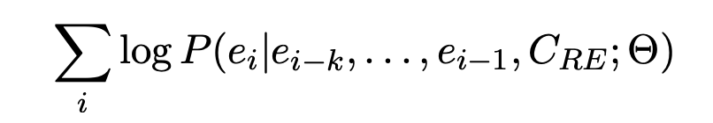
Reasoning
Model is fine-tuned on the question, answer choices, and explanation tokens, but not the actual label.
Objective Function (canonical conditional language modeling objective):
Notes:
The conditional probability P is modeled by a neural network with parameters Θ conditioned on CRE and previous explanation tokens. We call this kind of explanation reasoning because they can be automatically generated during inference to provide additional context for commonsense question answering. Reasoning about question without knowing the answer

Slide 18

Rationalization
Model is now also given the ground truth label a:
Objective Function is the same as before but is also conditioned on the label a
Thus, the explanations create rationalization that makes the model more interpretable
Notes:
The other direction of explanation is rationalization, in which the correct answer is given to the model as well
The training objective for the LM in rationalization is similar to that in reasoning except that in this case, the model has access to the ground truth labels to the input questions during training. Because the language model is conditioned on the predicted label, the explanations cannot be considered as common sense reasoning. Instead, they offer a rationalization that makes the model more accessible and interpretable. We find that this approach outperforms the current best model by 6% and also produces interestingly good quality explanations as discussed in Section 5.

Slide 19
Training Parameters
Generate sequences of maximum length 20
Batch Size: 36, Epochs: 10
Selected the best model using BLEU and perplexity scores

Slide 20
Commonsense Predictions with Explanations

Slide 21
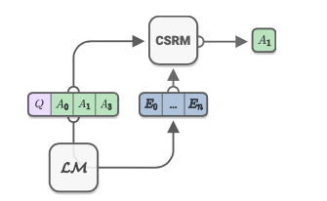
CAGE Phase 2 Intuition

Slide 22
CAGE Inference
Given human explanation from CoS-E or LM reasoning, can then perform predictions on CQA
Simply concatenate Question, [Sep], Explanation, [Sep], Answer Choice as input to downstream CSRM (classifier)
Use binary classification head on top of BERT backbone
3 answer choices → 3 input sequences
Take sequence yielding highest confidence as output

Slide 23
CSRM (BERT) Training HP
Train batch size: 24
Test batch size: 12
10 training epochs
Max sequence length of 50 for labels-only; 175 including explanations

Slide 24
Experimental Results

Slide 25
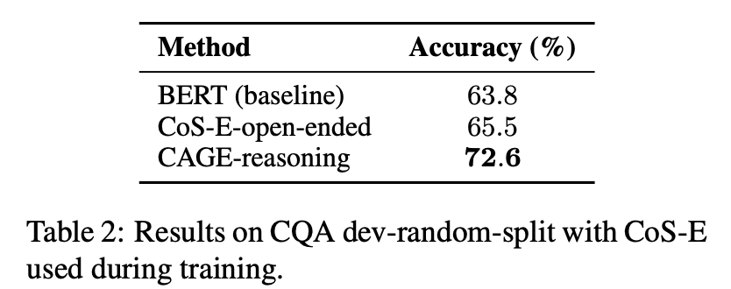
Experimental Results
Notes:
karly

Slide 26
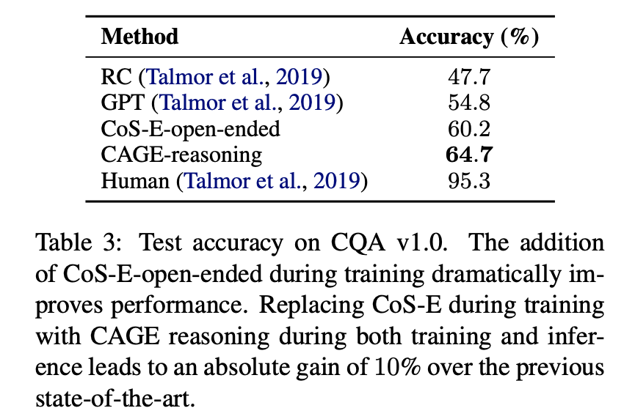
Experimental Results
Google search “question + answer choice” for each example and collected 100 top snippets per answer as context for Reading Comprehension model
Extra data did not improve accuracy
CAGE-reasoning resulted in 10% accuracy gain over previous SOTA
Notes:
CAGE-reasoning performance suggests that it provides much more useful info than can be achieved through simple heuristics like Google search to find relevant snippets.

Slide 27
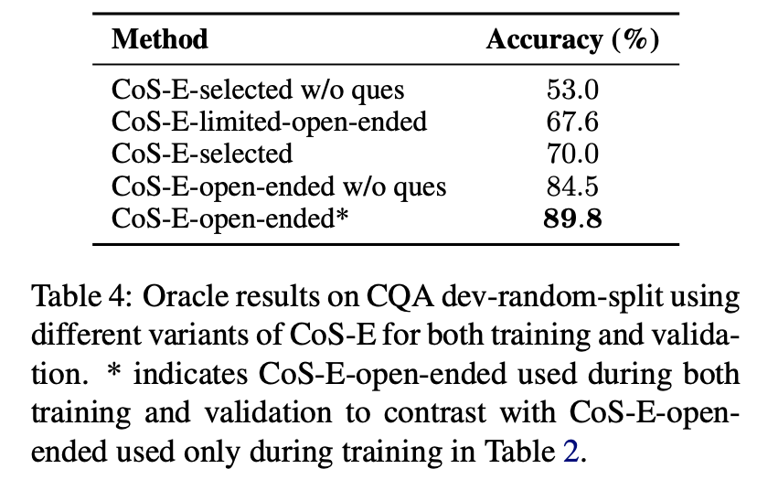
Experimental Results
Oracle upper-bound: human-generated explanations from CoS-E provided during training and validation
Unfair setting bc human that provided explanation had ground truth answer
“CoS-E selected”: explanation consists of words humans selected as justification for model
Notes:
limited: cannot use answer choices in response
asterisk: explanations used in both training and validation

Slide 28
Transferring Explanations Across Domains
How well do natural language explanations transfer from CQA to SWAG and Story Cloze Test?
Use GPT CAGE model fine-tuned on CQA train/dev to generate explanations on SWAG and Story Cloze Spring 2016 train/val
Rinse and repeat using BERT with classifier head

Slide 29
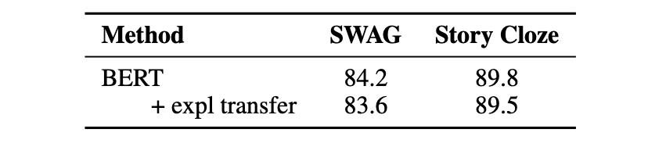
Experimental Results
Camburu et al (2018) show that transferring explanations from SNLI to MultiNLI performs very poorly
Transfer of explanations on commonsense reasoning tasks
NLI problem has small fixed set of pre-defined labels unlike commonsense reasoning tasks like CQA, SWAG, Story Cloze
Adding explanations led to very small decrease in performance
Notes:
karly

Slide 30
Qualitative Analysis

Slide 31
Analysis of CAGE
CAGE-reasoning at train + validation → 72% accuracy
CoS-E-open-ended performance at 90%—why the gap?
Measure quality of CAGE
Human evaluation (42% CAGE vs 52% CoS-E-open-ended)
BLEU score measures syntactical precision by n-gram overlap
Perplexity: token-level measure of how well language models predict next word
Result: beneficial to fine-tune the LM, but humans and LMs have widely varying ways of providing useful explanations

Slide 32
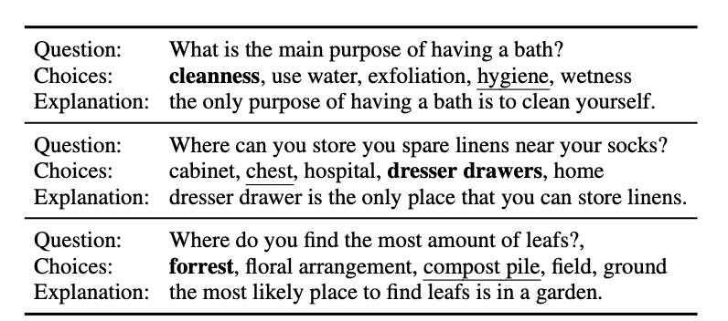
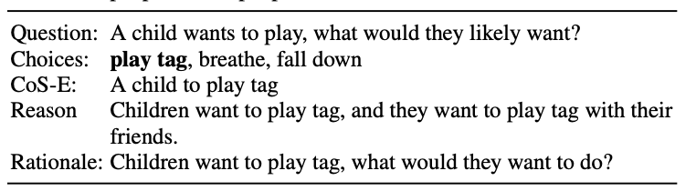
Analysis of baseline BERT model
Error analysis on baseline BERT w/o explanations: performs poorly on longer / more compositional questions → explanations help w this
CAGE reasoning typically simpler construction than CoS-E-open-ended, but adds meaningful context
However, CAGE still provides “incorrect” answers often

Slide 33
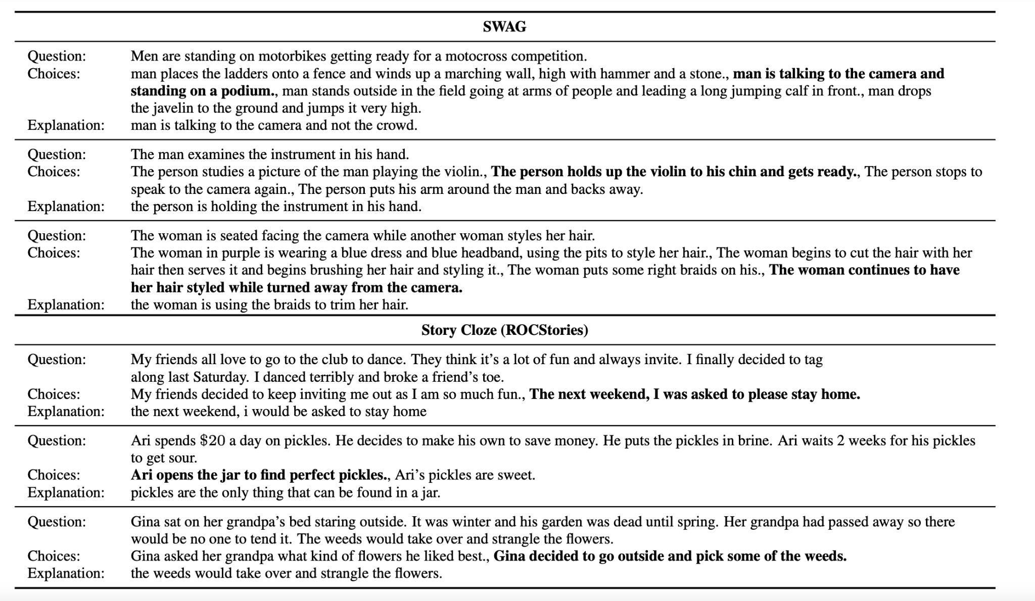
Domain transfer: SWAG + Story Cloze

Slide 34
Conclusion & Group Discussion

Slide 35
Conclusion
CoS-E on top of CommonsenseQA
CAGE framework → LM leverages explanations
Classifier on top of explanations
SOTA performance on a difficult commonsense reasoning task
Opens further avenues for studying explanation as it relates to interpretable commonsense reasoning

Slide 36
Discussion questions
BLEU and perplexity as measures of goodness?
Has been shown multiple times to correlate poorly with human judgement
Joint training of explanation and label? Not one prior to other
Can commonsense reasoning help general reasoning (e.g. mathematics, Fermi, counterfactual) in other domains?
How to align human/machine explanations?
Research merit of this work?
Recent work (RLPrompt, AutoPrompt) has shown that optimal prompts for LMs (with respect to downstream task performance) are often times gibberish
What does this say about the validity of using SOTA LMs for explanations?
Can we regularize LM training to better align with human reasoning?

