Slide 1
Evaluating Interpretability
CS 282 BR Topics in Machine Learning: Interpretability and Explainability
Ike Lage
02/01/2023

Slide 2
Overview
Evaluating interpretability in the interpretable ML community:
Interpretability depends on human experience of the model
Disagreement about the best way to measure it
These papers:
Evaluating factors related to interpretability through user studies

Slide 3
Other Relevant Fields
Human-Computer Interaction (HCI):
Theories for how people interact with technology
Psychology:
Theories for how people process information
Both have thought carefully about experimental design

Slide 4
Outline
Research paper: “Human Evaluation of Models Built for Interpretability” by Lage et al.
Research paper: “Manipulating and Measuring Model Interpretability” by Poursabzi-Sangdeh et al.
Discussion

Slide 5
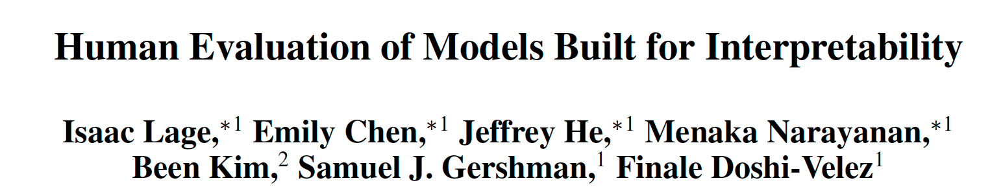
Paper 1

Slide 6
Contributions
Research Questions:
Which types of decision set complexity most affect human-simulatability?
Is relationship between complexity and human-simulatability context dependent?
Approach:
Large scale, carefully controlled user studies

Slide 7
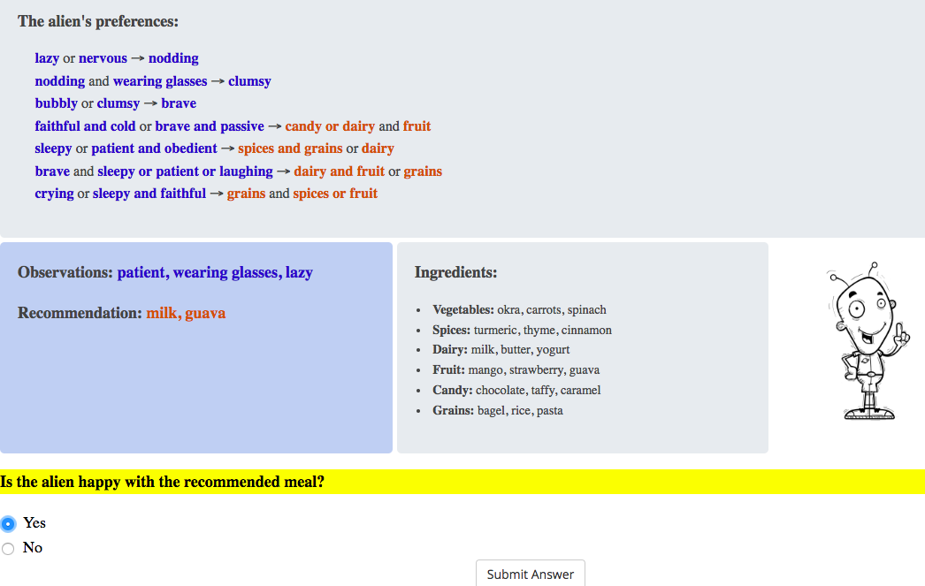
Decision Sets
Logic-based models are often considered interpretable
Many approaches for learning them from data

Slide 8

Regularizers
There are many ways to regularize decision sets that make them less complex
What kinds of complexity is it most urgent to regularize to learn interpretable models?
Choose a
regularizer for
interpretability
Optimize
With regularizer
Interpretable Model?

Slide 9
Types of Complexity
Cognitive chunks
Model size
Variable repetitions

Slide 10
Types of Complexity
Cognitive chunks
Model size
Variable repetitions
What if we optimized the models with data?

Slide 11
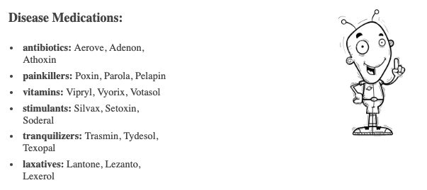
Context: Domains
Low Risk: Alien meal recommendation
High Risk: Alien medical prescription

Slide 12
Context: Domains
Low Risk: Alien meal recommendation
High Risk: Alien medical prescription
What if we used 2 different real domains?

Slide 13
Context: Tasks
Simulation:
What would the model recommend the alien?
Verification:
Is milk and guava a correct recommendation?
Counterfactual:
If patient were replaced with sleepy, would the correctness of the milk and guava recommendation change?

Slide 14
Context: Tasks
Simulation:
What would the model recommend the alien?
Verification:
Is milk and guava a correct recommendation?
Counterfactual:
If patient were replaced with sleepy, would the correctness of the milk and guava recommendation change?
What if we used more realistic tasks?

Slide 15
Tradeoff between control and generalizability
Tradeoff between the ability to tightly control the experiment and running it under realistic conditions (generalizability)
This paper
Tightly controlled
Realistic

Slide 16
Procedure
Experiment posted on Mturk
Takes around 20 minutes
Participants paid 3 USD
Excluded participants who could not complete practice questions
Total: 50-70 participants out of 150
Instructions
3-6 practice questions
15-18 test questions
Payment code

Slide 17
Statistical Analysis: Linear Model
We use a linear model for each metric in each experiment
Response time
Accuracy
Satisfaction

Slide 18
Statistical Analysis: Linear Model
We use a linear model for each metric in each experiment
Response time
Accuracy
Satisfaction
Example – Model Size, Response Time:
Step 1: Fit linear regression to predict response time from number of lines and number of output terms
Step 2: Interpret coefficients as effects of number of lines and number of output terms on response time

Slide 19
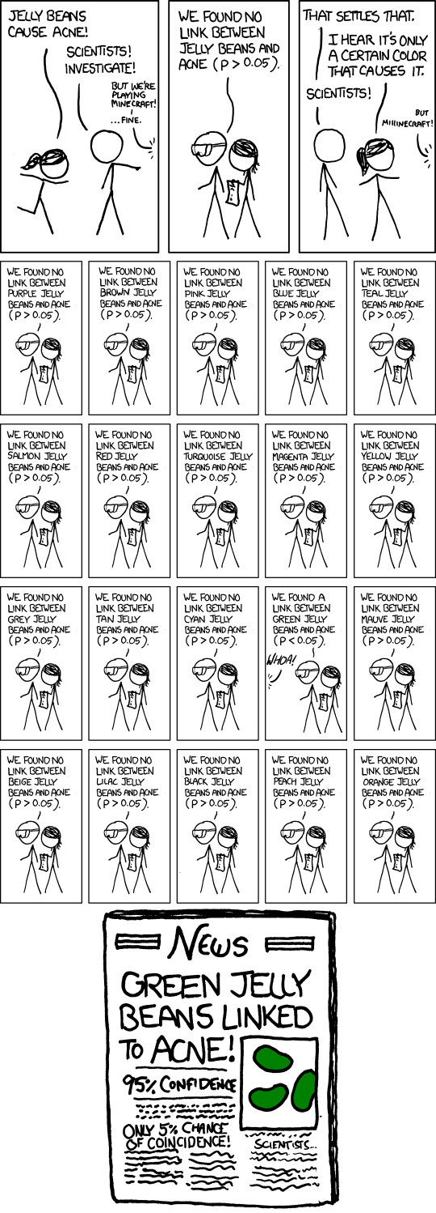
Stat. Analysis: Multiple Hypothesis Testing
We use a Bonferroni correction
Instead of p < 0.05, use
p < (0.05 / # comparisons)
…
Link: https://xkcd.com/882/

Slide 20
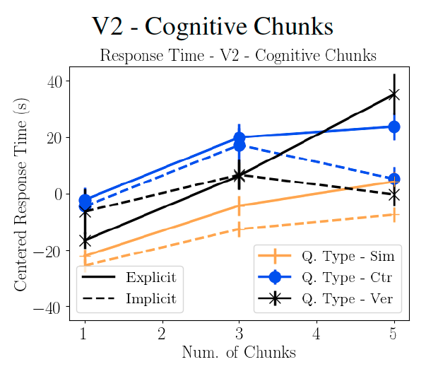
Results: Complexity increases response time
Recipe Domain
Longer response time
Greater Complexity
Greater complexity results in longer response time for all kinds of
complexity

Slide 21
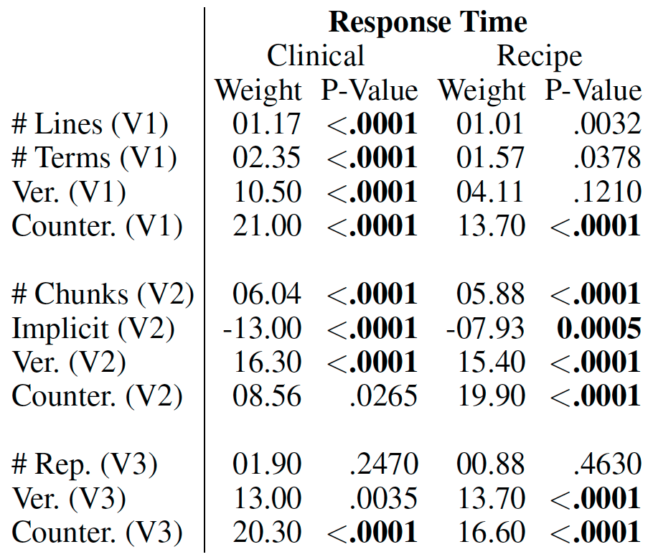
Results: Type of complexity matters
Model size
Significant in one domain
Significant in all domains
Cognitive chunks
Variable repetitions
Significant in neither domain
Response time for: cognitive chunks > model size > repeated terms

Slide 22
Results: Consistency - Domains, Tasks, Metrics
Model size
For example:
Similar effect sizes, both statistically significant
Cognitive chunks
Variable repetitions
Results consistent across domains, tasks and the response time and subjective difficulty metrics

Slide 23
Results: Counterfactuals are hard
Model size
Cognitive chunks
In all experiments, longer response time than simulation
Variable repetitions
The counterfactual task is much more challenging than simulation!

Slide 24
Discussion
Consistent guidelines for interpretability
Simplified tasks to measure interpretability
Using Mturk workers as a proxy for domain experts

Slide 25
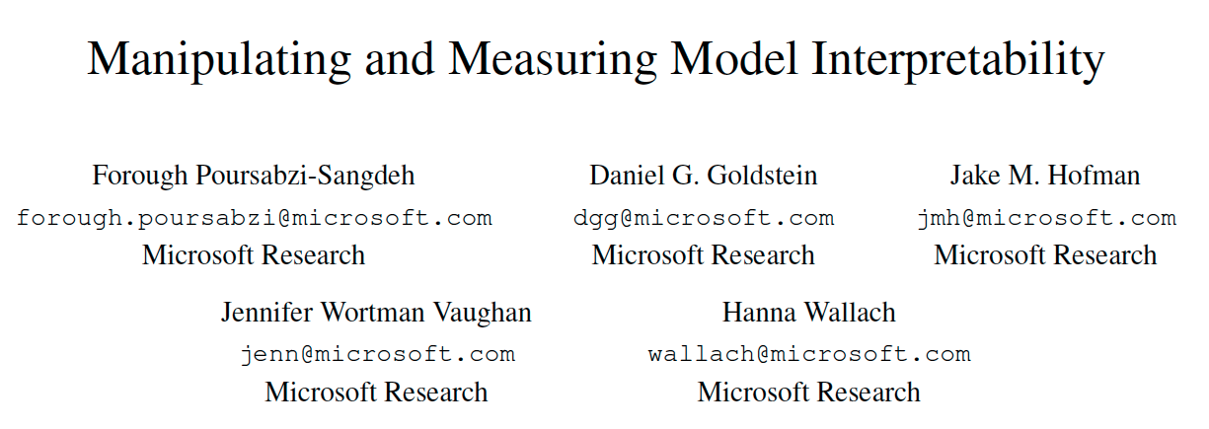
Paper 2

Slide 26
Motivation
Interpretability as a latent property that can be manipulated or measured indirectly
What are the factors through which it can be manipulated effectively?
Bring HCI methods to interpretable ML since interpretability is defined by user experience

Slide 27
Contributions
Research Questions:
How well can people estimate what a model will predict?
How much do people trust a model’s predictions?
How well can people detect when a model has made a sizable mistake?
Approach:
Large-scale, pre-registered user studies to answer these questions in the context of linear regression models

Slide 28
Comparison to Paper 1
Studies linear regression models instead of decision sets
Measures people’s ability to make their own predictions in addition to forward simulation
Uses real-world housing dataset and models optimized with data

Slide 29
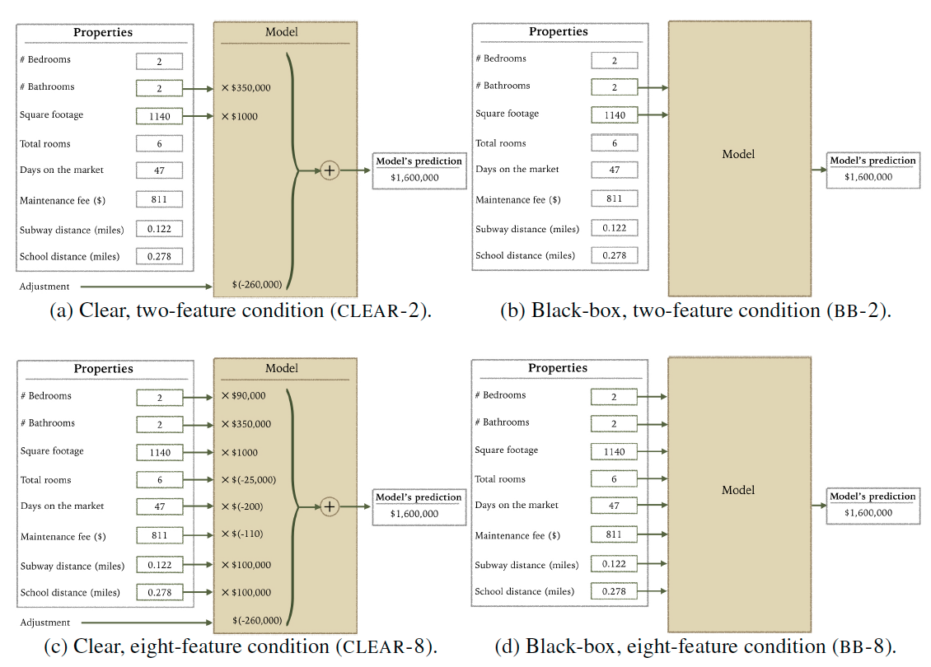
Ways to Manipulate Interpretability
# of Features
Transparency

Slide 30
Procedure
Participants shown:
Training: 10 apartments
Testing: 12 apartments (this is the data they use)
Participants paid 2.5 USD
750-1,250 participants per experiment
Each Trial
Forward simulate model’s prediction
View model’s true prediction
Make own prediction

Slide 31
Statistical Analysis: Participant Specific Effects
A repeated measures experimental design
Each participant makes many predictions
Use a mixed-effects model to control for correlations between a participant’s responses
Assumes a random, participant-specific effect

Slide 32
Stat. Analysis: Multiple Hypothesis Testing
Pre-registering hypotheses corresponds to deciding and publishing which analyses you will run before collecting data
Reduces the probability that effects were discovered by chance
For example:
https://aspredicted.org/xy5s6.pdf

Slide 33
Design choices
Randomized the order of the first 10 (normal) apartments and fixed the order of the last 2 (unusual)
All participants are shown an identical set of apartments
Each participant completed a single condition (between subjects design)
Notes:
Fixed would reduce variance, but could increase the amount of bias. For example, their concern that seeing bad apartments would decrease people’s trust. Question of whether it’s ok to control for that in this way!

Slide 34
Design choices
Randomized the order of the first 10 (normal) apartments and fixed the order of the last 2 (unusual)
All participants are shown an identical set of apartments
Each participant completed a single condition (between subjects design)
Can introduce bias
Increases variance
Fix sources of randomness
Randomize as much as possible
Notes:
Fixed would reduce variance, but could increase the amount of bias. For example, their concern that seeing bad apartments would decrease people’s trust. Question of whether it’s ok to control for that in this way!

Slide 35
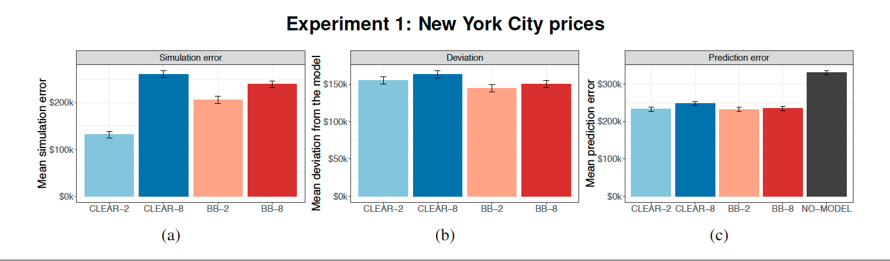
Results: Simulating small, transparent models
Best simulation accuracy with small, transparent models

Slide 36
Results: No difference in trust or prediction
None of the conditions are statistically different for trust or prediction error

Slide 37
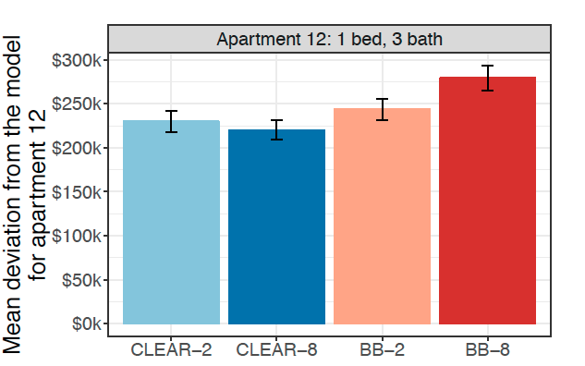
Results: Clear models make mistakes worse
Deviation
Higher is better
Participants deviate less from the bad prediction with clear models
Notes:
Participants deviate less from the model’s bad prediction in the clear case (on apartment 12)

Slide 38
Additional Experiments
Scaled down prices to better reflect national average
Same results

Slide 39
Additional Experiments
Scaled down prices to better reflect national average
Better trust metrics
No significant different in trust between models

Slide 40
Additional Experiments
Scaled down prices to better reflect national average
Better trust metrics
Attention check for unusual features
People catch more errors

Slide 41
Discussion
Highlighting weird inputs helps catch errors
Having people predict before seeing the model helped catch errors
Transparency actually makes people worse at catching errors

