Slide 1
Additive Explanations
Shapley Values
Approximations
Experiments
Extensions
A Unified Approach to Interpreting Model Predictions
Scott Lundberg and Su-In Lee
Max Nadeau, Max Li, and Xander Davies
February 22, 2023
Max Nadeau, Max Li, and Xander Davies
A Unified Approach to Interpreting Model Predictions

Slide 2
Additive Explanations
Shapley Values
Approximations
Experiments
Extensions
Outline
Additive Explanations
Overview and relation to LIME Desiderata
Shapley Values
Introduction to Shapley values Removing features
Approximations
Experiments
Extensions
Global interpretability Inner interpretability
Max Nadeau, Max Li, and Xander Davies
A Unified Approach to Interpreting Model Predictions

Slide 3
Additive Explanations Shapley Values Approximations Experiments Extensions
Overview and relation to LIME
Introduction to Additive Feature Attribution Methods
This paper unifies 6 previous methods for local interpretability (i.e. explaining the output of a model f on a particular input x ) as “additive feature attribution methods”, (AFAMs).
An additive feature attribution method consists of:
An enumeration of the features present in x
A protocol for “removing some of the features” from x , and therefore a definition of “the input that has no features”, here called y .
An approximation of f (x ) called g (x ′), and an approximation
of f (y ) called g (y ′)
A partition of g (x ′) − g (y ′) among the enumerated features of x , indicating how important each feature was for the model’s output on x .
The importance of a feature i is denoted ϕ_{i} , so
^{Σ}_{i} ϕ_{i} = g (x ′) − g (y ′)
Max Nadeau, Max Li, and Xander Davies
A Unified Approach to Interpreting Model Predictions

Slide 4
Additive Explanations Shapley Values Approximations Experiments Extensions
Overview and relation to LIME
LIME as an Additive Feature Attribution Method
You all remember LIME from the last presentation.
LIME (for explaining a classification of some image x ) is an AFAM.
The set of superpixels is the set of features of x
We remove a superpixel (i.e. feature) by replacing its pixels with grey. So the image containing no features is all grey. LIME outputs a function g that approximates f (x ) and f (y ) as g (x ′) and g (y ′).
g provides a weighting g_{i} for the importance of each superpixel
in determining f (x ); these serve as the ϕ_{i} .
Max Nadeau, Max Li, and Xander Davies
A Unified Approach to Interpreting Model Predictions

Slide 5
Additive Explanations Shapley Values Approximations Experiments Extensions
Overview and relation to LIME
DeepLIFT as an Additive Feature Attribution Method
DeepLIFT is another local interpretability method, proposed in (Shrikumar et al., 2019).
DeepLIFT (for explaining a classification of some image x ) is an AFAM.
The set of pixels is the features of x .
We pick some “reference value” to serve as y , the image with no features. Removing a feature of x consists of setting a pixel to the value of that pixel in the reference image.
DeepLIFT doesn’t approximate f (x ) and f (y ), it just uses
g (x ′) = f (x ) and g (y ′) = f (y ).
DeepLIFT calculates a value C_{∆xi ∆o} for each pixel x_{i} such that
Σ
C = f (x ) − f (y ). Each C
represents the
∆x ∆o ∆x ∆o
i i
i
importance of x_{i} to classification f (x ).
Max Nadeau, Max Li, and Xander Davies
A Unified Approach to Interpreting Model Predictions

Slide 6
Additive Explanations Shapley Values Approximations Experiments Extensions
Desiderata
Desiderata for Additive Feature Attribution Methods
They propose three desirable properties for an AFAM. Local accuracy: g (x ′) = f (x ). As we saw on the last two slides, DeepLIFT meets this criterion but LIME does not necessarily.
Consistency: For some input x , let x \ i denote “removing feature i from x ”. Let z be an alternative input produced by removing some of x ’s features. Suppose you have two models, f and f ′. If, ∀z , f (z ) − f (z \ i ) ≥ f ′(z ) − f ′(z \ i ), then our AFAM should have ϕ_{i} (f , x ) ≥ ϕ_{i} (f ′, x ).
In other words, if including feature i in the input always makes
a bigger difference in model f than in model f ′, then the AFAM should give a higher importance ϕ_{i} for the model f than for f ′.
Missingness: This third criterion is described as “really just a minor book-keeping property”, so we’ll ignore it.
Max Nadeau, Max Li, and Xander Davies
A Unified Approach to Interpreting Model Predictions

Slide 7
Additive Explanations Shapley Values Approximations Experiments Extensions
Introduction to Shapley values
Cooperative games
Suppose we have a game with d players, where each player can choose whether or not to cooperate.
Assume a reward function g : P([d ]) → R. If S ⊂ [d ] is the set of players that choose to cooperate, then the group receives reward g (S ).
We want to determine how much each player “contributes” to the reward. However, the marginal contribution of player i may depend on which other players have also chosen to cooperate. g does not need to be monotonic!
Max Nadeau, Max Li, and Xander Davies
A Unified Approach to Interpreting Model Predictions

Slide 8
Additive Explanations Shapley Values Approximations Experiments Extensions
Introduction to Shapley values
Shapley values
Maybe we can just take the average of player i ’s marginal contribution over all subsets. In fact, this calculation gives player i ’s Banzhaf power index:
1 ₂d −1
Σ
g (S ⊔ {i }) − g (S ) (1)
S ⊂[d ]\{i }
The Shapley value reweights the marginal contributions based on the size of the subset S :
 
d −1
Σ
−1
Σ
1
d j

d − 1
g (S ⊔ {i }) − g (S )  (2)
j=0 S ⊂[d ]\{i }, |S |=j
or, equivalently, ^{Σ}_{σ∈Sd} g (σ([σ(i )])) − g (σ([σ(i ) − 1]))
Max Nadeau, Max Li, and Xander Davies
A Unified Approach to Interpreting Model Predictions

Slide 9
Additive Explanations Shapley Values Approximations Experiments Extensions
Introduction to Shapley values
From games to local interpretability
Suppose that for some input x , a model produces prediction f (x ), and we would like to measure how “important” each feature was for the model prediction. We can treat the features as players in a cooperative game, and ask how much each contributed to the output.
However, to prompt the model, we need to provide all the input features S . How do we measure what the model would have predicted if it only had access to a subset of the features?
In other words, the function g : P([d ]) → R is not well-defined.
Max Nadeau, Max Li, and Xander Davies
A Unified Approach to Interpreting Model Predictions

Slide 10
Additive Explanations Shapley Values Approximations Experiments Extensions
Removing features
Previously proposed: separate models
In “Shapley regression values,” for every subset of features S ⊂ [d ], we can train a model f_{S} that tries to predict the labels.
The resulting Shapley values are a good metric for how important each feature is for good prediction of the labels.
However, they do not provide interpretability for the specific model f we were working with, i.e. what f might do without any information about the features in [d ] ⊂ S might be very different than optimal prediction.
Max Nadeau, Max Li, and Xander Davies
A Unified Approach to Interpreting Model Predictions

Slide 11
Additive Explanations Shapley Values Approximations Experiments Extensions
Removing features
Feature ablation
We want to capture what our particular model on f would do if it had no access to features [d ] ⊂ S .
This notion is captured by the expectation of the model output given features S .
E [f (x ) | x_{S} ]
We can approximate this quantity by sampling over the conditional distribution:
(3)
N
1
N
Σ
f (x ^{(i )}), x ^{(i )} ∼ x |x
(4)
S
i =1
Max Nadeau, Max Li, and Xander Davies
A Unified Approach to Interpreting Model Predictions

Slide 12
Additive Explanations
Shapley Values
Approximations
Experiments
Extensions
Model Agnostic: Feature independence
Computing SHAP values requires calculating 2^{d} differences
g (s ⊔ {i }) − g (s).
One way to improve this is to assume features are independent, ∀S
E [f (x ) | x_{S} ] = E_{xS¯|xS} [f (x )] ≈ E_{xS¯} [f (x )] We can then estimate SHAP values via sampling
(5)
approximations (the Shapley sampling values method) which require fewer than 2^{d} difference calculations.
But, still requires lots of computations.
Max Nadeau, Max Li, and Xander Davies
A Unified Approach to Interpreting Model Predictions

Slide 13
Additive Explanations
Shapley Values
Approximations
Experiments
Extensions
Model Agnostic: Kernel SHAP via LIME
LIME: The kernel weights (π_{x}′ ), loss function (L), and simplicity function (Ω) proposed in LIME aren’t consistent with our desired properties (local accuracy & consistency).
We can adjust these choices to fix that, forming the Shapely kernel:
Ω(g ) = 0, (6)
(M − 1)
π ′
′
x
z =
, (7)
(M choose |z ′|) |z ′| (M − |z ′|)
Σ
L (f , g, π ′ ) =
′ ′
2
′
f h z − g z π ′ z ,
(8)
x
x
x
z′∈Z
where |z ′| is the number of non-zero elements in z ′.
Max Nadeau, Max Li, and Xander Davies
A Unified Approach to Interpreting Model Predictions

Slide 14
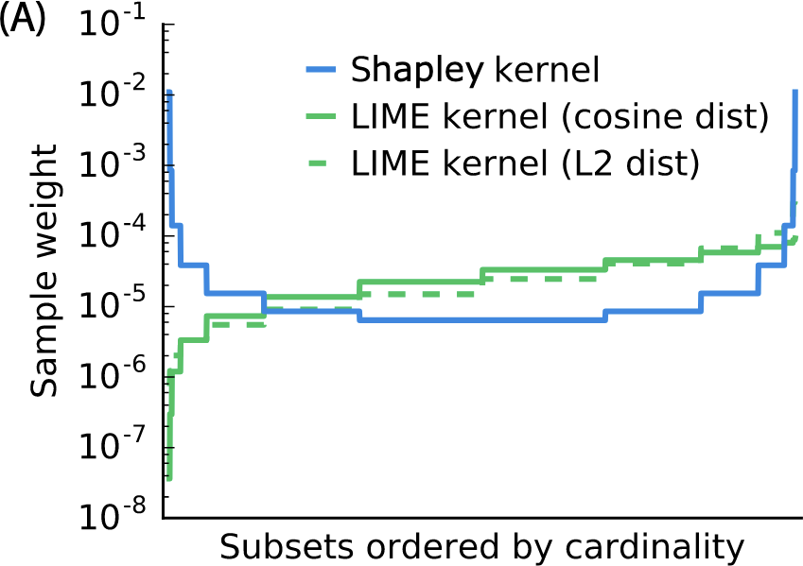
Additive Explanations
Shapley Values
Approximations
Experiments
Extensions
Model Agnostic: Kernel SHAP (cont.)
Max Nadeau, Max Li, and Xander Davies
A Unified Approach to Interpreting Model Predictions

Slide 15
Additive Explanations
Shapley Values
Approximations
Experiments
Extensions
Model Agnostic: Kernel SHAP (cont.)
We can consider LIME’s feature removing protocol an approximation of SHAP values that assumes f is linear (eek), so that E [f (x ) | x_{S} ] = f (x ∗), where
(
x if i ∈ S
∗
i
x =
(9)
i
E [x_{i} ] otherwise
Since we can solve for g in (8) as a weighted linear regression problem, we have a regression-based, model-agnostic estimation of SHAP values!
This is more efficient than previously, since we jointly solve for SHAP values.
Max Nadeau, Max Li, and Xander Davies
A Unified Approach to Interpreting Model Predictions

Slide 16
Additive Explanations
Shapley Values
Approximations
Experiments
Extensions
Model-Specific Approximations: Linear SHAP
We can do better by looking for model-specific approximations.
If the model is affine and we assume feature independence, feature i ’s importance for x is its difference from the mean multiplied by its weight.
Σ
That is, if f (x ) =
M
j=1
w_{j}x_{j} + b, then ϕ₀(f , x ) = b and
ϕ_{i} (f , x ) = w_{j} (x_{j} − E [x_{j} ])
Max Nadeau, Max Li, and Xander Davies
A Unified Approach to Interpreting Model Predictions

Slide 17
Additive Explanations
Shapley Values
Approximations
Experiments
Extensions
Model-Specific Approximations: Deep SHAP
DeepLift approximates SHAP values assuming that the input features are independent of one another and the deep model is linear, since it:
linearizes the non-linear components of a network (”heuristically chosen”)
replaces values with a reference value, which we can consider
E [x ] (like LIME)
Currently, this satisfies local accuracy (and missingness), but not consistency.
We can choose new linearizations which satisfy consistency →
Deep SHAP!
Max Nadeau, Max Li, and Xander Davies
A Unified Approach to Interpreting Model Predictions

Slide 18
Additive Explanations
Shapley Values
Approximations
Experiments
Extensions
User Experiments
The authors run a experiment in which they tell a story about people playing a cooperative game, and find that human assignments of credit align better with SHAP’s assignment than with LIME’s or DeepLIFT’s.
This is a very different setting from attribution in neural networks, seemingly selected to make SHAP look good, so this experiment is unimpressive evidence that SHAP aligns with human intuition for NN credit assignment.
Max Nadeau, Max Li, and Xander Davies
A Unified Approach to Interpreting Model Predictions

Slide 19
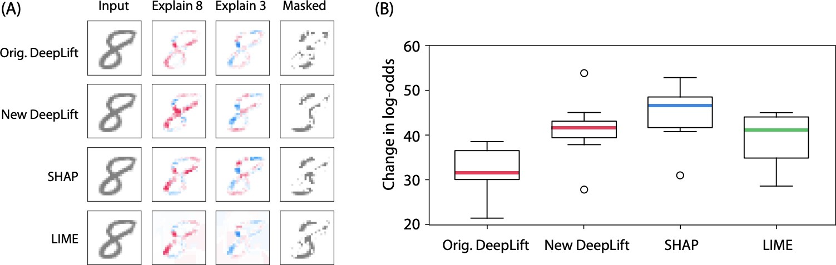
Additive Explanations
Shapley Values
Approximations
Experiments
Extensions
Class Difference Experiments
Using an image of an “8” and an MNIST classifier, the authors identified which pixels (according to SHAP, LIME, and DeepLIFT) are most important for the model’s log-odds (i.e. logit difference) of 8 versus 3.
Removing the pixels identified by SHAP produced larger changes in log-odds from 8 to 3 than the other methods.
Max Nadeau, Max Li, and Xander Davies
A Unified Approach to Interpreting Model Predictions

Slide 20
Additive Explanations Shapley Values Approximations Experiments Extensions
Global interpretability
Shapley values for the whole model
Rather than attributing Shapley values for the model’s prediction on a particular value x , we can instead attribute Shapley values for the model’s prediction over the entire input distribution. Naively, we can define g : P([d ]) → R by g (S ) = E [E [f (x )|x_{S} ]], which reduces trivially to E [f (x )] by Adam’s law. Instead, to capture the amount of the model’s behavior we can explain with only a subset of the features, we need to impose a symmetric loss function, for instance
g (S ) = Var(E [f (x ) | x_{S} ])
Methods that do this include SAGE (Covert et al, 2020) and Shapley Effects (Owen, 2014).
Max Nadeau, Max Li, and Xander Davies
A Unified Approach to Interpreting Model Predictions

Slide 21
Additive Explanations Shapley Values Approximations Experiments Extensions
Inner interpretability
Neuron Shapley
We can treat neurons as features (Ghorbani and Zou, 2020). This paper uses zero ablation.
We can also use multi-armed bandit sampling algorithms to estimate Shapley values.
Max Nadeau, Max Li, and Xander Davies
A Unified Approach to Interpreting Model Predictions

