Slide 1
Axiomatic Attribution for Deep Networks
Presented by Alex Lin, Steve Li, Kevin Huang
Notes:
Guidelines for Presentation
Motivation
Problem Statement
Summary of Contributions
Related Work
Preliminaries + Background (Intuition First!)
Approach (Intuition First!)
Key Experimental Results
Conclusions
Your Perspective on the Weaknesses of Paper
What would you do differently?

Slide 2
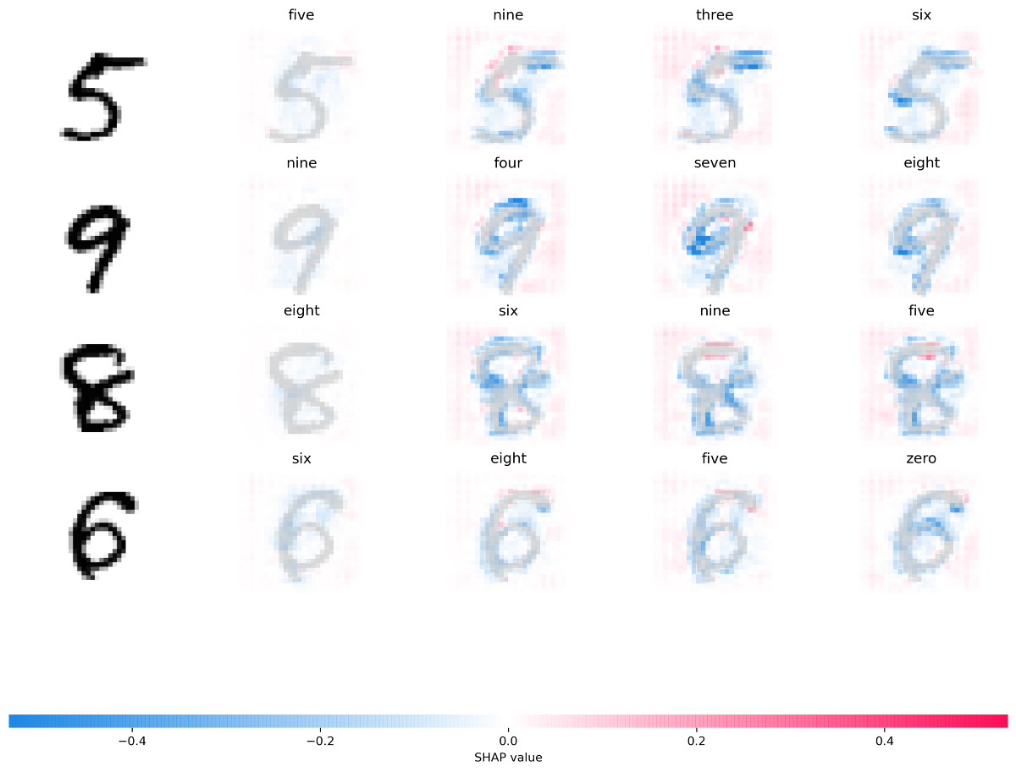
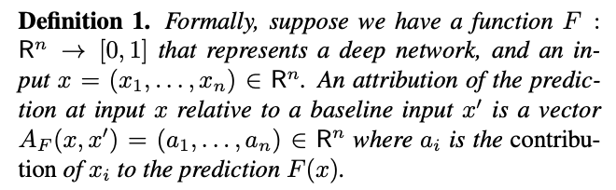
Motivation and Problem Statement
Feature Attribution:
Examples: in a CNN an attribution method could reveal which pixels were responsible for a certain label being picked (we saw this with LIME/SHAP)
Problem: attribution technique are hard to evaluate empirically - hard to separate errors from model vs errors from attribution method
Ex. Gradients
Baseline: black image, empty text, etc.
Notes:
Picture of a CNN example

Slide 3
Summary of Contributions
Present two axioms: Sensitivity and Implementation Invariance
Sensitivity: For every input and baseline that differ in one feature but have different predictions then the differing feature should be given a non-zero attribution.
Implementation Invariance: The attributions are always identical for two functionally equivalent networks.
2 axioms → integrated gradients
Overview: path integral of the gradients along the straight line path from an input x to a baseline input x’
Notes:
Make it more clear - explanations are a little lengthy

Slide 4

Two Axioms (Desiderata)
Sensitivity (a)
Invariance
Definition: When 2 inputs that differ in only one feature result in different predictions, the differing feature should be given a non-zero attribution.
Definition: The attributions are always identical for two functionally equivalent networks.
Notes:
Sensitivity:
Practically, the lack of sensitivity causes gradients to focus on irrelevant features.
Invariance:
First, notice that gradients are invariant to implementation.
To see this, think of g and f as the input and output of a
system, and h being some implementation detail of the
system. The gradient of f with respect to g can be computed
either directly by ignoring the intermediate function h
Which is an implementation detail, or by invoking the chain
rule via h.
If an attribution method fails to satisfy Implementation Invariance, the attributions are potentially sensitive to unimportant aspects of the models.

Slide 5
Other Attribution Methods
Gradients (of the output with respect to the input)
Breaks sensitivity - prediction function can flatten at the input, giving 0 gradient despite function value at the input being different from the baseline
Example:
Single ReLU network: f(x) = 1 - ReLU (1 - x)
Baseline: x = 0, input: x = 2
f(0) = 0, f(2) = 1
Since f is flat at x = 1, gradient gives attribution of 0 to x
Notes:
Convey how each method doesnt

Slide 6
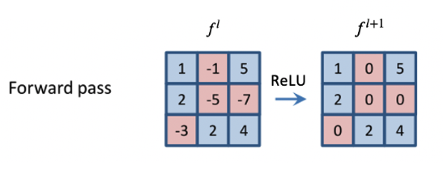
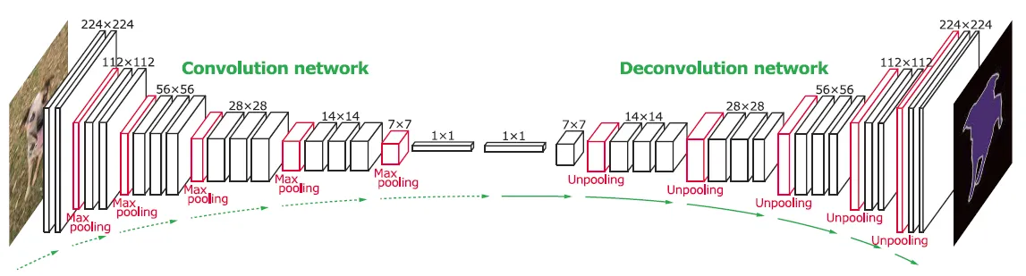
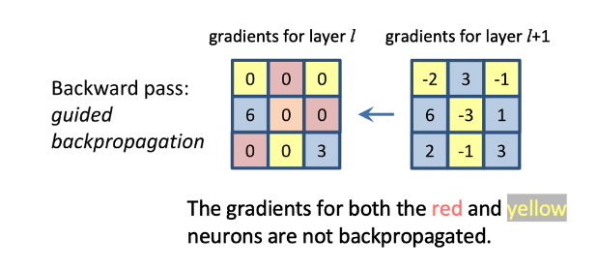
Other Attribution Methods
Methods that Break Sensitivity
DeConvNets, Guided back-propagation
Only back-prop through a ReLU if the ReLU is turned on at the input
Attribution is 0 for features with 0 gradients, despite non-zero gradient at the baseline
Notes:
Convey how each method doesnt

Slide 7
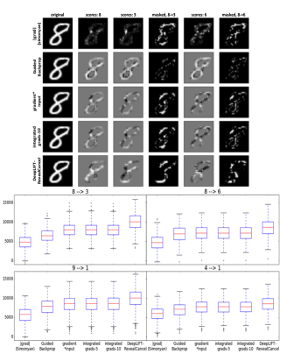
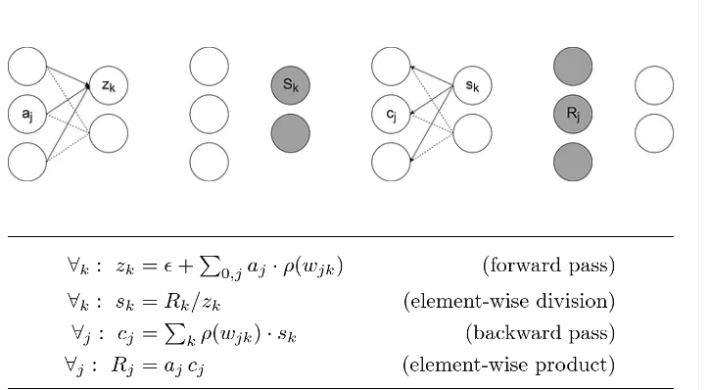
Other Attribution Methods
Methods that Break Implementation Invariance
DeepLift and Layer-wise relevance propagation (LRP)
Replace gradients with discrete gradients, use a modified form of backpropagation
Chain rule doesn’t hold for discrete gradients (calculating gradients would be different) → breaks implementation invariance
Notes:
Convey how each method doesnt

Slide 8
The Method

Slide 9
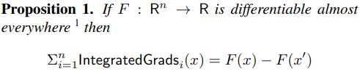
Integrated Gradients
Definition
New Axiom
The path integral of the gradients along the straight-line path from the baseline 𝑥’ to the input 𝑥.
Completeness: The sum of the attributions is equal to the difference of the outputs.
Notes:
What are IGs:
We consider the straight-line path (in ℝn) from the baseline 𝑥’ to the input 𝑥, and compute the gradients at all points along the path. Integrated gradients are obtained by accumulating these gradients. This is called a path integral.
Satisfies both sensitivity(a) and implementation invariance.
In fact satisfies a new axiom called completeness. It is a sanity check that the attribution method is somewhat comprehensive in its accounting,
a property that is clearly desirable if the networks score is
used in a numeric sense, and not just to pick the top label
The authors claim that every empirical evaluation technique they could think of could not differentiate between artifacts that stem from perturbing the data, a misbehaving model, and a misbehaving attribution method.

Slide 10
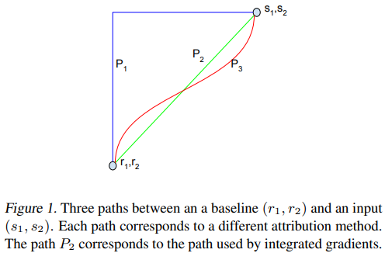

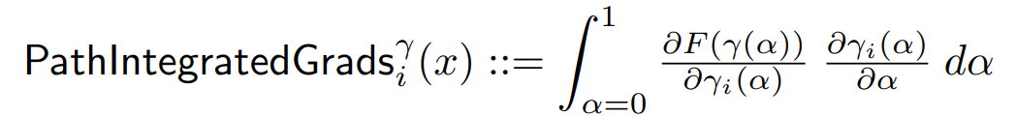


Uniqueness of Integrated Gradients
Path Methods
Axioms
Sensitivity (b): If the function does not depend (mathematically) on some input, then the attribution for that input is always zero.
Linearity: Attributions preserve any linearity within the network.
Symmetry-Preserving: For symmetric variables, if they have identical values in the input and identical values in the baseline, they then receive identical attributions.
Notes:
Path Methods:
There are many other (non-straightline) paths that monotonically interpolate between the two points, and each such path will yield a different attribution method.
Path Integrated Gradients are the generalization of integrated gradients
Axioms:
Path Methods also satisfy 2 additional axioms or Desiderata: sensitivity(b) and linearity.
Path methods are the only attribution methods that always satisfy Implementation Invariance, Sensitivity(b), Linearity, and Completeness.
Proven in cost-sharing literature in economics
Integrated gradients is the unique path method that is symmetry preserving.
Two input variables are symmetric w.r.t. a function if swapping them does not change the function. For instance, x and y are symmetric w.r.t. F if and only if F(x, y) = F(y, x) for all values of x and y.

Slide 11
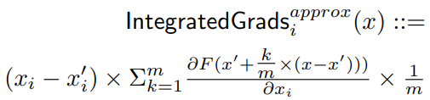

Using Integrated Gradients
Selecting a Baseline
Computing IGs
Two Components:
Zero-Score
Conveys Absence of Signal
Examples:
Object Recognition: All-black image
Text: All-zero input embedding vector
Notes:
Baseline:
The score of the baseline should be zero such that the attributions can be seen as a function of the input.
Baselines can be constructed adversarially so baselines should in addition convey an absence of signal.
Computing IGs:
The integral of integrated gradients can be efficiently approximated via a summation. We simply sum the gradients at points occurring at sufficiently small intervals along the straightline path from the baseline 𝑥’ to the input 𝑥.

Slide 12
Experimental Results

Slide 13
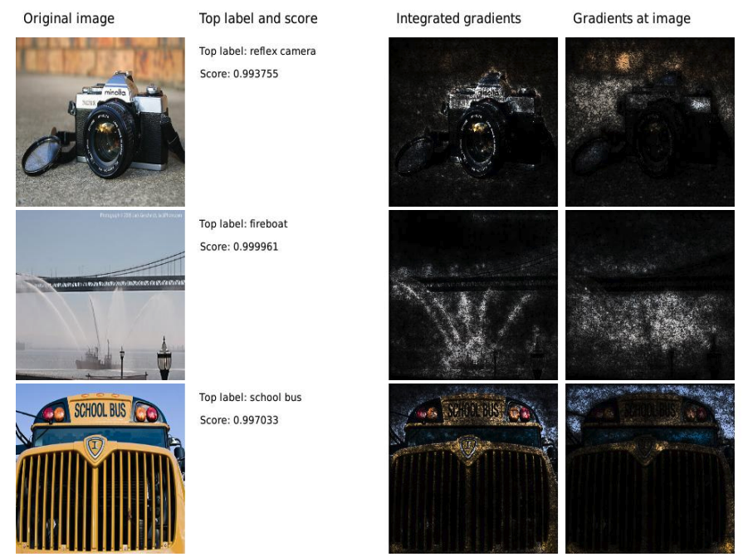
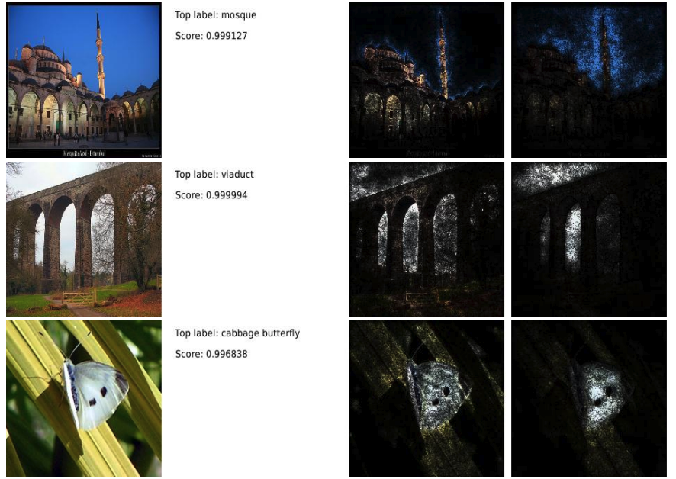
Object Recognition CNN
Task: Given image, predict the category of the object
Image
Prediction
Integrated Grad.
Grad at Image
Image
Prediction
Integrated Grad.
Grad at Image

Slide 14
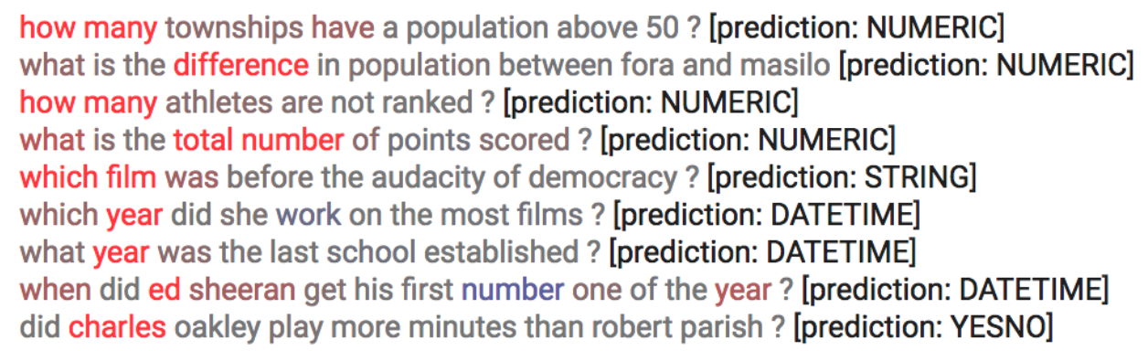
Question Classification CNN
Task: Given question, predict what type of answer it is looking for.
red = positive attribution, blue = negative attribution, gray = neutral attribution

Slide 15
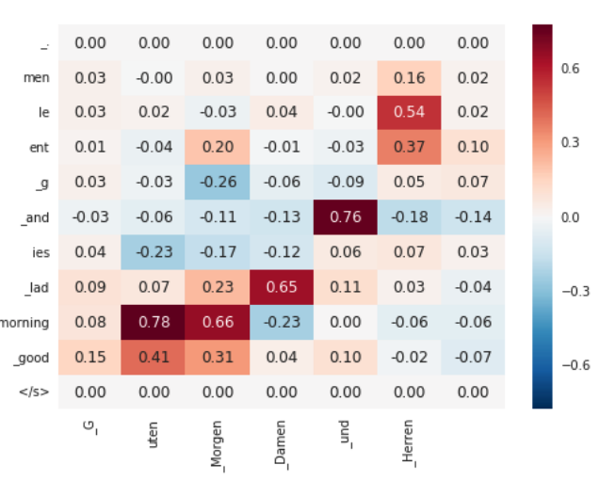
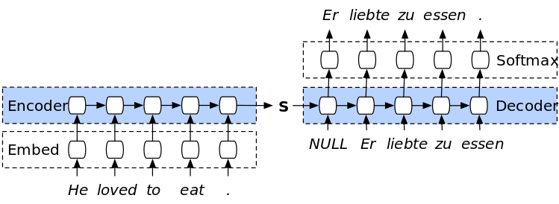
Machine Translation RNN
Task: Given English sentence, predict German translation
Example RNN Architecture

Slide 16
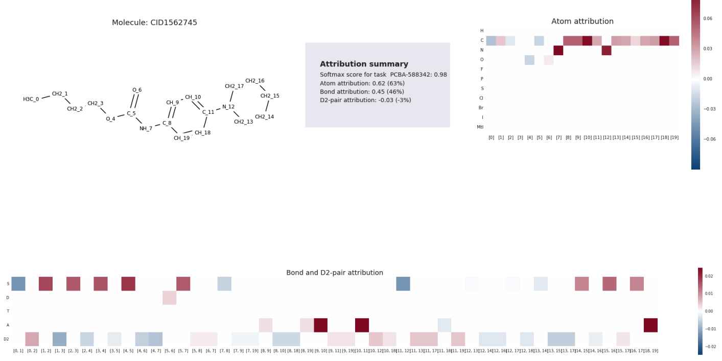
Ligand Screening Graph CNN
Task: Given molecular graph, predict whether it is active against an enzyme
Take-aways:
More attribution to atom-pairs with bond (46%) compared to without bond (-3%)
Attribution can help identify degenerate features (e.g. indicate that features are not fully convolved) (?)

Slide 17
Conclusion and Discussion
Summary
Formalizes two axioms for attribution: sensitivity, implementation invariance
Propose integrated gradients and argue that it is theoretically superior to other gradient-based methods (e.g. DeepLift, LRP, guided backprop, etc.)
Perform experiments across several domains to showcase method
Discussion Questions
Are you convinced that these axioms are desirable?
Do you see any strengths or weaknesses in the idea of producing explanations through an integrated path?
Have the experiments convinced you of the superiority of their method?

