Slide 1
Fooling LIME and SHAP: Adversarial Attacks on Post hoc Explanation Methods
Authors: Dylan Slack*, Sophie Hilgard*, Emily Jia, Sameer Singh, Himabindu Lakkaraju
Presented by: Chelsea (Zixi) Chen, Xin Tang, Prayaag Venkat
Notes:
https://arxiv.org/pdf/1911.02508.pdf

Slide 2
Motivation
ML has been applied for critical decision making
Healthcare
Criminal justice
Finance
The decision makers must clearly understand the model behavior to
Diagnose the error and potential biases
Decide when and how much these ML models should be trusted
Notes:
Need for interpretability -> vulnerable -> not faithful and can cause problems
Use animation and point-by-point illustration
What is the boundary for post-hoc explanations? To what degree can we trust them
Safety and trust, legal issues
Fairness issue

Slide 3
Motivation
Trade-off between interpretability and accuracy
Simple models can be easily interpreted (e.g., linear regression)
Complex but also black-box model has much better performance (e.g., deep neural network)
Can a ML method be both interpertable and accurate?
Post hoc explanation can seemingly solve this problem:
First build complex and accurate ML models for good performance
Then use post hoc explanation for model interpretation
The question is:
How robust and reliable is the post hoc explanation methods?

Slide 4
Contribution: A framework to ‘fool’ the post hoc explanation method
A novel framework that can effectively mask the discriminatory biases of any black box classifier
Fooling the perturbation based post hoc explanation method
LIME and SHAP
Allowing an adversarial entity to control and generate an arbitrary desired explanation
Demonstration using real-world datasets with extremely biased classifier
Existing post hoc explanation techniques are NOT sufficiently robust for ascertaining discriminatory behavior of classifiers in sensitive applications
Notes:
It’s just the title
A way to fool the post hoc methods
Post questions on reliability of current explanations
Introduce what is a discriminatory biase

Slide 5
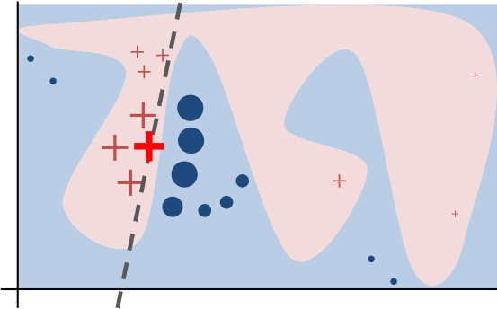
Perturbation-based post hoc explanation method

Slide 6
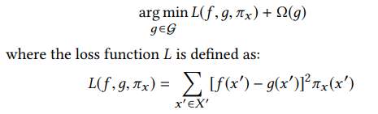
Preliminaries & Background
f is the original classifier and x is the datapoint we want to explain
g is the explanation we want to learn, 𝝮(g) is the “complexity” of g
𝜋 is the proximity measure
X’ is a synthetic dataset, consisting of perturbations of x
Notes:
LIME picks Omega and pi heuristically; SHAP picks them based on some game-theoretic motivation

Slide 7
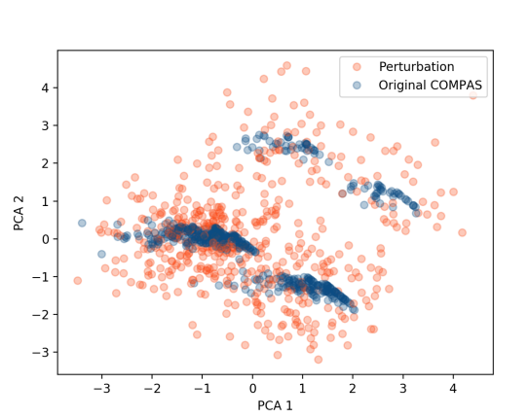
Intuition
Notes:
Intuition: Perturbed data in the synthetic dataset X’ are OOD.

Slide 8
Approach: Set-up
Adversary would like to deploy a biased classifier f!
Background: the biased model f uses sensitive attributes to make critical decisions
Requirement: give access of black-box models to customers and regulators who use post-hoc explanations
Goal: hide bias of the classifier f

Slide 9
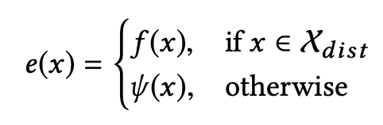
Approach: Set-up
What do we need?
Input: dataset sampled from real-world distribution
Target Product: an adversarial classifier e
f is the biased model to be explained, while ψ is an unbiased model

Slide 10
Approach: OOD Detection
Which of the inputs belong to the real-world distribution?
Build another classifier for OOD detection
Assign label “False” (not OOD) to all instance in the dataset X
Perturb all instances in X and assign them label “True” (OOD)
Exceptions: instances too close to observations from X
Combine data and train OOD detection classifier

Slide 11
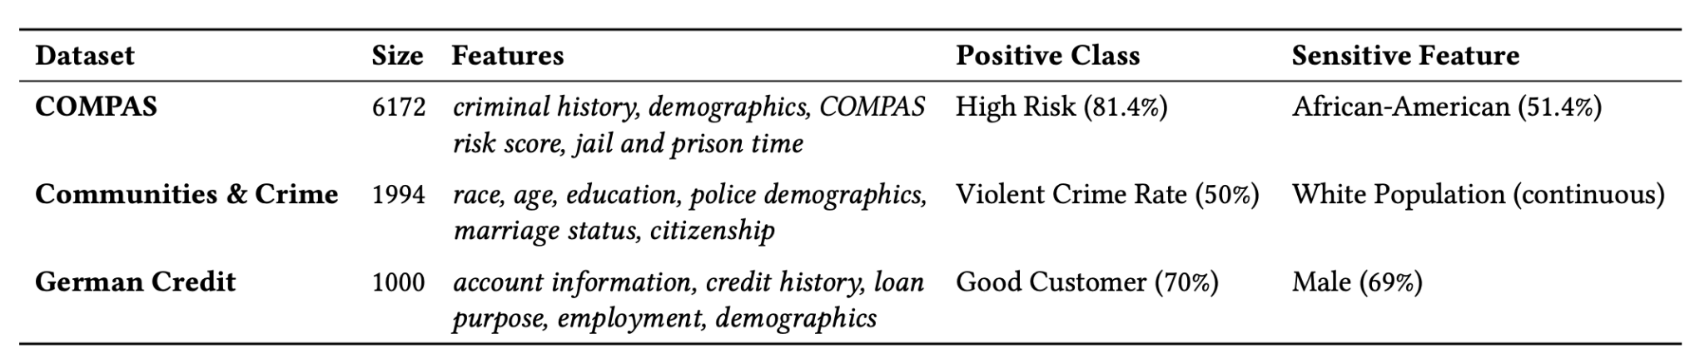
Experiment: Set-up
90% training & 10% test
Biased classifier f makes predictions purely based on sensitive attributes (race, gender)
Unbiased classifier ψ uses only features uncorrelated with the sensitive attributes

Slide 12
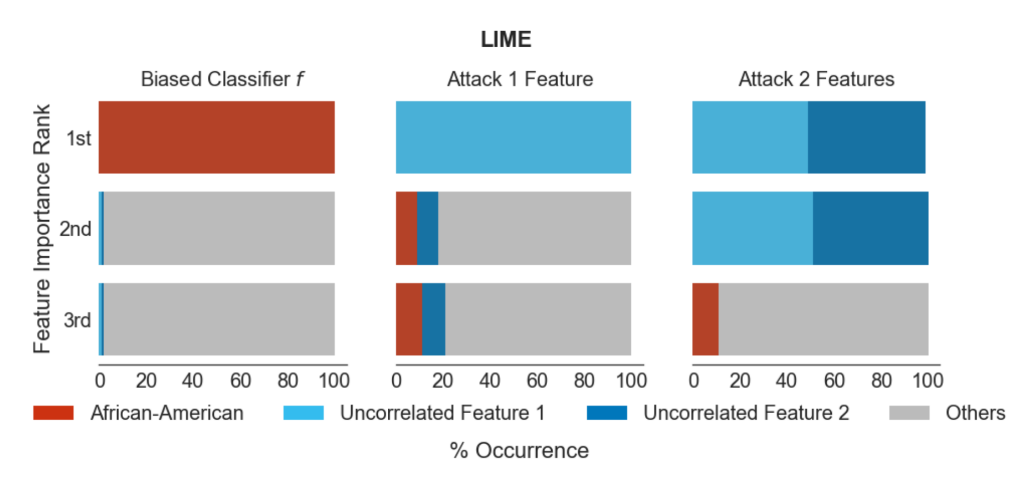
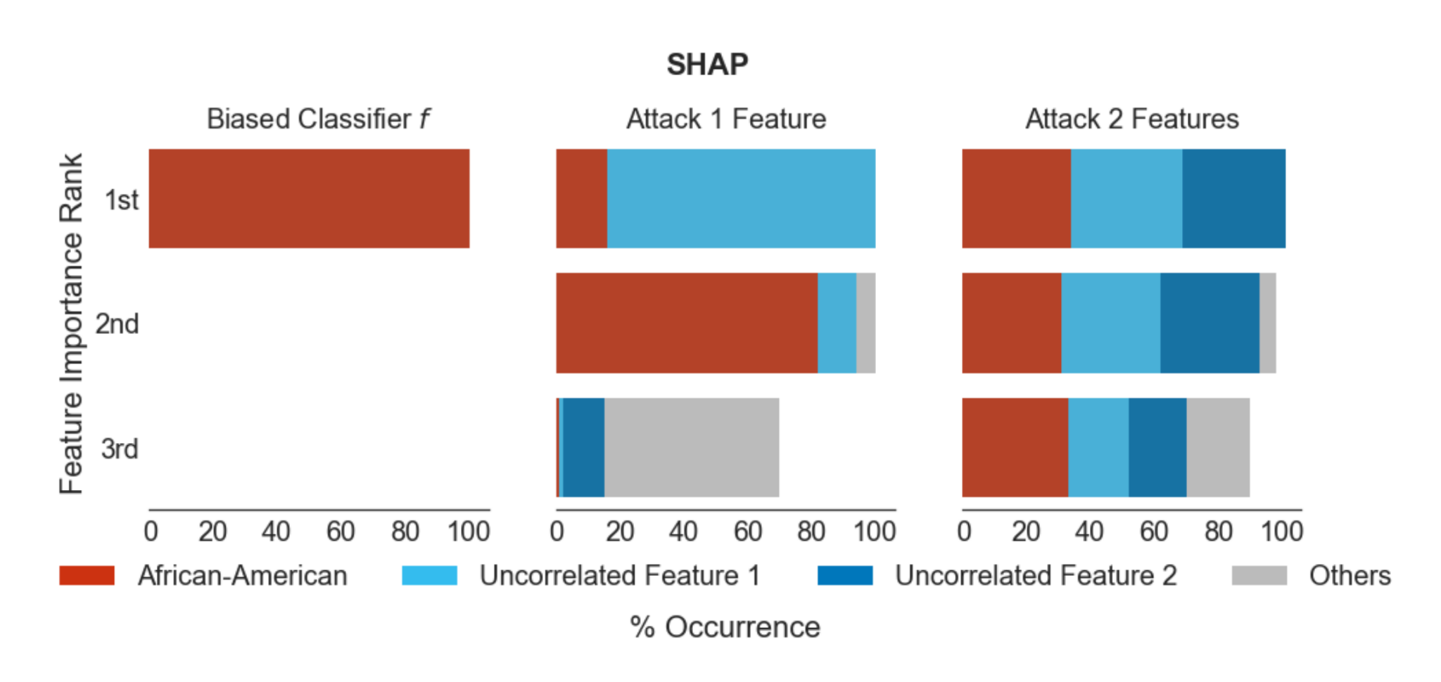
Experiment: Results - COMPAS

Slide 13
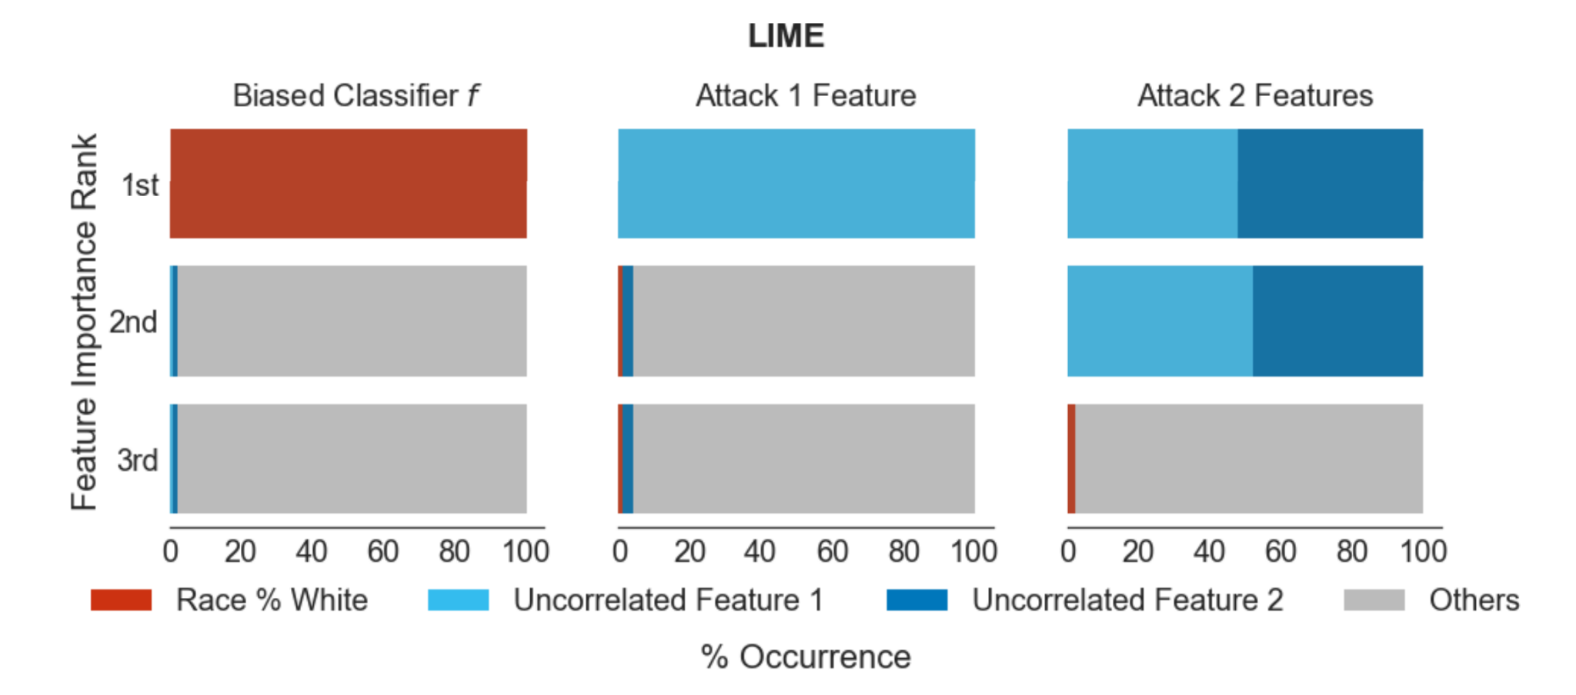
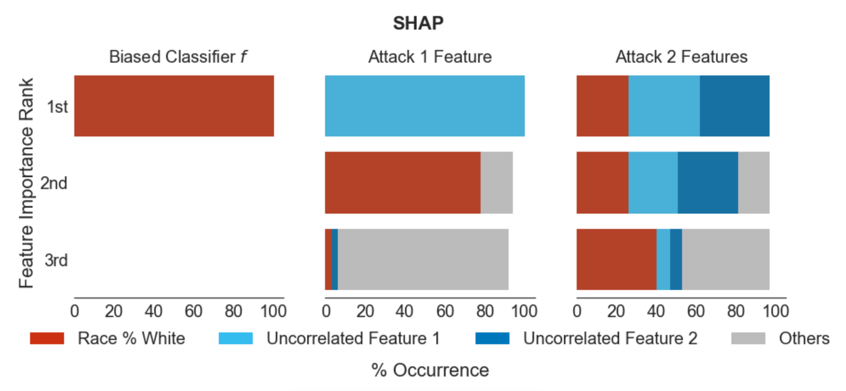
Experiment: Results - Communities and Crime

Slide 14
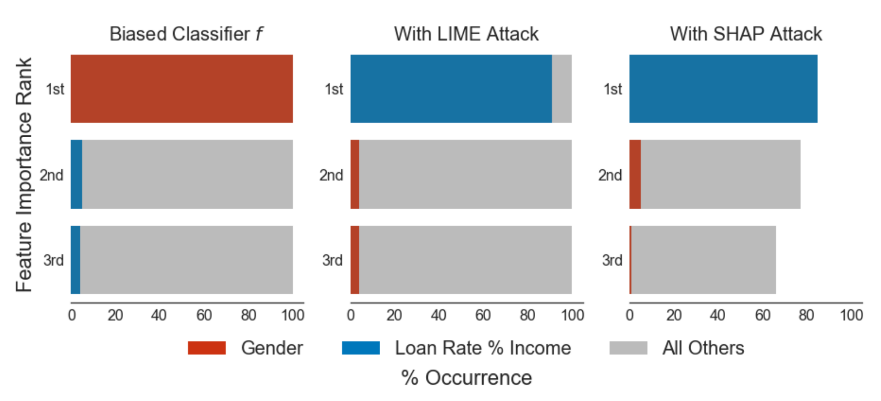
Experiment: Results - German credit

Slide 15
Takeaway from experiments
Accuracy of the OOD classifier -> success of the adversarial attack
Adversarial classifiers to LIME are ineffective against SHAP explanations
Any sufficiently accurate OOD classifier is sufficient to fool LIME, while fooling SHAP requires more accurate classifiers
SHAP less successful when using two features <- local accuracy property
Distribute attributions among several features
Notes:
start
Chelsea:
end

Slide 16
Conclusions
Main contribution: A framework for converting any black-box classifier into a scaffolded classifier that fools perturbation-based post-hoc explanation techniques like LIME and SHAP
Effectiveness of this framework demonstrated on sensitive real-world data (criminal justice and credit scoring)
Perturbation-based post-hoc explanation techniques are not sufficient to test whether classifiers discriminate based on sensitive attributes

Slide 17
Related Works
Issues with post-hoc explanations:
[Doshi-Velez and Kim] identify explainability of predictions as a potentially useful feature of interpretable models.
[Lipton] and [Rudin] argues post-hoc explanations can be misleading and are not trustworthy for sensitive applications.
[Ghorbani et al.] and [Mittelstadt et al.] identified further weaknesses of post-hoc explanations.
Adversarial explanations
[Dombrowski et al.] and [Heo et al.] show how to change saliency maps in arbitrary ways by imperceptibly changing inputs.
Notes:
Dombrowski et al and Heo et al are more “white box” methods.

Slide 18
Q&A
Are the experimental results sufficient to justify the conclusions?
In particular, how can we explain the discrepancy in results for LIME vs. SHAP?
What about fooling other classes of post-hoc explanation methods?
Past work: gradient-based methods
Alternatively, can one design post-hoc explanations that are adversarially robust?
Notes:
There is a large literature on learning adversarially robust models - can we leverage some of these techniques?

