Slide 1
Evaluating Interpretability
CS 282 BR Topics in Machine Learning: Interpretability and Explainability
Ike Lage
09/13/2019

Slide 2
Outline
Research paper: “Human Evaluation of Models Built for Interpretability” by Lage et al.
Break: 15 minutes (around 1:15)
Research paper: “Manipulating and Measuring Model Interpretability” by Poursabzi-Sangdeh et al.
Project discussion: 15 minutes

Slide 3
Overview
Evaluating interpretability in the interpretable ML community:
Interpretability depends on human experience of the model
Disagreement about the best way to measure it
These papers:
Evaluating factors related to interpretability through user studies

Slide 4
Other Relevant Fields
Human-Computer Interaction (HCI):
Theories for how people interact with technology
Psychology:
Theories for how people process information
Both have thought carefully about experimental design

Slide 5
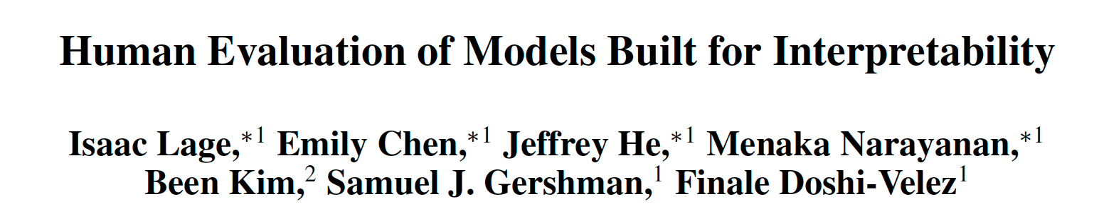
Paper 1
To appear at HCOMP 2019 (Human Computation)

Slide 6
Contributions
Research Questions:
Which types of decision set complexity most affect human-simulatability?
Is relationship between complexity and human-simulatability context dependent?
Approach:
Large scale, carefully controlled user studies

Slide 7
Prior Work: Interpretable Machine Learning
Technical approaches with face validity
When user studies are run: A/B tests

Slide 8
Prior Work: Domain Specific Human Factors
Thorough user studies in specific domains
Not designed to generalize to new contexts

Slide 9
Prior Work: General Human Factors
User studies to identify general principles
Our work falls in this category

Slide 10
Paper 1: Roadmap
Preliminaries
Factors Studied
Experimental Design
Design Choices
Results
Discussion

Slide 11
Paper 1: Roadmap
Preliminaries
Factors Studied
Experimental Design
Design Choices
Results
Discussion

Slide 12
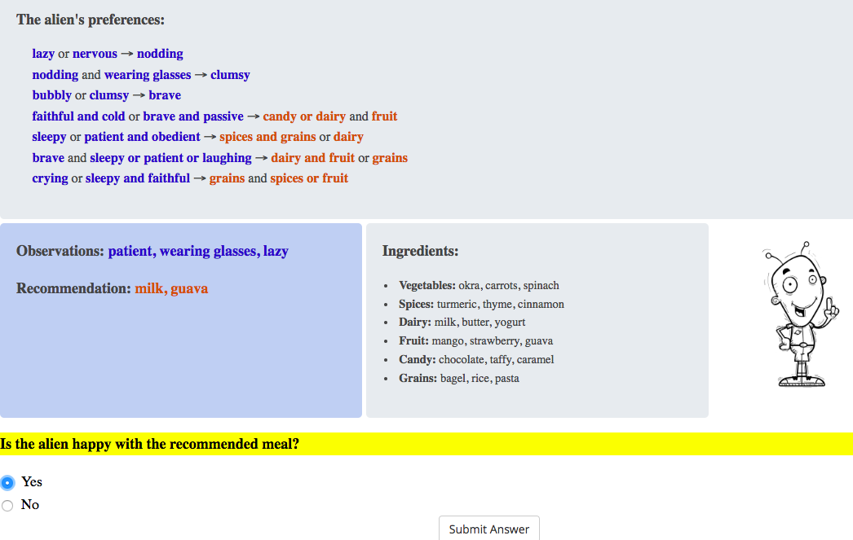
Decision Sets
Logic-based models are often considered interpretable
Many approaches for learning them from data

Slide 13

Regularizers
There are many ways to regularize decision sets that make them less complex
What kinds of complexity is it most urgent to regularize to learn interpretable models?
Choose a
regularizer for
interpretability
Optimize
With regularizer
Interpretable Model?

Slide 14
Paper 1: Roadmap
Preliminaries
Factors Studied
Experimental Design
Design Choices
Results
Discussion

Slide 15
Types of Complexity
Cognitive chunks
Model size
Variable repetitions

Slide 16
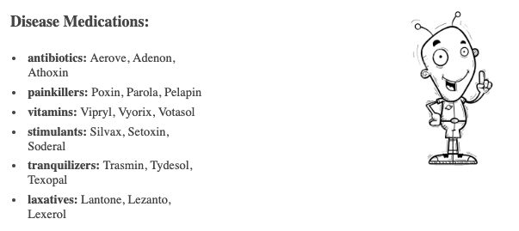
Domains
Low Risk: Alien meal recommendation
High Risk: Alien medical prescription

Slide 17
Tasks
Simulation:
What would the model recommend the alien?
Verification:
Is milk and guava a correct recommendation?
Counterfactual:
If patient were replaced with sleepy, would the correctness of the milk and guava recommendation change?

Slide 18
Paper 1: Roadmap
Preliminaries
Factors Studied
Experimental Design
Design Choices
Results
Discussion

Slide 19
Experiment 1: Model Size
Interpretability: frequently used (Freitas 2014)
Psychology: Boolean concept learning (Feldman, 2000)
# lines {2, 5, 10}
# output terms {2, 5}

Slide 20
Experiment 2: Cognitive Chunks
Psychology: recoding information (Miller, 1956)
# cognitive chunks {1, 3, 5}
{explicit or implicit}

Slide 21
Experiment 3: Repeated Terms
Interpretability: used as metric (Lakkaraju, Bach and Leskovec, 2016)
Psychology: facilitates scanning (Treisman and Gelade, 1980)
# variable repetitions {2, 3, 4, 5}

Slide 22
Procedure
Experiment posted on Mturk
Takes around 20 minutes
Participants paid 3 USD
Instructions
3-6 practice questions
15-18 test questions
Payment code

Slide 23
Participants: Exclusion Criteria
Participants excluded based on practice questions
Final count: 50-70 participants out of 150
Pros: people who can do the task well
Cons: results don’t generalize to all laypeople

Slide 24
Participants: Demographics
Participants:
Younger
More educated
From the US/Canada
Results may not generalize to other populations

Slide 25
Metrics
Response Time
Accuracy
Subjective Difficulty of Use

Slide 26
Statistical Analysis: Linear Model
We use a linear model for each metric in each experiment
Example – Model Size, Response Time:
Step 1: Fit linear regression to predict response time from number of lines and number of output terms
Step 2: Interpret coefficients as effects of number of lines and number of output terms on response time

Slide 27
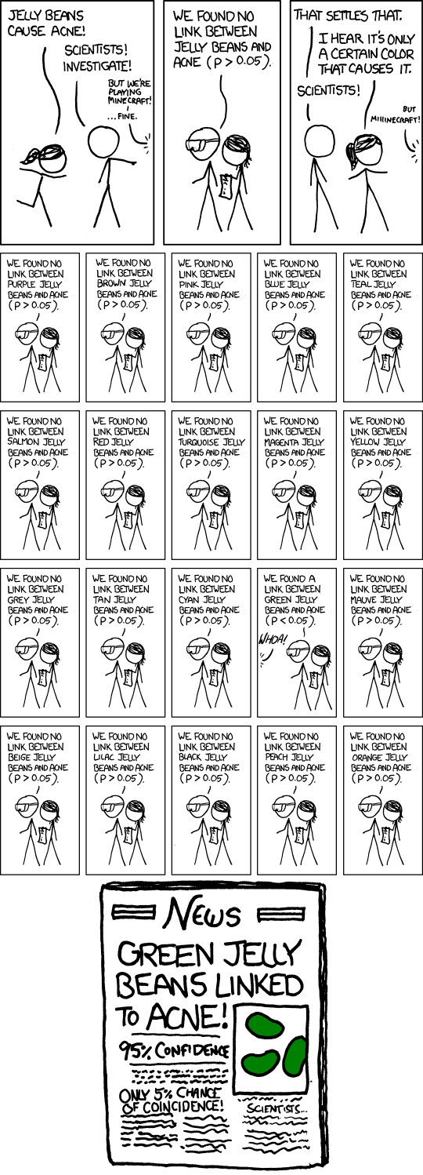
Stat. Analysis: Multiple Hypothesis Testing
…
Link: https://xkcd.com/882/

Slide 28
Stat. Analysis: Multiple Hypothesis Testing
We use a Bonferroni correction
Instead of p < 0.05, use p < (0.05 / # comparisons)

Slide 29
Statistical Analysis: Participant Specific Effects
We have multiple responses for each participant
Correct for differences in each participant’s response times
Subtract off participant specific mean response time

Slide 30
Paper 1: Roadmap
Preliminaries
Factors Studied
Experimental Design
Design Choices
Results
Discussion

Slide 31
Controlled Domains vs. Real-world Datasets
We used exactly parallel, synthetic domains
Question: What if we had used 2 different real-world datasets?
Notes:
In general, keeping things between conditions as similar as possible let you draw stronger conclusions about differences being causes by the factors you’re studying, but the more you control for, the less realistic your experiment is (and it may not generalize)

Slide 32
Simulation-based vs. Real Downstream Tasks
All of the tasks we consider depend on forward-simulation
Question: What if we used more realistic downstream tasks?
Notes:
While the tasks are more aligned with what people will use the model to do, they rely on people’s background knowledge about the domain. This is hard to control for!

Slide 33
Wizard of Oz vs. Optimized with Data Models
The models we use are hand generated to have the properties we study
Question: What if we optimized the models with data?
Notes:
Using real machine learning models is more realistic and more closely resembles the decision sets that can be generated in practice, but it is hard to generate decision sets with the exact combination of properties we need to carefully test our hypotheses

Slide 34
Tradeoff between control and generalizability
Tradeoff between the ability to tightly control the experiment and running it under realistic conditions (generalizability)
This paper
Tightly controlled
Realistic

Slide 35
Paper 1: Roadmap
Preliminaries
Factors Studied
Experimental Design
Design Choices
Results
Discussion

Slide 36
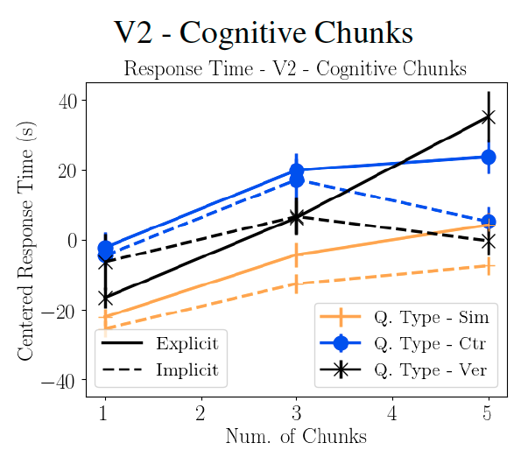
Results: Complexity increases response time
Recipe Domain
Longer response time
Greater Complexity
Greater complexity results in longer response time for all kinds of
complexity

Slide 37
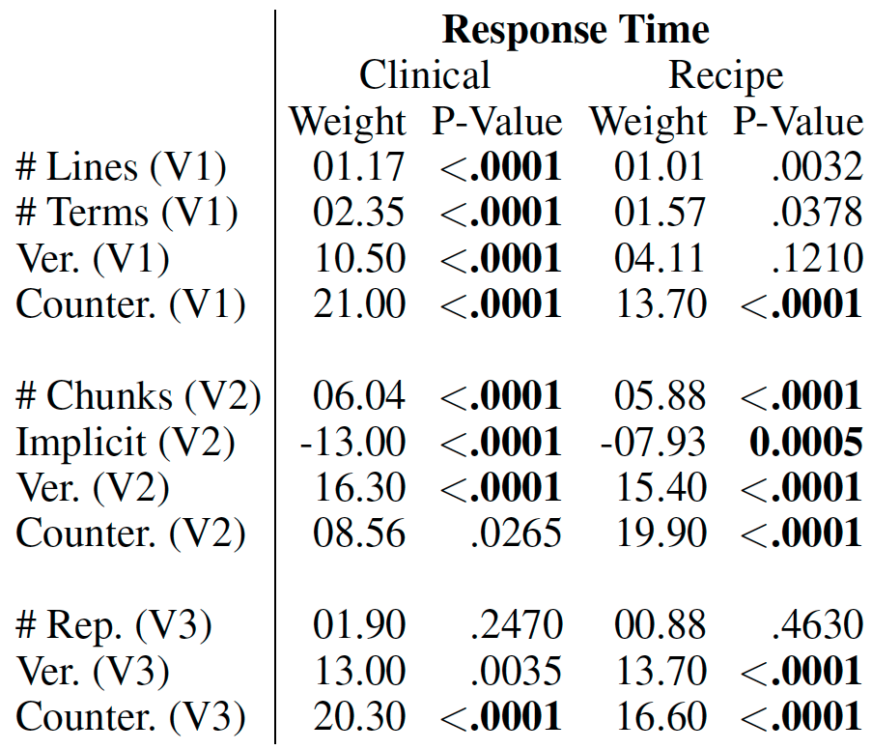
Results: Type of complexity matters
Model size
Significant in one domain
Significant in all domains
Cognitive chunks
Variable repetitions
Significant in neither domain
Response time for: cognitive chunks > model size > repeated terms

Slide 38
Results: Consistency - Domains, Tasks, Metrics
Model size
For example:
Similar effect sizes, both statistically significant
Cognitive chunks
Variable repetitions
Results consistent across domains, tasks and the response time and subjective difficulty metrics

Slide 39
Results: Counterfactuals are hard
Model size
Cognitive chunks
In all experiments, longer response time than simulation
Variable repetitions
The counterfactual task is much more challenging than simulation!

Slide 40
Paper 1: Roadmap
Preliminaries
Factors Studied
Experimental Design
Design Choices
Results
Discussion

Slide 41
Discussion: Consistent guidelines?
Consistency of the results across domains and metrics
Can we identify general guidelines for interpretable machine learning systems?

Slide 42
Discussion: Simplified tasks?
Consistency of the results across tasks
Counterfactuals more challenging than simulation
Can we use simplified tasks to measure interpretability?

Slide 43
Discussion: MTurk vs. Domain Experts
Our exclusion criteria excluded many MTurkers
(How) can we use Mturk to evaluate interpretability for domain experts?

Slide 44
Discussion: Preference for implicit cog. chunks
We expected users to prefer explicit cognitive chunks
Their preference for implicit cognitive chunks could be interesting to follow up

Slide 45
Discussion: Limitations
Different interfaces?
New classes of models?
Link human-simulatability to real-world tasks?

Slide 46
Discussion: Takeaways
For decision sets, human-simulatability is most impacted by:
cognitive chunks > model size > repeated terms
These results are consistent across:
Domains
Tasks
Some metrics (response time and subjective difficulty)

Slide 47
Questions?

Slide 48
Critique

Slide 49
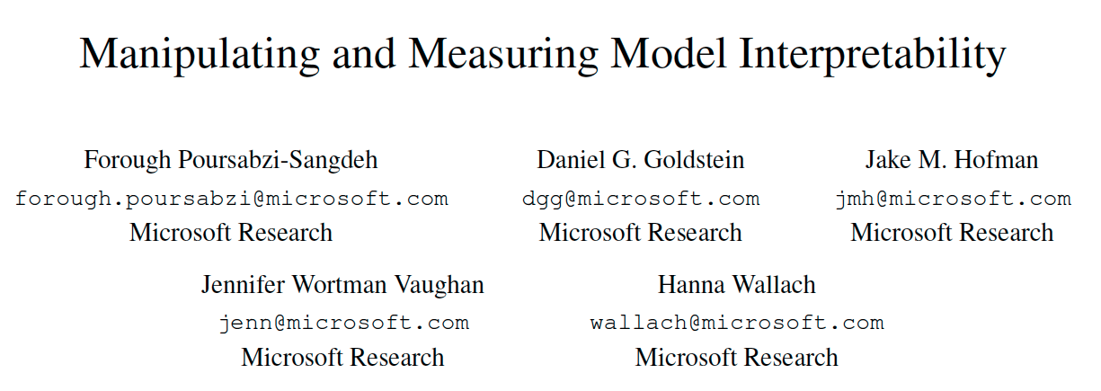
Paper 2
On ArXiv

Slide 50
Motivation
Interpretability as a latent property that can be manipulated or measured indirectly
What are the factors through which it can be manipulated effectively?
Bring HCI methods to interpretable ML since interpretability is defined by user experience

Slide 51
Contributions
Research Questions:
How well can people estimate what a model will predict?
How much do people trust a model’s predictions?
How well can people detect when a model has made a sizable mistake?
Approach:
Large-scale, pre-registered user studies to answer these questions in the context of linear regression models

Slide 52
Comparison to Paper 1
Studies linear regression models instead of decision sets
Measures people’s ability to make their own predictions in addition to forward simulation
Uses real-world housing dataset and models optimized with data

Slide 53
Paper 2: Roadmap
Factors Studied
Experimental Design
Design Choices
Results
Discussion

Slide 54
Paper 2: Roadmap
Factors Studied
Experimental Design
Design Choices
Results
Discussion

Slide 55
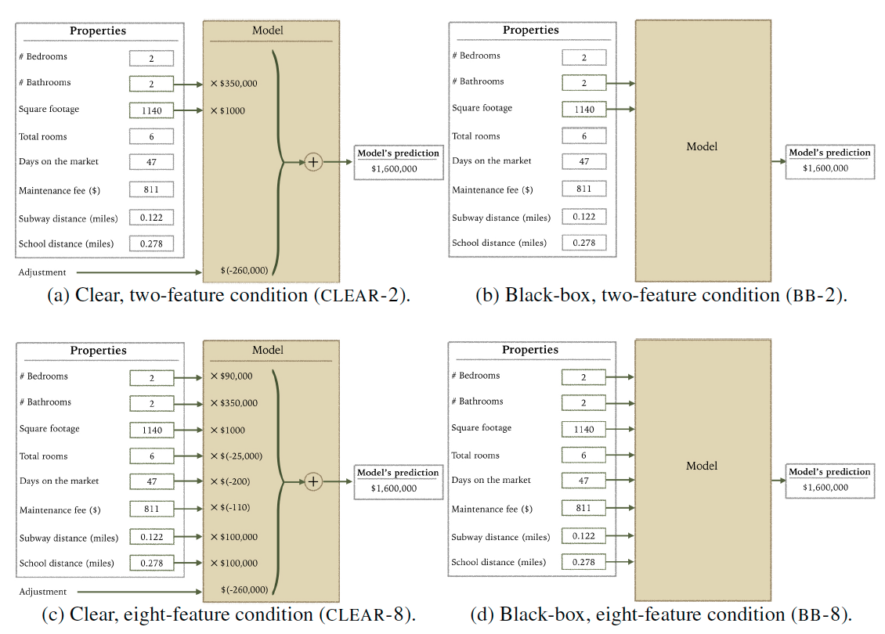
Ways to Manipulate Interpretability
# of Features
Transparency

Slide 56
Tasks
Forward simulate the model’s prediction:
What would the model predict for the input?
Make your own, correct prediction:
What is the correct prediction (with or without following the model)?

Slide 57
Paper 2: Roadmap
Factors Studied
Experimental Design
Design Choices
Results
Discussion

Slide 58
Experiment 1: Predicting Apartment Prices
Factors studied: number of features and the transparency
How do these affect laypeople’s ability to simulate the model, trust the model, and detect mistakes?
Factors and tasks chosen based on the literature

Slide 59
Procedure
Participants shown:
Training: 10 apartments
Testing: 12 apartments (this is the data they use)
Participants paid 2.5 USD
Each Trial
Forward simulate model’s prediction
View model’s true prediction
Make own prediction

Slide 60
Participants
Recruitment on Amazon Mechanical Turk with approval rating > 97%
No additional exclusion criteria
750-1,250 participants per experiment

Slide 61
Statistical Analysis: Participant Specific Effects
A repeated measures experimental design
Each participant makes many predictions
Use a mixed-effects model to control for correlations between a participant’s responses
Assumes a random, participant-specific effect

Slide 62
Stat. Analysis: Multiple Hypothesis Testing
Pre-registering hypotheses corresponds to deciding and publishing which analyses you will run before collecting data
Reduces the probability that effects were discovered by chance
For example:
https://aspredicted.org/xy5s6.pdf

Slide 63
Paper 2: Roadmap
Factors Studied
Experimental Design
Design Choices
Results
Discussion

Slide 64
Fixed vs. Random Apartment Order
They randomized the order of the first 10 (normal) apartments and fixed the order of the last 2 (unusual)
Question: What if the apartment order was fixed for all 12? Randomized for all 12?
Notes:
Fixed would reduce variance, but could increase the amount of bias. For example, their concern that seeing bad apartments would decrease people’s trust. Question of whether it’s ok to control for that in this way!

Slide 65
Identical vs. Random Examples
All participants are shown an identical set of apartments
Question: What if we showed each participant a different random sample of apartments?
Notes:
This would give you results that are more likely to generalize to the entire dataset (e.g. what if you chose a weird apartment by accident?), but it would introduce more variance, which means you would need more participants to see an effect

Slide 66
Within vs. Between Subjects Design
Each participant completed a single condition (between subjects design)
Question: What if each participant had completed all conditions (within subjects design)?
Notes:
Removes variance from different baseline participant capabilities, but might increase variance from 1) longer study so participants get tired, or 2) people get

Slide 67
Tradeoff between bias and variance
Fixing all sources of randomness can introduce bias,
Randomizing aspects of the experiment can increase variance
Can introduce bias
Increases variance
Fix sources of randomness
Randomize as much as possible

Slide 68
Paper 2: Roadmap
Factors Studied
Experimental Design
Design Choices
Results
Discussion

Slide 69
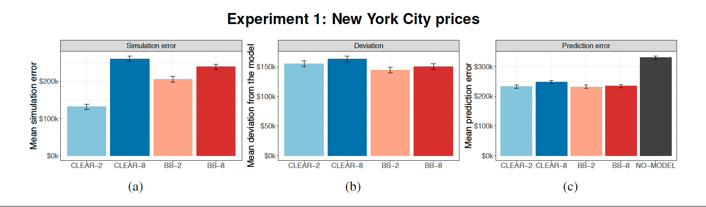
Results: Simulating small, transparent models
Best simulation accuracy with small, transparent models

Slide 70
Results: No difference in trust or prediction
None of the conditions are statistically different for trust or prediction error

Slide 71
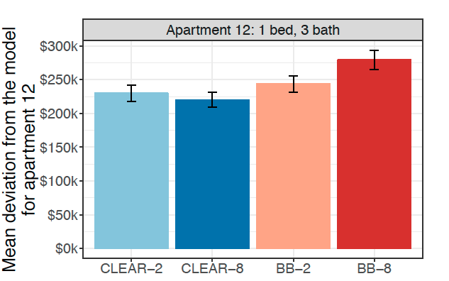
Results: Clear models make mistakes worse
Deviation
Higher is better
Participants deviate less from the bad prediction with clear models
Notes:
Participants deviate less from the model’s bad prediction in the clear case (on apartment 12)

Slide 72
Experiment 2: Scaled-down Prices
Results may not be valid because participants are not domain experts in NYC’s high housing prices
Same experiment with Scaled down prices to US average

Slide 73
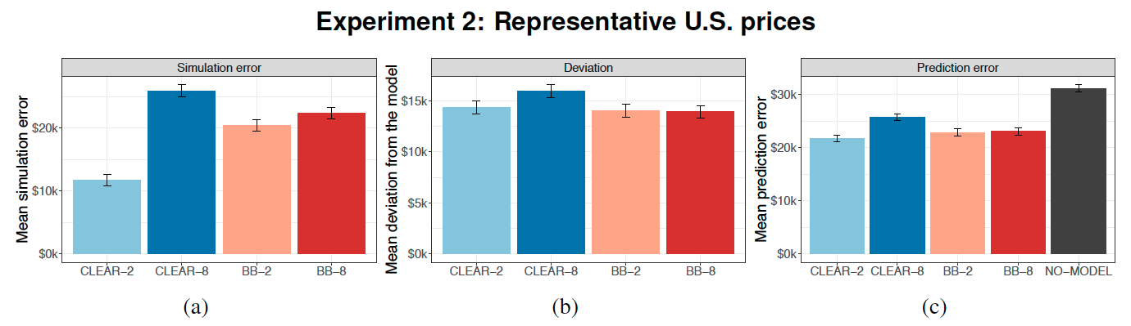
Results: Same as experiment 1
They find the same results as in the first experiment

Slide 74
Experiment 3: Alternative Measures of Trust
What if the trust metric didn’t capture the right notion?
They try 2 different measures of trust:
Deviation: difference from the model’s prediction
Weight of advice: difference between prediction before seeing model, and prediction after seeing model

Slide 75
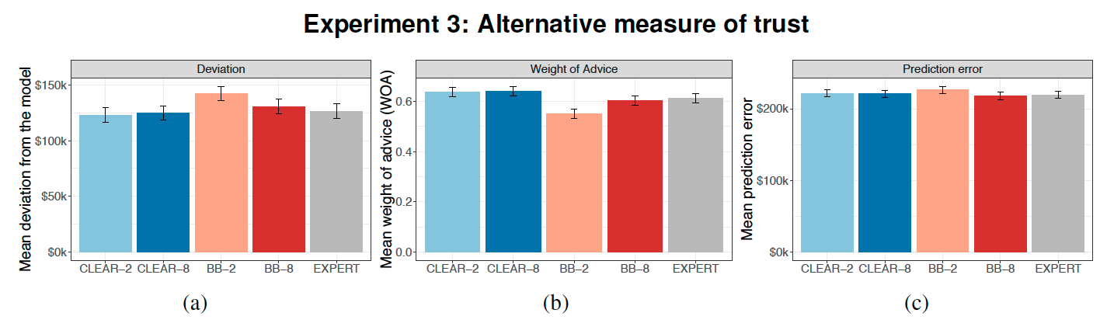
Results: No significant difference in trust
No difference in trust between conditions with either metric

Slide 76
Experiment 4: Attention Check
In experiment 3: no difference in ability to predict errors
Participants made predictions after seeing the model in experiments 1 and 2, and before seeing the model in experiment 3
Does drawing people’s attention to unusual features improve their predictions with transparent models?

Slide 77
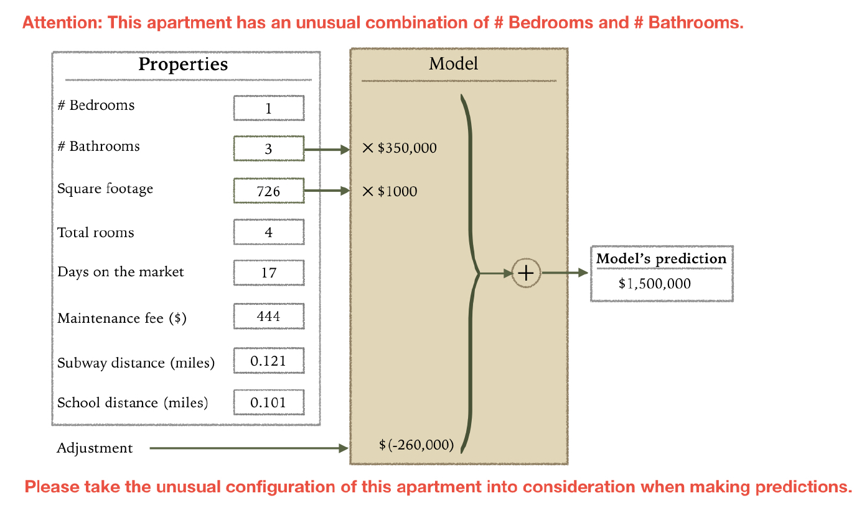
Attention Check

Slide 78
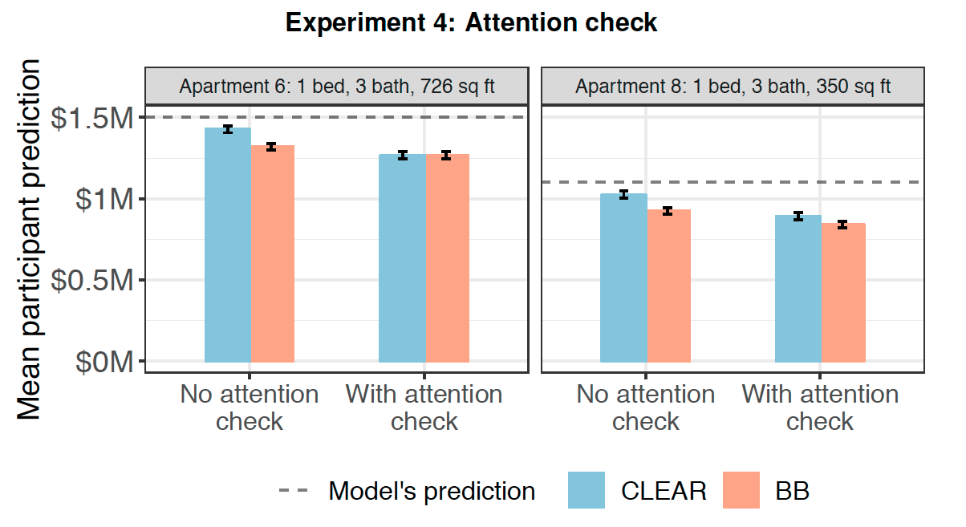
Results: Attention checks -> more deviation
Mean participant prediction
Lower is better
Explicit attention checks improve people’s ability to catch errors

Slide 79
Paper 2: Roadmap
Factors Studied
Experimental Design
Design Choices
Results
Discussion

Slide 80
Discussion: Highlight weird inputs
Highlighting unusual inputs improves people’s ability to detect errors
Should we build this into interpretable machine learning systems?

Slide 81
Discussion: Make people predict first
Having people first make their own prediction improved their ability to detect errors
Should we always do this in interpretability user studies? In practice?

Slide 82
Discussion: Don’t default to transparent
Assumption that transparency is better
But it can hamper people’s ability to detect errors
How do we show users information without overwhelming them?

Slide 83
Discussion: Takeaways
People are most able to forward simulate small, transparent models
Transparency can hamper people’s ability to detect mistakes
In general, transparency and few features don’t improve people’s ability to make correct predictions

Slide 84
Questions?

Slide 85
Critique

