Slide 1
Process Chains
Jena, 12/03/2009
Thomas Bergmann, Senior Software Engineer

Slide 2
Agenda
Problem description
Goals
Technical aspects
  Everything is a task
  Example chain
  Ignore an error
  Process overview
Hints
Further documentation
Q&A

Slide 3
Problem description
Schedules are running processes
  On different resources
    Infrastructure (FileSystem, DB, external systems)
    Business objects
    Business Units (channels)
  With different execution times
Difficult to organize schedules
  Large set of schedules
  Less knowledge about schedules, dependencies
  Execution time is not fix
    Increasing business units/objects
    Different amount of user activities per day
  Fix time frame for execution (e.g. 2h a day)
How to minimize the execution time ???

Slide 4
Goal
Avoid conflicts in case of overlapping jobs (administrator)
Less waiting periods between jobs – more online time (customer)
Minimize the scheduling effort (administrator)
Restart a set of schedules if a task/schedule fails (administrator)
Send notifications if schedule or set of schedules fails or finishes successfully (administrator)
Easy configuration via xml files (developer/administrator)

Slide 5
Everything is a task
sequence
Task
1
Task2
Task3
Task4
Error
Sequence
concurrent
job
pipeline
processchain
Task
1
Site
1
Task2
Site
2
concurrent
Task3
Site
3
OR
Task4
Site
4
sequence

Slide 6
Execution plan – 11 Blocks
Step 1 - Job
Step 2 - Concurrent
Step 2.2 - Sequence
Step 2.1
Pipeline
Step 2.2.1
Job
Step 2.2.2
Pipeline
Error - Sequence
Step 3 – Job
Notes:
ProcessChain - executes

Slide 7
Execution Plan – 1 XML file
<?xml version="1.0" encoding="UTF-8"?>
<p:chain name="Chain Example">
<p:sequence name="Chain is a sequence">
<p:job job="CheckOrders" name="Step 1 - Job" />
<p:concurrent name="Step 2 - Concurrent">
<p:pipeline pipeline="ExecuteProcessChain" name="Step 2.1 - Pipeline">
<p:parameter name="XmlFileName">*.xml</p:parameter>
</p:pipeline>
<p:sequence name="Step 2.2 - Sequence">
<p:job allsites="true" concurrent="true" job="ArchiveOrders"
name="Step 2.2.1 - Job" />
<p:pipeline pipeline="..." name="Step 2.2.2 - Pipeline" />
<p:error name=„Step 2.2 Error Sequence">
<p:pipeline pipeline="SendNotification" name="Error - Pipeline" />
</p:error>
</p:sequence>
</p:concurrent>
</p:sequence>
</p:chain>

Slide 8
Ignore Errors
Each task execution has a result – a status
Status is represented by a „bit“ – status of a set of tasks is the bitwise OR
A mapping (and constants) define a text for each status
  STATUS_SUCCESS = 0;
  STATUS_WARNING = 1;
  STATUS_FAILURE = 2;
  STATUS_ERROR = 4;
  STATUS_NOTFOUND = 8;
  STATUS_INTERRUPTED = 16;
ProcessConstants registers text and bit mapping

Slide 9
Ignore – sub element of each task
<p:concurrent name="Step 2 - Concurrent">
<p:sequence name="Step 2.2 - Sequence">
<p:ignore>NOTFOUND</p:ignore>
<p:job allsites="true" concurrent="true" job="ArchiveOrders"
name="Step 2.2.1 - Job" />
<p:pipeline pipeline="..." name="Step 2.2.2 - Pipeline" />
<p:error name=„Step 2.2 Error Sequence">
<p:pipeline pipeline="SendNotification" name="Error - Pipeline" />
</p:error>
</p:sequence>
</p:concurrent>

Slide 10
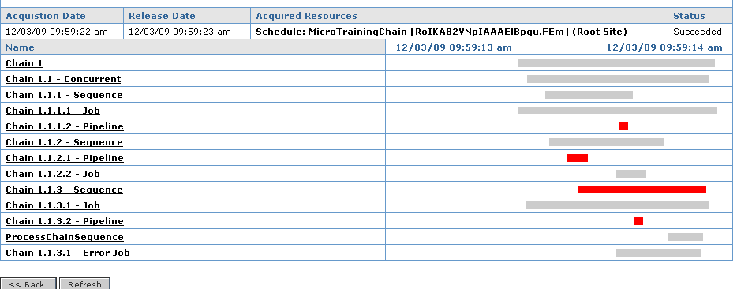
Locking – Process - Subprocesses
Additional information about process execution
GANT diagram

Slide 11
Hints
XSD is in shared/system/config/cluster/processchain.xsd
processchain.xml.example shows all important elements and attributes
Build medium sized process chains – incl. dependencies, to restart a group
Build chains in chains to reduce schedule effort – call a process chain schedule
UI in 6.4.x ???
\\jcc1\view\main_LATEST\rnd_vob\projects\EnfinitySuite6\general_documents\concepts_and_specifications\DS-ProcessChain.doc

Slide 12

Question, Discussion …

Slide 13
Corporate Headquarters
Intershop Communications AG
Intershop Tower
D - 07740 Jena
Germany
Telefon +49-3641-50-0
Fax +49-3641-50-1111
info@intershop.de
www.intershop.de
Americas Headquarters
Intershop Communications, Inc.
282 2nd Street, 2nd Floor
San Francisco, CA 94105
USA
Phone +1-415-844-1500
Fax +1-415-844-3800
info@intershop.com
www.intershop.com
Intershop Communications
Online Marketing GmbH
Ludwigstraße 31
D-60327 Frankfurt am Main
Germany
Telefon +49-69-2549-490
Fax +49-69-2549-4949
info@intershop.de
www.intershop.de
© 2009 Intershop Communications AG. Alle Rechte vorbehalten. Alle Warenzeichen sind Eigentum ihrer jeweiligen Inhaber. Angaben in diesem Dokument dienen nur der Produktbeschreibung und stellen keine zugesicherten Eigenschaften im Rechtssinn oder Garantien dar. Garantien bedürfen einer ausdrücklichen und schriftlichen Bestätigung von Intershop. Intershop behält sich Änderungen und Anpassungen vor.
© 2008 by Intershop® Communications AG. All rights reserved. All other trademarks are the property of their respective owners.
This document provides only product descriptions, which do not constitute warranted characteristics in the legal sense or other guarantees. Guarantees require an explicit and written confirmation by Intershop. Intershop reserves the rights to changes and modifications.

