Slide 1
Built to boost your business. code
Intershop Communications AG
April 11th, 2022

Slide 2


How do deployments in the Intershop Commerce Platform work?
Built to boost your business. code
Welcome to the DEV Community Meetup
Thomas
Johannes
Monday April 11 2022
Ribbeck
Metzner

Slide 3
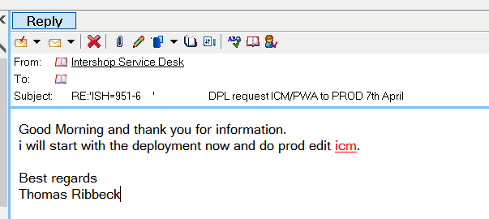
Step 1: Communicate the start of deployment
Built to boost your business. code
Intershop Dev Community Meetup
April 11 2022

Slide 4
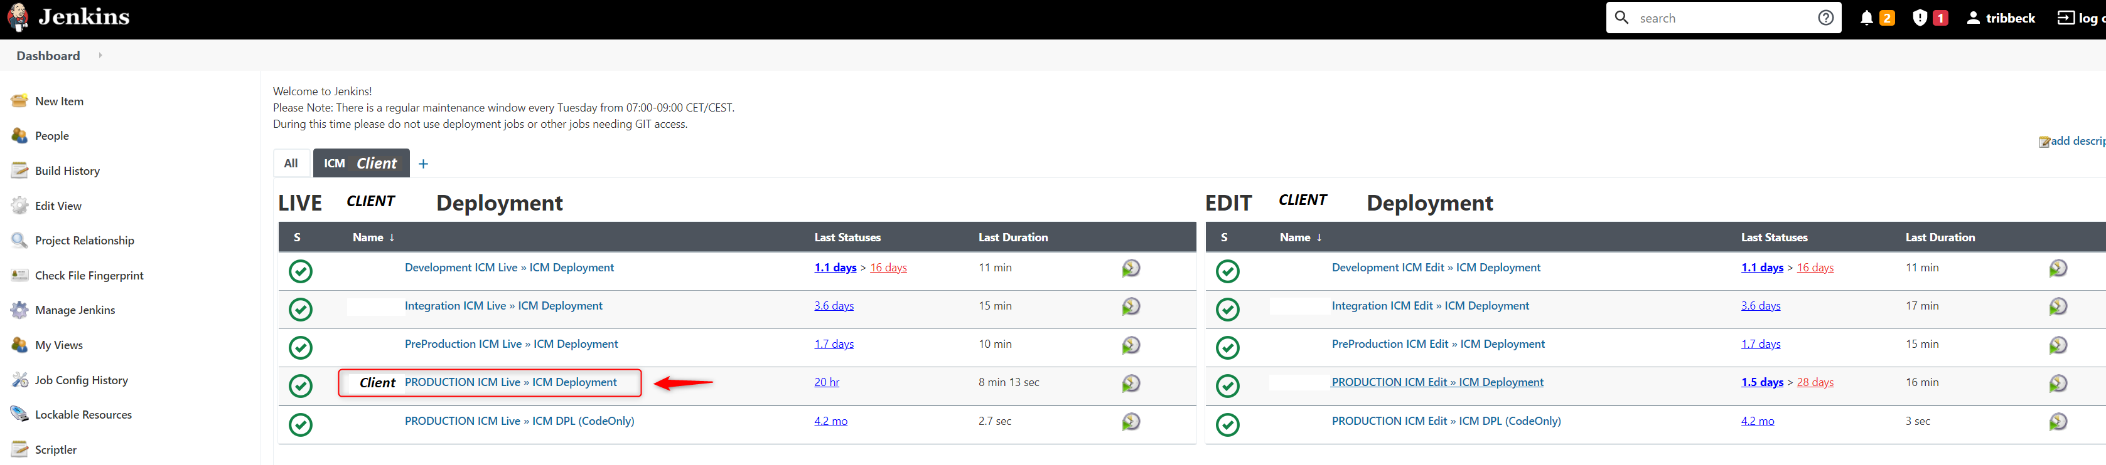
2. Choose your environment
Built to boost your business. code
Intershop Dev Community Meetup
April 11 2022

Slide 5
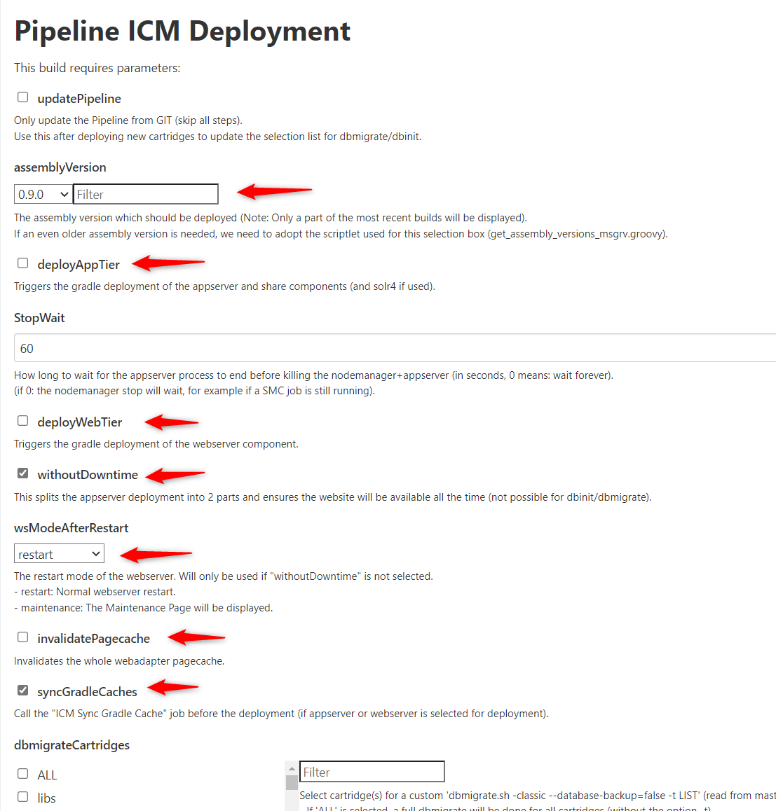
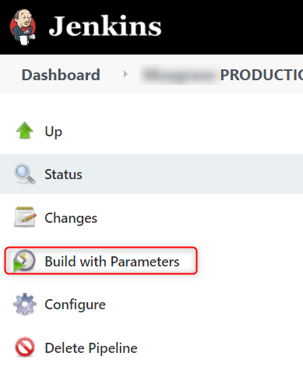
3. Set parameters for deployment
Built to boost your business. code
Intershop Dev Community Meetup
April 11 2022

Slide 6
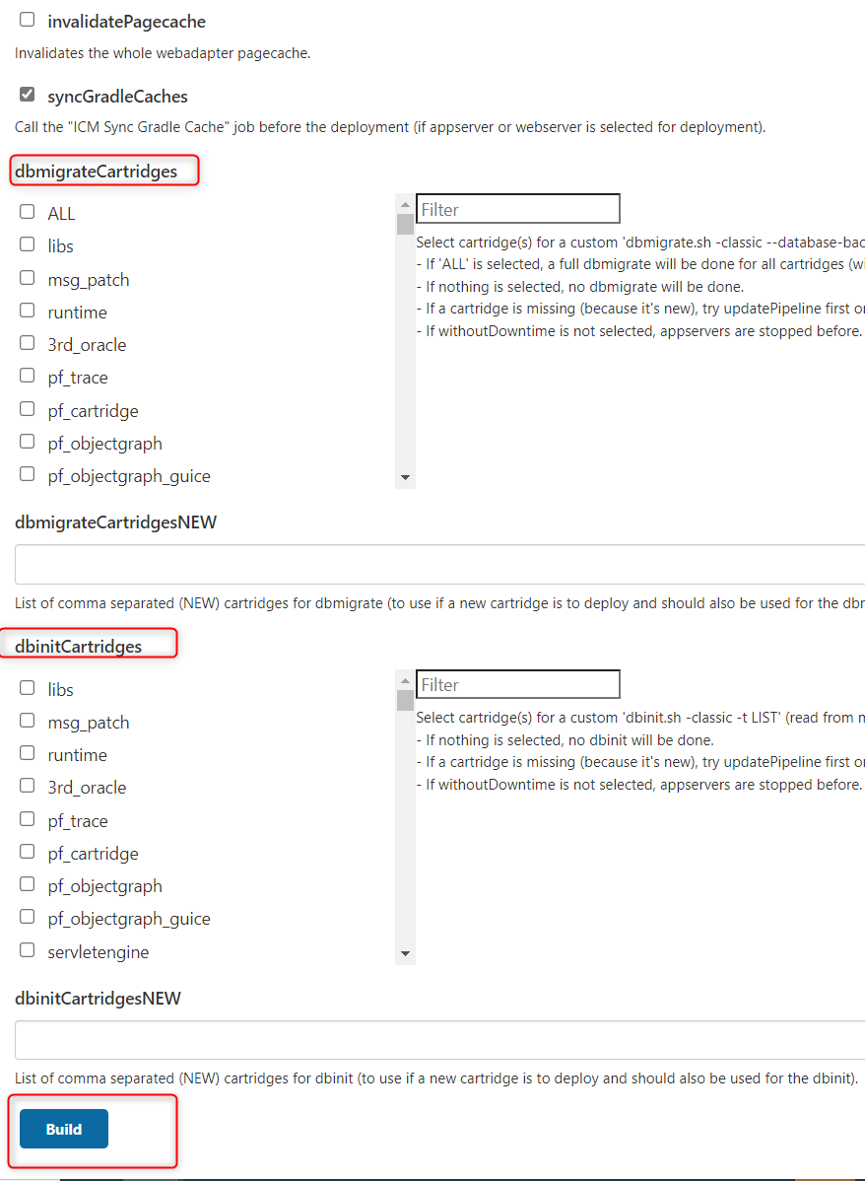
3. Set parameters for deployment
Built to boost your business. code
Intershop Dev Community Meetup
April 11 2022

Slide 7
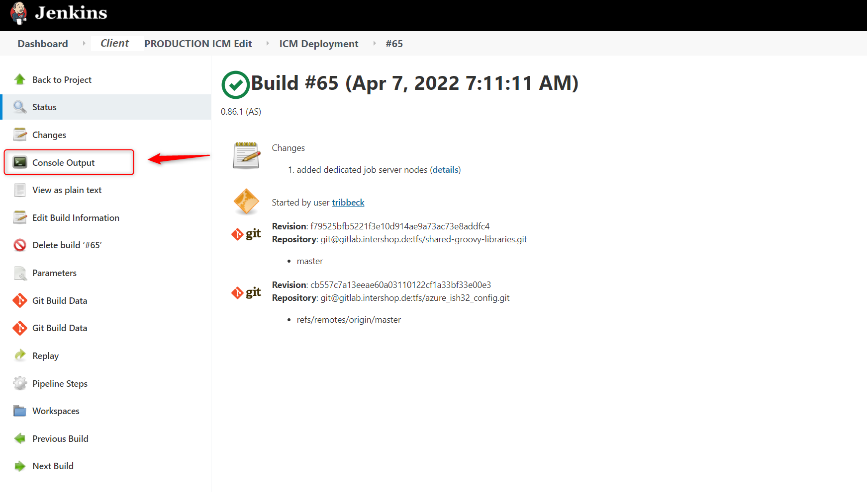
4. Monitor the deployment process
Built to boost your business. code
Intershop Dev Community Meetup
April 11 2022

Slide 8
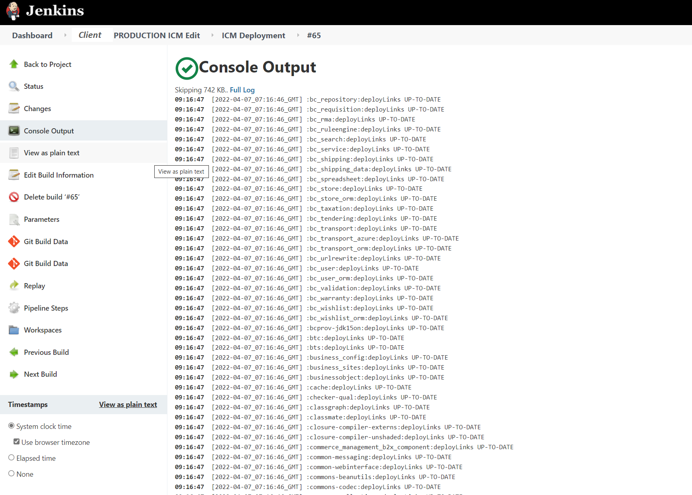
4. Monitor the deployment process
Built to boost your business. code
Intershop Dev Community Meetup
April 11 2022

Slide 9
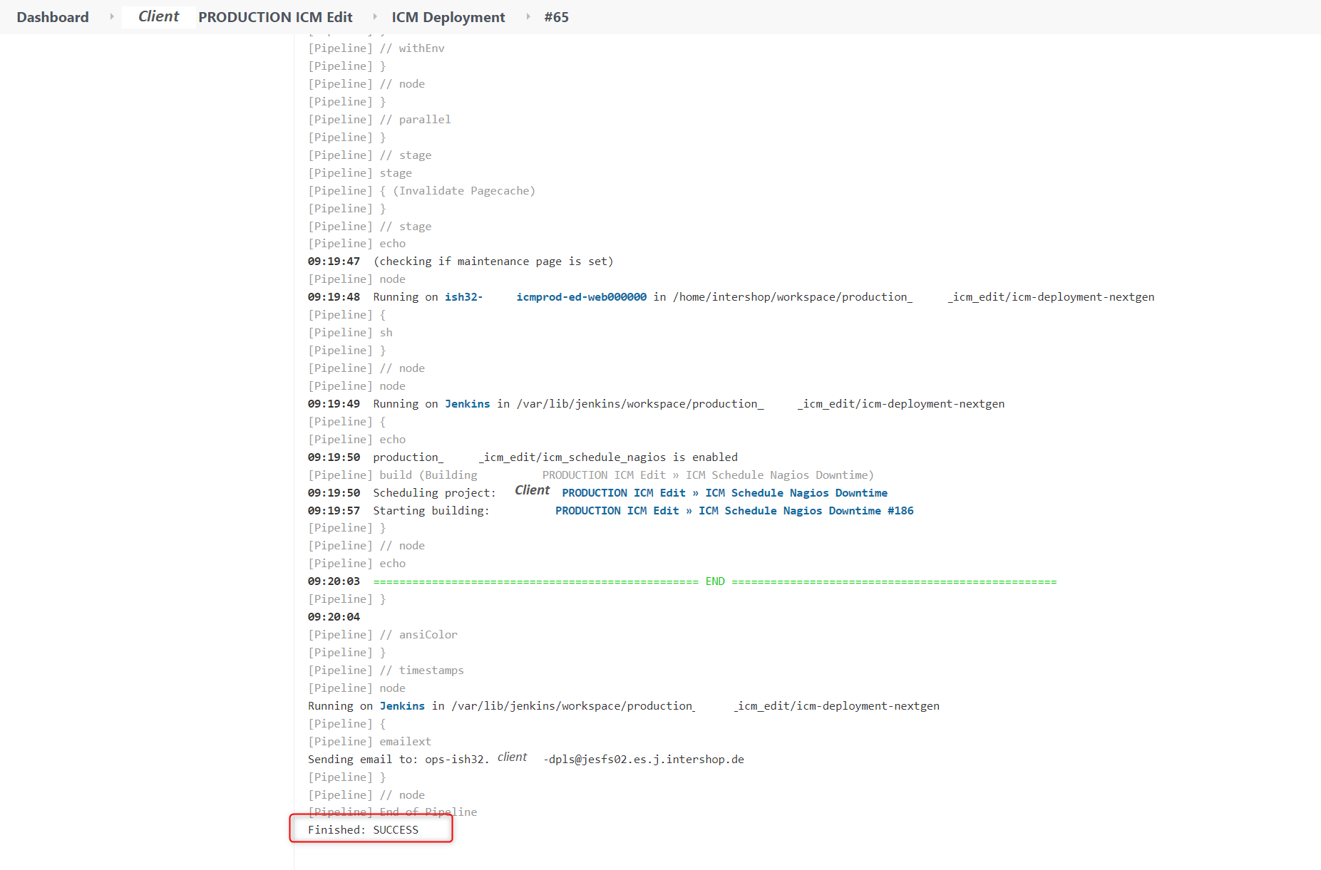
4. Monitor the deployment process
Built to boost your business. code
Intershop Dev Community Meetup
April 11 2022

Slide 10

ICM Deployment done. Questions?
Built to boost your business. code
Intershop Dev Community Meetup
April 11 2022

Slide 11
One last thing... PWA

Slide 12
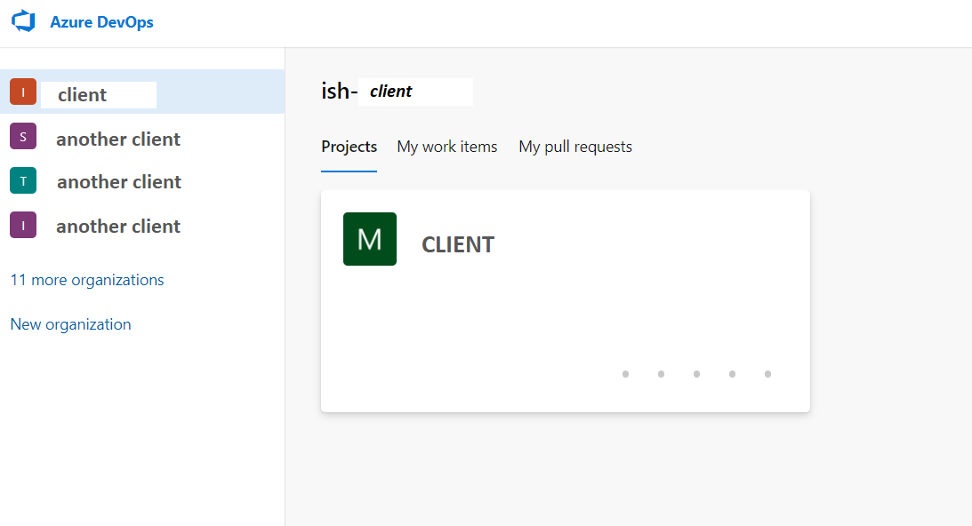
PWA Deployment
Built to boost your business. code
Intershop Dev Community Meetup
April 11 2022

Slide 13
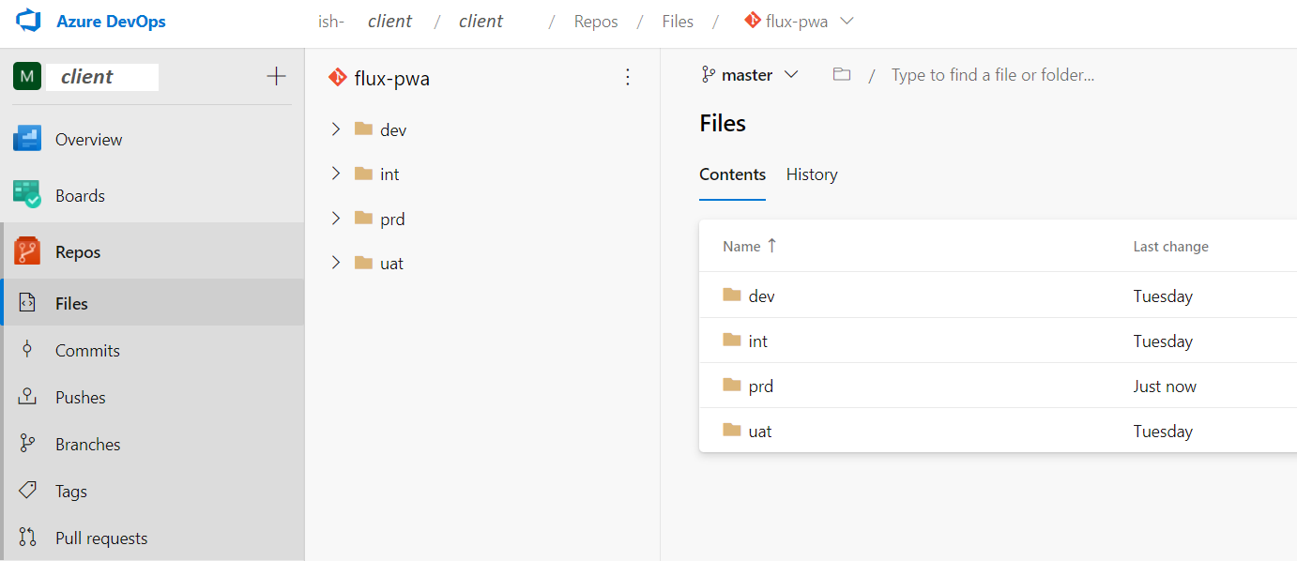
PWA Deployment
Built to boost your business. code
Intershop Dev Community Meetup
April 11 2022

Slide 14
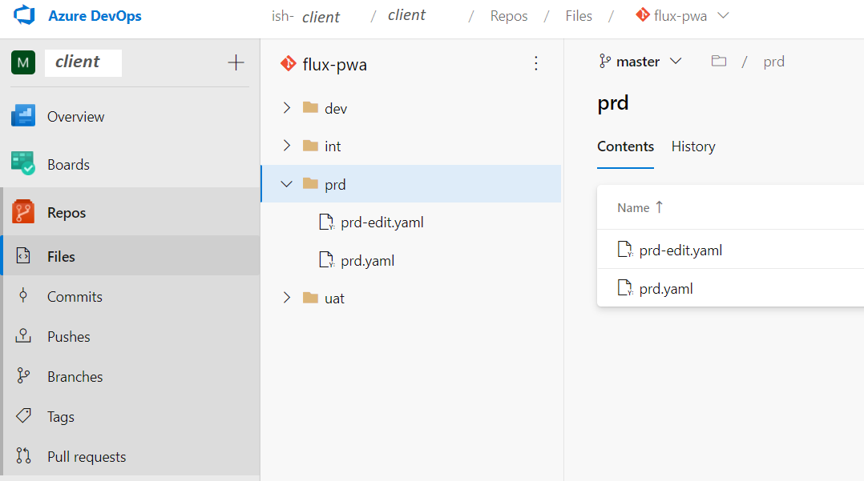
PWA Deployment
Built to boost your business. code
Intershop Dev Community Meetup
April 11 2022

Slide 15
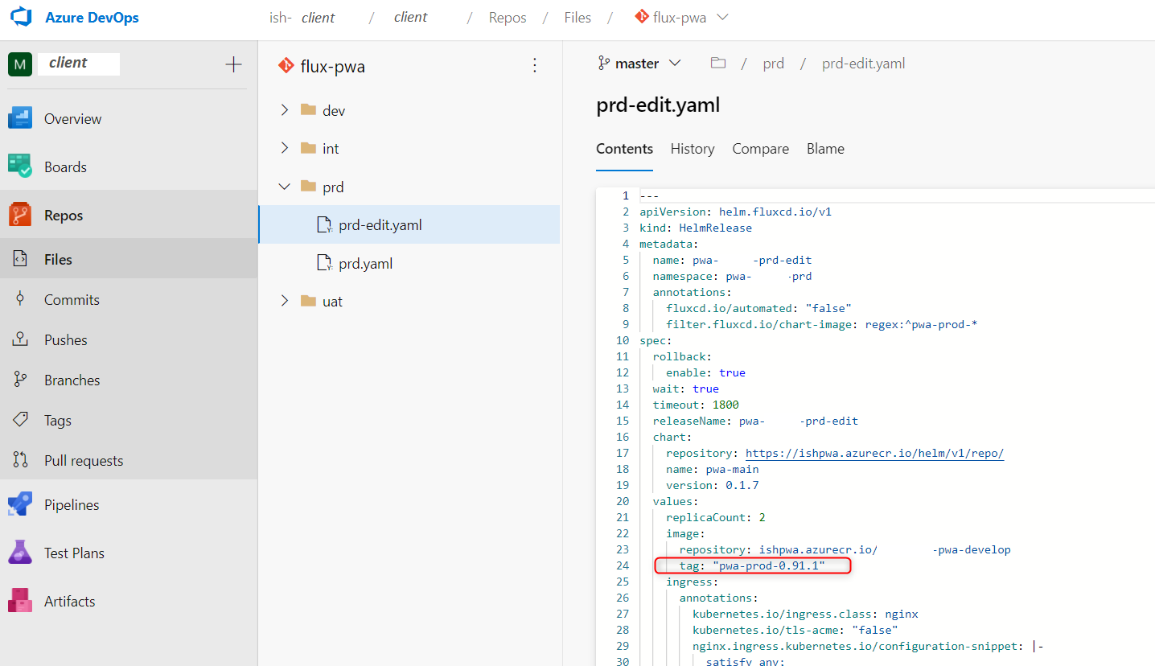
PWA Deployment
Built to boost your business. code
Intershop Dev Community Meetup
April 11 2022

