Slide 1
Analytic Services Overview

Slide 2
Agenda
Background
Evolution
Analytics
Where does Analytics Fit
Analytics Challenges
Insights
Analytics Core Services
Recommendation Engine
Creative Model
User Model
Data Loading
Scoring
Scorecards
Mobile Analytics Platform

Slide 3
Progression
Pre 2008
2008 - 2010
2010 - 2011
2011 - 2013
Workflow
Static Modeling
Analytics Framework
SaaS Portal
Columnar OLAP
Consumer Trends
Portal Offering
Spring MVC
SOA
Parallel Analytics
On-Demand Analytics
Real time Scoring
Real time Profiling
Web services (SOAP)
ecommerce Integration
Area Level Data
Principal Components
Enhanced Profiling
Enhanced Segmentation
Branding
Mobile Campaign Analysis
Distributed Caching
Feature Selection
Mobile Analytics
On-Demand Decisioning
Analytics Core
Real time Decisioning
Response Analysis
Recommendations
Email Mktg
Direct Mktg
Multichannel Mktg
Self-Service Portals
Email Mktg
Direct Mktg
Web Mktg
Portals
Private Labels
Mobile Mktg
Email Mktg
Direct Mktg
Web Mktg
Private Labels
Mobile Wireless
RT Decisioning
Tracking
Analytics Core
Scalability

Slide 4
Analytics

Slide 5
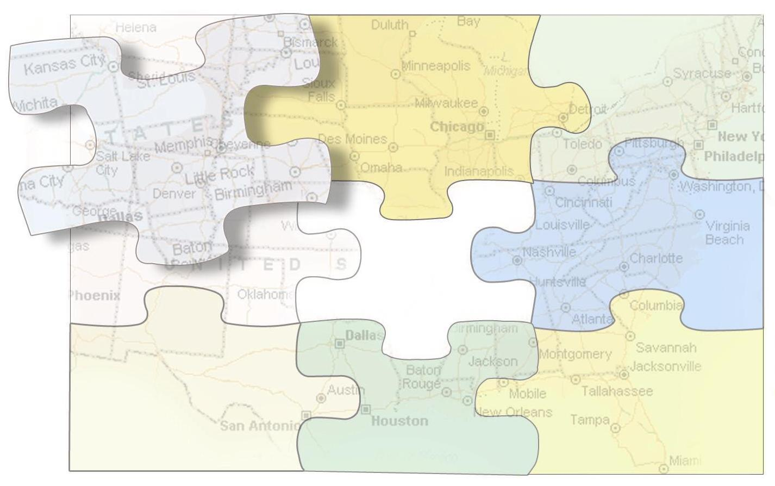
Where Does Analytics Fit?
Mobile Advertising
Data Assets
Mobile Campaigns
Rich Media Ads
Targeting
Decisioning
Segments
Attributes
Clusters
Analytics
Modeling
Scoring
Profiling
Targeting
Mobile Enterprise
Metrics
SMS Campaigns
Micro-sites, Apps
Alerts / Notifications
Dashboards
Trends
Storefront
Designer
Gateway
Mobile Storefront
Content Management
Distribution / Billing
Content
Mobile Internet
Social Networking
Direct Connect
Carrier Connectivity

Slide 6
Analytics Services
Analysis Techniques Evolve
Incorporate new algorithms, techniques, & approaches
Data Synthesis is Essential
Smart ways to reduce data into essential elements
Data Storage and Retrieval
Fast data retrieval that enables data mining and search capability
Automation
Remove human element in favor of automated techniques
Real-time Computing
Return actionable results in milliseconds
Scalability
Take advantage of cloud computing and highly distributed architectures
Presentation of Information
Present complex information in easy to understand formats
Open Systems Architecture
Allow external applications access to analytical computing services

Slide 7
Insights Predictive Analytics

Slide 8
What is Insights?
Push form of Predictive Analytics
Match users to content
Identify propensity of user to respond
Isolates and scores characteristics correlated with a target
Consists of Target, Reference, and Scoring populations
Utilizes data from various sources
Behavioral data – interaction of users to offers
Aggregated transactional data – RFM (Recency, Frequency, Monetary Value)
Enhancement data – additional (modeled) summarized data
Relies on mathematical algorithms to provide a set of predictors
Predictors used to evaluate potential outcomes against a control sample (holdout sample)
Deployed on a population to determine most likely segment to respond
Regression, CF, Clustering, Optimization, Neural Nets

Slide 9
Insights Process
Target Selection
Establish the target population that will be used as the basis for modeling
Targets could include responders, segments, clusters
Feature Selection
Determine the most important variables to consider in the model
Insights uses entropy based expected probability and univariate
Model Training
Determine the most significant predictors among all considered
Optimize until thresholds are achieved
Evaluate against a control sample (20% holdout)
Model Deployment
Deploy model predictors (scorecard) on a population under consideration
Produce ranked list of responders with associated propensities (lift)
Response Analysis
Incorporate feedback (response) through transactional data capture
Re-evaluate model with updated transactional response data

Slide 10
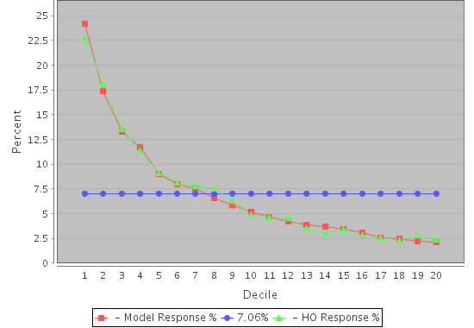
Model Lift with Control Sample

Slide 11
Feature Selection Transcript
February 25, 2012 12:52:46 PM UTC | SimpleViva selecting final variables from all scored variables...
February 25, 2012 12:52:46 PM UTC
February 25, 2012 12:52:46 PM UTC | EProb(y) Threshold = 0.0050
February 25, 2012 12:52:46 PM UTC | VarId: 7602_322221 Viva Score: 0.8041562335964396 EpY Threshold Score: 0.0024237042440140577
February 25, 2012 12:52:46 PM UTC | VarId: 7602_322220 Viva Score: 0.8038582797079696 EpY Threshold Score: 0.002125750355544076
February 25, 2012 12:52:46 PM UTC | VarId: 7919_324583 Viva Score: 0.8036177578904639 EpY Threshold Score: 0.0018852285380382972
February 25, 2012 12:52:46 PM UTC | VarId: 7620_322283 Viva Score: 0.803520152255335 EpY Threshold Score: 0.0017876229029094581
February 25, 2012 12:52:46 PM UTC | VarId: 7725_322799 Viva Score: 0.8033825650074987 EpY Threshold Score: 0.0016500356550731565
February 25, 2012 12:52:46 PM UTC | VarId: 7846_322920 Viva Score: 0.8032684590401914 EpY Threshold Score: 0.0015359296877658357
February 25, 2012 12:52:46 PM UTC | VarId: 7843_322917 Viva Score: 0.8031599731499527 EpY Threshold Score: 0.0014274437975271281
February 25, 2012 12:52:46 PM UTC | VarId: 7707_322782 Viva Score: 0.803151286815523 EpY Threshold Score: 0.0014187574630973865
February 25, 2012 12:52:46 PM UTC | VarId: 7723_322797 Viva Score: 0.8029827101113913 EpY Threshold Score: 0.0012501807589657687
February 25, 2012 12:52:46 PM UTC | VarId: 7837_322911 Viva Score: 0.8028845813866322 EpY Threshold Score: 0.001152052034206652
February 25, 2012 12:52:46 PM UTC | VarId: 7842_322916 Viva Score: 0.802873959777635 EpY Threshold Score: 0.001141430425209422
February 25, 2012 12:52:46 PM UTC | VarId: 7840_322914 Viva Score: 0.8028525605906816 EpY Threshold Score: 0.0011200312382559918
February 25, 2012 12:52:46 PM UTC | VarId: 7925_324611 Viva Score: 0.8027848406157805 EpY Threshold Score: 0.0010523112633549214
February 25, 2012 12:52:46 PM UTC | VarId: 7617_322263 Viva Score: 0.8027551075238568 EpY Threshold Score: 0.0010225781714312543
February 25, 2012 12:52:46 PM UTC | VarId: 7709_322784 Viva Score: 0.8027033003224873 EpY Threshold Score: 9.707709700617073E-4
February 25, 2012 12:52:46 PM UTC | VarId: 7617_322262 Viva Score: 0.8026859525363856 EpY Threshold Score: 9.534231839600782E-4
February 25, 2012 12:52:46 PM UTC | VarId: 7873_322947 Viva Score: 0.8026816176754263 EpY Threshold Score: 9.490883230007796E-4
February 25, 2012 12:52:46 PM UTC | VarId: 7731_322805 Viva Score: 0.8026373394543453 EpY Threshold Score: 9.048101019197841E-4
February 25, 2012 12:52:46 PM UTC | VarId: 7670_322745 Viva Score: 0.8025163418867689 EpY Threshold Score: 7.838125343433422E-4
February 25, 2012 12:52:46 PM UTC | VarId: 7671_322746 Viva Score: 0.8025136041503305 EpY Threshold Score: 7.810747979049015E-4
February 25, 2012 12:52:46 PM UTC | VarId: 7836_322910 Viva Score: 0.8025121786348344 EpY Threshold Score: 7.796492824088119E-4

Slide 12
Model Transcript with Dynamic Model Repair
February 24, 2012 12:26:54 AM UTC | ==================================================
February 24, 2012 12:26:54 AM UTC | MODELING PROCESS STARTED
February 24, 2012 12:26:54 AM UTC | ==================================================
February 24, 2012 12:26:54 AM UTC | found model: regressionModel
February 24, 2012 12:26:54 AM UTC | Modeling Service Starting...
February 24, 2012 12:26:54 AM UTC | Using Logistic Regression Classifier for performing modeling...
February 24, 2012 12:27:06 AM UTC | Now checking for singular variables...
February 24, 2012 12:27:07 AM UTC | Discarded 2 Model Variables due to Singularity or Pct Non-Zero Values...
February 24, 2012 12:27:07 AM UTC | Total Missing Value Rows Identified = 0 ...
February 24, 2012 12:27:07 AM UTC | -------------------------------------------------------
February 24, 2012 12:27:07 AM UTC | Starting Logistic Classifier run on Model Segment 1 for Regression Model
February 24, 2012 12:27:07 AM UTC | -------------------------------------------------------
February 24, 2012 12:27:07 AM UTC | Adding 98 independent variables associated with this model iteration as a batch.
February 24, 2012 12:27:08 AM UTC
February 24, 2012 12:27:10 AM UTC | Preparing to run logistic regression estimation...
February 24, 2012 12:27:10 AM UTC | Using prior initial beta values...
February 24, 2012 12:27:10 AM UTC | Scaling dependent and independent data matrix...
February 24, 2012 12:27:10 AM UTC | Solving in the Minimization Solver...
February 24, 2012 12:27:10 AM UTC | Finished Minimization solver in 360 iterations.
February 24, 2012 12:27:10 AM UTC | Computing the variance covariance matrix, lambdas, and new yHats....
February 24, 2012 12:27:11 AM UTC | Finished computing the variance covariance matrix, lambdas, and new yHats....
February 24, 2012 12:27:11 AM UTC | Now creating a Cholesky decomposition, factoring, and taking the inverse to get new var covar matrix....
February 24, 2012 12:27:11 AM UTC | Variance-covariance matrix experienced the error: Matrix is not positive definite.
February 24, 2012 12:27:11 AM UTC | Logistic Regression estimation error: Matrix is not positive definite.
February 24, 2012 12:27:11 AM UTC | -------------------------------------------------------
February 24, 2012 12:27:11 AM UTC | Predictive model experienced a problem during model execution.Will attempt to repair model using Stepwise Regression Failure Policy...
February 24, 2012 12:27:11 AM UTC
February 24, 2012 12:27:11 AM UTC | Removing previous variables from model...
February 24, 2012 12:27:11 AM UTC | Stepwise Model Repair - Creating new Stepwise model attempting to maximize number of Model Variables in each step...
February 24, 2012 12:27:11 AM UTC

Slide 13
Insights Service Architecture
Apps & Clients
Web Services SOAP API
Software Services
Workflow & Service Access
Admin.
Acct. Mgt.
Security
Tracking
Billing
Data Mgt.
Hygiene
Matching
Linking
Analytics
Modeling
Multivariate
Automated
Workflow
Scoring
Outside List
3rd Party
National
Real-time
List Mgmt.
Data Appends
Market Counts
Suppression
GIS Mapping
Pt. Mapping
Thematic
Distance
Coding
Profiling
Ad Hoc
Data Mining
Scheduled
Usage
Marketing Svcs
Decisioning
Segmentation
Targeting
Response
3rd Party
Data
Client
Data
Templates
Rules
Admin
Users
Targets
Work
Flow
Enterprise Databases
Internal & Specialty Databases

Slide 14
Insights Top Level SW Components
Core Controllers
Interceptors
Actions
Core Services
Analytics Services
Numeric Processing Services
Common Services
Administrative Services
Portal Services
Parsing Services
Location Services
Web Services
eServices (shopping cart)
Core Utilities
Frameworks
Core Objects
Models
Datasets and Datasources
Application Modules
Generic – Enterprise portal
Application specific (Kintera, Salesforce.com)
Workflow
Projects and Tasks
User Interface
JSP pages

Slide 15
Analytics Core
Separation of Analytics services into “finer grained” services
Filtering
Feature Selection
Modeling
Scoring
Clustering
Optimization
Targeting
Provide a launching point for the use of highly parallel algorithms with big data technologies
Hbase, Hadoop, Mahout, Custom Algos

Slide 16
RECOMMENDATIONS

Slide 17
Recommendation Ranking
Return highest ranking (score cards) Creatives
Recommendations span across all active Creatives
Algorithm Preference
Item based collaborative filtering
Refresh Rate
Once per day

Slide 18
Collaborative Filtering (CF) – Memory-based Techniques
LOGICAL VIEW: Transactional Data Only
 | Items (Purchases)
 | 1 | 2 | 3 | … | n
1
2
3
…
m
- Purchase Event / Purchase Rate
Users
Item-based CF (Find Co-paired items)
 | Items (Purchases)
 | 1 | 2 | 3 | … | n
1
2
3
…
m
Find Items similarly with similar Patterns
(e.g. Item correlation or ‘distance’)
Users
User-based CF (Find Similar Users)
 | Items (Products, Page Links)
 | 1 | 2 | 3 | … | n
1
2
3
…
m
Find Users similarly with similar Patterns (e.g. User correlation or ‘distance’)
Users

Slide 19
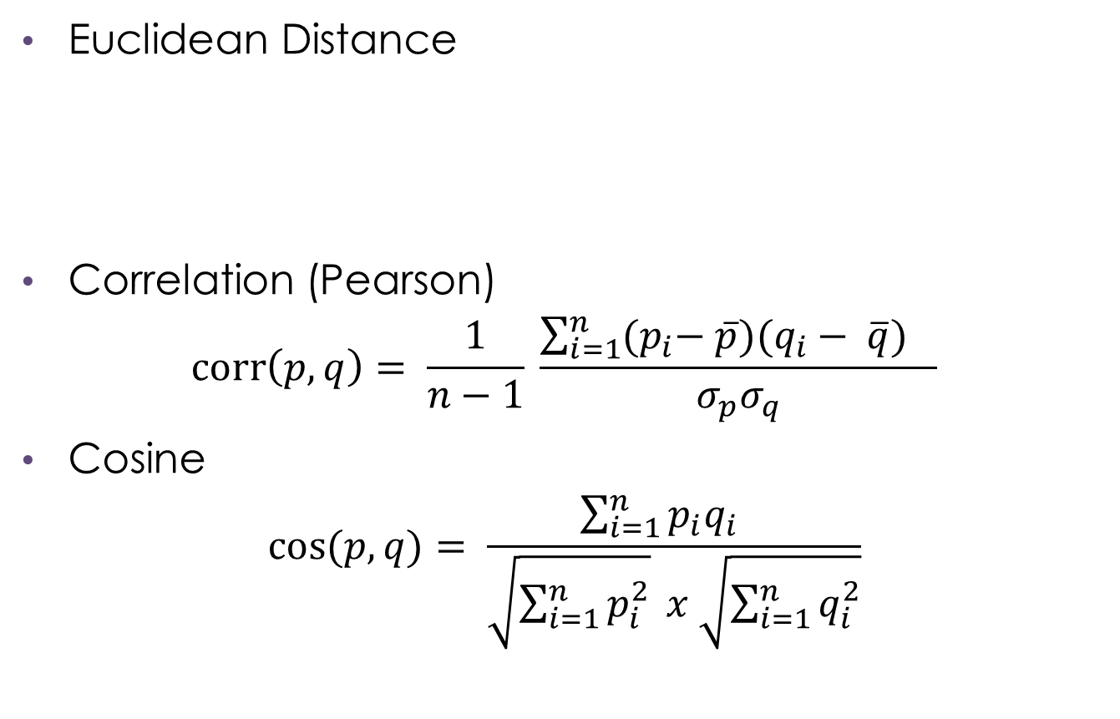
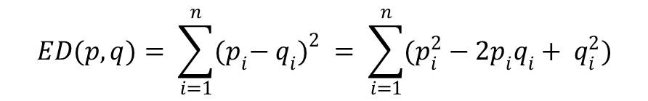
Release 1.0 Algorithms

Slide 20
Item Based cf approach
Item-based Collaborative Filtering Models
 | Euclidean - Items (All Items)
 | 1 | 2 | 3 | … | m
1
2
3
…
m
 | Euclidean - Items by Type
 | 1 | 2 | 3 | … | m
1
2
3
…
m
 | Cosine - Items (All Items)
 | 1 | 2 | 3 | … | m
1
2
3
…
m
 | Cosine - Items by Type
 | 1 | 2 | 3 | … | m
1
2
3
…
m
 | Correlation - Items (All Items)
 | 1 | 2 | 3 | … | m
1
2
3
…
m
 | Correlation - Items by Type
 | 1 | 2 | 3 | … | m
1
2
3
…
m

Slide 21
Performance Based cf approach
Performance-based Collaborative Filtering Models
 | Euclidean – Performances (All Performances)
 | 1 | 2 | 3 | … | m
1
2
3
…
m
 | Euclidean - Performances by Type
 | 1 | 2 | 3 | … | m
1
2
3
…
m
 | Cosine - Performances (All Performances)
 | 1 | 2 | 3 | … | m
1
2
3
…
m
 | Cosine - Performances by Type
 | 1 | 2 | 3 | … | m
1
2
3
…
m
 | Correlation - Performances (All Performances)
 | 1 | 2 | 3 | … | m
1
2
3
…
m
 | Correlation - Performances by Type
 | 1 | 2 | 3 | … | m
1
2
3
…
m

Slide 22
Collaborative Filtering
Collaborative Filtering
(CF)
User-based CF
(Find Similar Users)
Item-based CF
(Find Similar Items)
Cold-Start Techniques
(New User, New Item)
Memory-based Techniques
Model-based Techniques
Hybrid Techniques
Top Sellers
Hot Items
Similarity Measure
Categorical Predictions:
Event (Click/Purchase)
Rating (Best-Worst)
Continuous Predictions:
Click-Through/Browse Rate (CTR)
Purchase Rate

Slide 23
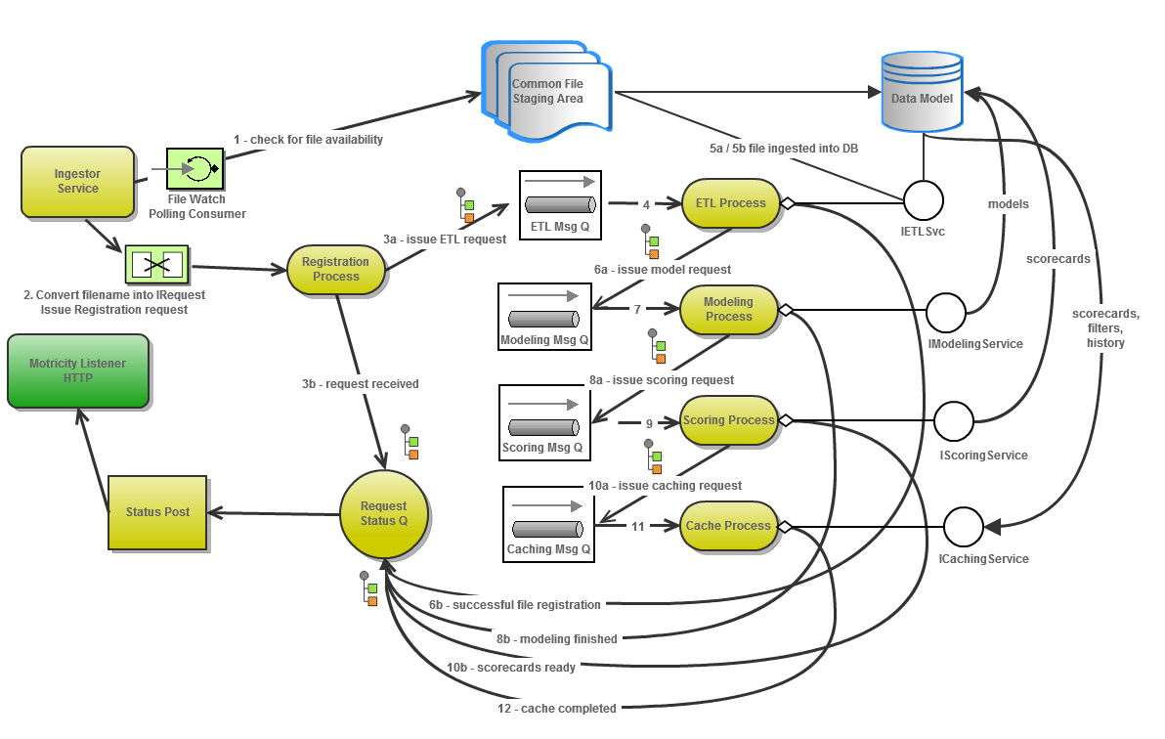
Data Loading

Slide 24

Recommendation service
Online
Data
Services
Flat Files
Impaktu
Network
1
I1,I2,…In
2
1
3
Destination
3
Filter n
Strategy
Filter 2
Model
Recommendation
Engine
4
2
5
Distributed Cache
Scorecards
Filters
Tx history
Offline
Working

Slide 25
Workflow – producer (batch mode)
Import
Registration
Transformation
Feeds
Service
Ingestor
Service
Registration
Service
Transformation
Service
RE
Registration
Service
RE
ETL
Service
Flat Files
SybaseIQ
SybaseIQ
SybaseIQ
Nightly XML
Events
Summary
Periodic XML
Item
Import for
Events (tx)
Summary
Item
Item - Device
Staging Form of
Events
Summary
Item
Item - Device
Data Model Form of
Events
Summary
Item
Item - Device
Normalized
Denormalized

Slide 26
Workflow – producer (batch mode)
Modeling
Scoring
Deployment
Prediction
Service
Scoring
Service
Distributed
Cache Service
RE
CF
Service
RE
Scoring
Service
Scorecard
Scorecard
Scorecard
Scorecard
Scorecard
Scorecard
Scorecard
Scorecard Cache
Scorecard(s)
Overall (all Tx)
By product type
By attribute filter
Item based
Ranked Items
Overall
By product type
By attribute filter
All scorecards
Distributed Cache
Distributes cache over node cluster
Appears as a local cache
Updated once per day
Read only to real time
SybaseIQ

Slide 27
Workflow – recommendation realtime
Deployment
Deployment
Decisioning
Distributed
Cache Service
Suggestor
Service
From Impaktu Ad Network
Request for
Recommendations
Targeting
Service
User Id to
Purchased Item Ids
Filtering
Service
Purchased Item Ids
Device Id to
Item Ids
Scored Item Ids
RE Filtering
Service
< 500 ms / recommendation
Top Selling
Item Ids
by Product Type
Filter Item Ids
Device Filter
User Id to
Exclusion Item Ids
Exclusion Filter
{ranked item list}
Top Selling Filter
To Impaktu Ad Network

Slide 28
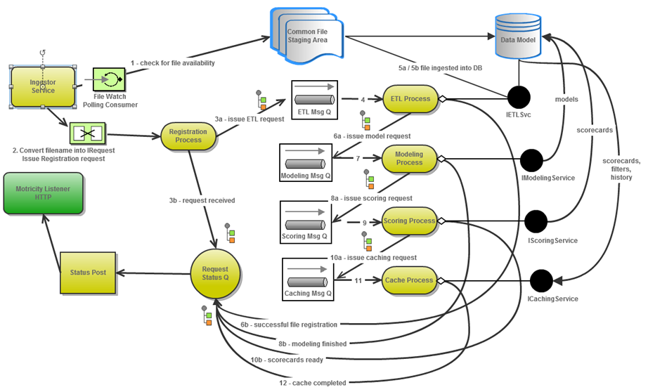
Ingestor Service workflow

Slide 29
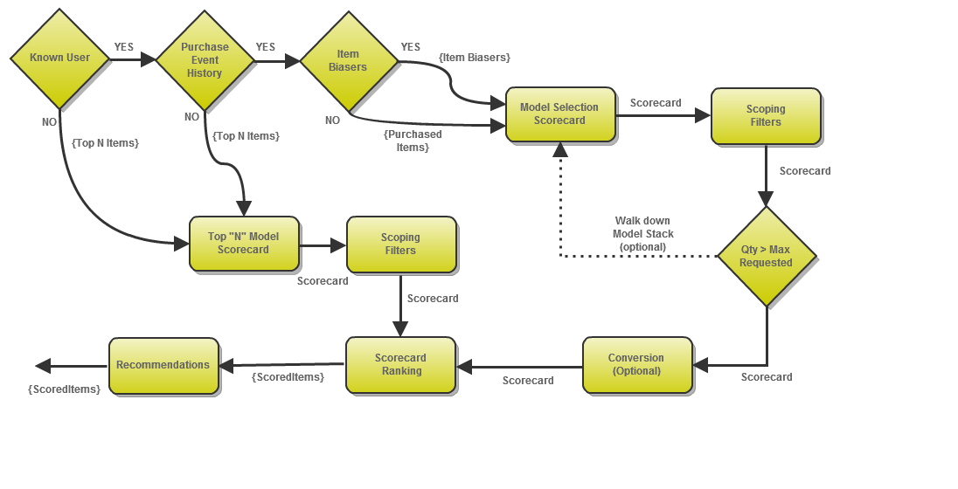
Strategy Logic

Slide 30
Formation of Analytics Core
Filtering
Services
Modeling
Services
Scoring
Services
Targeting
Services
Filtering
Core
Modeling
Core
Scoring
Core
Targeting
Core
Analytics Core

Slide 31
Recommendation Flow
Analytics Core Services
Recommendation Services
Collaborative
Filtering
Filtering
Remote Access
Items
Scoring
Targeting
SOAP
APIs
Services
Workflow
Bulk Insert
Distributed
Cache
Scored Results
Data Access
Ingestion Services
Content
Purchase TX

Slide 32
Recommendations Services – Online Ingestor API
Offline
Feeds Service
(Data Services)
Data
File Watcher
File Import
Ingestor
Service
SOAP – RT Tx IF
Recommendation
Engine
Suggestor
Service
Online
RECO Service
RECO
Client
SOAP – Recommendation Request

Slide 33
Recommendation Configuration
Collaborative Filtering
(CF)
User-based CF
Item-based CF
Cold-Start Techniques
(New User, New Item)
Memory-based Techniques
Model-based Techniques
Hybrid Techniques
Top Sellers
Hot Items
Similarity Measures
- Purchased Items
Categorical Predictions:
Event (Click/Purchase)
Rating (Best-Worst)
Continuous Predictions:
Click-Through/Browse Rate (CTR)
Purchase Rate
Business Rules Layer:
Suppression Rules (previously bought items)
Outlier Rules (most/least popular)
Add / reduce Weight for Types of Items, Users, etc.

Slide 34
Modeling – Creative Level
Creative-based CF (Co-paired items based on purchase history)
 | Items (Purchases)
 | 1 | 2 | 3 | … | n
1
2
3
…
m
Find Items with similar purchase patterns
(e.g. Item correlation or ‘distance’). Consumers who purchased item ia purchased items ic and id.
Users
Amazon Equivalent:
Customers Who Bought This Item Also Bought…
Creative-based CF (Co-paired items based on browse and purchase history)
 | Items (Browsed - Clicks)
 | 1 | 2 | 3 | … | n
1
2
3
…
m
Find Items with similar browse and purchase patterns (e.g. Item correlation or ‘distance’). Consumers who browsed item ia purchased items ic and id.
Users
Amazon Equivalent:
What Other Items Do Customers Buy After Viewing This Item?

Slide 35
RECO 1.1 Modeling – User Model on Levels of Engagement + Device Attrs
User-based model
 | Items (Levels of Engagement)
 | Item 1 | Item 2 | Item 3 | … | Item n
1 | 5 | 1 | 3 | 5 | 5
2 | 2 | 3 | 1 | 3 | 5
3 | 5 | 5 | 5 | 2 | 5
… | 2 | 3 | 3 | 1 | 1
m | 1 | 1 | 1 | 5 | 5
Device Attributes
A1 | A2 | A3 | … | An
0 | 1.5 | 3 | 0 | 1
1 | 2.0 | 1 | 0 | 1
1 | 1.0 | 5 | 1 | 0
0 | 1.25 | 3 | 1 | 1
1 | 1 .0 | 1 | 1 | 1
Users
New independent variables modeling device attributes
Users are compared based on their levels of engagement and device attributes
Amazon Equivalent:
Similar Customers Also Bought These Items…

Slide 36
Modeling Scorecards –
Three Distinct Models – α1S1 + α2S2 + α3S3 where
S1 = User Model with Item level of engagement and Device Attributes
α1 = weight of the user model
S2 = Purchase-based item Model
α2 = weight of the item purchase model
S3 = Browse-based item Model
α3 = weight of the item browse model

Slide 37
Offline
Online
Session Data
Data
Services
Flat Files
Impaktu
Ad Networks
1
I1,I2,…In
2
1
3
Staging
3
User Model
Filter n
Strategy
Purchase Model
Filter 2
Browse Model
Models
Recommendation
Engine
4
2
5
Distributed Cache
Scorecards
Filters
Tx history
Working

Slide 38
Recommendations + Insights = Push / Pull SOA

Slide 39
Promotion Push Services
Recommendation Pull Services
Acquire
Upsell /
Cross-sell
Products
Services
Retain
Respond
Content
Offers
Analytics Core Services
Remote Access
Predictive Modeling
Feature
Selection
Segmentation
Filtering
Response
Analysis
Profiling
Reporting
REST
APIs
Scoring
Clustering
Classification
Sampling
Geo
Location
Targeting
Diagnosis
SOAP
APIs
JMS
APIs
Platform Services
Monitors
Workflow
Bulk Insert
Distributed
Cache
Distributed
File System
Data Access
Logs / Trace
Scored Results
Camel
DSL
Ingestion Services
Registration Services
Customer
Content
Clicks / Browse / Purchase
Context
Consumer
Transform
Match
Append

Slide 40
Mobile Analytics Platform

Slide 41
Recommendation Refresh Process
Tracker
REST API
Data Bag
Data Bag
Targeted
Offer
Event
Notifier
Recommendation
Engine
Ad Server
3rd Party System
Recorded
Business Overrides
Impaktu or
3rd Party
Decodes & Creates Data Bag
User Id
Device Id
Location
Time of Day
Day of Week
Carrier Operator
Mobile Number
Event Path
Event Type (Mobile App Offer*)
Client Id*
User Agent
Data Bag
Business Logic
Transaction Listener
Relevant
Ranked Offers
Data Bag
Staleness Filter
Data
Bag
Device Compatible
Ranked Offers
Analytics DB
Device Filter
Aggregated Tx’s
RFM Data
3rd Party Enhancement Data
Ranked Offers
* Decoded from url
Scoring Engine
Model Data Ingestor
Scorecards & Offers
Target & Reference Population
Dependent &Independent Variables
Strategy: Optimizing (CPC, CPA)
Real-time Cache
User Profile, Offers, Scorecards
Real-time
Modeling Engine
Non Real-time
Offer Scorecard
Recommedations
Insights

Slide 42
Analytics Platform Considerations A/B/N Testing
Description | Data | Connectivity | KPI / Algorithm
Self-learning algorithm that optimizes campaigns for CTR based on evaluating performance of multiple ad creatives in real-time. Use Cases: Real-time optimization of Creative selection. Differences in being 1st party vs. 3rd party ads delivery. Audience – Advertiser | Content Network / Publisher / Site / Zone Attributes (name, medium, channel, tags..) Agency / Advertiser / Campaign / Ad Group / Ad / Creative Attributes (name, medium, channel, format, delivery and targeting parameters,…) User Attributes (may need tracking cookies): User Agent, User Event Summary impressions, clicks, User Profile or Segment Device Attributes (DIS, DM,…) Geography Attributes (IP-based, Lat-Lon- based,…) Operator Attributes Data Model Attributes (Ad Server DW) + Derived Attributes (TOD, DOW) + Enhancement Attributes (ComScore, Census, Experian,…) Design-time vs. Real-time Attribute Availability | Blind – Minimal predictive model Semi-Blind – Richer model with more granular targeting Fully – Comprehensive model with high level of fidelity | KPI = CTR Logistic regression, Bayesian Bias by device, TOD, DOW, User (when able)
Operational Mode | Modeling | Scoring | Tech Stack | Barriers
Run-time – on the fly optimization Requires a startup period to meet minimum obs | Initially one-off Progress to perpetual Small number of attrs Interaction terms Scorecard | Realtime (<50 ms) Scorecard based Post filters Rules | RECO Ingestor (w HDFS) Analytics Core (w Hadoop + Mahout) RECO Real-time Suggestor (Scoring + Filtering) RECO Workflow (Camel) RECO Distributed Cache | 3rd Party Ad Server may not allow control of content selection

Slide 43
Analytics Platform Considerations Agency Ad Optimization (DSP)
Description | Data | Connectivity | KPI / Algorithm
Use predictive analytics for ad placement optimizing for CTR Use Case: Media Planner and Agency Dashboard Enable agencies to discover high-value publishers Audience – Agency, Advertisers | Content Network / Publisher / Site / Zone Attributes (name, medium, channel, tags..) Agency / Advertiser / Campaign / Ad Group / Ad / Creative Attributes (name, medium, channel, format, delivery and targeting parameters,…) User Attributes (may need tracking cookies): User Agent, User Event Summary impressions, clicks, User Profile or Segment Device Attributes (DIS, DM,…) Geography Attributes (IP-based, Lat-Lon- based,…) Operator Attributes Data Model Attributes (Ad Server DW) + Derived Attributes (TOD, DOW) + Enhancement Attributes (ComScore, Census, Experian,…) Design-time vs. Real-time Attribute Availability | Blind – Minimal predictive model Semi-Blind – Richer model with more granular targeting Fully – Comprehensive model with high level of fidelity | KPI = CTR Logistic Regression, Bayesian, CF Models, Clustering Bias by device, TOD, DOW, User (when able)
Operational Mode | Modeling | Scoring | Tech Stack | Barriers
Design time – Media planning Run-time – on the fly optimization | Regular intervals Possible chaining Possibly large number of attrs Interaction terms Scorecard | Realtime (<50 ms) Scorecard based Post filters Rules Targeting Delivery Backfill | RECO Ingestor (w HDFS) Analytics Core (w Hadoop + Mahout) Real-time Suggestor (Scoring + Filtering) RECO Workflow (Camel) RECO Distributed Cache | Data acquisition and availability Publisher and advertiser relationships

Slide 44
Analytics Platform Considerations Publisher Ad Optimization (SSP)
Description | Data | Connectivity | KPI / Algorithm
Use predictive analytics for ad placement optimizing for publisher revenue, e.g. Yield Optimization scenarios Use Case: Inventory worth calculator, or a tool that predicts how much their Inventory will likely yield given past performance Audience – Publisher, Traffic Manager | Content Network / Publisher / Site / Zone Attributes (name, medium, channel, tags..) Agency / Advertiser / Campaign / Ad Group / Ad / Creative Attributes (name, medium, channel, format, delivery and targeting parameters,…) User Attributes (may need tracking cookies): User Agent, User Event Summary impressions, clicks, User Profile or Segment Device Attributes (DIS, DM,…) Geography Attributes (IP-based, Lat-Lon- based,…) Operator Attributes Data Model Attributes (Ad Server DW) + Derived Attributes (TOD, DOW) + Enhancement Attributes (ComScore, Census, Experian,…) Design-time vs. Real-time Attribute Availability | Blind – Minimal predictive model Semi-Blind – Richer model with more granular targeting Fully – Comprehensive model with high level of fidelity | KPI = Yield Logistic Regression, Bayesian, CF Models, Clustering + LP optimization Note: model selection depends on pricing model (CPM, CPC, CPA) Bias by device, TOD, DOW, User (when able)
Operational Mode | Modeling | Scoring | Tech Stack | Barriers
Design time – Inventory management Run-time – on the fly optimization | Regular intervals Possible chaining Possibly large number of attrs Interaction terms Scorecard | Realtime (<50 ms) Scorecard based Post filters Rules Targeting Delivery Backfill | RECO Ingestor (w HDFS) Analytics Core (w Hadoop + Mahout) Real-time Suggestor (Scoring + Filtering) RECO Workflow (Camel) RECO Distributed Cache | Data acquisition and availability Publisher and advertiser relationships Ad Server must perform ad selection

Slide 45
Analytics Platform Considerations Ad Network Optimization
Description | Data | Connectivity | KPI / Algorithm
Manage "system wide" campaign optimization for meeting impression and CTR goals of agency buys Use Case: Recommend sites & zones for the ads in a given insertion order based on matching IOs objectives with the available inventory. Audience – Traffic Mgrs. | Content Network / Publisher / Site / Zone Attributes (name, medium, channel, tags..) Agency / Advertiser / Campaign / Ad Group / Ad / Creative Attributes (name, medium, channel, format, delivery and targeting parameters,…) User Attributes (may need tracking cookies): User Agent, User Event Summary impressions, clicks, User Profile or Segment Device Attributes (DIS, DM,…) Geography Attributes (IP-based, Lat-Lon- based,…) Operator Attributes Data Model Attributes (Ad Server DW) + Derived Attributes (TOD, DOW) + Enhancement Attributes (ComScore, Census, Experian,…) Design-time vs. Real-time Attribute Availability | Blind – Minimal predictive model Semi-Blind – Richer model with more granular targeting Fully – Comprehensive model with high level of fidelity | KPI = Margin, CTR, Yield LP Optimization, Logistic Regression, Bayesian, CF Models, Clustering Bias by device, TOD, DOW, User (when able)
Operational Mode | Modeling | Scoring | Tech Stack | Barriers
Design time – Media planning, Inventory management Run-time – on the fly optimization | Regular intervals Model chaining Possibly large number of attrs Interaction terms Scorecard Rules | Realtime (<50 ms) Scorecard based Post filters Rules Targeting Delivery Backfill | RECO Ingestor (w HDFS) Analytics Core (w Hadoop + Mahout) Real-time Suggestor (Scoring + Filtering) RECO Workflow (Camel) RECO Distributed Cache | Data acquisition and availability Publisher and advertiser relationships Operate own Ad Server or fully integrated into 3rd party Ad Server

Slide 46
Analytics Platform Considerations Real-time Bidding (DSP and/or SSP)
Description | Data | Connectivity | KPI / Algorithm
Real-time bidding platform supporting hands-off network for advertisers and publishers Use Case: Enable advertisers to set campaign targets, and bid price for certain user/publisher attributes Recommend bid prices for combinations of attributes Audience – Agency, Advertisers, Publishers | Content Network / Publisher / Site / Zone Attributes (name, medium, channel, tags..) Agency / Advertiser / Campaign / Ad Group / Ad / Creative Attributes (name, medium, channel, format, delivery and targeting parameters,…) User Attributes (may need tracking cookies): User Agent, User Event Summary impressions, clicks, User Profile or Segment Device Attributes (DIS, DM,…) Geography Attributes (IP-based, Lat-Lon- based,…) Operator Attributes Data Model Attributes (Ad Server DW) + Derived Attributes (TOD, DOW) + Enhancement Attributes (ComScore, Census, Experian,…) Design-time vs. Real-time Attribute Availability | Blind – Minimal predictive model Semi-Blind – Richer model with more granular targeting Fully – Comprehensive model with high level of fidelity | KPI = CTR, Yield LP Optimization, Logistic Regression, Bayesian, CF Models, Clustering Bias by device, TOD, DOW, User (when able)
Operational Mode | Modeling | Scoring | Tech Stack | Barriers
Design time – bid preferences, auction rules, inventory management Run-time – real time | Regular intervals Model chaining Possibly large number of attrs Interaction terms Scorecard | Realtime (<50 ms) Scorecard based Post filters Rules Targeting Delivery Backfill Remnant | RECO Ingestor (w HDFS) Analytics Core (w Hadoop + Mahout) Real-time Suggestor (Scoring + Filtering) RECO Workflow (Camel) RECO Distributed Cache Bidder (does not exist) Auctioner (does not exist) | Data acquisition and availability Publisher participation User attributes Advertiser relationships

Slide 47
Automated Modeling – All Use Cases
CTR/CTA |  | User Self-Reported Attributes |  |  | User Modeled Attributes |  | Offer /Ad Attributes |  | Geo Attributes | Device Attributes | Aggregated Tx Attrs | Content Attributes | InteractionAttributes | 3rd Party Appended Attributes |  | Time Attributes
 | User Id | Gender | Age | … | ClusterId | SegmentId | Offer-Ad Id | … | … | … | … | … | … | Children | Online Buyer | …
… | 1 |  |  |  |  |  | 1 | …
… | 1 |  |  |  |  |  | 2 | …
… | 2 |  |  |  |  |  | 1 | …
… |  |  |  |  |  |  |  | …
N | N |  |  |  |  |  | 1 | …
Dependent Variable
Independent / Explanatory Variables
Offline Non-Realtime Process: Models are continually updated automatically to produce up-to-date scorecards
used by the realtime scoring engine
Candidate Models: Continuous Regression, Discrete Choice Regression, K Nearest Neighbors, Collaborative Filtering
Attribute Families:
Ad Attributes - Advertiser/Agency/Campaign/Ad Group/Ad
User Attributes – Id, Self-Reported Opt-in, Modeled (Cluster and Segment), 3rd Party
Device Attributes
Content Attributes – Network/Publisher/Site/Zone
Geo Attributes – Location
Time Attributes – Time of day, day of week
Aggregated Transaction Attributes – Recency, Frequency, Monetary Value (RFM)

Slide 48
Modeled User Attributes – Creating Dynamic Clusters
Fine-Grained Clusters
Continuous Dynamic Clustering
Predictive Intent with Propensities
Improved Clustering
New Clusters
Predictive Intent
Confidence and Value
Segment-Based
Limited Predictive Intent
SMS, Mobile Web / Apps
Response Data
Opt-In
Machine Learning
SMS, Mobile Web / Apps
Limited Machine Learning
Cold Start
Time

Slide 49



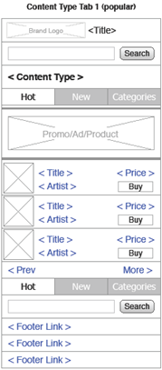
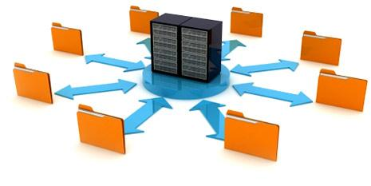


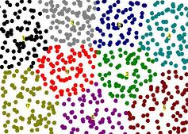
Modeled Clusters and Segment Building Process
SMS/ MobileWeb/ Mobile Apps
Tracker
Sites/Zones, Device, Historical
Tx Database
Batch
Ingestor
3rd Party Enhancement Data
Segment Builder
User Modeled Attributes
For
Predictive Modeling
or Cold Start Offer Selection
Clustering Engine

Slide 50
Realtime Scoring Process
SMS/ MobileWeb/ Mobile Apps
Tracker
Recommendation
Engine
Data Bag used to retrieve “appropriate” Model Scorecard
Model Scorecard “matched” to Source (SMS, Mobile Web, Mobile App)
Each “Offer” is scored using Model Scorecard
Scoring data combines Data Bag with Reference Data
Ranked list of Scored Offers sent to Filtering Stack
Scoring
Engine
Score (Index) |  | User Self-Reported Attributes |  |  | User Modeled Attributes |  | Offer /Ad Attributes |  | Geo Attributes | Device Attributes | Aggregated Tx Attrs | Content Attributes | InteractionAttributes | 3rd Party Appended Attributes |  | Time Attributes
 | User Id | Gender | Age | … | ClusterId | SegmentId | Offer-Ad Id | … | … | … | … | … | … | Children | Online Buyer | …
120 | 1 |  |  |  |  |  | 1 | …
200 | 1 |  |  |  |  |  | 2 | …
80 | 1 |  |  |  |  |  | 3 | …
… |  |  |  |  |  |  |  | …
130 | 1 |  |  |  |  |  | N | …
Computed
Score Index
Appended Scorecard Variables (Reference data and Data Bag)

