Slide 1
Team - 8
Chat EDI

Slide 2

Operational Challenges with InterSystems Event Logs
Volume and Complexity of Logs
InterSystems platforms produce vast, detailed logs that are difficult to analyze manually and require specialized expertise.
Impact on Incident Resolution
Verbose and distributed logs increase mean time to detect and resolve incidents, affecting business continuity.
Limitations of Traditional Tools
Current monitoring tools focus on alerts, requiring users to switch between multiple interfaces and limiting efficiency.
Need for Conversational Interface
An intelligent, natural language interface can simplify log analysis and enable faster corrective actions without deep expertise.
Notes:
InterSystems-based platforms generate a large volume of event logs that capture critical operational, technical, and business-level information. These logs include service failures, warning messages, connectivity issues, message backlogs, and system health indicators. While this data is extremely valuable, it is often difficult for operations and support teams to efficiently extract actionable insights from it. Log entries are typically verbose, technical, and distributed across time, making manual analysis slow and error-prone. Teams frequently need deep InterSystems expertise to interpret patterns, understand dependencies between services, and identify the true root cause of incidents. As a result, mean time to detect (MTTD) and mean time to resolve (MTTR) incidents can increase significantly, impacting business continuity and service-level agreements. Additionally, traditional monitoring tools often focus on alerts rather than conversational understanding, forcing users to switch between dashboards, documentation, and command-line tools. There is a clear need for a more intuitive, conversational, and intelligent interface that allows users to ask natural language questions, quickly understand what is happening in the system, and take corrective action without deep technical overhead. Addressing these challenges forms the foundation for the proposed Streamlit-based chatbot solution.

Slide 3
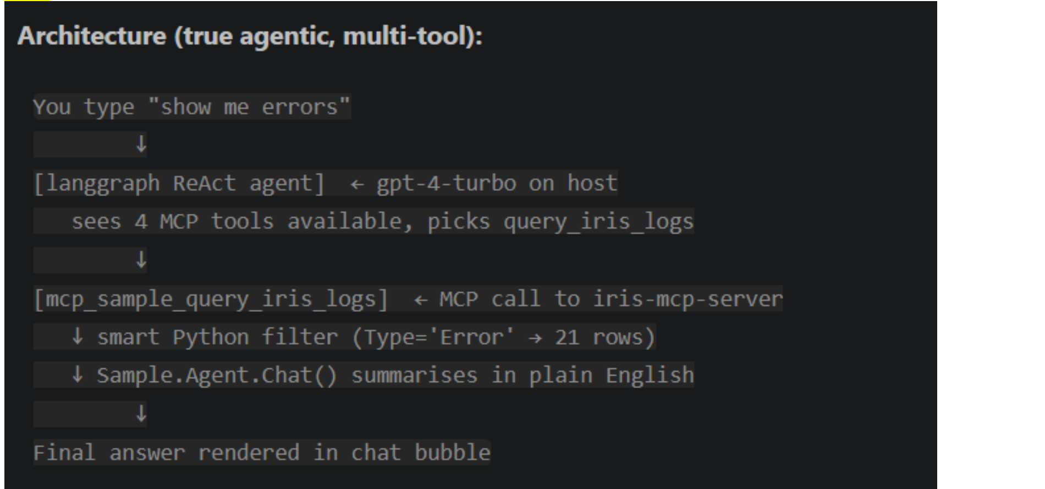
MCP Architecture

Slide 4
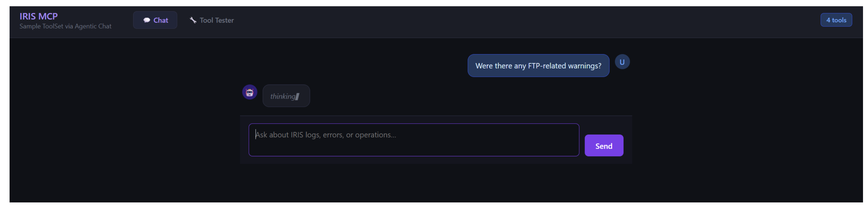
Draft UI

