Slide 1
REDIS in CACHÉ
Marek Bernád

Slide 2
What is Redis?
Redis means REmote DIctionary Server. Salvatore Sanfilippo, the original developer of Redis, was hired by VMware in March, 2010.
Redis is a software project that implements data structure servers. It is open-source, networked, in-memory, and stores keys with optional durability.
Redis is an open source, in-memory data structure store, used as a database, cache and message broker

Slide 3
What is Redis?
Redis also supports trivial-to-setup master-slave asynchronous replication, with very fast non-blocking first synchronization, auto-reconnection with partial resynchronization on net split
It supports data structures such as strings, hashes, lists, sets, sorted sets with range queries, bitmaps, hyperloglogs and geospatial indexes with radius queries.
In order to achieve its outstanding performance, Redis works with an in-memory dataset
No SQL or non-relational database (no tables, no relations)

Slide 4
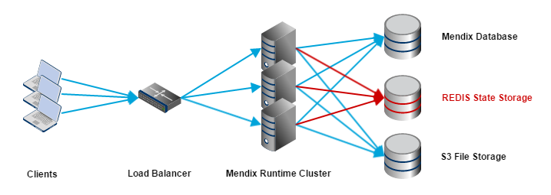
What is Redis?

Slide 5
Where is redis used most?
A list of well known companies using Redis:
Twitter
GitHub
Vine
Pinterest
Snapchat
Craigslist
Digg
StackOverflow
Flickr
Another USAGE:
Transactions
Pub/Sub
Lua scripting
Keys with a limited time-to-live
LRU eviction of keys
Automatic failover

Slide 6
Where is redis used most?
Twitter
Connect with your friends and other fascinating people. Get in-the-moment updates on the things that interest you. And watch events unfold, in real time, from every angle.
GitHub
Powerful collaboration, code review, and code management for open source and private projects.
Vine
Vine is the best way to see and share life in motion. Create short, beautiful, looping videos in a simple and fun way for your friends and family to see.
StackOverflow
A language-independent collaboratively edited question and answer site for programmers. It features questions and answers on a wide range of topics in computer programming.

Slide 7
Supported languages for redis
Many languages have Redis bindings, including: ActionScript, C, C++, C#, Chicken Scheme, Clojure, Common
Lisp, D, Dart, Erlang, Go, Haskell, Haxe, Io, Java, JavaScript (Node.js), Julia, Lua, Objective-C, OCaml, Perl, PHP, Pure Data, Python, R,Racket, Ruby, Rust, Scala, Smalltalk and Tcl.

Slide 8
What am I worked on?
Implement redis to caché as my api
redis-caché api works with globals
Offer to use any redis function with caché (but now i have only some functions)
More quality of code, using oop programming
More Control about implementation of functions by other programmers
REST API for work with on WEB
Resloving problems around efficiency (optimalization problems)

Slide 9
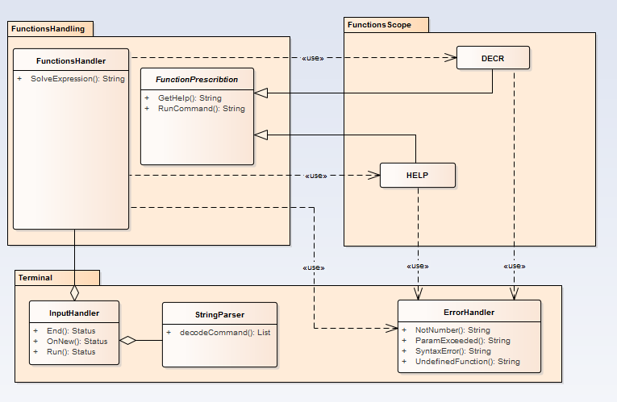
How it works?

Slide 10
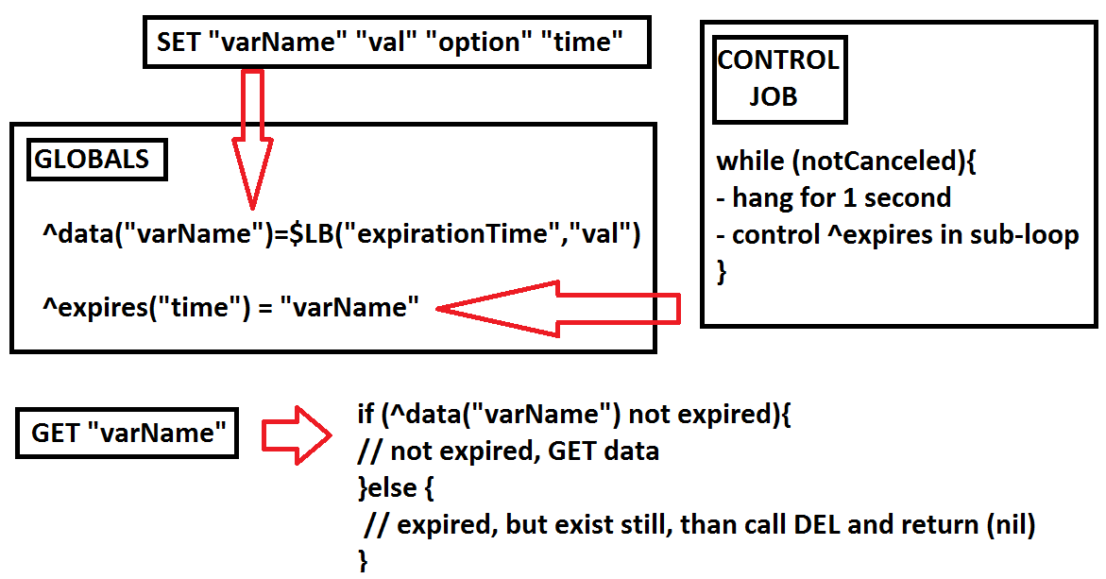
HOW IT WORKS?
Timed variables:

Slide 11
What was hardest or my problems?
Start with clear project (I lost my work from last year)
Optimalization issues
Design architecture

Slide 12
LINKS
Pictures:
https://docs.mendix.com/refguide6/attachments/16714073/16844069.png
Informations:
http://techstacks.io/tech/redis
https://redis.io/topics/whos-using-redis
https://redis.io/topics/introduction

