Slide 1
Before

Slide 2
After

Slide 3

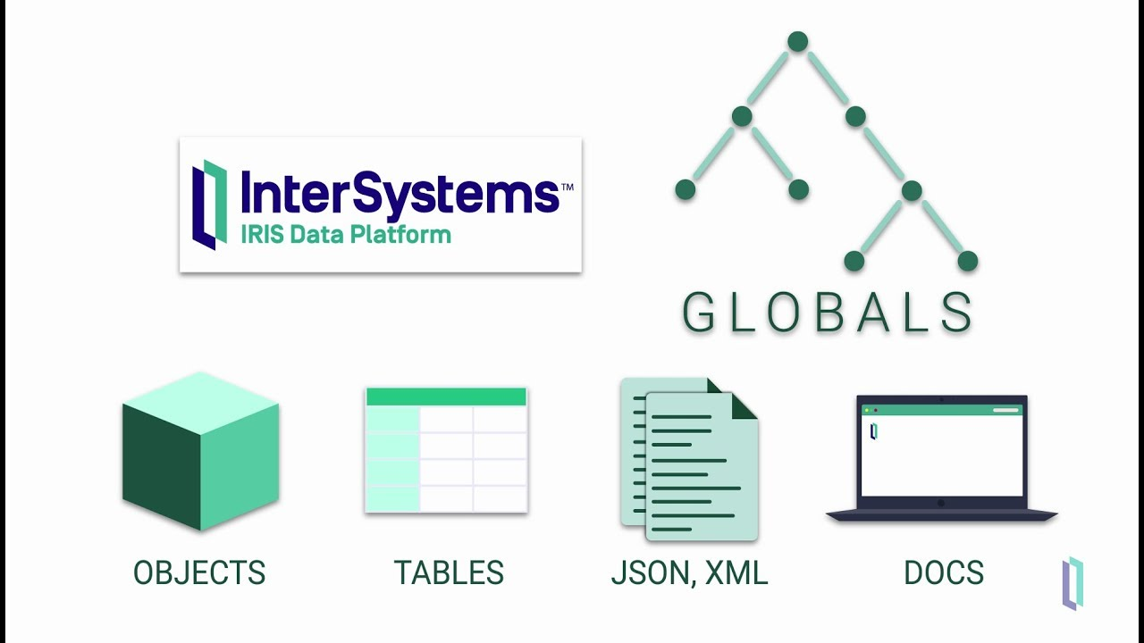

OEE Application
IRIS Data Service
IRIS Canonical Mining Model
QuickML
Production Compliance Application
Dispatch
MineCare DB
PowerViewDB
Signos Vitales Flota
Operación Mina

Slide 4
Software Compatible
Software | Marca | DB Data | Version | DB Engine
Dispatch | Modular | MineCare | 2.X | SQL Server
Dispatch | Modular | PowerView | 3.X, 4.X | SQL Server
Gypso | Exxagon | ?? | x.x+ | ?
Gypso | Exxagon | ?? | x.x+ | ?

Slide 5
Informacion Utilizada – EJ: Dispatch
Tipo de dato | Fuente | Descripcion
Tipos de Eventos | MineCare | []
Valor de Eventos | MineCare
History View | MineCare

