Slide 1
Performing Analytics on FHIR Data Patrick W. Jamieson, M.D. Technical Product Manager Russ Leftwich, M.D. Senior Clinical Advisor, Interoperability

Slide 2

Who has done analytics on FHIR data before?
Who has done analytics on FHIR data before?

Slide 3
Learning Goals
Understand the challenges of FHIR data analytics
Explore how IRIS for Health simplifies the process
Gain hands-on experience with FHIR SQL Builder outputs using Pandas
Notes:
In the next hour, we’ll explore FHIR analytic. I want to set the stage by outlining three learning goals. First, we’ll understand the challenges of FHIR data analytics. While FHIR is a powerful standard for healthcare interoperability, its nested and resource-based structure can make data extraction and analysis non-trivial as we have seen last hour. We’ll look at why common tools struggle with FHIR and what makes querying it for analytics unique compared to traditional tabular data.
Second, we’ll explore how InterSystems IRIS for Health simplifies the process. IRIS for Health includes powerful features like the FHIR SQL Builder, which transforms complex FHIR data into relational projections that are easier to query. We’ll break down what’s happening under the hood, how the SQL Builder works, and how it aligns with real-world use cases in healthcare analytics.
Finally, we’ll gain hands-on experience using Pandas to work with FHIR SQL Builder outputs. This part is all about Health Care Analytics practice. You’ll learn how to connect to the SQL Builder via Python, query transformed FHIR data, and use Pandas for cleaning, analysis, and visualization. By the end of this lesson, you’ll have a practical workflow to take FHIR data from IRIS and turn it into actionable insights.

Slide 4

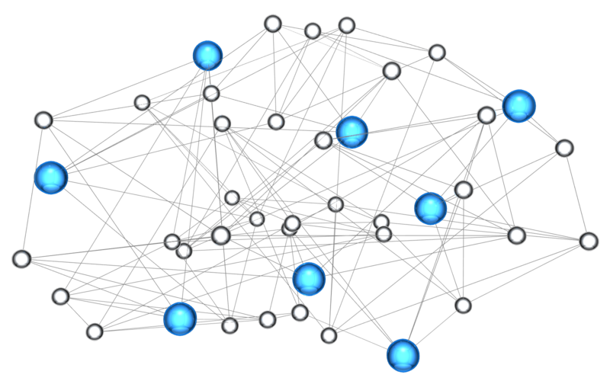
The Challenge of Querying FHIR Data
Why Standard Analytics Tools Struggle with FHIR
Notes:
FHIR data is fundamentally structured as a directed graph—a network of interconnected resources where nodes represent resources like Patient, Encounter, Observation, and Condition, and edges represent references between them. What this means is that, rather than a flat table of rows and columns like in traditional relational databases, FHIR resources are deeply nested and interlinked.
This architecture is ideal for document-based search and resource retrieval—for example, fetching a Patient and their related Observations. It supports RESTful queries and is highly modular and extensible. But this flexibility comes at a cost.
When we try to run population-based analytics, such as calculating the average BMI for patients over 65, or counting the number of diabetics with uncontrolled A1c levels across an organization, the graph structure becomes a barrier. Traversing references across multiple resources is non-trivial, and standard analytics tools like SQL engines, BI platforms, or even Pandas struggle to make sense of this structure without extensive pre-processing.

Slide 5
FHIR Data Is Flexible — and That’s the Problem
Designed for interoperability, not analytics
JSON format with deeply nested, recursive structures
Linked resources via references (e.g., Observation → Patient)
{ "resourceType": "Observation", "id": "f001", "text": { "status": "generated",
"identifier": [ { "use": "official", "system": "http://www.bmc.nl/zorgportal/identifiers/observations", "value": "6323" } ],
"status": "final",
"code": { "coding": [ { "system": "http://loinc.org", "code": "15074-8", "display": "Glucose [Moles/volume] in Blood" } ] },
"subject": { "reference": "Patient/f001", "display": "P. van de Heuvel" },
"effectivePeriod": { "start": "2013-04-02T09:30:10+01:00" }, "issued": "2013-04-03T15:30:10+01:00",
"performer": [ { "reference": "Practitioner/f005", "display": "A. Langeveld" } ], "valueQuantity": { "value": 6.3, "unit": "mmol/l", "system": "http://unitsofmeasure.org", "code": "mmol/L" },
"interpretation": [ { "coding": [ { "system": "http://terminology.hl7.org/CodeSystem/v3-ObservationInterpretation", "code": "H", "display": "High" } ] } ],
"referenceRange": [ { "low": { "value": 3.1, "unit": "mmol/l", "system": "http://unitsofmeasure.org", "code": "mmol/L" }, "high": { "value": 6.2, "unit": "mmol/l", "system": "http://unitsofmeasure.org", "code": "mmol/L" } } ] }
Notes:
FHIR’s strength—its flexibility—is also its biggest challenge when it comes to analytics. FHIR was designed for interoperability, not analytics. It’s optimized for exchanging clinical data between systems, not for cohort analysis or reporting.
FHIR resources are stored in JSON format, which means they are deeply nested and often recursive. On the right side of the slide, you can see a snippet of an Observation resource. There are arrays, objects within objects, and many layers of nesting. To extract a simple value like a glucose measurement, you need to traverse several levels of structure.
Additionally, FHIR relies heavily on resource references. In this example, the subject is a reference to a Patient resource. The performer is a reference to a Practitioner. That means to get a full picture of just one observation, you may need to resolve several additional resources.
This makes it hard for traditional tools like SQL databases, Excel, or BI platforms to work directly with FHIR. They expect tabular data, not JSON graphs. This is why we need specialized tooling—like FHIR SQL Builder—to bridge the gap between FHIR's flexible structure and the rigid expectations of analytics workflows.

Slide 6
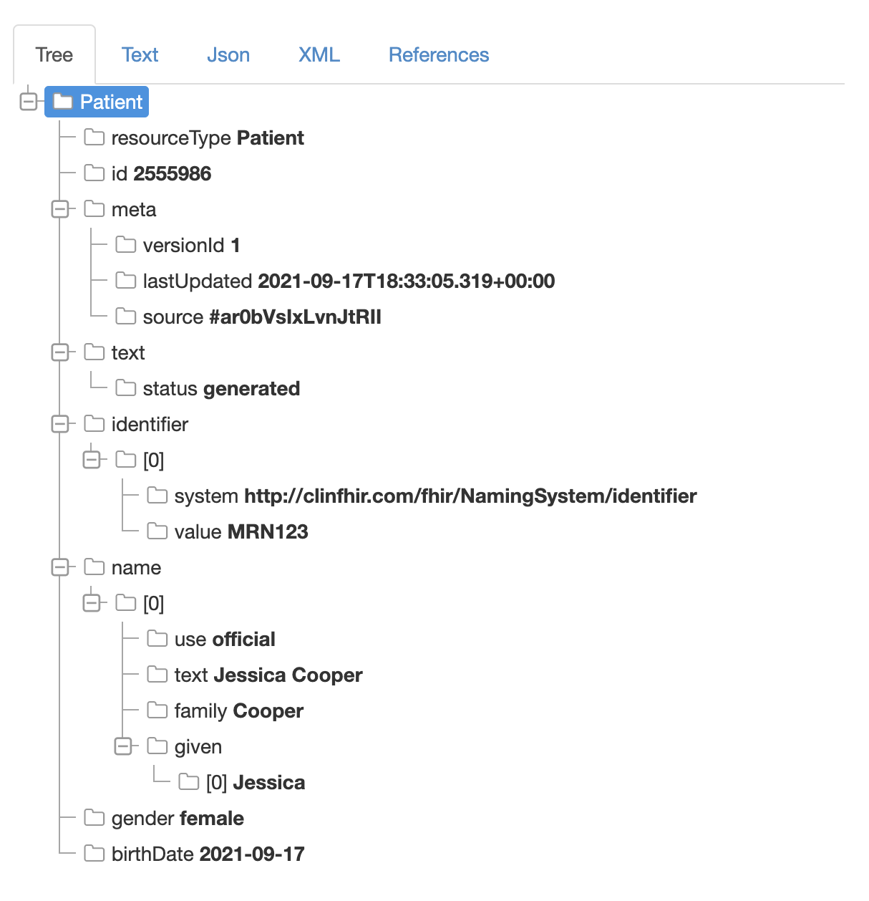
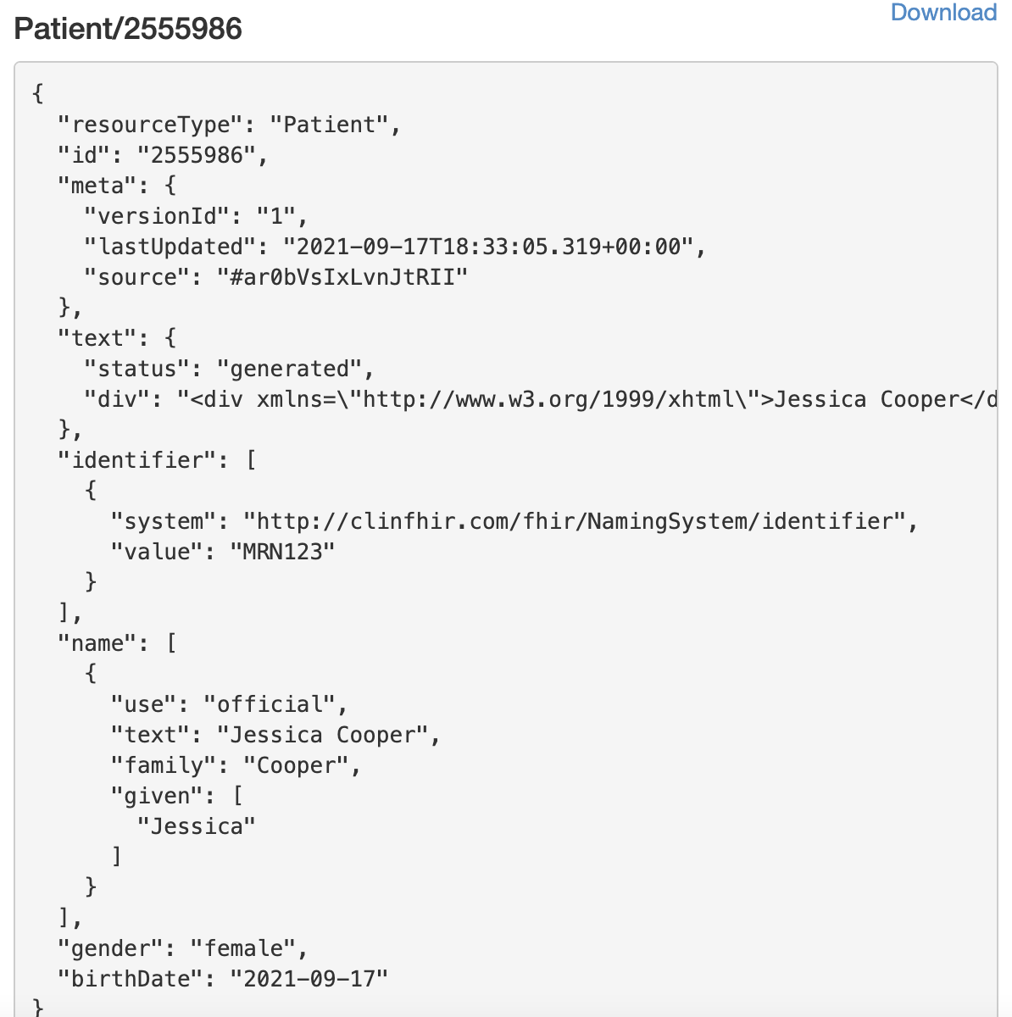
A Resource is a Tree
Often with Arrays of Nested Objects
FHIR objects are often nested JSON structures
Notes:
To dive deeper into FHIR’s structure, let’s take a look at what a single FHIR resource really looks like under the hood. This slide illustrates a common point of confusion: each FHIR resource is a tree, not a flat row of data. On the left, we see a visual tree representation of a Patient resource, and on the right, the same data in raw JSON format.
Notice how every element can contain arrays and sub-objects. For instance, the identifier field is an array of objects, each with its own system and value. The name field is also an array—meaning a patient can have multiple names, each with structured components like family name, given names, and use. These kinds of nested patterns are repeated throughout FHIR.
Why does this matter? Because when working with traditional analytics tools, we often expect data in flat, table-like form—think columns and rows. But here, the data is hierarchical. Flattening it into a format usable for SQL or Pandas typically requires custom transformation logic. That’s where a lot of the pain in FHIR analytics originates.
Understanding this tree structure is key to grasping why FHIR is so powerful for exchange—but so tricky for computation.

Slide 7
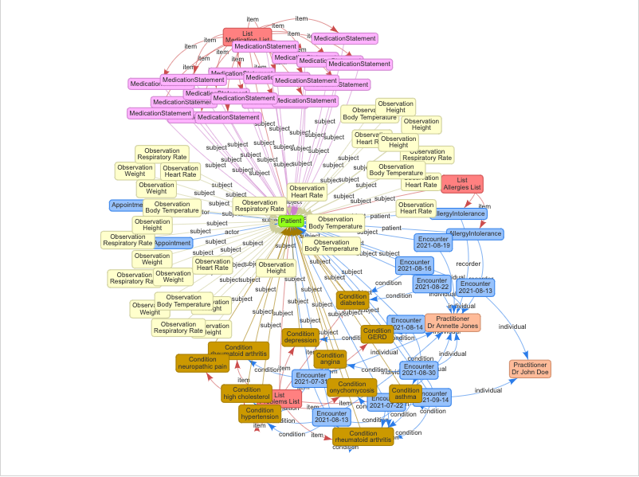
A Patient’s FHIR Graph
Notes:
This slide visually reinforces everything we’ve discussed so far by showing a real-world example of a FHIR graph centered around a single patient. At the center is the Patient resource, and radiating outward are the many linked resources that make up their clinical story: Observations, Conditions, Encounters, MedicationStatements, Allergies, and more.
Each arrow in this diagram represents a reference—a link from one FHIR resource to another. These connections form a directed graph, where nodes are resources and edges are relationships like "subject", "recorder", or "item". This is what makes FHIR such a rich, expressive model of healthcare data: it captures relationships just as they exist in real life.
But as you can see, even for a single patient, the graph becomes complex very quickly. There are dozens of interrelated nodes. If you wanted to, for example, find all patients with arthritis who had a high BMI in their last encounter, you would need to traverse multiple resources and relationships—Condition → Encounter → Observation → Patient.
This slide illustrates why querying FHIR at scale is so difficult using standard SQL or spreadsheet tools. The graph is perfect for interoperability and navigation, but not for summarizing or slicing across populations.

Slide 8
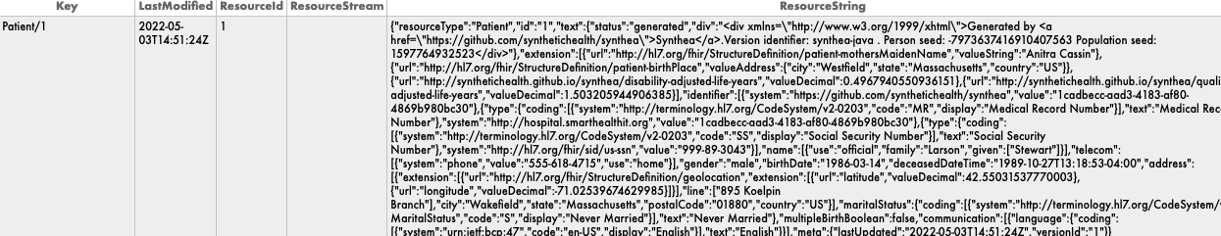
Inside a FHIR Repository
Notes:
This slide illustrates why querying FHIR at scale is so difficult using standard SQL or spreadsheet tools. The graph is perfect for interoperability and navigation, but not for summarizing or slicing across populations.

Slide 9
Consider this Use Case
"Find all female patients over age 50 who have a diagnosis of hypertension, and an abnormal systolic blood pressure (SBP > 140 mmHg) recorded in the past year."
Notes:
Let’s now ground everything we've covered in a real-world use case. Suppose a clinical quality team wants to identify a population of interest: female patients over age 50 who have both a diagnosis of hypertension and an abnormal systolic blood pressure (SBP > 140 mmHg) recorded in the past year.
This is a common kind of query in healthcare analytics—but it’s also the kind of query that’s surprisingly difficult to execute directly on raw FHIR data.
To answer this, we need to pull from at least three different resource types:
Patient for gender and date of birth,
Condition for diagnoses of hypertension, and
Observation for systolic blood pressure readings.
And here’s the challenge: FHIR stores these resources separately, each in its own structure, often deeply nested and linked only by reference. There is no single, simple SQL table that holds everything we need.
In a traditional relational model, this might be a single query joining patient demographics with diagnosis and vitals. But with FHIR, the graph-like, document-centric structure means we need to traverse links, filter nested fields, and interpret coded values.
This example underscores the need for tools like FHIR SQL Builder to transform and flatten this data—so that complex population health questions become answerable with simple SQL or Pandas.

Slide 10
Step 1: Search for female patients over age 50
GET /Patient?gender=female&birthdate=lt1974-06-21
Notes:
Let’s now walk through how we might approach this use case using the standard FHIR API. Step 1 is to identify the population—female patients over the age of 50.
In FHIR, this can be done using a search query on the Patient resource. The syntax here follows the RESTful FHIR search format
GET /Patient?gender=female&birthdate=lt1974-06-21
Let’s break this down:
gender=female filters for patients whose gender is recorded as female.
birthdate=lt1974-06-21 filters for patients born before June 21, 1974, which would make them over 50 years old as of today (assuming the current date is June 21, 2024).
This kind of query is straightforward to write and execute using any FHIR server that supports the base specification. However, this only returns the demographics portion of the overall query logic. We're not yet filtering based on conditions or observations—that comes next.
Also, even though this step is simple, it returns resource bundles with deeply nested JSON structures. We’ll need to extract patient IDs from the response to use them in follow-up queries.

Slide 11
Step 2: Add Reverse Chain for Hypertension Diagnosis (e.g., Hypertension = SNOMED CT 38341003)
GET /Patient?gender=female&birthdate=lt1974-06-21
&_has:Condition:subject:code=38341003
Notes:
Now that we've filtered for female patients over age 50, let’s narrow down the group further by requiring a diagnosis of hypertension.
To do this, we use a special FHIR search feature called a reverse chain. In FHIR, the Condition resource references the Patient via the subject field—but we want to search starting from the Patient and find those who have a Condition pointing to them. That’s what the _has operator allows.
Here’s the full query:
GET /Patient?gender=female&birthdate=lt1974-06-21
&_has:Condition:subject:code=38341003
Let’s break down the new part:
_has:Condition:subject:code=38341003 says: “Find patients who are the subject of a Condition where the code is 38341003.”
38341003 is the SNOMED CT code for hypertension, which we’re using as a standardized way to identify the condition.
This query effectively joins the Patient and Condition resources, using the Patient’s ID as the reverse reference target. It’s powerful—but not all FHIR servers support _has, and the syntax is tricky.

Slide 12
Step 3: Add Reverse Chain for High Systolic BP Observation (e.g., systolic blood pressure (LOINC: 8480-6))
GET /Patient?gender=female&birthdate=lt1974-06-21
&_has:Condition:subject:code=38341003
&_has:Observation:subject:code=8480-6
&value-quantity=gt140
&date=ge2024-06-21
Notes:
In this final step, we add one more layer of criteria to complete our use case: identifying patients who had an abnormally high systolic blood pressure (SBP > 140 mmHg) recorded in the past year.
We continue building on our FHIR query using a second reverse chain, this time from the Observation resource. Here's the full query:
GET /Patient?gender=female&birthdate=lt1974-06-21
&_has:Condition:subject:code=38341003
&_has:Observation:subject:code=8480-6
&value-quantity=gt140
&date=ge2024-06-21
Let’s break this down:
The LOINC code 8480-6 represents systolic blood pressure.
value-quantity=gt140 filters for readings greater than 140 mmHg.
date=ge2024-06-21 ensures that the measurement occurred on or after June 21, 2024—in other words, within the past year if we're assuming today's date is June 21, 2025.
With these three filters—demographics, diagnosis, and lab/measurement—you have a precisely defined patient cohort. But look at how complex the FHIR query has become!
This example demonstrates the analytical power of FHIR's search API, but also the pain points: verbosity, reliance on coding systems, and the challenge of combining filters across multiple resource types and time dimensions.

Slide 13
Why Complex?
Requires chaining or manual cross-referencing of Patient, Condition, and Observation
Systolic blood pressure is embedded in a component of a composite Observation (LOINC 55284-4)
Filtering by valueQuantity inside a component isn't supported natively in FHIR Search
Result sets need post-processing logic outside of the API
Notes:
Now that we’ve walked through that multi-step FHIR query, let’s take a moment to reflect on why this is so complex—even for what seems like a straightforward use case.
First, the query spans three different FHIR resource types—Patient, Condition, and Observation. Each resource is separate, requiring either chaining or reverse chaining to cross-reference them. This is not just verbose—it’s fragile, especially if your FHIR server doesn’t fully support the _has parameter.
Second, systolic blood pressure isn’t always a standalone Observation. It’s often recorded as a component within a composite Observation using LOINC code 55284-4. That’s a vital signs panel that includes both systolic and diastolic blood pressure. In those cases, systolic is nested under a component field—not directly accessible at the top level of the Observation.
This brings us to the third issue: FHIR Search doesn’t natively support filtering inside nested component.valueQuantity fields. That means you can’t just say “find me SBP > 140” unless it’s already at the root level of the resource.
Finally, even after querying, you often need to perform post-processing logic outside the API—merging results, filtering by time, or checking unit consistency. This breaks the idea of a clean, declarative query.

Slide 14
Spark-Based Analytics: Power at a Price
Scalable: Built on distributed computing (Apache Spark), can process terabytes of nested FHIR data efficiently.
Flexible Schema Handling: Can ingest raw FHIR JSON bundles and process them using schema-on-read.
BigQuery Integration: In systems like Google Cloud, FHIR data can be transformed and queried via SQL after flattening.
Custom Pipelines: Ideal for organizations with specialized transformation, validation, and enrichment needs.
Heavy Setup: Requires orchestration of pipelines using Dataflow, Spark, or Apache Beam.
Transformation Coding: Flattening nested FHIR into relational form needs custom logic (e.g., mapping JSON to flat tables via Spark jobs).
Expertise Required: Requires deep understanding of FHIR structure and Spark programming paradigms (RDDs, DataFrames, nested schemas).
Batch-First: Often not ideal for real-time or interactive analytics — oriented toward nightly/weekly batch jobs.
Notes:
When it comes to large-scale FHIR analytics, many organizations turn to Apache Spark or similar distributed processing frameworks. And for good reason—Spark can handle terabytes of nested FHIR data, making it an attractive solution for enterprise-scale workloads.
On the plus side:
Spark offers scalability through distributed computing. It’s built to efficiently process massive JSON bundles like those in FHIR.
It supports schema-on-read, meaning it doesn’t need fixed database schemas ahead of time. That’s ideal for flexible or evolving FHIR profiles.
Spark integrates well with platforms like Google BigQuery, enabling SQL-based querying after flattening.
Organizations with complex requirements—like custom validation, enrichment, or temporal logic—can build custom pipelines tailored to their specific needs.
But this power comes at a price:
There’s a heavy setup cost—you need to build and orchestrate data pipelines using Spark, Apache Beam, or Google Dataflow.
Flattening FHIR into relational form isn’t automatic—it requires custom code and logic for each resource.
Teams need deep expertise in both FHIR’s structure and Spark’s programming model—RDDs, DataFrames, and nested schemas.
Finally, Spark is often batch-first. It’s great for nightly ETL, but not ideal for real-time dashboards or ad-hoc querying.

Slide 15
Traditional SQL Meets Its Limits
No tables or schema to join—just resources and references
JOIN logic requires understanding of FHIR profiles
Complex to query across resources (e.g., Conditions + Observations)
SELECT subject.reference, AVG(value.quantity.value) avg_hdl FROM observation o, UNNEST(o.code.coding) c WHERE c.system = 'http://loinc.org' AND c.code = '2085-9' AND o.effective.datetime > '2017' GROUP BY subject.reference
FHIR makes data interoperable
— but not immediately usable for analytics.
Notes:
This slide highlights a key tension in FHIR analytics: FHIR makes data interoperable, but not immediately usable for analytics—especially not with traditional SQL.
Let’s start with the challenge: there are no native tables in FHIR—just resources like Patient, Condition, Observation, and references between them. So if you're used to joining tables with foreign keys, you'll find FHIR’s structure much harder to work with.
The example SQL on the right shows just how messy it can get. We’re querying Observation, but to get a specific lab test like HDL cholesterol (LOINC 2085-9), we have to UNNEST the code.coding array—because codes are deeply nested inside each Observation. Even extracting a value and filtering by time requires specialized syntax, and this is all for a single resource.
Now imagine trying to join Patient demographics, Conditions, and Encounters. You’d need to understand the FHIR profile, reference paths, and potentially unroll arrays or components. It’s possible, but not intuitive—and definitely not efficient for ad hoc or clinical analysts.
That’s why many organizations either build complex ETL pipelines or turn to tools like the FHIR SQL Builder, which transforms this complexity into relational, queryable formats—bridging the gap between interoperability and usability.

Slide 16
Approaches | Drawbacks | Works with BI tools
SQL on FHIR | Not ANSI SQL | No
FHIRPath | Learn new syntax | Possible, move/copy data
Notes:
Before we introduce the FHIR SQL Builder, it’s worth taking a look at two commonly used alternatives for querying FHIR data—SQL on FHIR and FHIRPath—and why they often fall short for analytics.
First, SQL on FHIR is not truly ANSI SQL. It’s a limited, custom implementation that allows for basic querying of FHIR resources—often implemented as an abstraction layer over the REST API. The downside is that it doesn’t support rstandard SQL functions, and it can’t integrate with BI tools like Tableau or Power BI. So while it's great for quick filtering of individual resources, it's not practical for complex analysis.
Then there’s FHIRPath—as we saw last hour a powerful expression language designed to navigate the structure of FHIR resources. It’s useful for validating profiles, extracting data, or writing search conditions inside Implementation Guides. But it requires users to learn a new syntax, and it’s not designed for analytics. It doesn’t handle joins or aggregations well, and using it in BI tools typically means exporting and transforming data first, which introduces duplication and latency.
In short, both options serve important use cases—but neither was built for seamless, scalable, interactive analytics. That’s the gap the FHIR SQL Builder is designed to fill.

Slide 17

FIHR SQL Builder
A Projection Tool
Create custom SQL schemas on FHIR repository
No need to learn FHIR search or FHIRPath syntax
Resources are mapped to tables, and elements to columns
No separate SQL repository required
A data steward is firmly in control of the SQL schema
Easy to use UI
Create multiple schemas for different use cases
Use familiar analytics tools like PowerBI or Tableau
Notes:
Now let’s talk about the FHIR SQL Builder, and why it’s such a game-changer for FHIR analytics.
At its core, the SQL Builder is a projection tool. It doesn’t create new data or replicate anything—it simply creates a relational SQL schema view on top of your existing FHIR repository. That means you're working directly with live FHIR data, but in a format that’s easy to query.
Here’s what makes it powerful:
First, you don’t need to learn FHIRPath or the FHIR RESTful search syntax. If you know SQL, you can jump right in.
The Builder maps FHIR resources to tables, and their elements to columns—just like a normalized database.
Importantly, there’s no separate data warehouse. Everything is projected live from the FHIR store, reducing duplication and latency.
A data steward can define multiple schemas tailored to different needs—like clinical quality metrics, operational dashboards, or research queries.
The interface is point-and-click friendly, so setting up or modifying schemas doesn’t require deep programming.
And best of all, it connects to common BI tools like Power BI and Tableau—so your analysts can start building dashboards immediately using familiar tooling.
This dramatically lowers the barrier for scalable, real-time FHIR analytics.

Slide 18
Why Multi-Model Projections Matter for Real-Time FHIR Analytics
Real-time queries across multiple resources (e.g., “Patients with abnormal labs and recent encounters”) are slow and complex if run on raw JSON.
The FHIR SQL Builder can automatically project FHIR data into relational tables using the FHIR SQL Builder.
Projections are live — meaning:
New FHIR resources update the relational views immediately.
There’s no batch ETL delay like in traditional analytics pipelines.
Notes:
One of the most powerful features of the FHIR SQL Builder is its support for live, multi-model projections—and this is what enables real-time FHIR analytics.
Let’s start with the challenge: real-time queries across multiple FHIR resources—like “patients with abnormal labs and recent encounters”—are incredibly difficult and slow when running directly on raw JSON. Traversing nested structures and resolving references at query time is computationally expensive, especially at scale.
The SQL Builder solves this by projecting FHIR data into relational tables—flattening the structure while maintaining semantic relationships. These projections are defined once, and then automatically kept in sync with the underlying FHIR repository.
And here’s the key: the projections are live. That means as soon as a new Observation or Encounter is added to the FHIR store, it’s immediately reflected in the relational views—no need to wait for a batch job or ETL pipeline to run.
This eliminates a major bottleneck in healthcare analytics: latency. With SQL Builder, there’s no nightly delay—data becomes analytics-ready in real time. This is crucial for dashboards, clinical decision support, and operational monitoring, where fresh data can drive better, faster decisions.

Slide 19
SQL Builder Steps
Generate SQL projections
Display Resource and Element Counts
01
03
05
02
04
Edit transforms
Analyze FHIR Repository
Obtain user selections
Notes:
Let’s walk through how the FHIR SQL Builder actually works. This visual outlines the five main steps in creating a relational projection from your FHIR data. Each step helps turn complex, nested JSON into clean, queryable tables.
Step 0–1: Analyze FHIR Repository
The process begins with the SQL Builder analyzing your FHIR repository. It scans the available resources—like Patient, Observation, and Condition—and catalogs their structure and usage patterns.
Step 2: Display Resource and Element Counts
Next, it presents a visual summary—showing how many of each resource type exist and how often each element appears. This helps data stewards understand the shape of their data before building projections.
Step 3: Obtain User Selections
Here, users choose which resources and fields they want to include in the projection. You can select core elements, optional metadata, or even traverse references to related resources—like linking a Patient to their Conditions or Encounters.
Step 4: Generate SQL Projections
Once configured, the tool generates relational views that expose these selected elements as SQL tables and columns—no manual schema design or ETL required.
Step 5: Edit Transforms
Finally, you can fine-tune transformations—renaming columns, changing datatypes, or adding filters—before saving your schema.
This stepwise UI makes powerful FHIR analytics approachable for non-developers.

Slide 20
Mapping FHIR to SQL
FHIR Data
SQL Data
"entry": [
{
"resource": {
"resourceType": "Patient",
"id": "1",
{
"type": {
"coding": [
{
"system": "https://terminology.hl7.org/CodeSystem/v2-0203",
"code": "MR",
"display": "Medical Record Number"
}
],
"text": "Medical Record Number"
},
"system": "https://hospital.smarthealthit.org",
"value": "6e485b00-b00e-46df-9863-fe1ef0c69895"
},
Id | Race | MRN | LastName |  | FirstName |  | Birthdate |  | MaritalStatus |  | Gender
1 | Asian | 6e485b00-b00e-46df-9863-fe1ef0c69895 | Krajcik | Arianne |  | 1957-10-27 |  | M |  | female
10167 | NA | 136ccd0c-6475-479a-9c0e-d6ce7517e20a | Mann | Suzann |  | 1954-01-23 |  | M |  | female
10382 | NA | 317ff7bf-9a12-4286-9e52-71bc791a7666 | Murazik | Sydney |  | 1975-04-21 |  | M |  | male
11005 | NA | 292fe2ff-2beb-4cdf-bf97-a1b94db419f1 | Schinner | Synthia |  | 2018-03-03 |  | S |  | female
Notes:
This slide illustrates the transformation that the FHIR SQL Builder enables—mapping complex FHIR JSON into clean, tabular SQL.
On the left, we see an example FHIR Patient resource represented in raw JSON. This format is designed for interoperability and machine parsing, but as we’ve discussed, it’s difficult to query. Even simple values like a medical record number (MRN) or date of birth are buried within multiple nested layers—arrays, objects, codings, systems.
On the right, we see what that same information looks like after projection into SQL. Each Patient becomes a row in a relational table, and each selected element—such as Id, Race, MRN, LastName, FirstName, Birthdate, MaritalStatus, and Gender—becomes a column.
What’s important here is that this transformation is handled automatically by the SQL Builder. Users don’t need to write code to extract these values or flatten the data structure. Once projected, this table behaves just like any other SQL table—you can filter, join, aggregate, and even plug it into BI tools.
This slide represents the crux of the SQL Builder’s value: it turns complex, nested FHIR into analytics-ready relational views, without sacrificing the integrity of the original data.

Slide 21
FHIR SQL Builder ≠ Full Analytics — Why We Still Need Pandas
FHIR SQL Builder helps:
✅ Transforms FHIR JSON into clean relational tables
✅ Makes it easy to write standard SQL against complex FHIR resources
✅ Supports joins across Patient, Observation, Condition, etc.
But… it's not enough for deeper analytics:
❌ No support for advanced statistical analysis
❌ No built-in visualization or modeling tools
❌ No support for complex group-by or pivot operations
❌ SQL can become verbose for exploratory analysis
Notes:
The FHIR SQL Builder is a powerful enabler—it turns complex, nested FHIR data into clean, relational tables and allows analysts to use standard SQL across resources like Patient, Observation, Condition, and more.
✅ It simplifies querying
✅ It supports joins across resource types
✅ And it eliminates the need for custom ETL pipelines
But there are still important limitations—especially when it comes to deeper, exploratory analytics.
❌ First, SQL Builder isn’t designed for statistical analysis. If you need to calculate percentiles, correlations, or run regressions, you’ll need something beyond SQL.
❌ There are no built-in visualization or machine learning tools.
❌ SQL Builder doesn’t natively support pivoting or reshaping data the way Pandas does.
❌ And for large-scale exploratory work, SQL can become verbose—whereas in Pandas, one line of code can do a lot.
That’s why tools like Python and Pandas remain essential. You can use SQL Builder to extract exactly the data you need—flattened, cleaned, and joined—and then load it into Pandas for powerful, interactive analysis, visualizations, and modeling.
The takeaway is: SQL Builder gets you to clean data fast—but Pandas takes you the rest of the way.

Slide 22


Part One: Transforming FHIR Data to SQL Tables
Part Two: Manipulating SQL Data with Python and Pandas
Notes:
.
We are now going into the hands-on portion of the lesson, which is divided into two parts, each building on the last.
Part One focuses on transforming FHIR data into SQL tables using the FHIR SQL Builder. We’ll walk through the process of creating a projection from live FHIR data. You’ll see how to:
Select the resources and fields you need,
Automatically generate relational views,
And query them using familiar SQL syntax.
This part highlights how the SQL Builder simplifies working with complex FHIR structures, letting you use standard tools to access clinical data in a much more usable format.
Part Two shifts us into Python and Pandas. Now that the data is in clean tables, we’ll explore how to:
Load the results into a Pandas DataFrame,
Perform advanced filtering and grouping,
And even visualize or prepare the data for modeling.
The goal here is to move from data access to data insight—applying analysis workflows that go far beyond what SQL alone can offer.
think of this as a f pipeline: first we flatten and structure the data, then we analyze and extract meaning—all using tools that are accessible and flexible.

Slide 23
How to Connect to the IRIS FHIR SQL Builder
On your local machine the endpoint is at: http://127.0.0.1:8080/csp/fhirsql/index.html
Notes:
You can use IRIS for Health Community and the environment and login into the SQL builder at this address.

Slide 24
Python Connection to IRIS FHIR SQL Builder
Let’s set up the environment
Need to install python driver found at: https://intersystems-community.github.io/iris-driver-distribution/
We need the db-api driver that when downloaded to your downloads directory will be named something like: intersystems_irispython-3.2.0-py3-none-any.whl
Install this file into your project directory in VS Code
Create Your virtual environment first: python –m venv venv
Activate Your virtual environment: source venv/bin/activate
Now install the driver using pip3: pip install /path/to/intersystems_irispython-3.2.0-py3-none-any.whl
Juypter installation: Make sure Jupyter is installed in your virtual environment
pip install notebook ipykernel
Select the correct Python interpreter for the notebook
python -m ipykernel install --user --name=myenvname --display-name "Python (myenvname)"

Slide 25
Thank you

