Slide 1
TAGO
Group Reservation Hub

Slide 2
The Challenge
Manual tracking of complex group reservations
High risk of missed deadlines and payments
Lack of real-time visibility into profitability
Scattered data across emails and spreadsheets

Slide 3
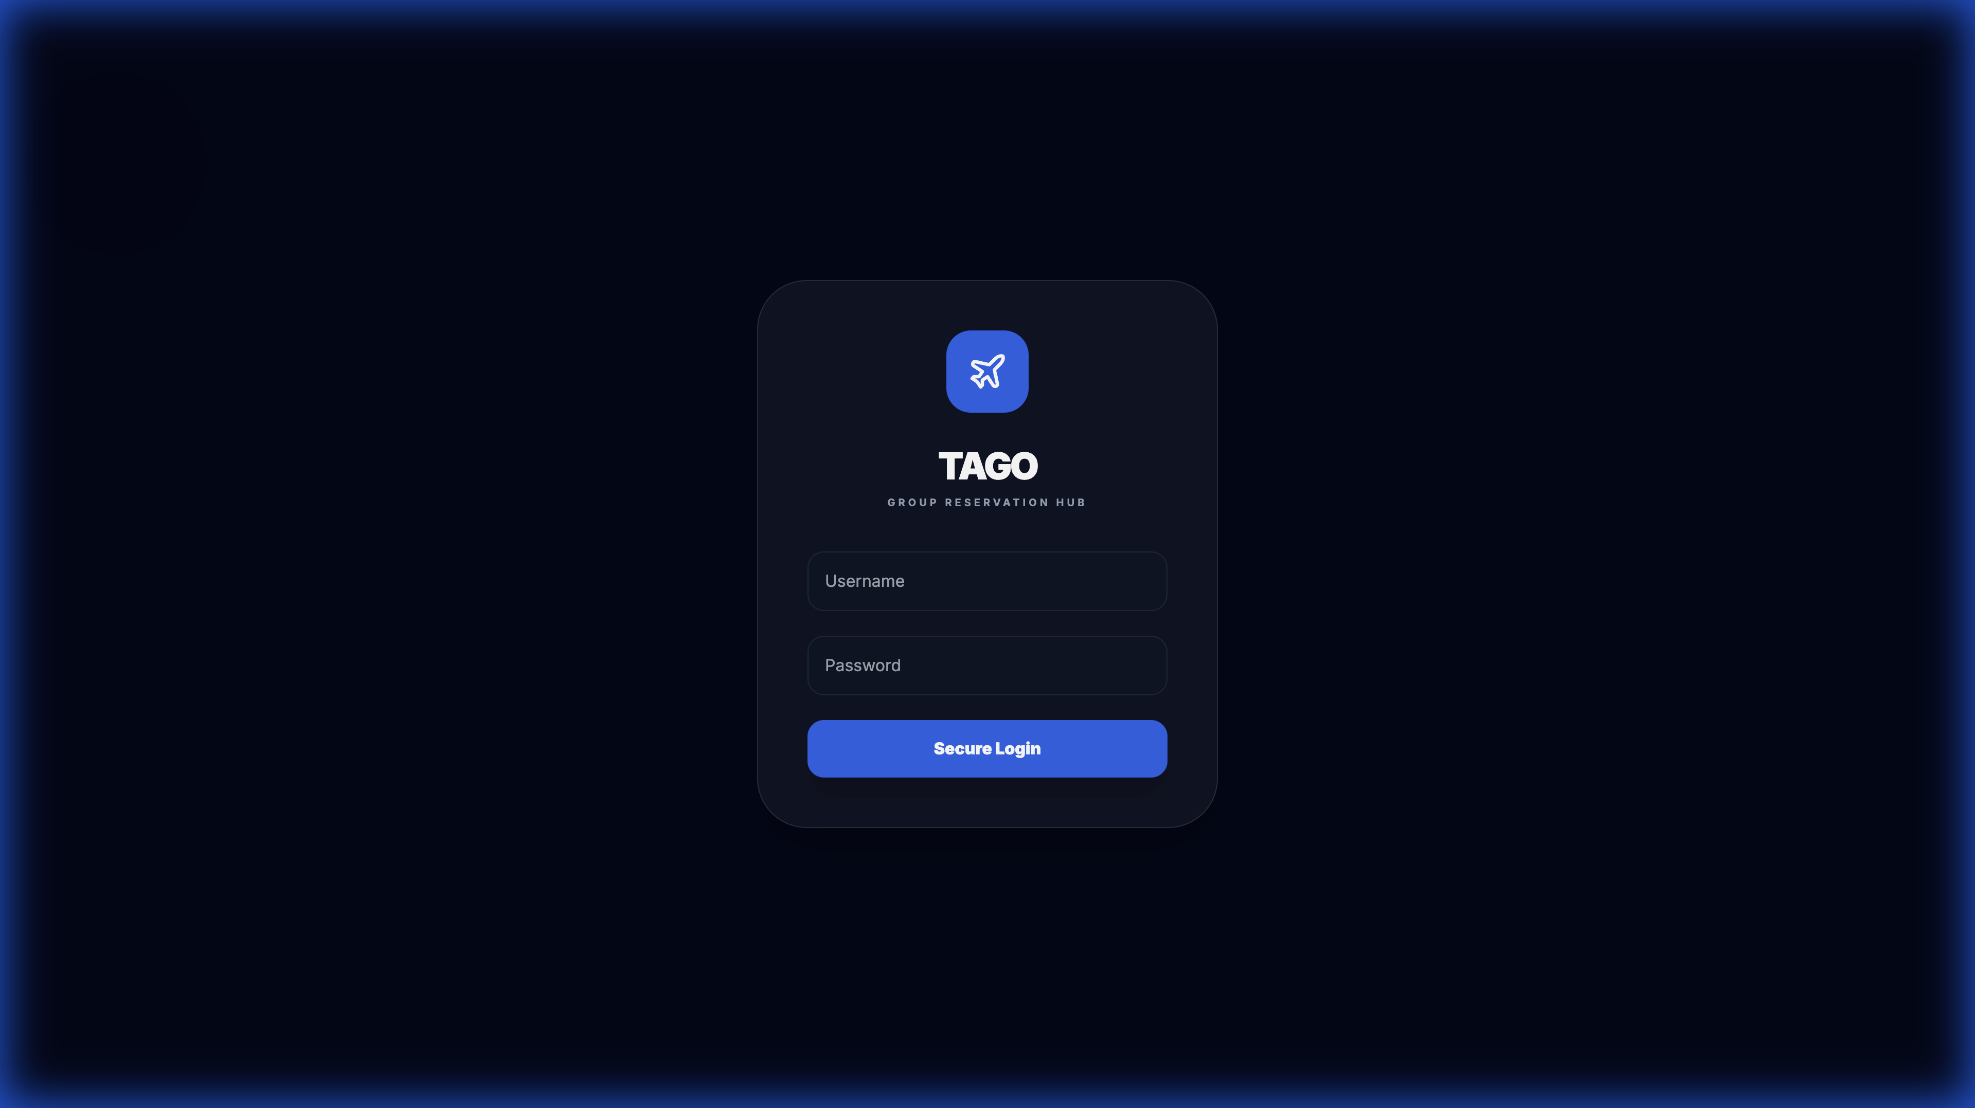
Introducing TAGO
Centralized Dashboard for all airlines and agencies
Automated Reminders for deposits and names
Real-time Statistics & Financial Insights
Secure Role-Based Access

Slide 4
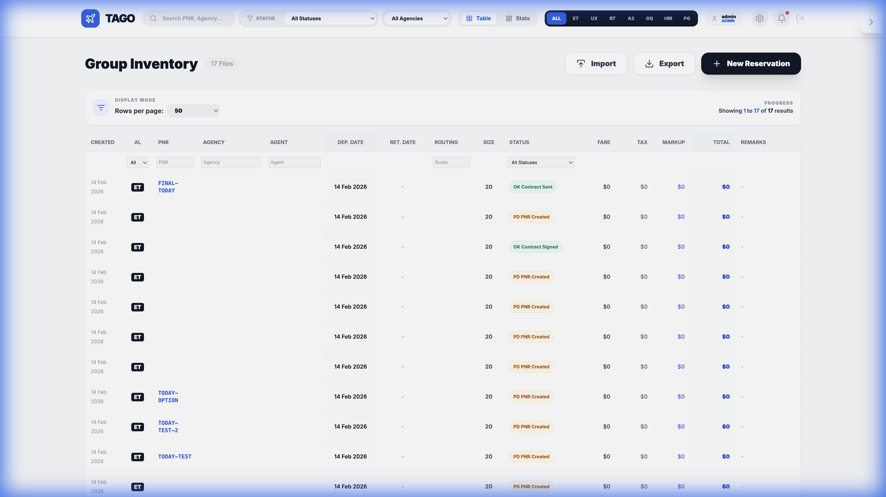
Powerful Dashboard
Instant overview of groups, passengers, and revenue with flexible calculation metrics.

Slide 5
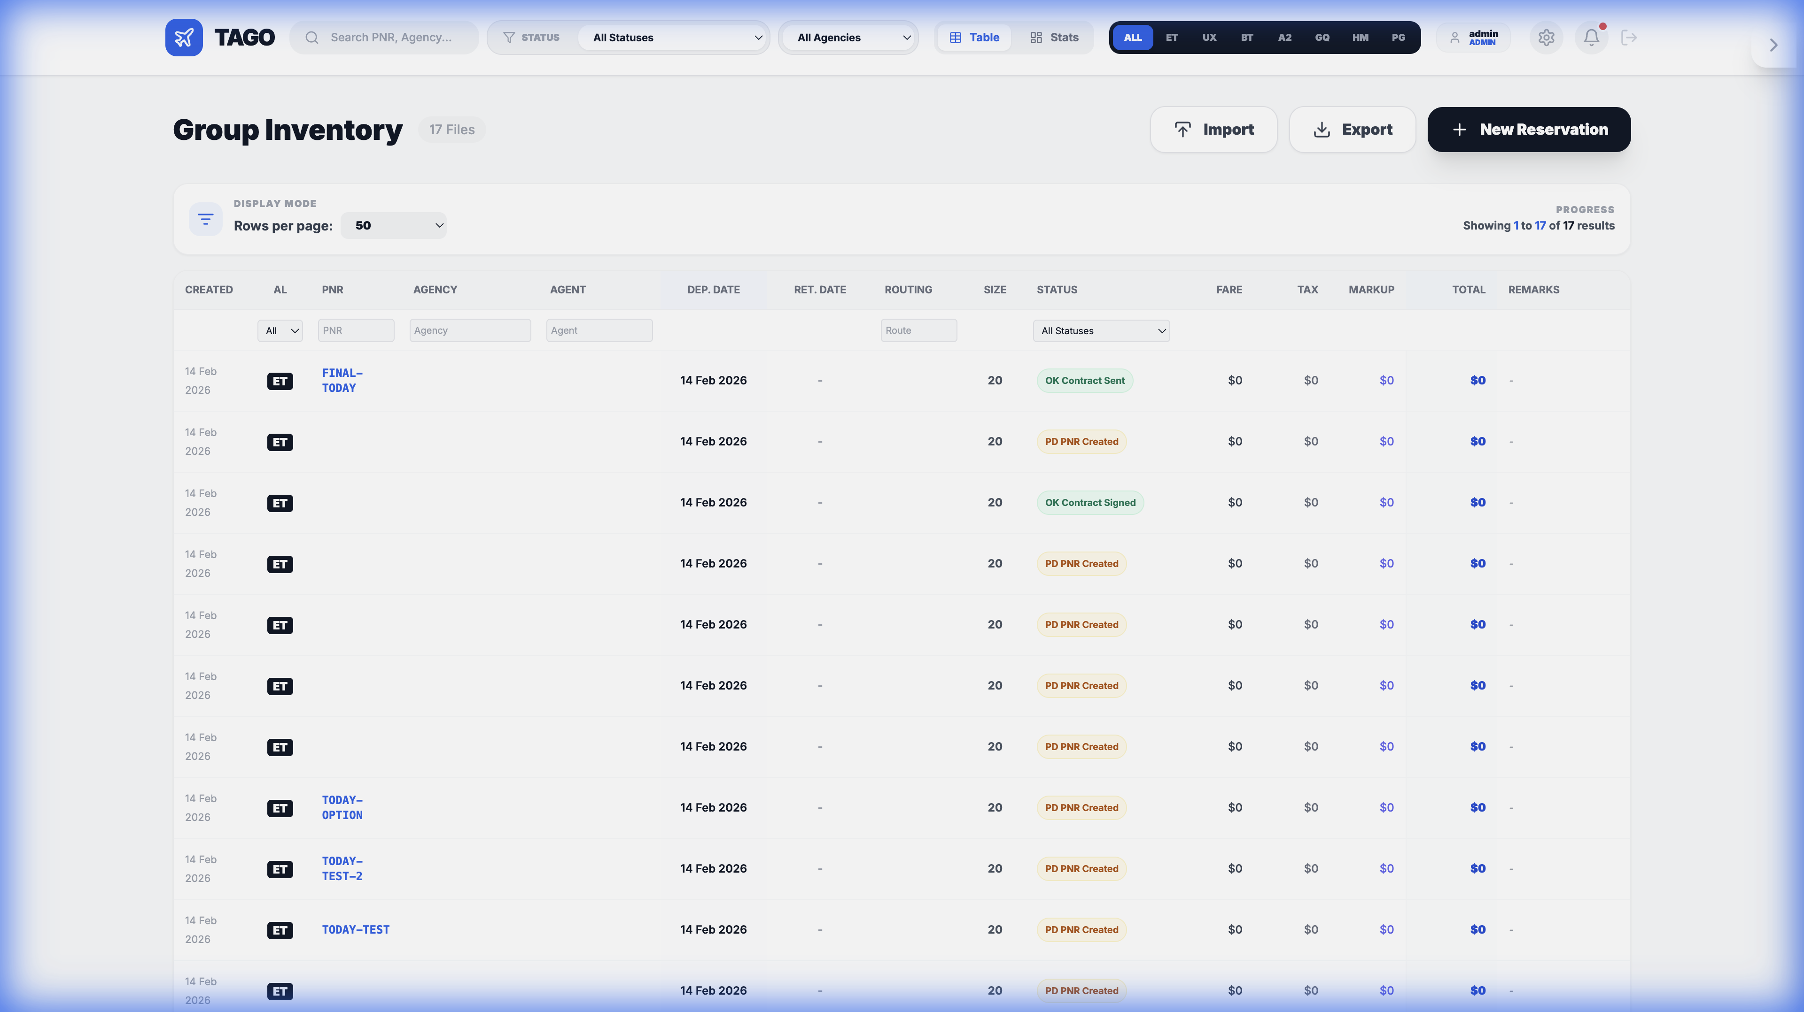
Efficient Management
Sort, filter, and search all groups. Export data instantly.

Slide 6
Live Demo
Let's see TAGO in action

