Slide 1
Git Overview
General overview of version control with Git and common Git usage
Heavy usage was made of the book Pro Git by Scott Chacon of GitHub (including images). Also made usage of the talk “Git Graphs, Hashes, and Compression, Oh My” by Matthew McCullough also of GitHub.

Slide 2
Version Control
The ability to concurrently work on an individual file or files and resolve differences.
A history of who made what changes and when to a file or set of files that comprise a project.

Slide 3
Centralized Version Control
Client-server model.
There is one authoritative central repository that is the “source of truth”.
Committing requires a network connection.
Branching can be expensive as it means copying some or all of the files in the repository.
Example systems: CVS, Subversion, Perforce

Slide 4
Distributed Version Control
Peer-to-peer model.
Lines of development can proceed independently on different hosts and be merged together at a later time.
Each host can have a complete copy of the repository. If network connection is lost work can continue.
There may still be a server that everyone agrees is the “central” repository.
Branching is inexpensive as it involves creating a reference to a commit and not a copy of the repository.
Example systems: Git, Mercurial

Slide 5
Git Characteristics
Git works locally as well as remotely.
Git adds only a single .git directory to the project and does not add files to every directory in the project like some central VCS's like SVN.
Git uses a mini Unix style file system to keep track of snapshots of the entire project over time.
History in Git describes the project as a whole and not individual files though it is possible to look at history on individual files.

Slide 6
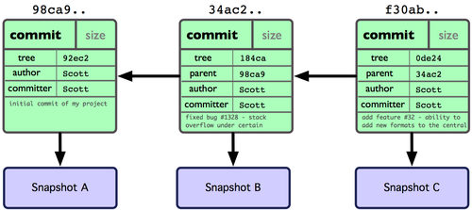
Git Project History
(Image from Pro Git by Scott Chacon)
Git keeps track of history as a series of commits.
Commits have one or more parents depending on the nature of the project history (a directed acyclic graph).
The history that led to a particular commit can be retraced from that commit.
Each commit represents a complete snapshot of the filesystem of the project at the time of the commit.

Slide 7
Git Objects
A Git repository is comprised of the following types of objects:
    Commit – A history object
    Tree – Represents a directory
    Blob – Represent a file
    Tag – An immovable reference to a commit

Slide 8
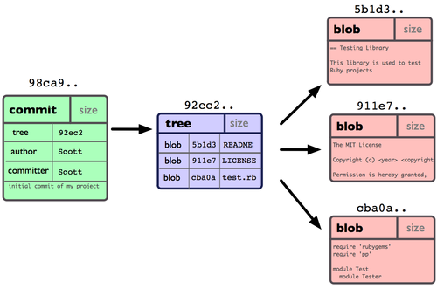
Git Objects (cont.)
(Image from Pro Git by Scott Chacon)
Each object is uniquely identifiable by a SHA-1 hash (40 hex characters or 20 bytes) and can be produced on Unix systems with the shasum script.
The objects are stored in the .git/objects directory.
Each file system snapshot is a combination of tree and blob objects.
A tree is a directory that can contain other trees (directories) and blobs (files).
A blob is the type, content length and file contents compressed together.

Slide 9
Local Git Usage
git init
  Turns an ordinary directory and the files within into a Git repository by the addition of a .git directory
  No files are yet tracked by Git. Any files that require tracking need to be added

Slide 10

Git Local File Status
(Image from Pro Git by Scott Chacon)

Slide 11
Change Local File Status
git add
  Tracks new files
  Stages modified files

Slide 12
Change Local File Status
git add <file>
  Tracks new files
  Stages modified files
git checkout -- <file>
  Unmodifies modified files
git reset HEAD <file>
  Untracks new files
  Unstages modified files

Slide 13
Commit
git commit
  Creates a new commit that captures a snapshot of all of the project files in the staged/unmodified state and references to its parent commits.
  Commits carry a timestamp, the name and email of the committer and a comment.
  Commits are identified by a SHA-1 hash and have SHA-1 hash references to their parent hashes and the tree object that describes the top level directory of the project.

Slide 14
Git Branches
A branch is a pointer to a commit that moves with each subsequent child commit (i.e. a branch points to the “head” of a line of history).
A new local Git repository has a branch called master by default.
Branches are “free” in Git. Creating a branch really means creating a pointer which is a file (.git/refs/heads/<branchname>) containing the 20 byte SHA-1 hash of the commit the new branch points to.
The special pointer called HEAD points to the latest commit of the branch that is currently being worked on (i.e. checked out).

Slide 15
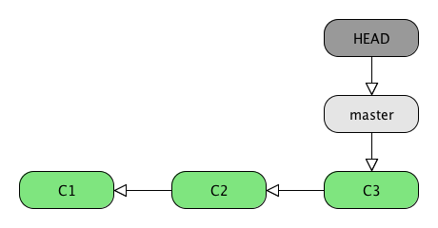
Listing Branches
git branch
  Lists all local branches
  Indicates the current branch (HEAD) with an asterisk

Slide 16
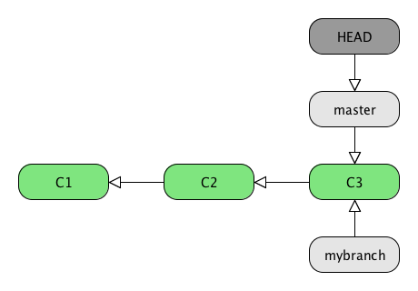
Creating Branches
git branch <branchname>
  Creates a new branch that points to the current commit.
  Example: git branch mybranch
  The current branch is still master.

Slide 17
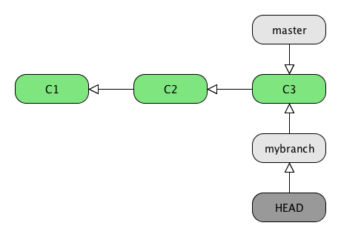
Changing Branches
git checkout <branchname>
  Moves the HEAD pointer to the commit pointed to by the specified branch.
  Example: git checkout mybranch
  Running git branch should indicate the mybranch branch with an asterisk.

Slide 18
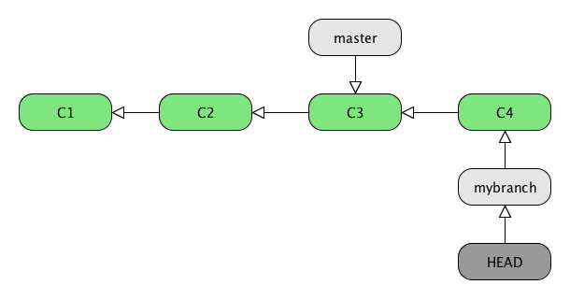
Committing on a Branch
git commit -a -m “did stuff on mybranch”
  Adds a commit to the history of the project.
  The mybranch branch pointer advances with the new commit.
  The master branch pointer does NOT advance with the new commit.

Slide 19
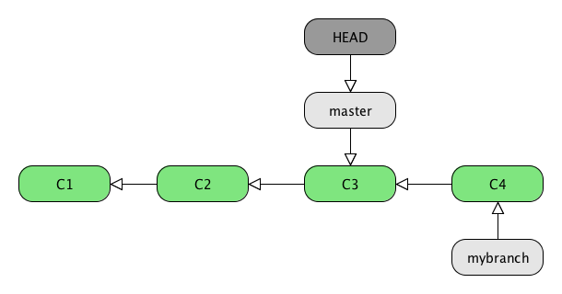
Diverging History
git checkout master
  Moves the HEAD pointer back to the master branch pointer
  Leaves the mybranch branch pointer where it is
  Updates the files in the working directory back to the snapshot pointed to by master

Slide 20
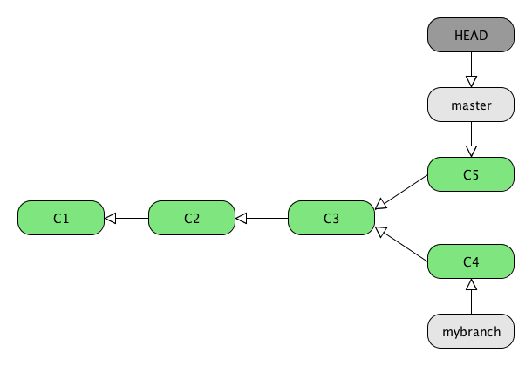
Diverging History (cont.)
git commit -a – m “did stuff on master”
  Adds a commit with the commit pointed to by master as the parent
  There is now divergence in the history

Slide 21
Merging
git merge [<branchname>...]
  Performs a merge onto the current branch from the specified branches (one or more can be specified, if more than one it's called an “Octopus” merge).
  Merges the files from the snapshot pointed to by each <branchname> with the files in the snapshot pointed to by the current branch.
  Creates a new commit with two (or more in the case of an Octopus) parents that indicates which files got merged.
  If there are merge conflicts they need to be resolved (either by hand or with a graphical merge tool) before the merge can proceed.

Slide 22
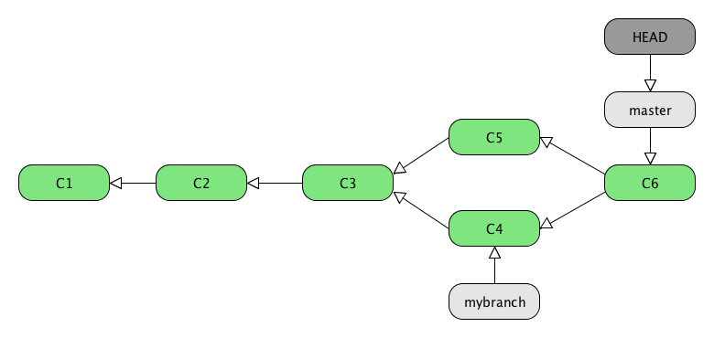
Merging (cont.)
git merge mybranch
  Merges the mybranch branch onto the master branch.
  Results in a new commit.
  One parent of the new commit points back to the previous commit on the master branch.
  The other parent of the new commit points back to the last commit on the mybranch branch.

Slide 23
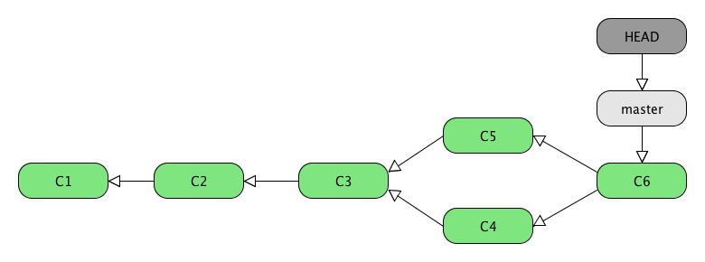
Delete Local Branch
git branch -d <branchname>
  Deletes only the branch pointer.
  Does not alter history or file contents at all.
  Example: git branch -d mybranch

Slide 24
Remote Git Repositories
A remote repository is any other Git repository either on the same host or a different host.
Git can communicate with remote repositories over a variety of protocols (file, SSH, HTTP):
  Local (file)
  Git (no authentication, generally read only)
  SSH (can use public/private keys for authentication)
  HTTP(S)
With the proper authentication a remote repository can be cloned/fetched from or pushed to.

Slide 25
Getting a Remote Repository
git clone <URL> [directory name]
  Creates a local directory with either the specified name or the name of the remote Git repository if not specified
  Initializes the local directory with a .git directory and copies all relevant Git database information down (refs, objects, etc.)
  The new local repository contains all the commit history of the remote repository
  The default local branch will be whatever HEAD pointed to in the remote repository

Slide 26
Git Remotes
A remote is a reference to the URL of a remote Git repository.
When a remote repository is cloned, a default remote called origin is created that is a reference to the URL the repository was cloned from.
Git allows you to list, add, rename and delete remotes.
Remotes can be used as shortcuts for URLs when performing remote Git operations such as fetching and pushing.

Slide 27
Updating from a Remote Repository
git fetch <remotename>
  Downloads history from the specified remote that is missing in the local repository and updates all Git objects (i.e. files in the .git/objects directory).
  Does NOT update the local working directory.
  Changes will come down on all branches on the remote
  No files in the local working directory will be changed until there is a merge

Slide 28
Merging a Remote Branch
git merge <remotename>/<branchname>
  Merges take place locally after a fetch.
  The current branch can be merged with one or more remote branch references in the same fashion as a merge with local branches.
  No changes are made to files on the remote host until a push is executed.

Slide 29
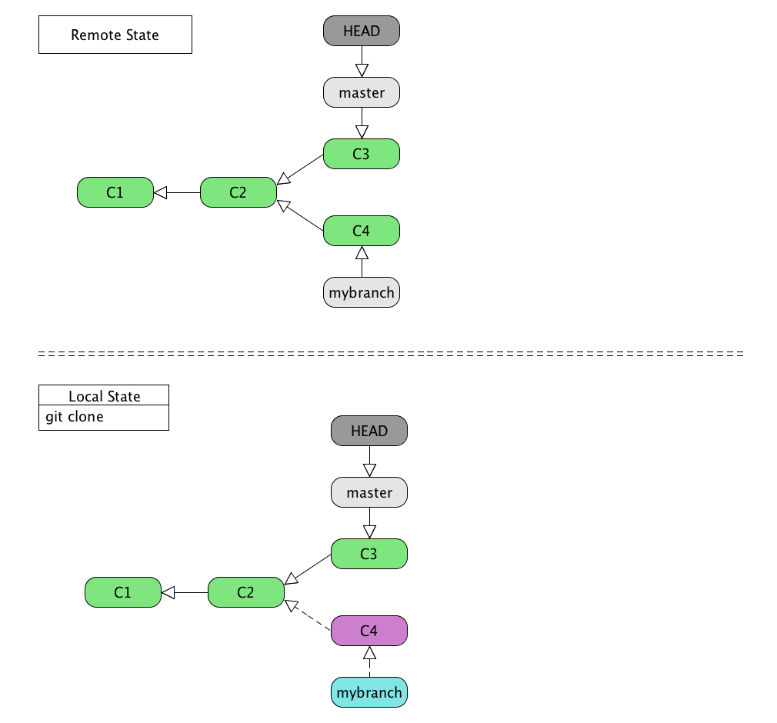
Clone Remote Repository

Slide 30
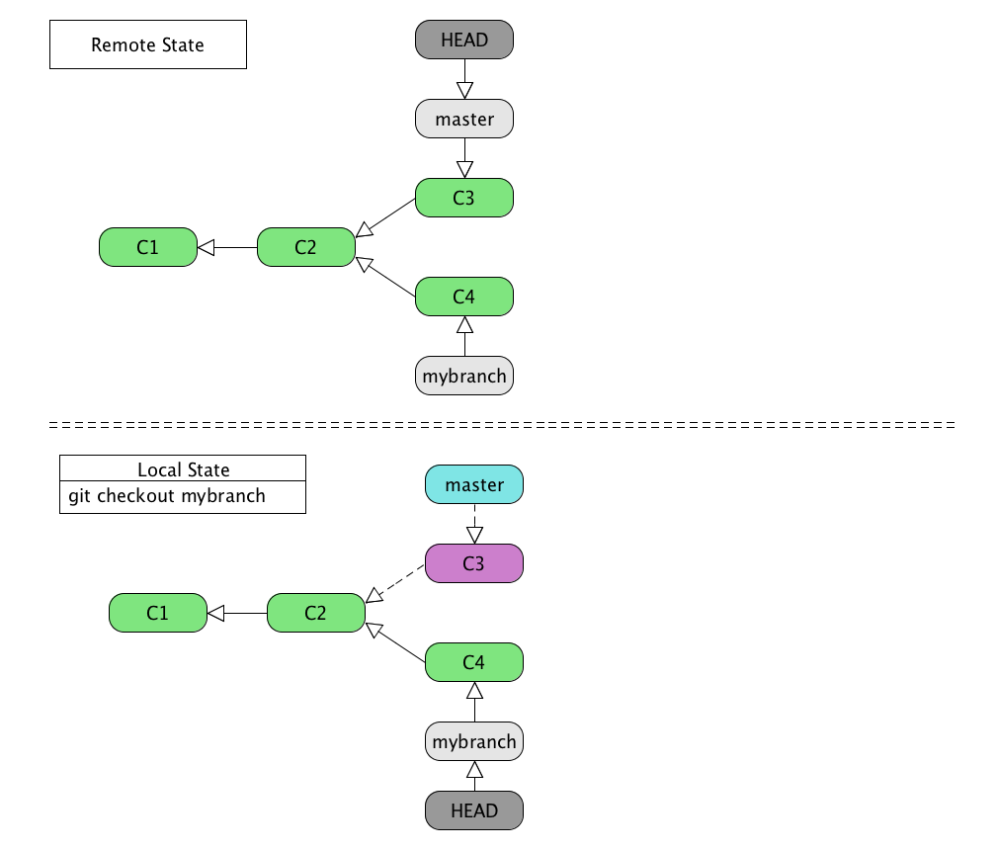
Checkout Remote Branch

Slide 31
Tracking Branches
git checkout <branchname> when there is a remote branch of the same name
  Creates a local branch reference to the same commit that the remote branch of the same name points to (mybranch points to C4).
  Alters the local working directory to the snapshot pointed to by the commit the branch points to (the files reflect the state of C4).
  Moves the HEAD pointer to the same commit that the branch points to (HEAD and mybranch point to C4).
  Makes the local branch track the remote branch so that Git knows which remote branch to pull from and push to.

Slide 32
Tracking Branches (cont.)
More generally:
git checkout -b <local branchname> --track <remote>/<remote branchname>
  Creates a local branch reference to the same commit that the remote branch points to (local and remote branch names do not need to match).
  Alters the local working directory to the snapshot pointed to by the commit the local branch points to.
  Moves the HEAD pointer to the same commit that the local branch points to.
  Makes the local branch track the remote branch so that Git knows which remote branch to pull from and push to.

Slide 33
Showing Tracking Branches
git remote show <remotename>
  Lists information about the specified remote including tracking branches
  Example: git remote show origin
    * remote origin
    Fetch URL: git@github.com:interzonedev/gittest.git
    Push URL: git@github.com:interzonedev/gittest.git
    HEAD branch: master
    Remote branches:
    master tracked
    mybranch tracked
    Local branches configured for 'git pull':
    master merges with remote master
    mybranch merges with remote mybranch
    Local refs configured for 'git push':
    master pushes to master (up to date)
    mybranch pushes to mybranch (up to date)

Slide 34
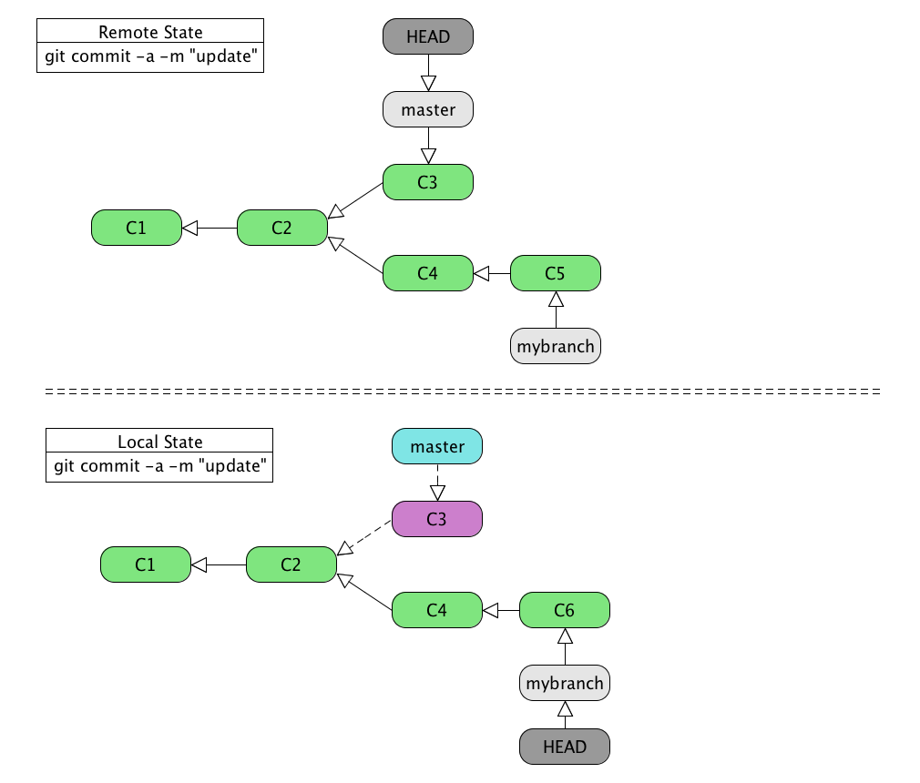
Commit on Remote and Local Branch

Slide 35
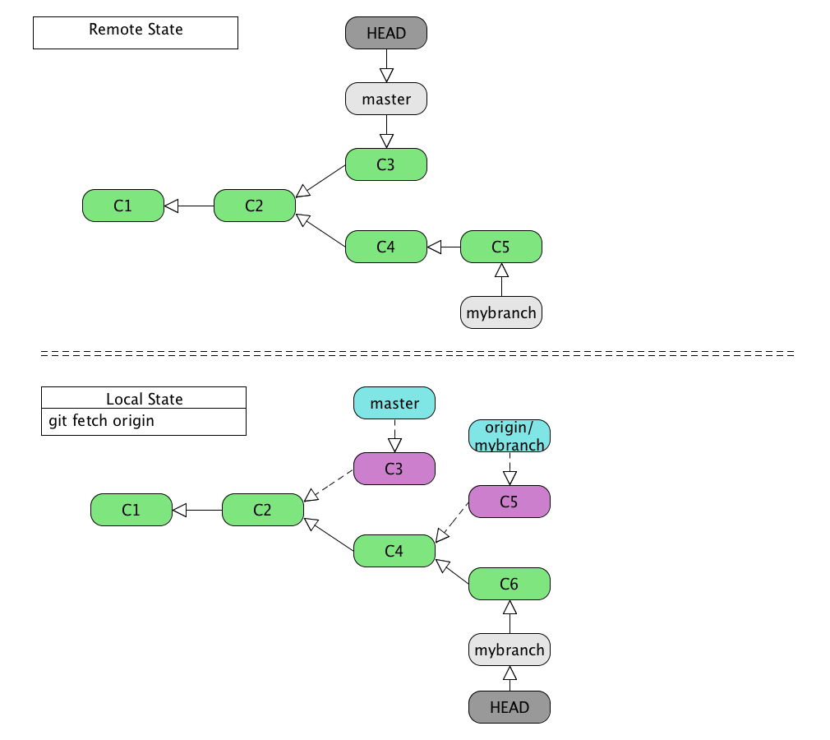
Fetch from Remote

Slide 36
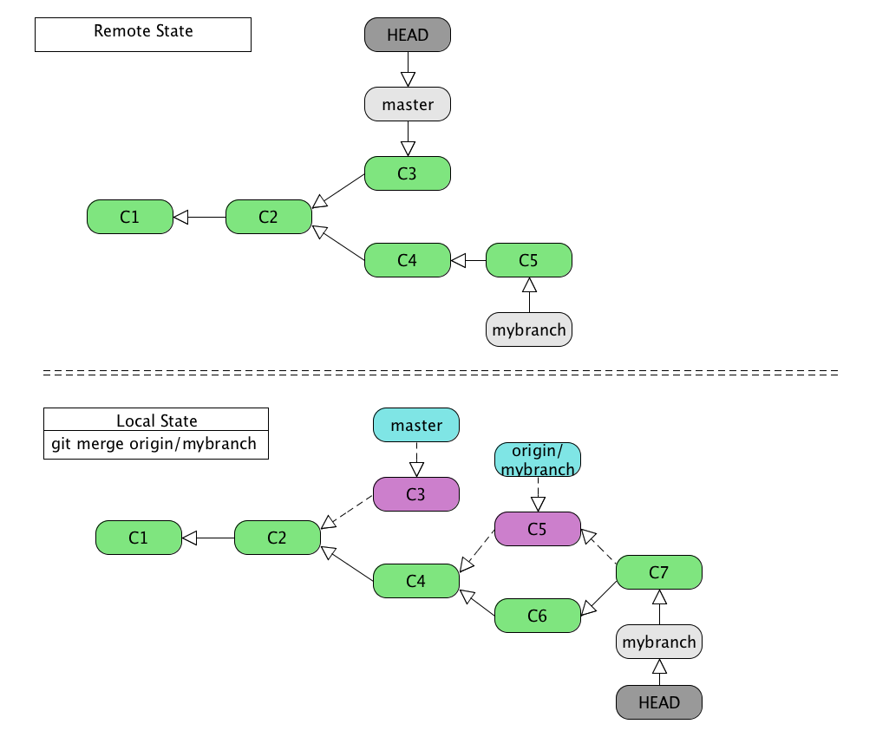
Merge Remote Branch

Slide 37
Fetch vs. Pull
git fetch <remotename>
  A fetch retrieves all history updates for the entire repository found at the specified remote.
  No changes are made to the local working directory (i.e. no merge takes place).
git pull
  A pull performs a fetch then merges the currently checked out branch if it is a tracking branch.
  If the currently checked out branch is not a tracking branch, performs a fetch but does not merge.
git pull <remotename> <branchname>
  Performs a fetch and merges the specified branch onto the currently checked out branch

Slide 38
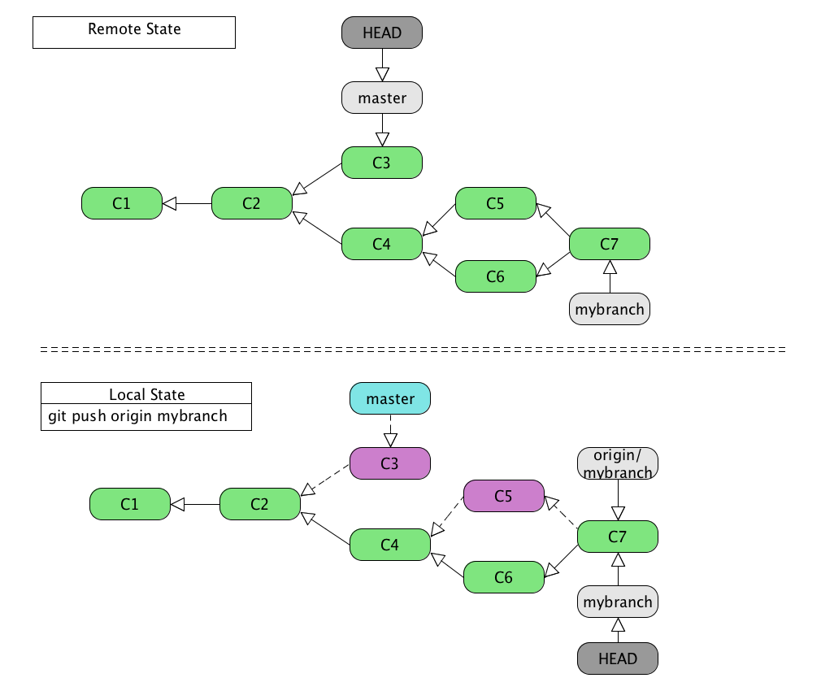
Push to Remote Repository

Slide 39
Git Push
git push
  Pushes all tracking branches.
  No action is taken on non tracking branches.
git push <remotename> <local branchname>:<remote branchname>
  Pushes changes from the specified local branch to the specified branch on the specified remote.
  If “<local branchname>:” is omitted uses the currently checked out branch.
  Does not automatically make the currently checked out branch a tracking branch.
git push -u <remotename> <local branchname>:<remote branchname>
  Pushes changes from the currently checked out branch to the specified branch on the specified remote.
  Makes the currently checked out branch a tracking branch.

Slide 40
Deleting Branches
git branch -d <branchname>
Deletes the local branch with the specified name.
git branch -rd <remotename>/<branchname>
Deletes the local reference to the branch with the specified name on the specified remote.
git push <remotename> :<remote branchname>
  Delete the branch with the specified name on the specified remote.
  It's like pushing null to the remote branch.

Slide 41
Further Discussion
Git flow branching strategy
Building and deploying from Git flow branches

Slide 42
References
The main Git reference on the Linux kernel site: https://www.kernel.org/pub/software/scm/git/docs
Pro Git by Scott Chacon: http://git-scm.com
Talk on advanced Git by Matthew McCullough: http://www.youtube.com/watch?v=ig5E8CcdM9g
The corresponding slide deck: https://speakerdeck.com/matthewmccullough/git-graphs-hashes-and-compression-oh-my-1
Lars Vogel Git Tutorial: http://www.vogella.com/articles/Git/article.html
Github learning resources: http://learn.github.com

