Slide 1
Root & litter boxplots
Gabriela Shirkey
6/12/25
15N is significantly related to root depth, site, and site*treatment
13C is significantly related to site and site*treatment, not root_depth

Slide 2
Data cleaning notes
Many duplicates noted by ‘d’ or ‘d#’ in the original csv
Created subplots within each site-treatment called samples. These are the holes dug in each site-treatment
Created a root_depth column
Suggest either removing all cases with a ‘d’ or ‘d#’ or averaging them together, removing instances with ‘NA’ for root depth or sample/hole.

Slide 3
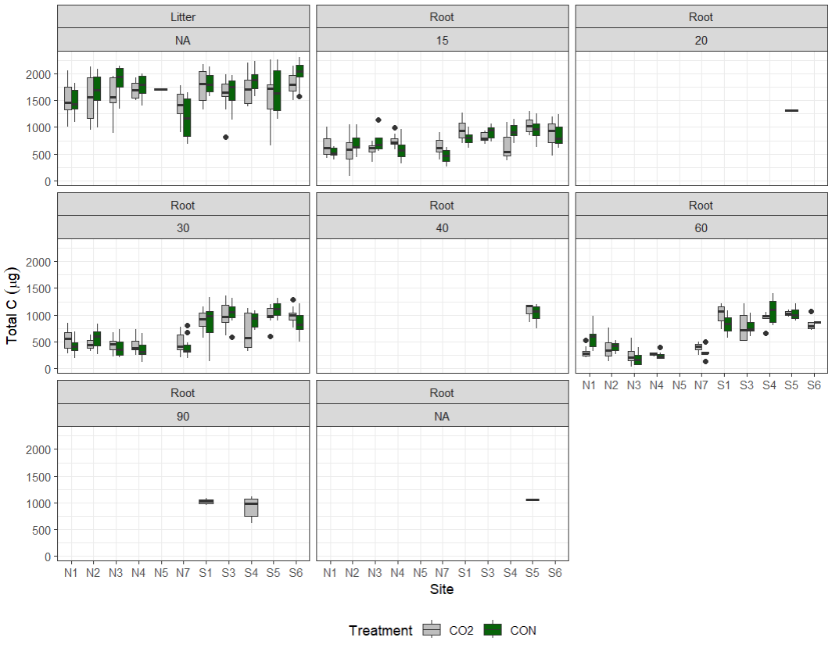

Slide 4
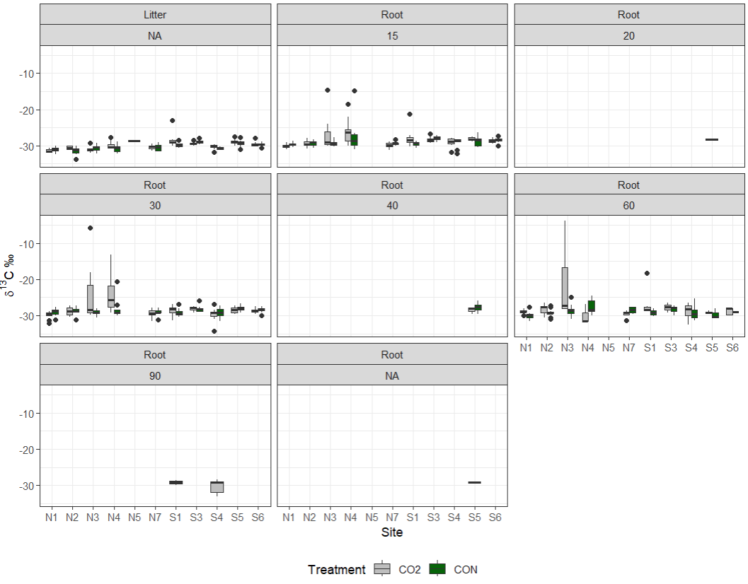

Slide 5
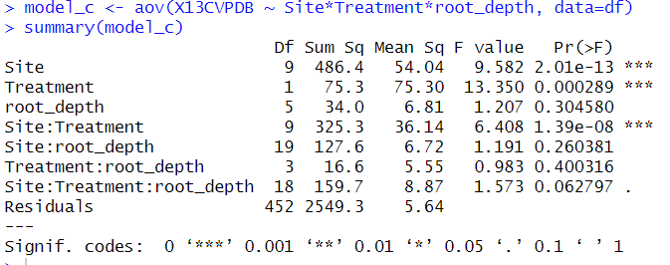

Slide 6
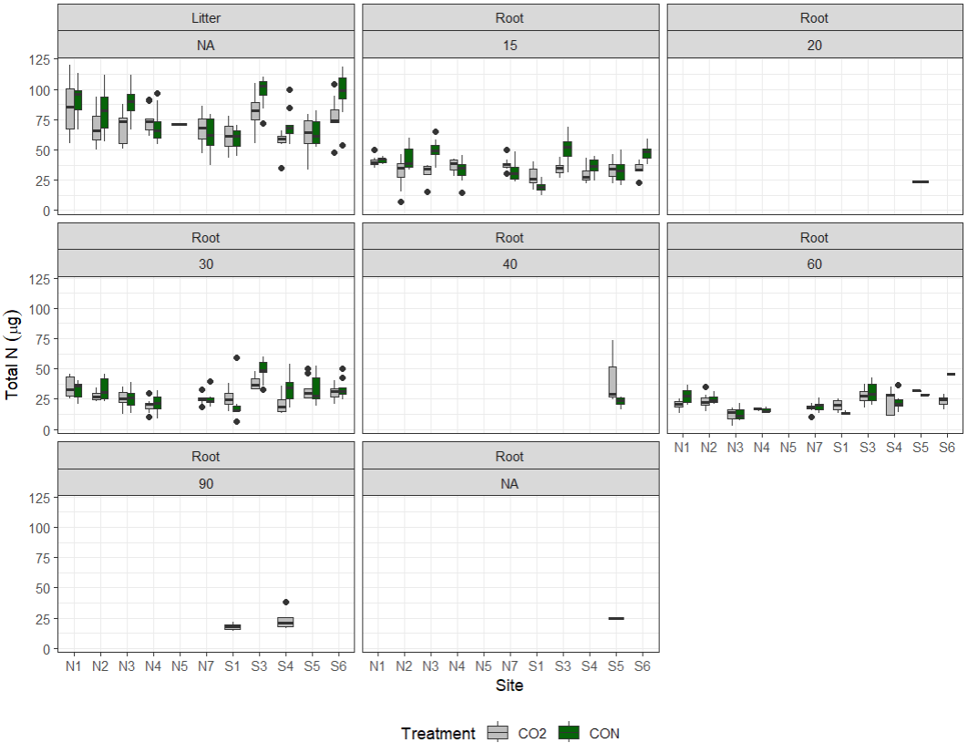

Slide 7
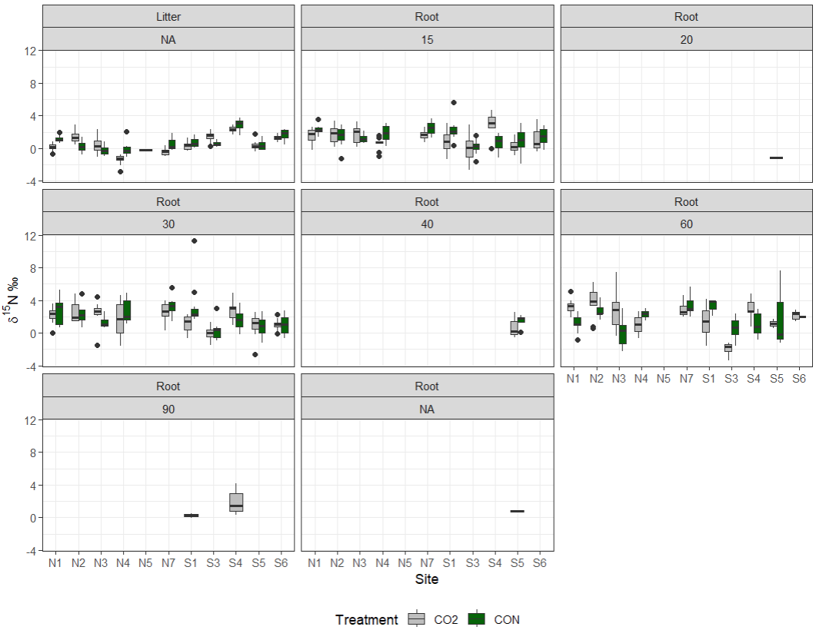

Slide 8
