Slide 1
Title:
Universal Language Model Fine-tuning for Text Classification
Authors: Jeremy Howard, Sebastian Ruder
Presented by:
Intiajul Alam Shah
ID: 19301185
Page 01

Slide 2
Introduction
Introduces Universal Language Model Fine-tuning (ULMFiT)
It aims to address the limitations of existing approaches in NLP which require task-specific modifications and training from scratch.
Can match the performance of training from scratch on 100x more data with only 100 labeled examples
Page 02

Slide 3
Related Work
The paper builds upon the concept of transfer learning, which has been impactful in computer vision but less so in NLP due to the requirement of task-specific modifications and training from scratch
Hypercolumns
Multi-task learning
Fine-tuning
Page 03

Slide 4
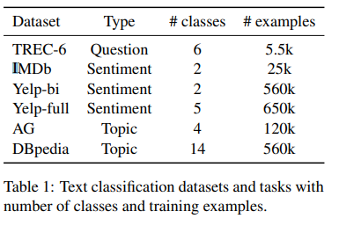
Dataset
The paper does not explicitly mention the datasets used. However, it mentions that the method was tested on six text classification tasks
six widely-studied datasets
Page 04

Slide 5
Method
The ULMFiT method includes techniques that are key for fine-tuning a language model.
It involves three stages: pre-training a language model on a large corpus, fine-tuning the pre-trained language model on target task data, and fine-tuning the classifier on the target task
Page 05

Slide 6
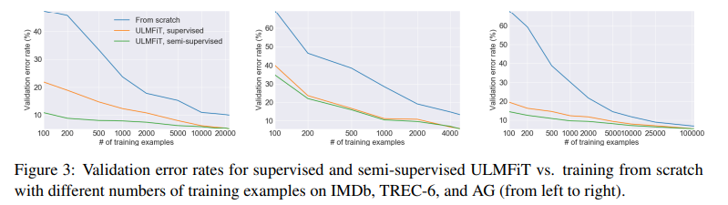
Result
The ULMFiT method significantly outperforms the state-of-the-art on six text classification tasks, reducing the error by 18-24% on the majority of datasets.
Page 06

Slide 7
The End
Page 07

