Slide 1
Title:
Happy parents’ tweets: An exploration of Italian
Twitter data using sentiment analysis
Page1
Authors:
Letizia Mencarini, Delia Irazú Hernández-Farías
Mirko Lai, Viviana Patti
Emilio Sulis, Daniele Vignoli
Presented by: Intiajul Alam Shah, ID: 19301185

Slide 2
Introduction
Page2
Social media data
disordered nature of social media texts
Demonstrate how computational linguistic techniques analyze
Focus on exploring opinions and semantic orientations
Two-step process involving Natural Language Processing (NLP) techniques.
Phase 1
Phase 2
Data derived from Italian tweets.
Emphasis on the value of social media data

Slide 3
Related Work
Page3
Sociodemographic research
Sentiment Analysis
Applications in Social Sciences
Challenges in Sentiment Analysis
Challenges with Italian Language

Slide 4
Dataset
Page4
Twita-2014, consisting of 259,893,081 Italian-language tweets, with 4,766,342 geotagged.
Correlation analysis with Italian provinces' tweet is 0.93
User Demographics
Data Filtering
Filtering Steps
Annotation Process with CrowdFlower

Slide 5
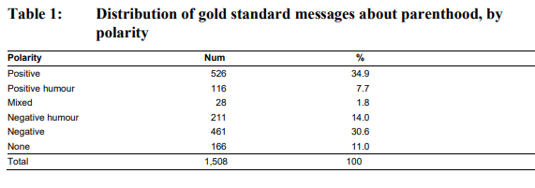
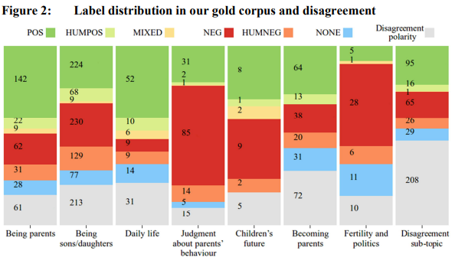
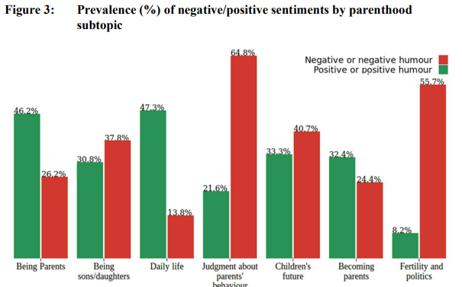
Page6

Slide 6
Method
Page7
Methodological Framework
methodological framework based on Natural Language Processing (NLP)
to extract sentiments from the large dataset of Italian tweets.
Supervised Machine-Learning Experiment
a binary Support Vector Machine for on-topic and off-topic tweet classification.
'bag-of-words' model, incorporating elements such as punctuation marks, tweet length, frequency of hashtags, mentions, emojis, and interjections.
Sentiment Inference
IRADABE sentiment analysis system
positive, negative, mixed (both positive and negative sentiments present), and none (neutral).
Performance Evaluation and Cross-Validation
Subtopic Classification

Slide 7
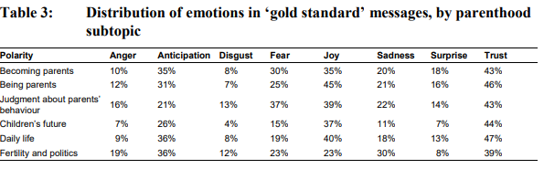
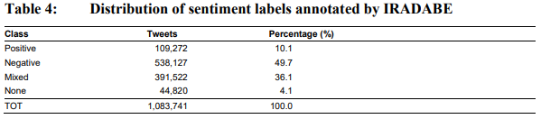
Method
Page8

Slide 8
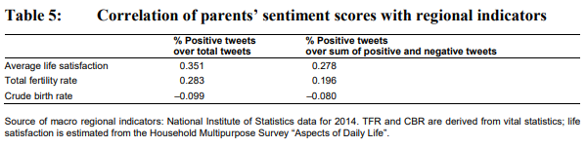
Result
Page9
about 25% related to parenthood were geotagged (120,307 out of 426,036)
found a positive correlation between the percentage of positive tweets and TFR, suggesting a potential association between higher fertility rates and more positive sentiments toward parenthood.
Crude Birth Rate (CBR), indicating the frequency of births in one year
Association with Life Satisfaction

Slide 9
Thank You
Page10

