Slide 1
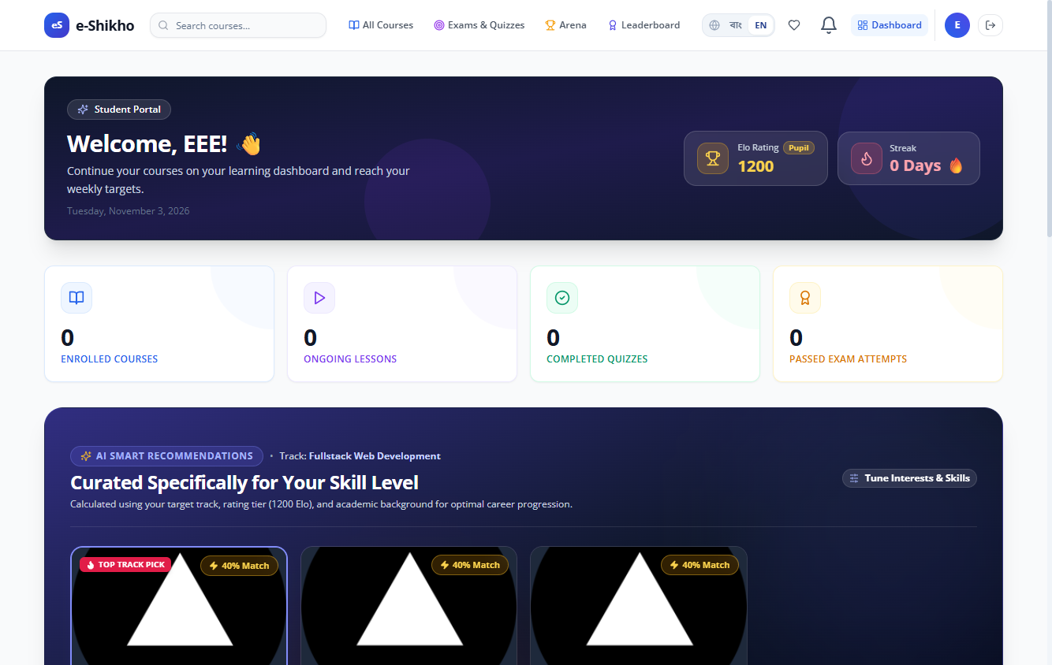
ACADEMIC PROJECT PRESENTATION
e-Sikho
A learning platform for
school, college, and
university students
Student dashboard with test records
Section B1 / Supervisor Tanjina Helali
Notes:
Introduce e-Sikho as a web application that connects course learning, assessments, and instructor oversight. The dashboard image uses temporary records from a browser test.
Project source: audit-local/final-readiness/selenium/SEL-28.png
Project source: docs/FINAL_DEMONSTRATION_PLAN.md

Slide 2
Learning needs by education level
Students use the same platform as their study needs change.
01
02
03
School
College
University
Build subject foundations with guided lessons and short quizzes.
Review course topics, track completed lessons, and practise with timed quizzes.
Study specialised topics and join eligible department contests.
e-Sikho
02
Notes:
These are example uses for each education level. Course availability depends on what instructors publish. Education level and department can determine eligibility for targeted assessments.
Project source: models/User.ts
Project source: docs/ASSESSMENT_WORKFLOWS.md

Slide 3
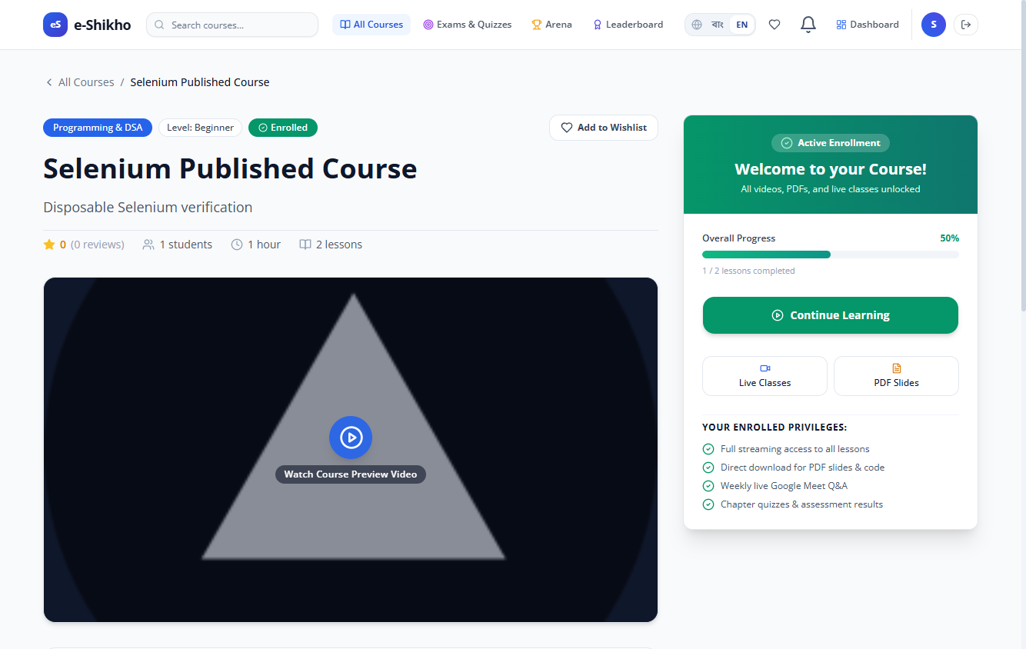
Courses and lesson progress
Find a course
Browse the published catalog and open a course syllabus.
Work through lessons
Watch recordings, join live sessions, and mark lessons complete.
Return to your studies
Open enrolled courses from the student dashboard.
Enrolled course view from browser testing
e-Sikho
03
Notes:
A course must be published and approved before it appears in the public catalog. The Selenium progress case marked one of two lessons complete and checked that the result persisted after reload. Mention live sessions as part of the wider course experience if time allows.
Project source: app/courses/page.tsx
Project source: audit-local/final-readiness/selenium/SEL-16.png

Slide 4
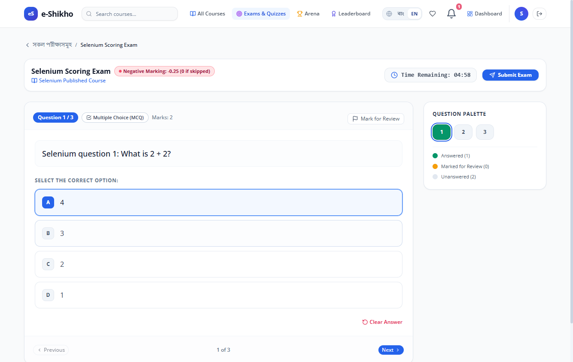
Exams, quizzes, and contests
Course assessments
Instructors create exams for courses they own or can teach.
Global assessments
Approved hosts can target a level, department, or selected students.
Scoring and attempts
MCQ results can reflect negative marking and retry rules.
Active exam view from browser testing
e-Sikho
04
Notes:
Explain that global exam and contest hosting permissions are separate. A superadmin can approve a hosting application, after which the instructor can publish within the allowed scope. Eligibility checks cover discovery and direct access.
Project source: docs/ASSESSMENT_WORKFLOWS.md
Project source: audit-local/final-readiness/selenium/SEL-20.png

Slide 5
Student, instructor, and admin roles
Student
Enrolls, studies lessons, tracks progress, and takes eligible assessments.
Instructor
Builds course modules and lessons, creates assessments, and applies to host global events.
Admin and superadmin
Review course submissions and demo purchases. Superadmins approve global hosting requests.
e-Sikho
05
Notes:
Separate the permissions for course publication, demo purchase approval, and global assessment hosting. During the demonstration, use separate student, instructor, and administrator sessions.
Project source: actions/admin.ts
Project source: actions/demo-purchases.ts
Project source: docs/ASSESSMENT_WORKFLOWS.md

Slide 6
Application and video architecture
Application stack
Protected playback
Next.js and React
Auth.js sessions and role checks
MongoDB with Mongoose
The server checks lesson access before it issues an expiring Bunny Stream embed token.
Students can open protected lessons after they gain course access.
e-Sikho
06
Notes:
Token authentication gates the signed embed flow. Browser testing checked unauthorized access, token tampering, and token expiry. Explain that this limits unauthorized access and sharing. Account-level DRM settings and physical-mobile playback require separate verification. Free previews follow their own lesson access rules.
Project source: package.json
Project source: actions/bunny-stream.ts
Project source: docs/VIDEO_SECURITY_AND_FUNCTIONAL_VALIDATION.md

Slide 7
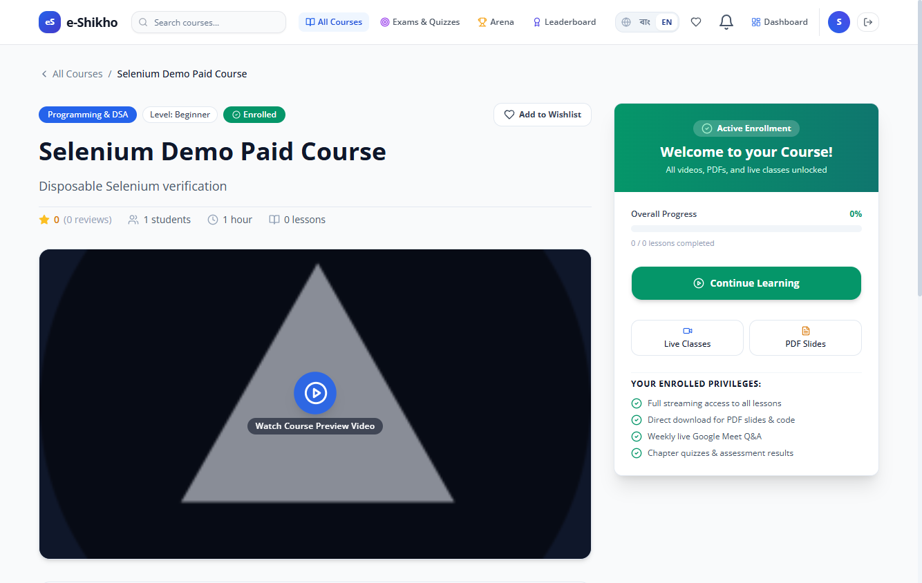
Demo checkout and approval
01 Student requests access
Checkout shows the course fee and a read-only sample card.
02 Admin reviews the request
The course stays locked while the request is pending.
03 Course unlocks
The system grants enrollment and records zero paid.
Student view after approval in the checkout browser test
e-Sikho
07
Notes:
Use the demo card flow to illustrate checkout without collecting card information or charging the student. Open the paid course as a learner, send a request, approve it from Admin Dashboard → Demo Purchases, then check status as the learner. The screenshot shows the result after approval.
Project source: actions/demo-purchases.ts
Project source: audit-local/demo-checkout-selenium-rerun/results.json
Project source: audit-local/demo-checkout-selenium-rerun/SEL-29.png

Slide 8
Testing and open checks
390
Selenium browser checks
Covered enrollment, assessment eligibility, progress, and demo purchase approval.
passing Vitest unit tests
Protected video checks
Verified token-gated playback and rejected invalid or expired tokens.
Latest recorded demo-checkout run
Open verification
PDF display in Chrome, delivered SMS codes, and playback on a physical phone.
e-Sikho
08
Notes:
The 390 unit tests passed in the recorded demo-checkout run on 4 November 2026. The focused SEL-29 browser test passed in a disposable database. The earlier broad Selenium run had 27 passing, 1 failing, and 4 blocked cases, including the PDF viewer failure. Live payment settlement is outside the demo scope.
Project source: docs/VIDEO_SECURITY_AND_FUNCTIONAL_VALIDATION.md
Project source: audit-local/final-readiness/selenium/results.json
Project source: audit-local/demo-checkout-selenium-rerun/results.json
Project source: 4 November 2026 demo-checkout implementation and test run

Slide 9
Live demonstration
01
Instructor
Open a course and show its modules, lessons, and assessment setup.
02
Student
Find a paid course and send a demo purchase request.
03
Admin
Approve the request in Demo Purchases.
04
Student
Check the request status, open the lesson, and mark it complete.
e-Sikho
09
Notes:
Prepare an approved paid course with a linked, ready-to-play lesson. Use a separate approved student with no existing enrollment. Keep the admin session open in another browser profile. For a deployed demo, enable ENABLE_DEMO_CHECKOUT.
Project source: docs/FINAL_DEMONSTRATION_PLAN.md
Project source: actions/demo-purchases.ts

Slide 10
Project team
Intisar Rahman Khan
Software Architect and Team Lead
Tamim Likhon
Software Developer
Mubtahijah Anisha
Product Manager
Shirin Akter
Business Manager
Prepared by Intisar Rahman Khan
e-Sikho
10
Notes:
Acknowledge the project team and supervisor Tanjina Helali, then invite questions.

