Slide 1
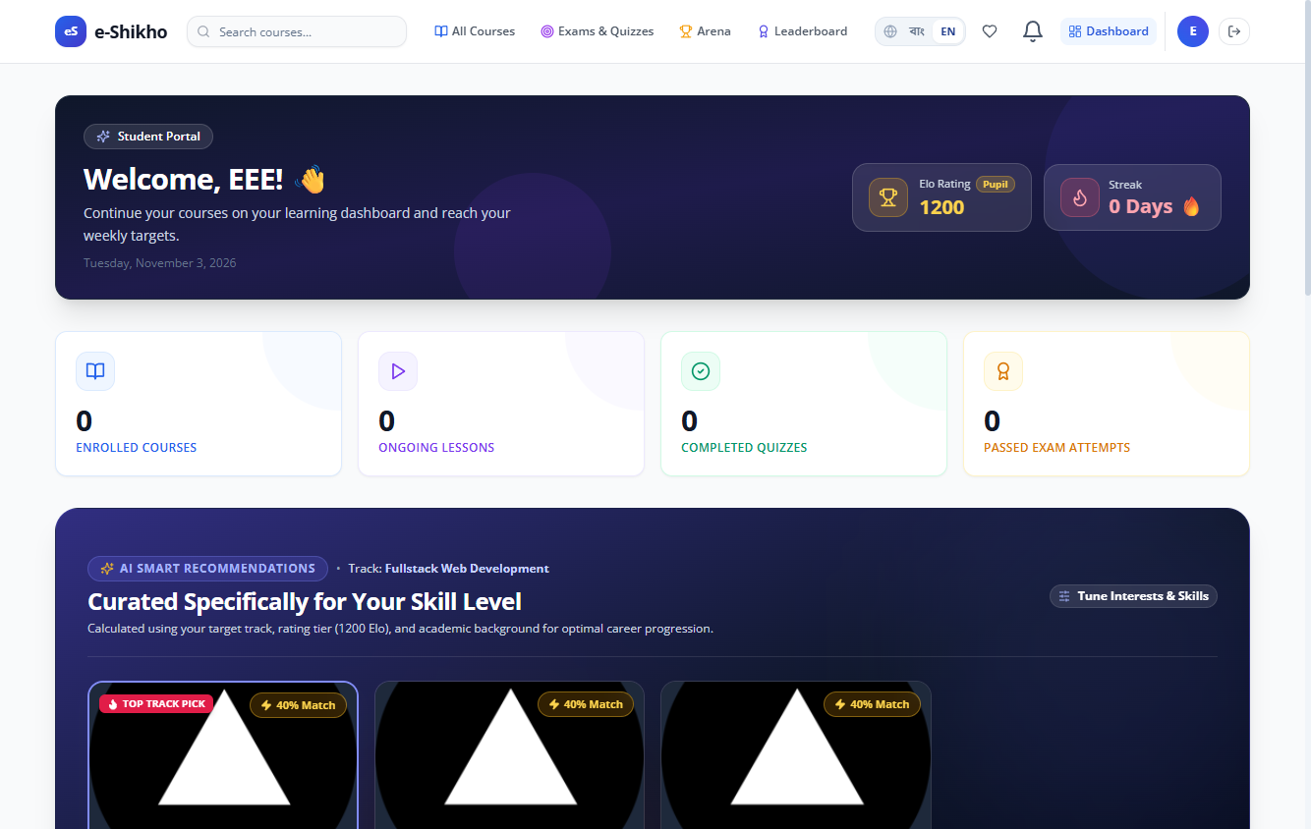
ACADEMIC SOFTWARE PROJECT
e-Sikho
A learning platform for
school, college, and
university students
Section B1
Student dashboard with test records
Supervised by Tanjina Helali
Notes:
Introduce e-Sikho as a web application that connects course learning, assessments, and instructor oversight. The dashboard image uses temporary records from a browser test.
Project source: audit-local/final-readiness/selenium/SEL-28.png
Project source: docs/FINAL_DEMONSTRATION_PLAN.md

Slide 2
Project purpose
A shared place to study and practise
For learners
Course materials, lesson progress, and assessment results sit within one student account.
For teaching teams
e-Sikho connects published courses with assessments students are eligible to take.
Instructors organise content and assessments. Administrators review publication and access requests.
e-Sikho
02
Notes:
Frame the project around two tasks. A learner needs to find the next lesson or assessment. A teaching team needs to manage what is published and who can take part. This slide states the design goals rather than reporting survey findings.
Project source: docs/FINAL_DEMONSTRATION_PLAN.md
Project source: docs/ASSESSMENT_WORKFLOWS.md

Slide 3
How students use e-Sikho
Example study activities by education level
01
02
03
School
College
University
Build subject foundations with guided lessons and short quizzes.
Review course topics, track completed lessons, and practise with timed quizzes.
Study specialised topics and join eligible department contests.
e-Sikho
03
Notes:
These are example uses for each education level. Course availability depends on what instructors publish. Education level and department can determine eligibility for targeted assessments.
Project source: models/User.ts
Project source: docs/ASSESSMENT_WORKFLOWS.md

Slide 4
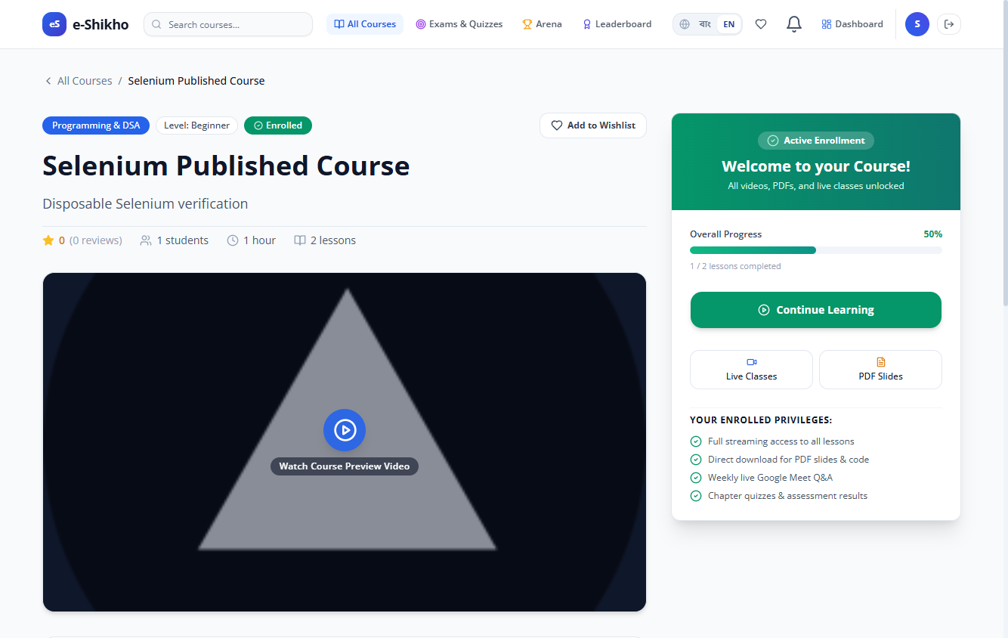
Courses and lesson progress
Find a course
Browse the published catalog and open a course syllabus.
Work through lessons
Watch recordings, join live sessions, and mark lessons complete.
Return to your studies
Open enrolled courses from the student dashboard.
Enrolled course view from browser testing
e-Sikho
04
Notes:
A course must be published and approved before it appears in the public catalog. The Selenium progress case marked one of two lessons complete and checked that the result persisted after reload. Mention live sessions as part of the wider course experience if time allows.
Project source: app/courses/page.tsx
Project source: audit-local/final-readiness/selenium/SEL-16.png

Slide 5
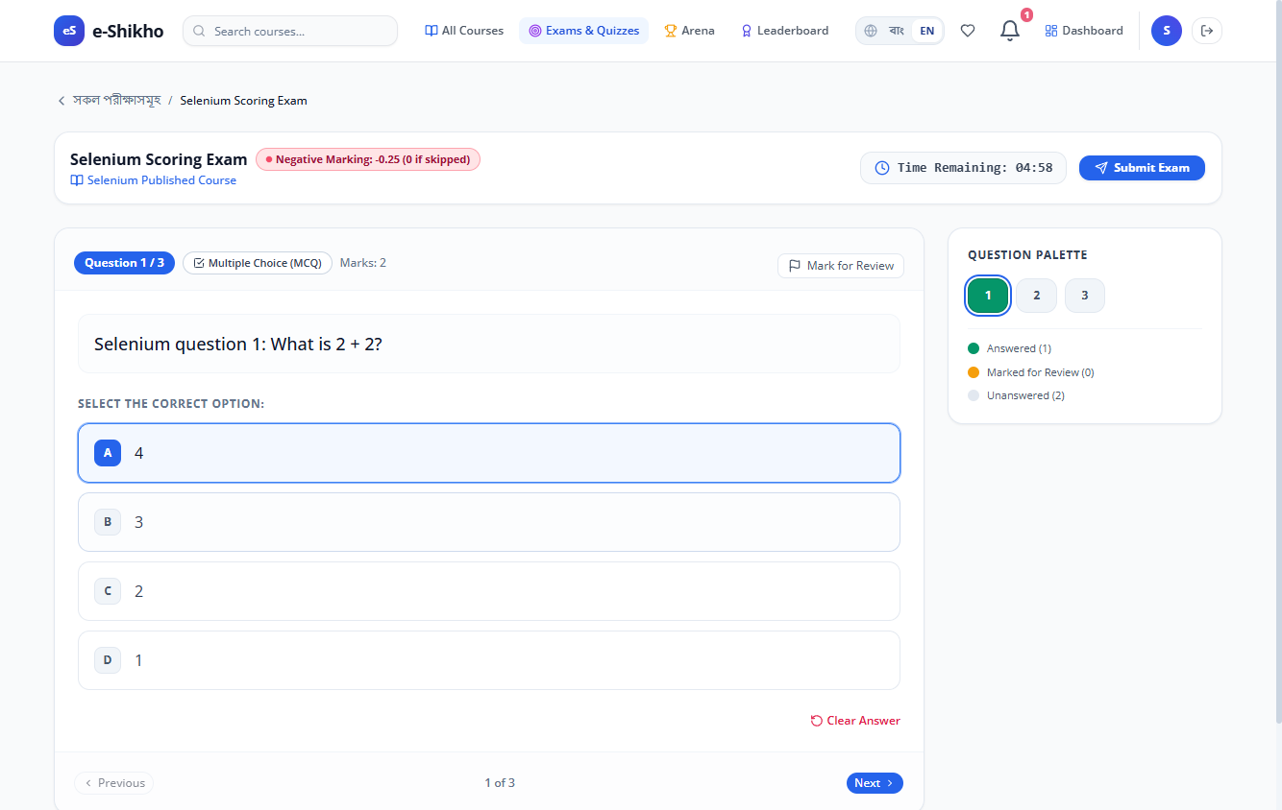
Exams, quizzes, and contests
Course assessments
Instructors create exams for courses they own or can teach.
Global assessments
Instructors apply for separate exam and contest hosting permissions.
Scoring and attempts
MCQ results can reflect negative marking and retry rules.
Active exam view from browser testing
e-Sikho
05
Notes:
Explain that global exam and contest hosting permissions are separate. A superadmin can approve a hosting application, after which the instructor can publish within the allowed scope.
Project source: docs/ASSESSMENT_WORKFLOWS.md
Project source: audit-local/final-readiness/selenium/SEL-20.png

Slide 6
Who can join a global assessment?
Example audience
University students
in CSE
Eligible student
A university CSE student can see the assessment and participate.
The host selects an education level and department. The student profile must match both.
Outside the audience
A college student or a university student in another department cannot join through a direct link.
e-Sikho
06
Notes:
This is an illustrative eligibility rule. Hosts can also select individual students. When several filters apply, the learner must satisfy every selected filter. The server enforces eligibility in listings, direct routes, and submissions. Education level and department are self-reported.
Project source: docs/ASSESSMENT_WORKFLOWS.md
Project source: audit-local/final-readiness/selenium/results.json

Slide 7
Student, instructor, and admin roles
Student
Enrolls, studies lessons, tracks progress, and takes eligible assessments.
Instructor
Builds course modules and lessons, creates assessments, and applies to host global events.
Admin and superadmin
Review course submissions and demo purchases. Superadmins approve global hosting requests.
e-Sikho
07
Notes:
Separate the permissions for course publication, demo purchase approval, and global assessment hosting. During the demonstration, use separate student, instructor, and administrator sessions.
Project source: actions/admin.ts
Project source: actions/demo-purchases.ts
Project source: docs/ASSESSMENT_WORKFLOWS.md

Slide 8
Application and video architecture
Application stack
Protected playback
Next.js and React
Auth.js sessions and role checks
MongoDB with Mongoose
The server checks lesson access before it issues an expiring Bunny Stream embed token.
Students can open protected lessons after they gain course access.
e-Sikho
08
Notes:
Token authentication gates the signed embed flow. Browser testing checked unauthorized access, token tampering, and token expiry. Explain that this limits unauthorized access and sharing. Account-level DRM settings and physical-mobile playback require separate verification. Free previews follow their own lesson access rules.
Project source: package.json
Project source: actions/bunny-stream.ts
Project source: docs/VIDEO_SECURITY_AND_FUNCTIONAL_VALIDATION.md

Slide 9
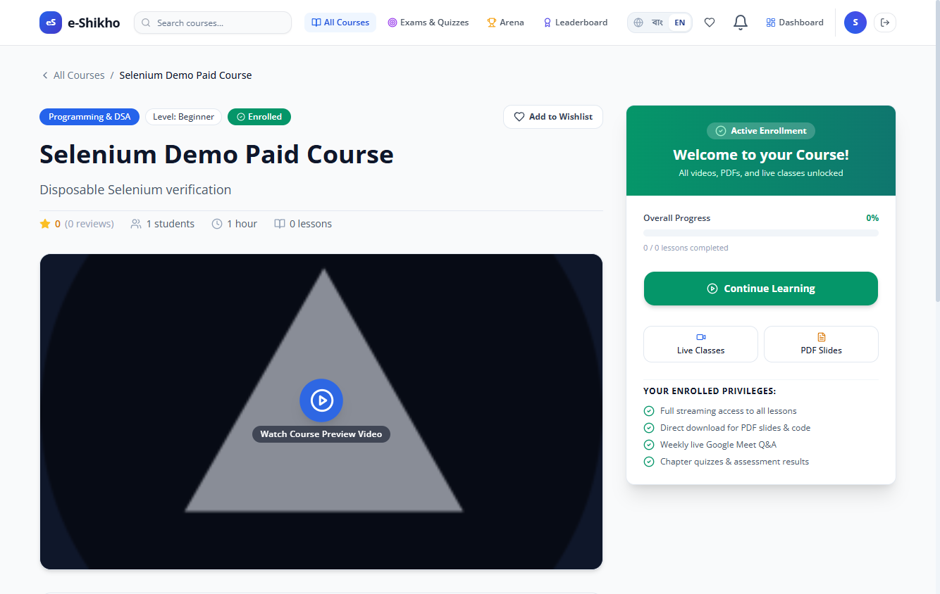
Demo checkout and approval
01 Student requests access
Checkout shows the course fee and a read-only sample card.
02 Admin reviews the request
The course stays locked while the request is pending.
03 Course unlocks
The system grants enrollment and records zero paid.
Student view after approval in the checkout browser test
e-Sikho
09
Notes:
The demo card flow illustrates checkout without collecting card information or charging the student. Optional live walkthrough: Prepare an approved paid course with a linked, ready lesson. Open the course with an approved learner account and send a request. Switch to the separate admin session and approve it under Demo Purchases. Return to the learner account, check status, open a lesson and mark it complete. The screenshot shows the result after approval. Enable ENABLE_DEMO_CHECKOUT for a deployed demo.
Project source: actions/demo-purchases.ts
Project source: audit-local/demo-checkout-selenium-rerun/results.json
Project source: audit-local/demo-checkout-selenium-rerun/SEL-29.png

Slide 10
Software verification
390
Core workflows in Selenium
27 passed, 1 failed, and 4 were blocked in the broad browser suite.
passing Vitest unit tests
Demo checkout in Selenium
A separate test confirmed that admin approval unlocked the course with zero paid.
Recorded on 4 November 2026
Protected video checks
The browser test played an authorised video and rejected altered or expired tokens.
e-Sikho
10
Notes:
The 390 unit tests passed in the recorded demo-checkout run on 4 November 2026. The focused SEL-29 browser test passed in a disposable database. In the earlier broad Selenium run, the PDF viewer was the failure. Keep the results of the different runs separate.
Project source: docs/VIDEO_SECURITY_AND_FUNCTIONAL_VALIDATION.md
Project source: audit-local/final-readiness/selenium/results.json
Project source: audit-local/demo-checkout-selenium-rerun/results.json
Project source: 4 November 2026 demo-checkout implementation and test run

Slide 11
Release scope
Available for the project demonstration
Published courses, lesson progress, targeted assessments, protected playback, and simulated checkout.
Checks still open
PDF display in Chrome, delivered SMS codes, and video playback on a physical phone.
Live payment settlement
Production billing requires a verified payment gateway.
e-Sikho
11
Notes:
Distinguish between the demonstrated features and the remaining release checks. The current checkout is a simulation. Other external flows, including Google consent and live meeting connection, were outside the verified scope.
Project source: docs/FINAL_DEMONSTRATION_PLAN.md
Project source: docs/VIDEO_SECURITY_AND_FUNCTIONAL_VALIDATION.md
Project source: app/api/payment/confirm/route.ts

Slide 12
Project team
Intisar Rahman Khan
Software Architect and Team Lead
Tamim Likhon
Software Developer
Mubtahijah Anisha
Product Manager
Shirin Akter
Business Manager
Prepared by Intisar Rahman Khan
e-Sikho
12
Notes:
Acknowledge the project team and supervisor Tanjina Helali, then invite questions.

